Slide 1
NetShield AI
Network Anomaly Detection &Threat Monitoring System
( MILESTONE-3 )

Slide 2
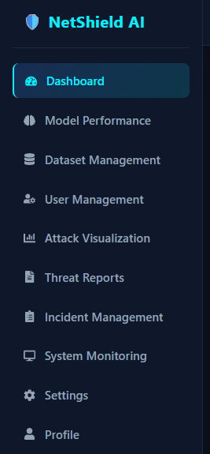
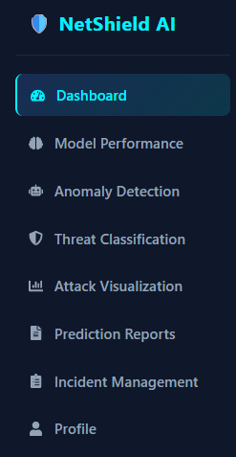
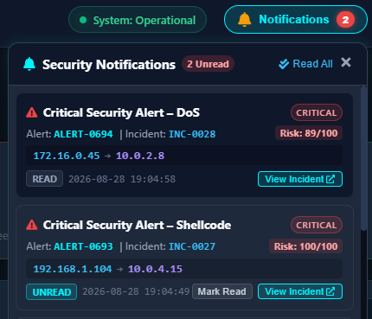

Admin Dashboard:
Analyst Dashboard:
Notifications:
The system automatically generates security notifications when a potential threat or attack is detected.

Slide 3
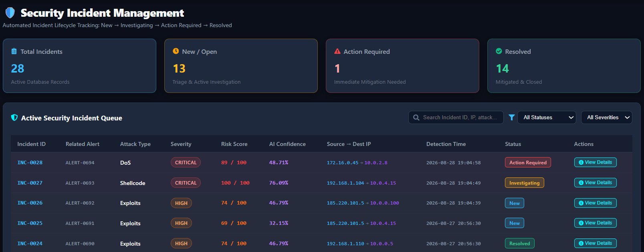
Incident Dashboard:
-to track detected security incidents.
Each incident displays details like: attack type, severity, risk score, AI confidence, source and destination IPs, and detection time.
The View Details option allows analysts to investigate an incident and take the required response action.
The dashboard also provides an overview of total, active, action-required, and resolved incidents.

Slide 4
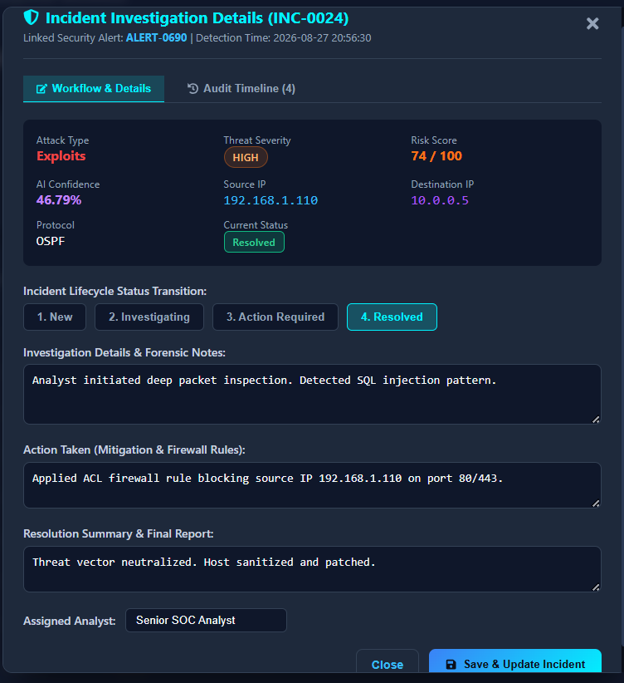
INCIDEnt management :
Once an alert is generated,
the security analyst needs to handle it.
The system should support an instant workflow.
-------------------------------------------------
The WORKFLOW:
Alert generated,
Track incident,
Investigation,
Take action
Reslove incident

Slide 5
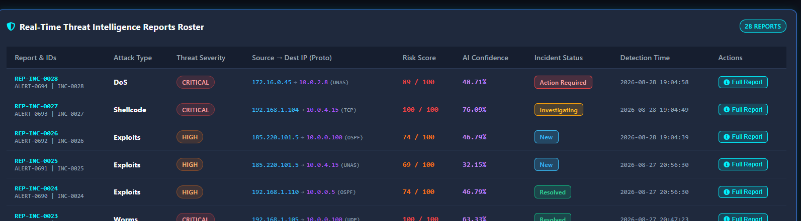
Threat intelligent reports:
Generates detailed threat intelligence reports from detected security alerts.
Provides attack type, threat severity, risk score, and AI confidence.
Displays source and destination IPs along with detection timestamp.

Slide 6
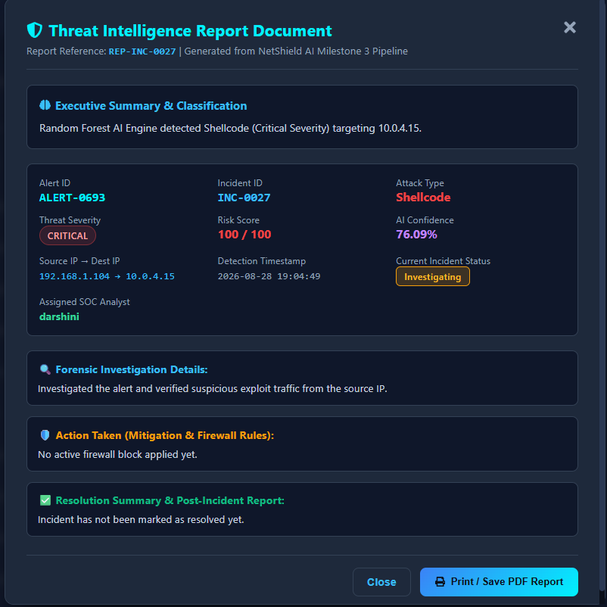
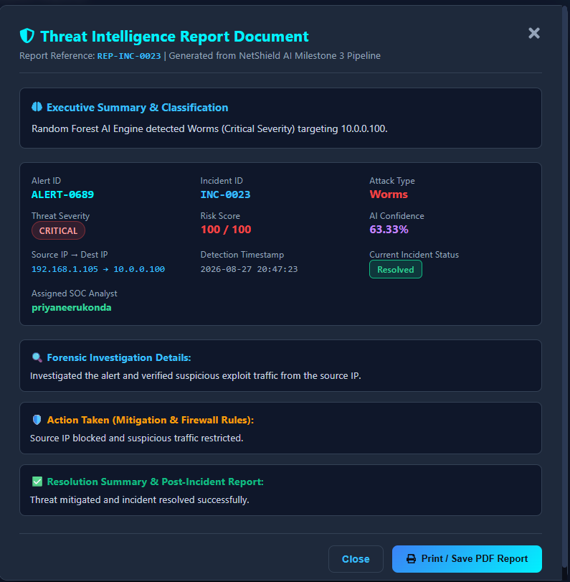
Threat report document:
Shows the current incident status and resolution summary, with an option to print/save the report as PDF.

Slide 7
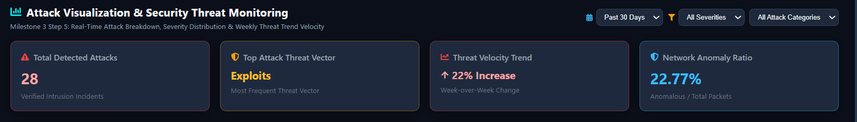
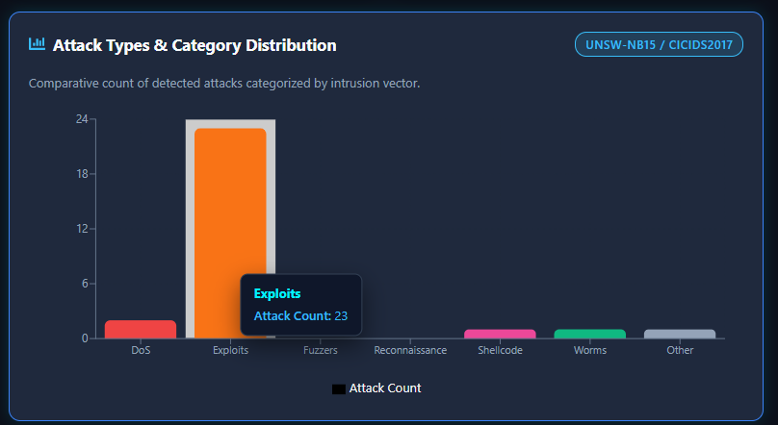
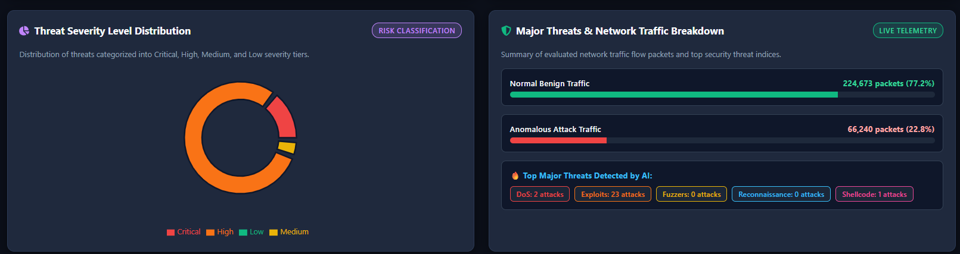
Attack visualization:
Shows the distribution of attack types such as DoS, Exploits, Fuzzers, and Reconnaissance.
Helps analysts understand attack trends, threat patterns,network security activity
through charts and graphs

Slide 8
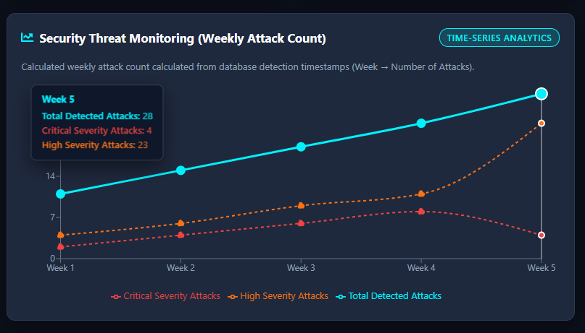
Weekly reports::
( Security Threat Monitoring )
The system will help the security team to understand how threats change over the time.
Tracks the number of detected attacks week by week using detection timestamps from the database.
For example, Week 5 records 28 total attacks, including 4 critical and 23 high-severity attacks.

Slide 9
Thank you
- Bhavani Gontina

