Slide 1
NetShield AI
Network Anomaly Detection &Threat Monitoring System
( MILESTONE-2 )

Slide 2
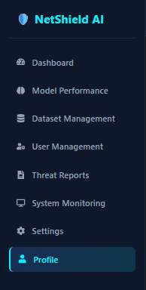
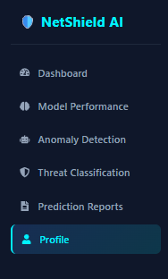
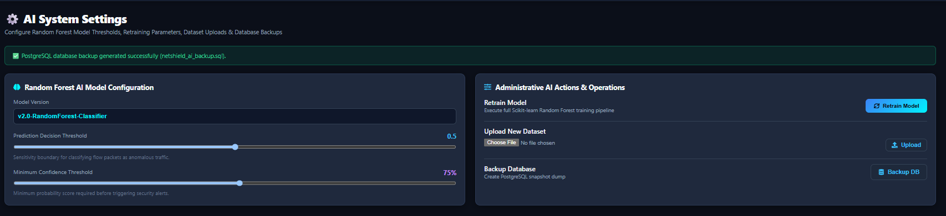
Admin Dashboard:
Analyst Dashboard:
Settings:

Slide 3
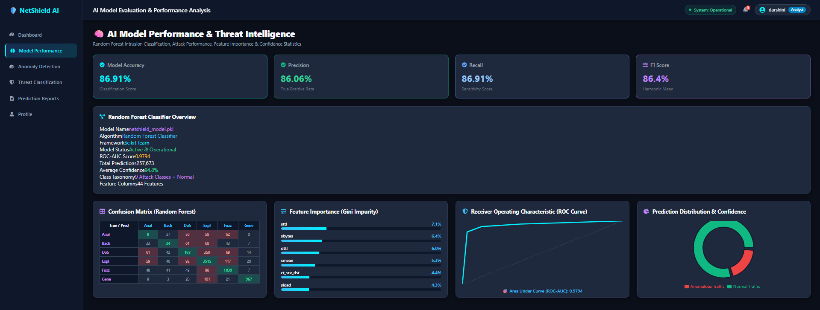
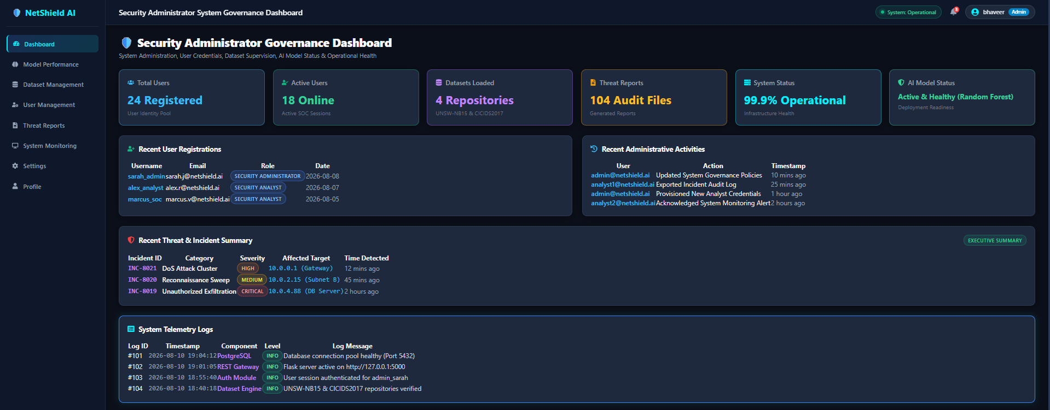
model performance metrics:
Includes:
accuracy, precision, recall, F1-score, confusion matrix, feature importance, ROC-AUC, and prediction confidence.
-------------------------------------------------
An Overview of :
users, datasets, threat reports, system health, AI model status, recent activities, incidents, and system logs.

Slide 4
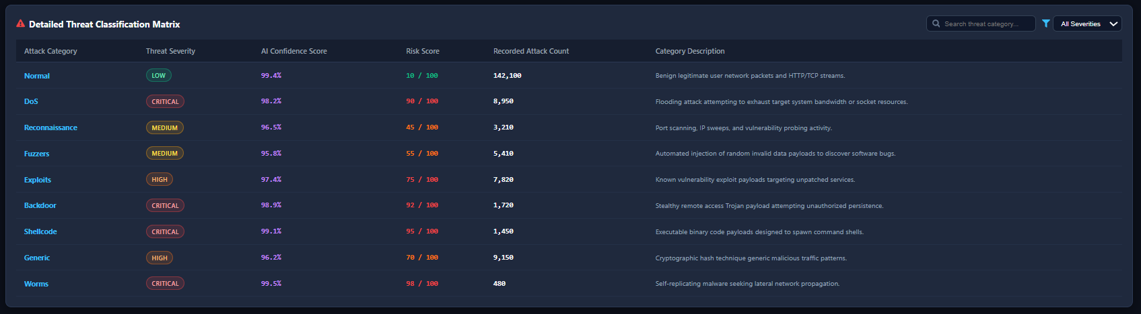
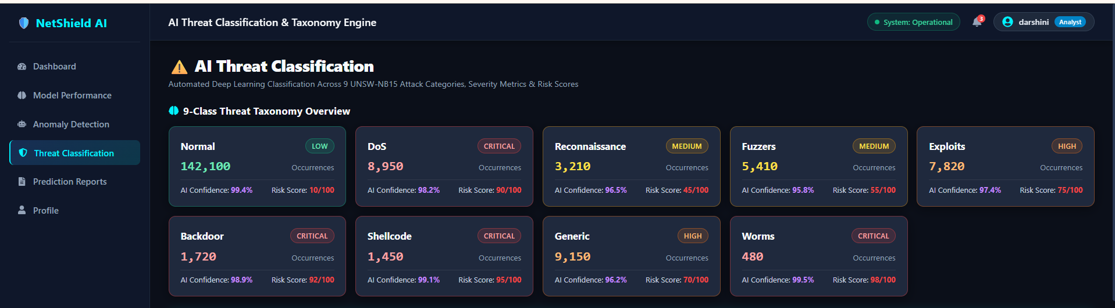
Threat classifications:
Normal 10/100 (Low)
DoS 90/100 (Critical)
Reconnaissance 45/100 (Medium)
Fuzzers 55/100 (Medium)
Exploits 75/100 (High)
Backdoor 92/100 (Critical)
Shellcode 95/100 (Critical)
Generic 70/100 (High)
Worms 98/100 (Critical)
Classifies network traffic into attack categories based on threat severity, AI confidence, risk score, attack count, and category description.

Slide 5
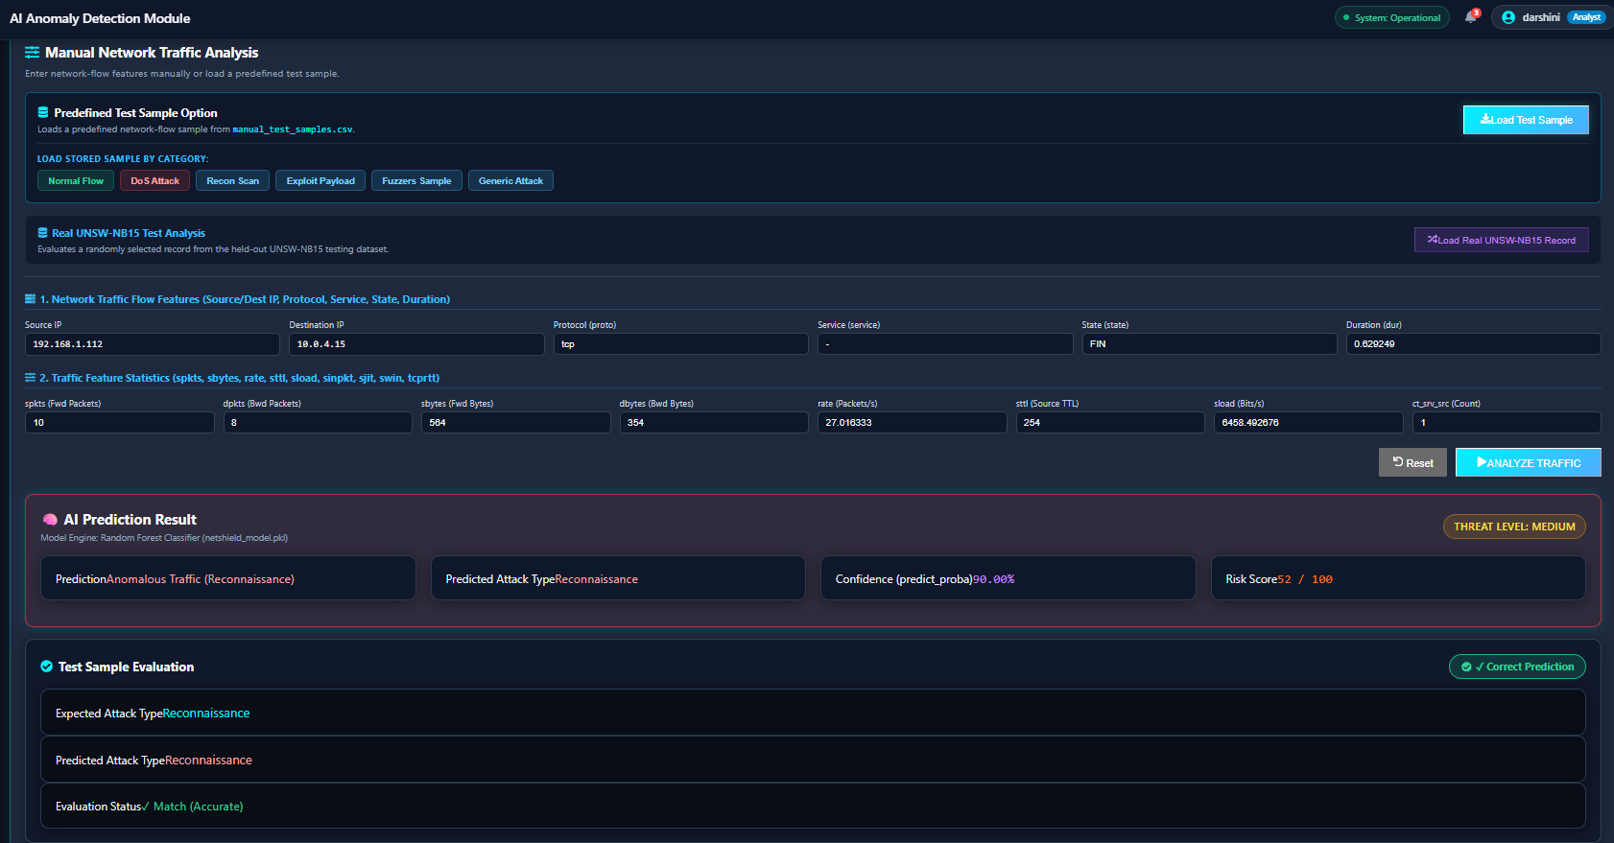
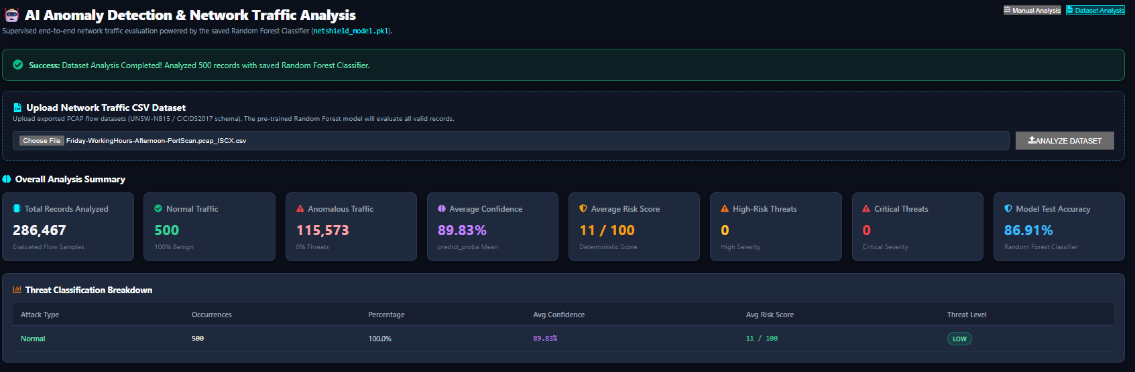
Model analysis:
Manual Analysis:
Dataset Analysis:
Allows users to enter network traffic parameters and instantly receive AI-based threat, risk, and confidence predictions.
Uploads network traffic datasets and analyzes multiple records using the trained Random Forest model to identify anomalies and threats.

Slide 6
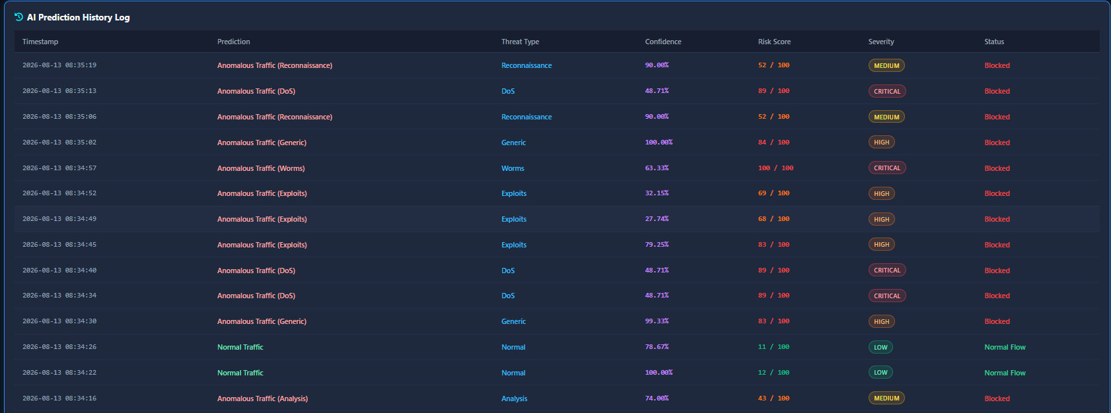
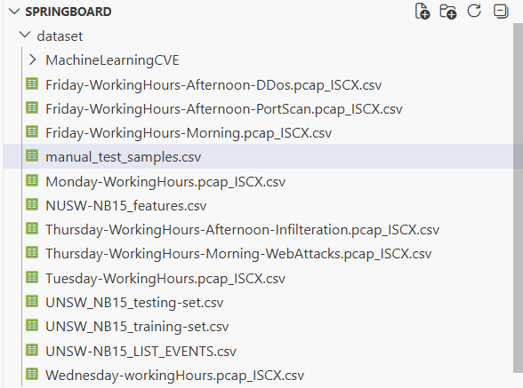
Storing:
( predicted history & datasets )
Maintains a record of previous
network traffic predictions.
Displays threat type, confidence score, risk score, severity, and action status for each prediction.
Helps analysts review and track detected threats over time.
Real-time test data is stored in manual_test_samples.csv, with results tracked in Prediction History.

Slide 7
Thank you
- Bhavani Gontina

