Slide 1
NetShield AI
Network Anomaly Detection &Threat Monitoring System
( MILESTONE-1 )

Slide 2
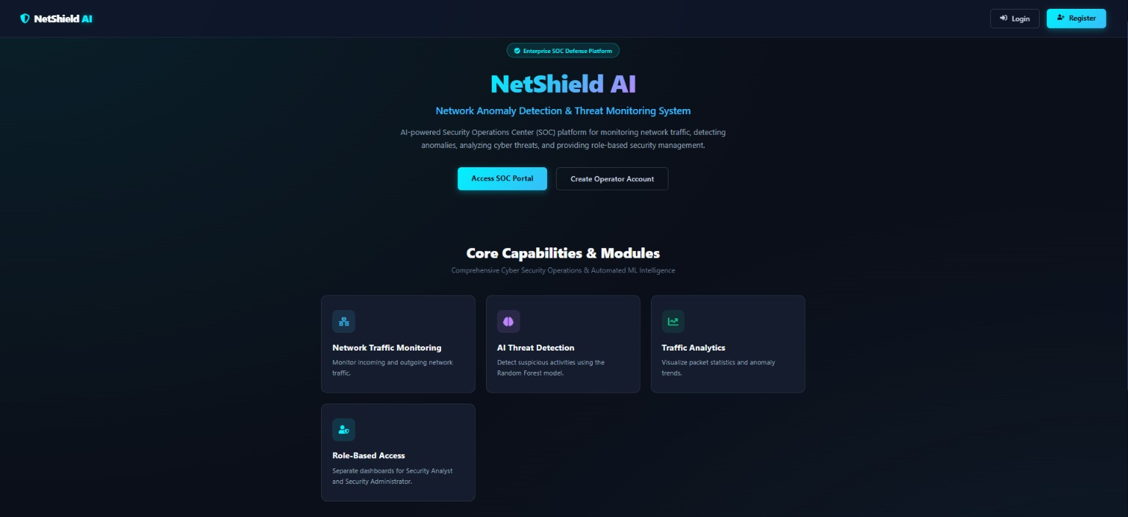
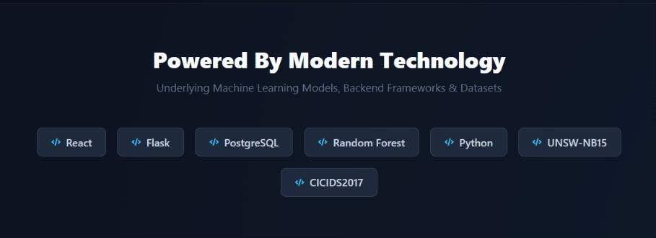
.
HOME PAGE:
Easy navigation to Login and Register
Highlights core features
(network traffic monitoring,
AI threat detection, and analytics)
Displays technology stack :
React
Flask
PostgreSQL
Random Forest
Python

Slide 3
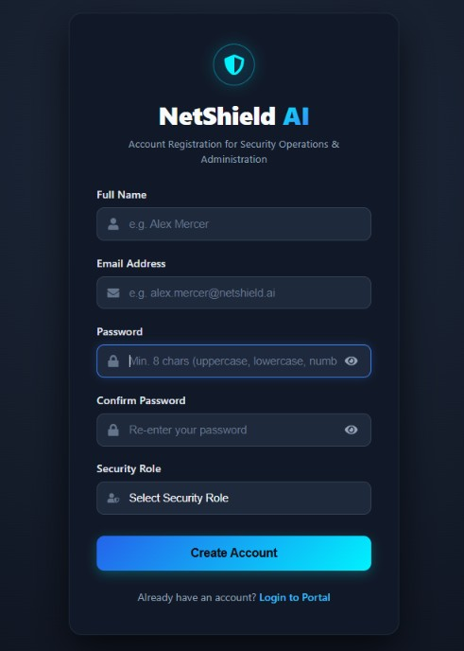
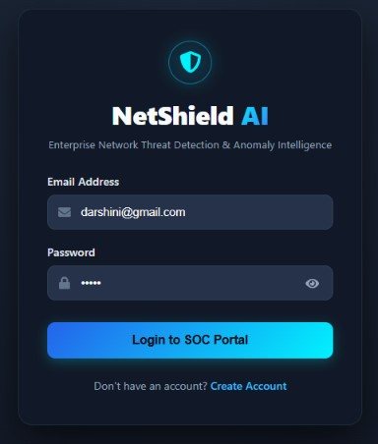
Registration Page:
Login Page:

Slide 4
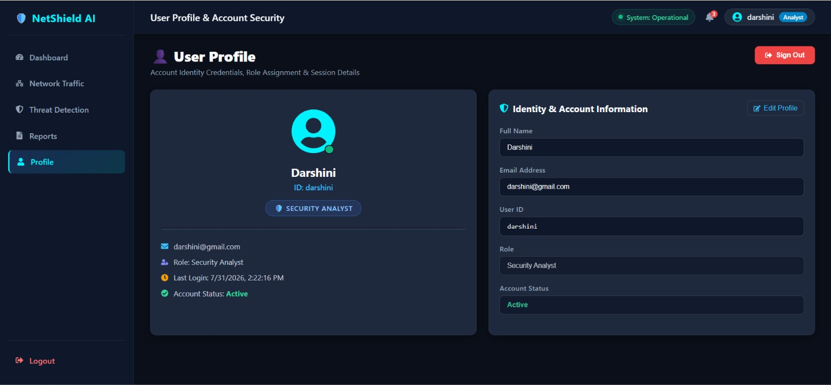
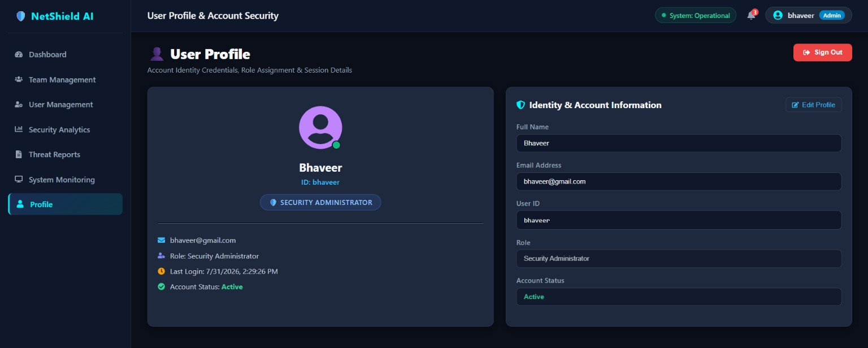
Analyst Dashboard:
Admin Dashboard:
Dashboard
Network Traffic
Anomaly Detection
Threat Detection
Reports
Profile
Dashboard
Team Management
User Management
Security Analytics
Treat Reporting
System Monitoring
Settings
Profile

Slide 5
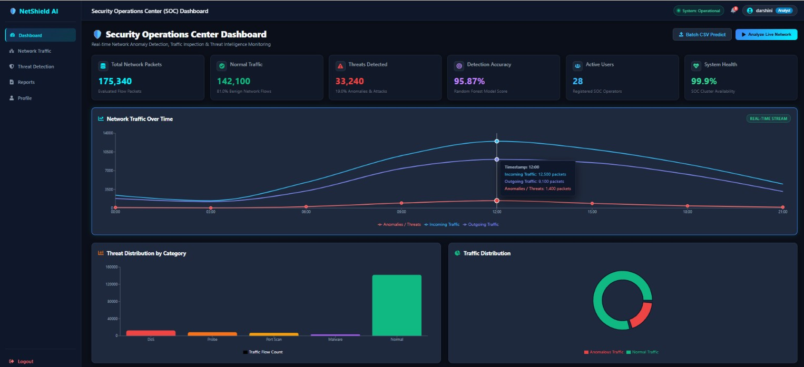
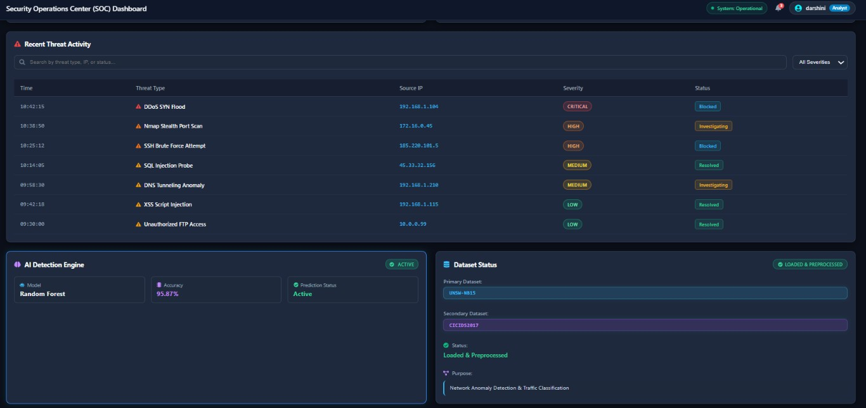
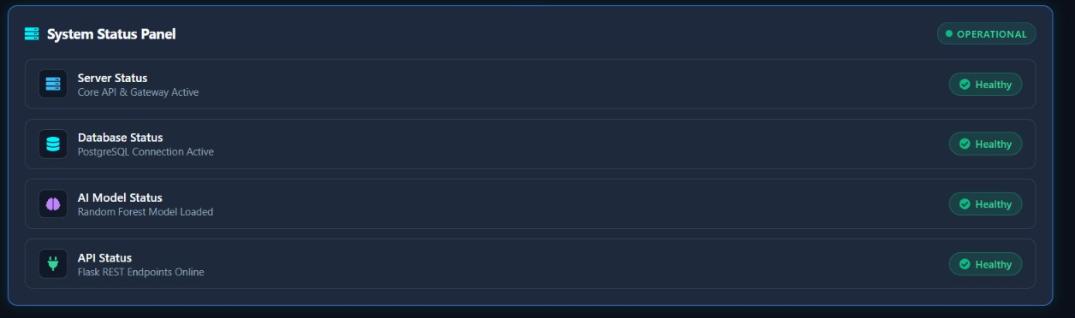
Analyst dashboard:
Centralized dashboard for monitoring network activity
Real-time network traffic visualization
AI-assisted anomaly and threat monitoring
Threat activity and incident reporting
System health and security status monitoring

Slide 6
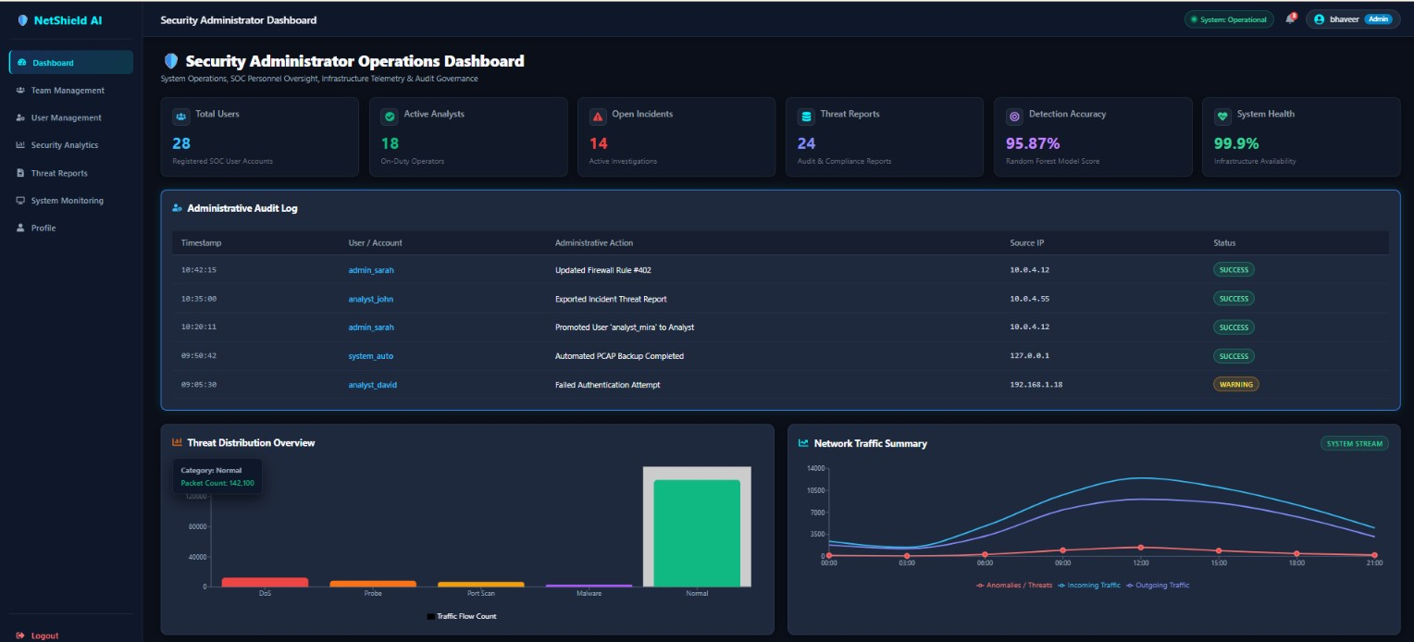
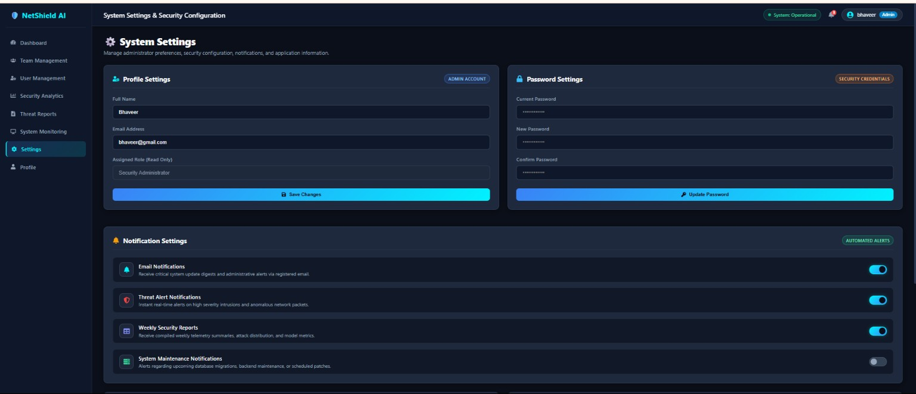
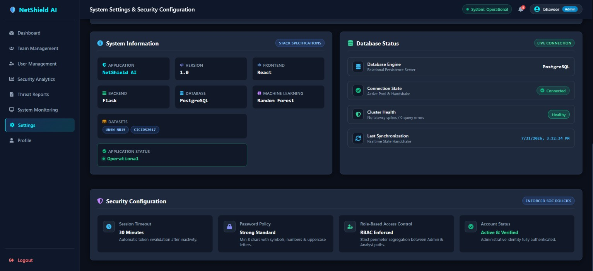
Admin Dashboard:
Manage users and security teams
Monitor system health and security status
View security analytics and threat reports
Configure application settings and notifications

Slide 7
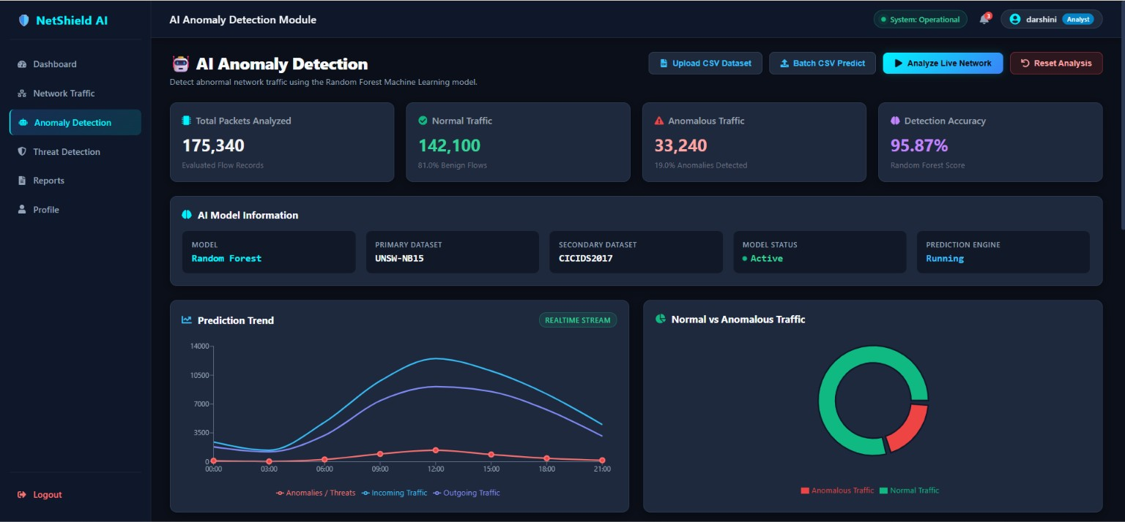
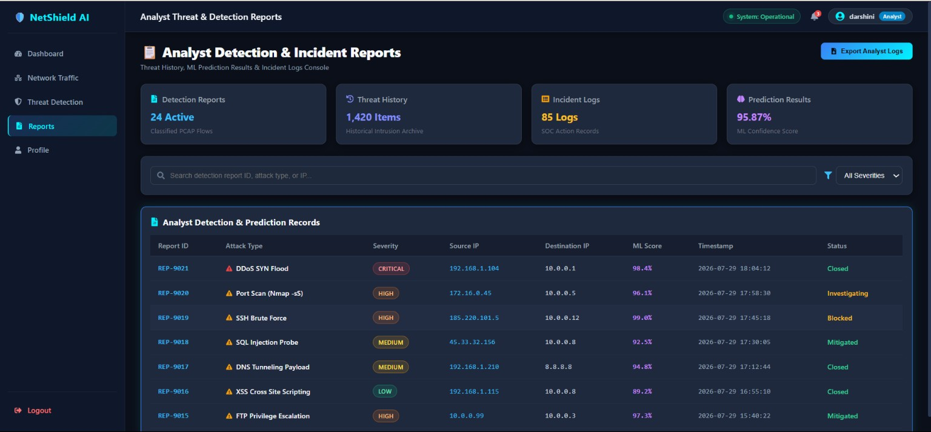
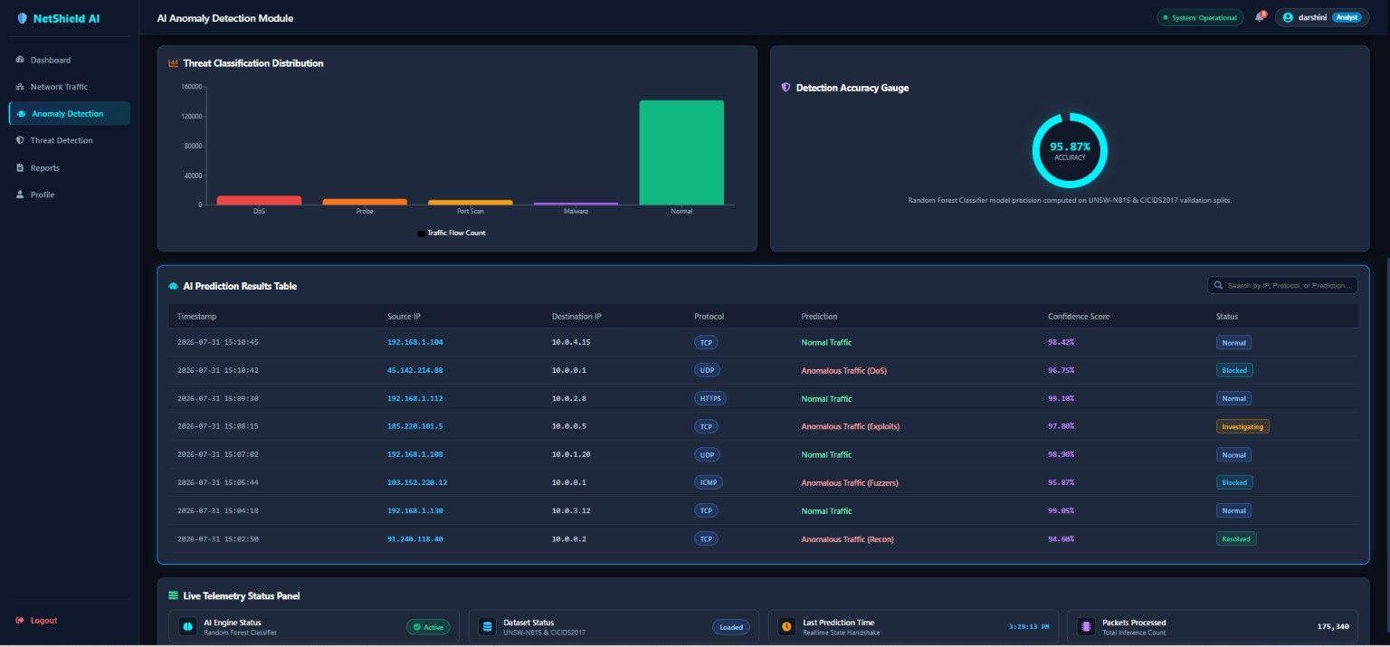
Security analyst:
Network Traffic Analysis: Monitor incoming and outgoing network traffic.
AI Anomaly Detection: Detect abnormal network traffic using ML.
Threat Detection: Analyze detected cyber threats.
Reports: Maintain detection history and investigation records.

Slide 8
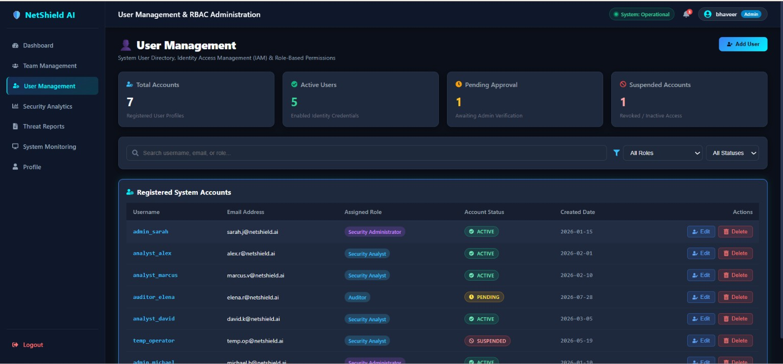
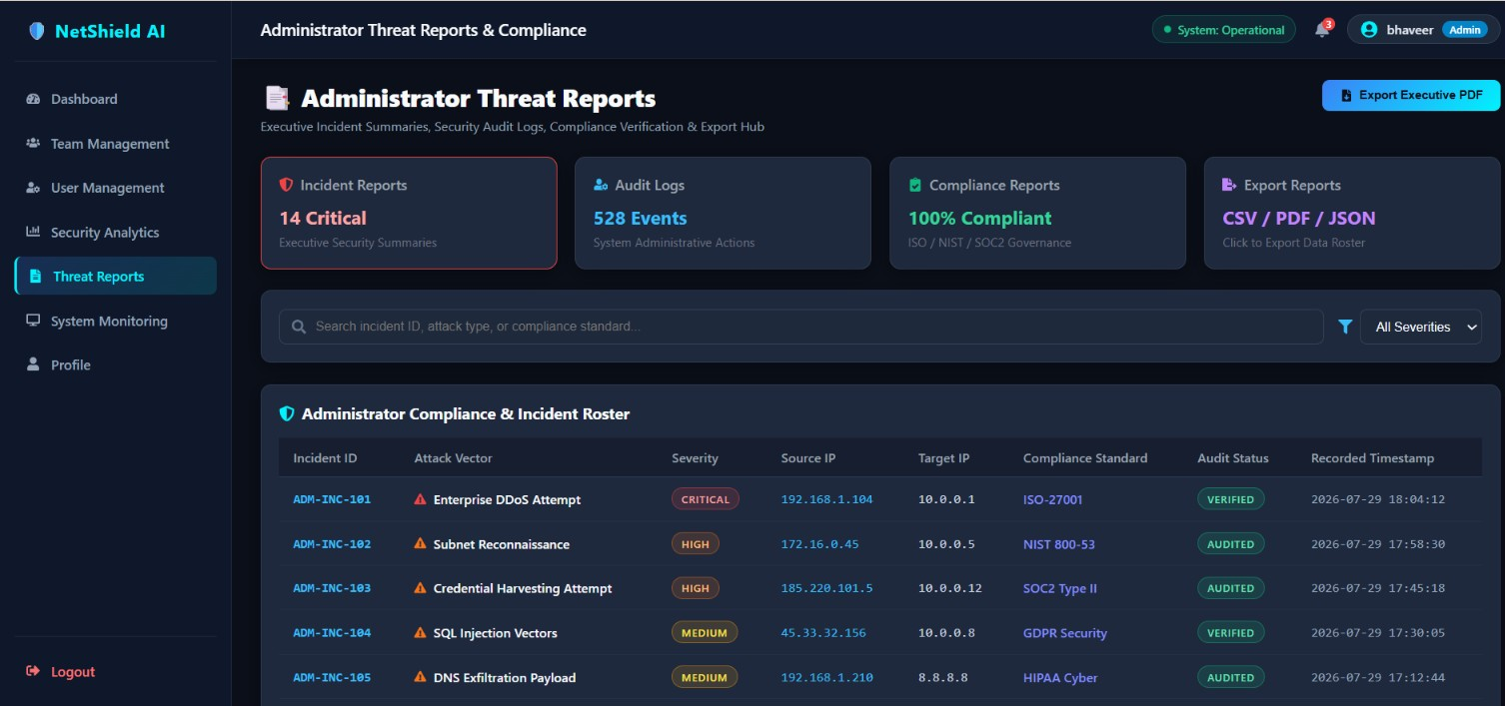
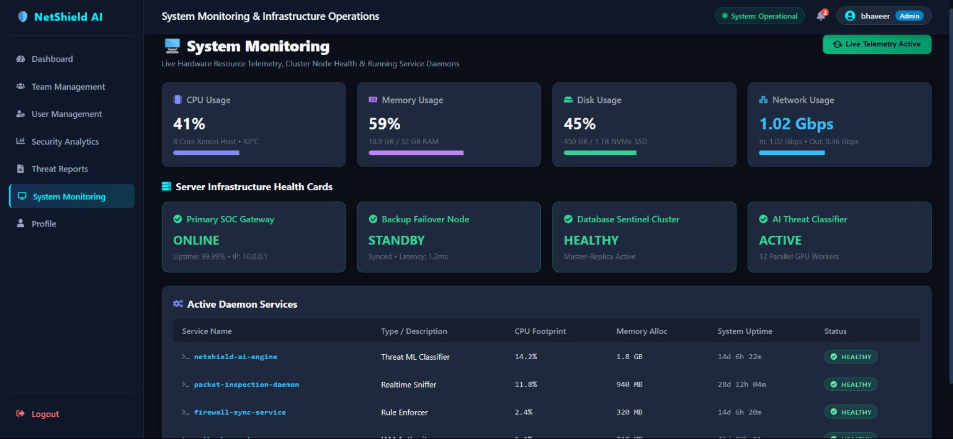
Security administrator:
Team Management – Manage security team members.
User Management – Manage users and access permissions.
Security Analytics – Analyze security trends and risks.
Threat Reports – View and manage security incidents.
System Monitoring – Monitor server and system health.
Settings – Configure system preferences.

Slide 9
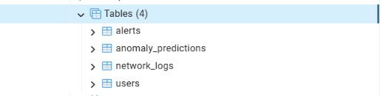
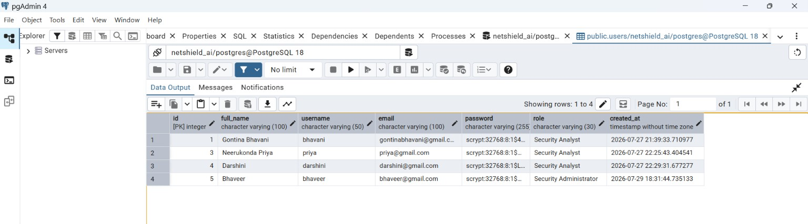
tables & Database (PostgreSQL)

Slide 10
THANK YOU
Bhavani Gontina

