Slide 1

HEALTHGAURD PRO
“Here we will track the health status of the user”

Slide 2

"Health Guard Pro” is a comprehensive health monitoring platform that empowers individuals to take control of their well-being. Our app integrates modern technology with user-centric design to provide actionable health insights, spanning physical health, mental wellness, nutrition.
Features:

Slide 3
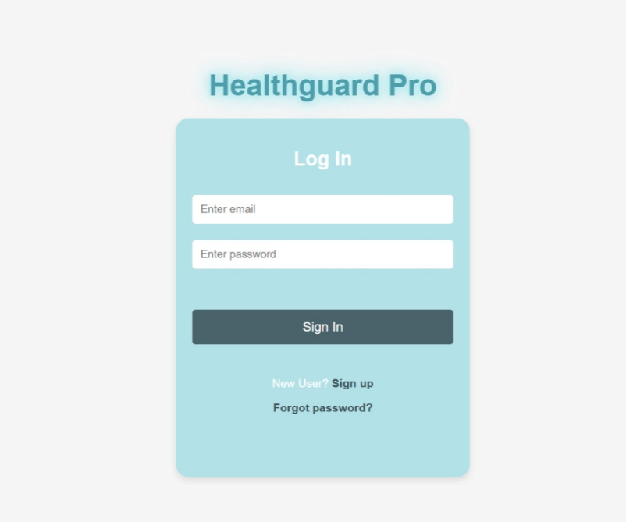
Let’s Login!
Requirements:
User Email (used during signup).
Password.
Forgot Password:
.
Enter Email
Client-Side:
Show clear and actionable error messages
(e.g., "Email is already in use" or "Passwords do not match").
Server-Side:
Return descriptive HTTP status codes (e.g., 400 for bad request, 409 for conflicts).
password

Slide 4
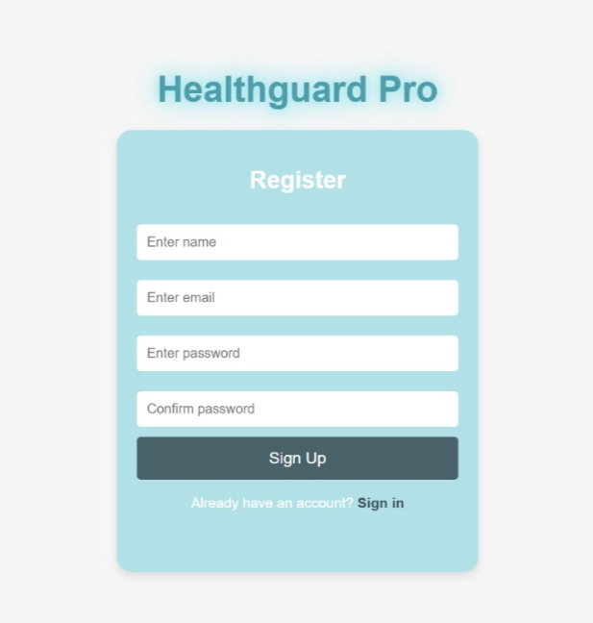
Sign-up Page:
Enter username
Enter valid Email
Choose strong password
Confirm password
Username : Users can choose a unique identifier for their profile.
Valid Email : Users must provide a valid email address that will serve as their primary contact and login ID.

Slide 5
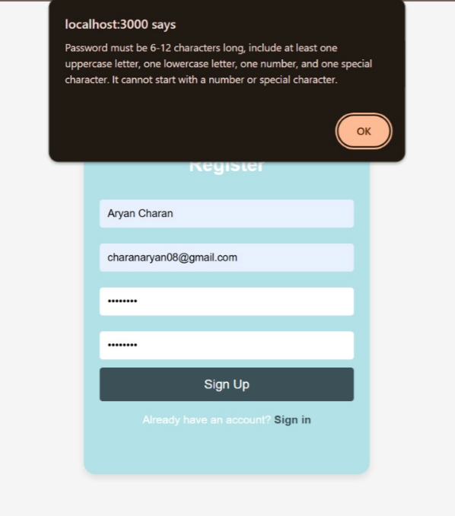
If below mentioned rules are not followed by user this pop message will be appeared.
We had used regex concept for strong password.
The password should follow below rules:
One uppercase letter
One lowercase letter
One special character
One digit

Slide 6
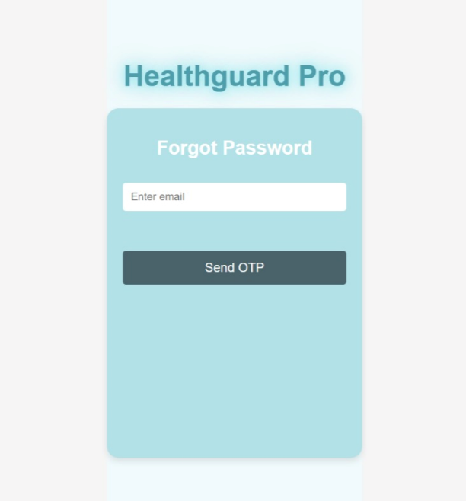
If user forget there password:
Enter user Email through which
they signup.
OPT will sent to user’s Email

Slide 7
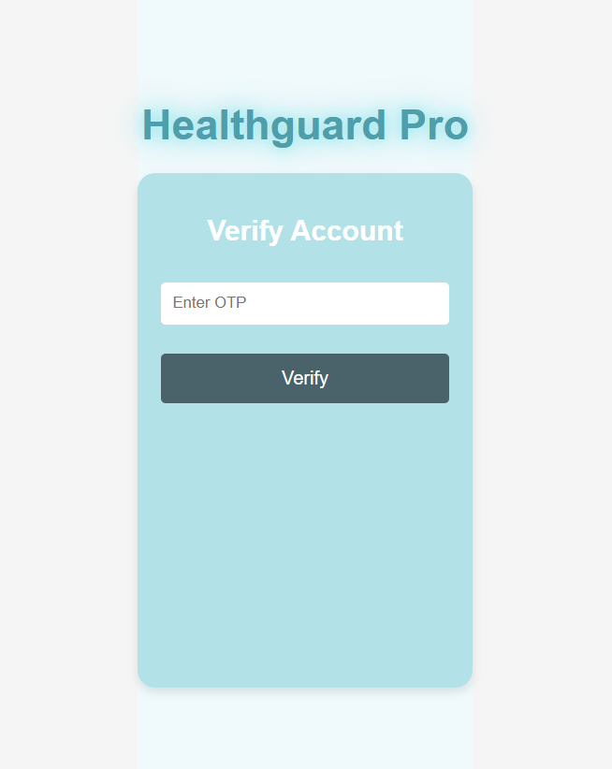
Verify OTP Page:
Enter OTP
OTP is directly send to user email , If they enter the OTP they can change their password.

Slide 8
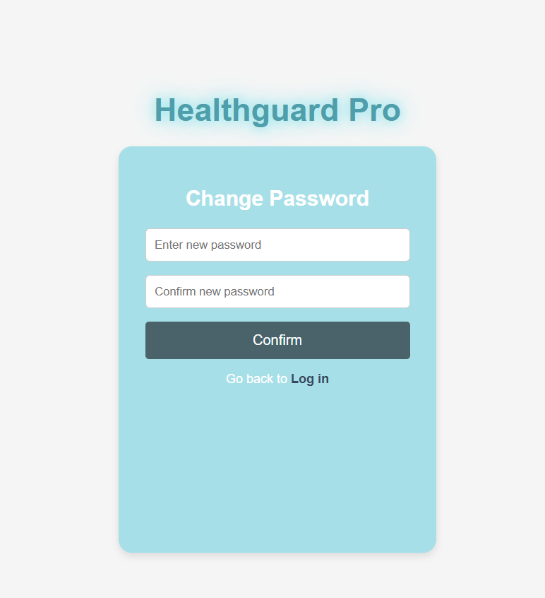
Change Password:
User can set their new password once they conformed there password they will redirect to login page .

Slide 9
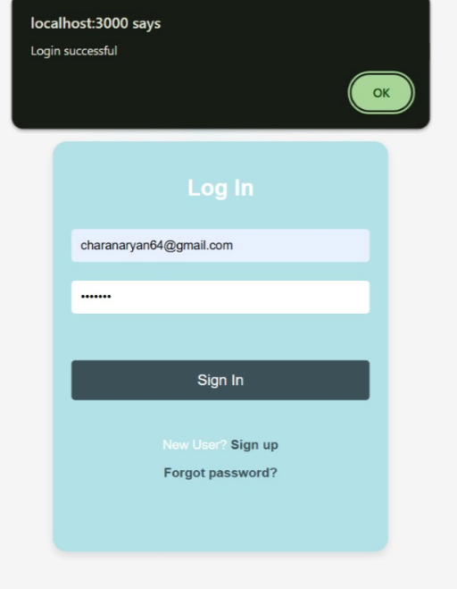
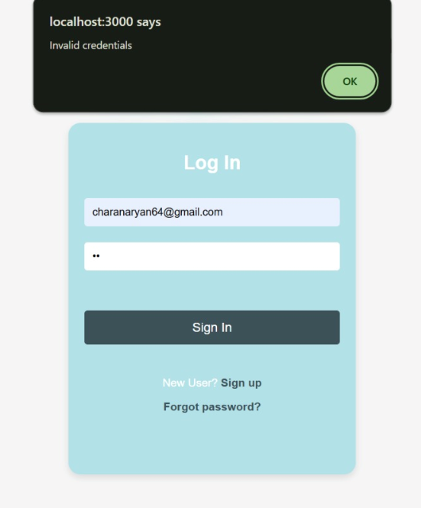
Valid and Invalid credentials:
Credential Validation : Alerts if the email provided is already registered.
Checks for matching passwords during input and gives immediate feedback if they do not match.

Slide 10
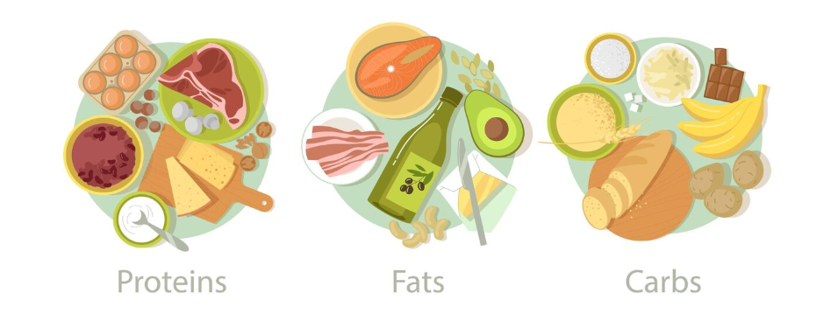
Assessment Blogs Leaderboard About-Us
DASHBOARD

Slide 11
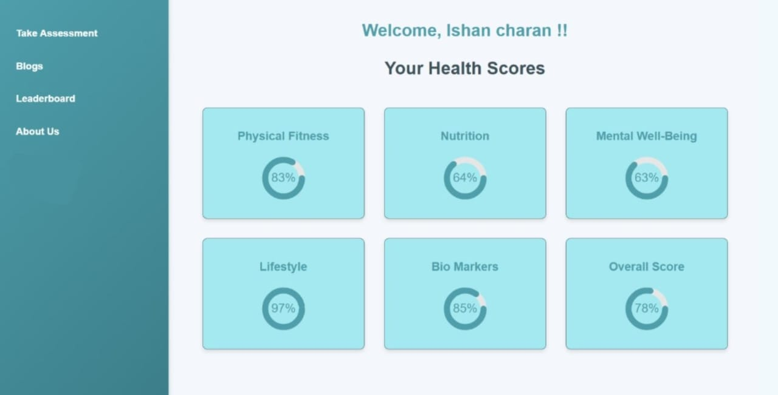
Dashboard page:
User can explore all these sectors
User can see there
Overall score
The dashboard serves as the central hub for users, providing a consolidated view of their health metrics, activities, and progress across various sectors. It is designed to be interactive, informative, and user-friendly, with a clean layout that adapts to different devices.

Slide 12
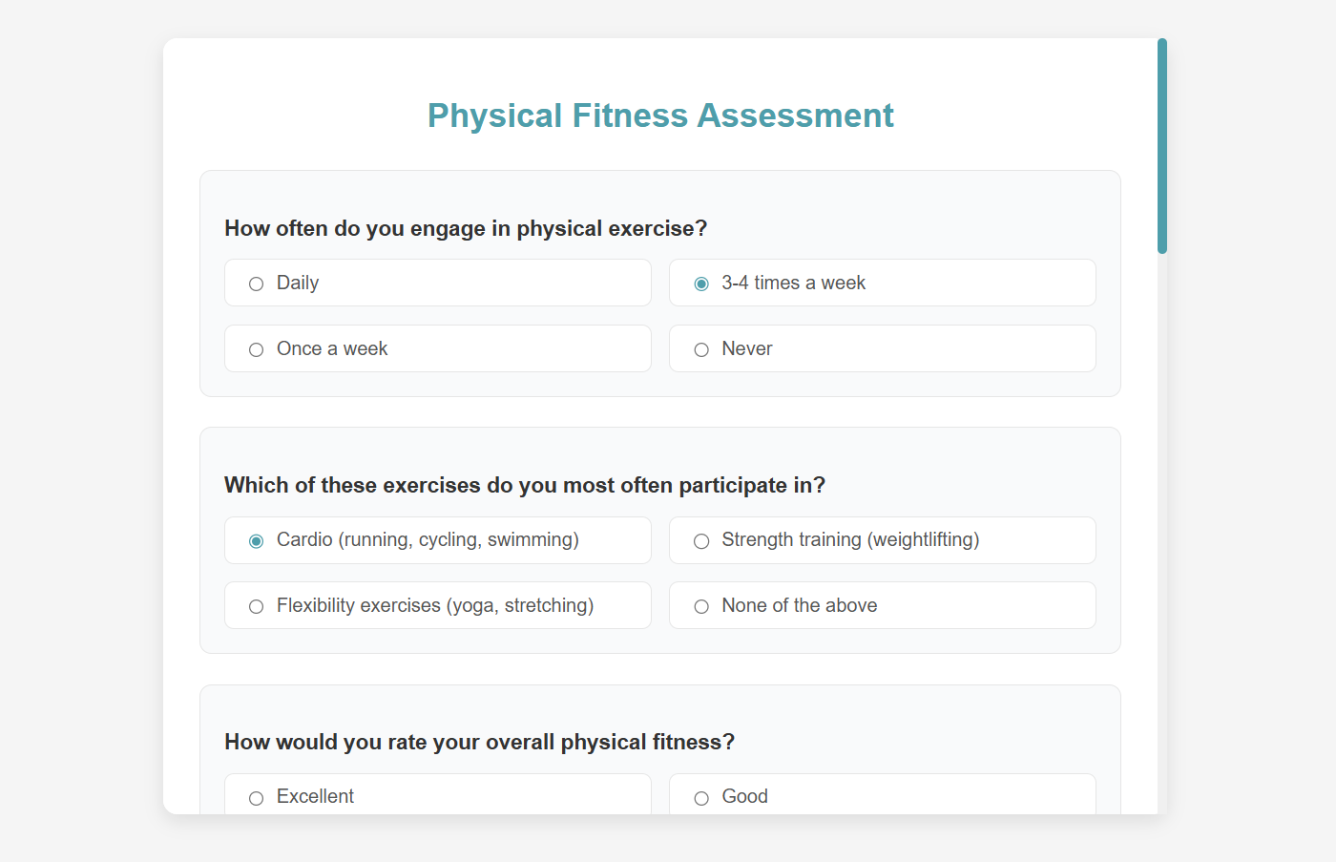
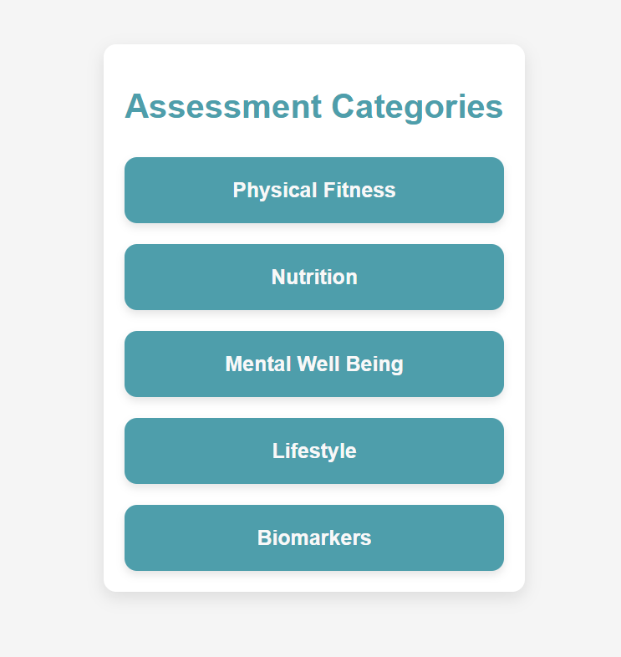
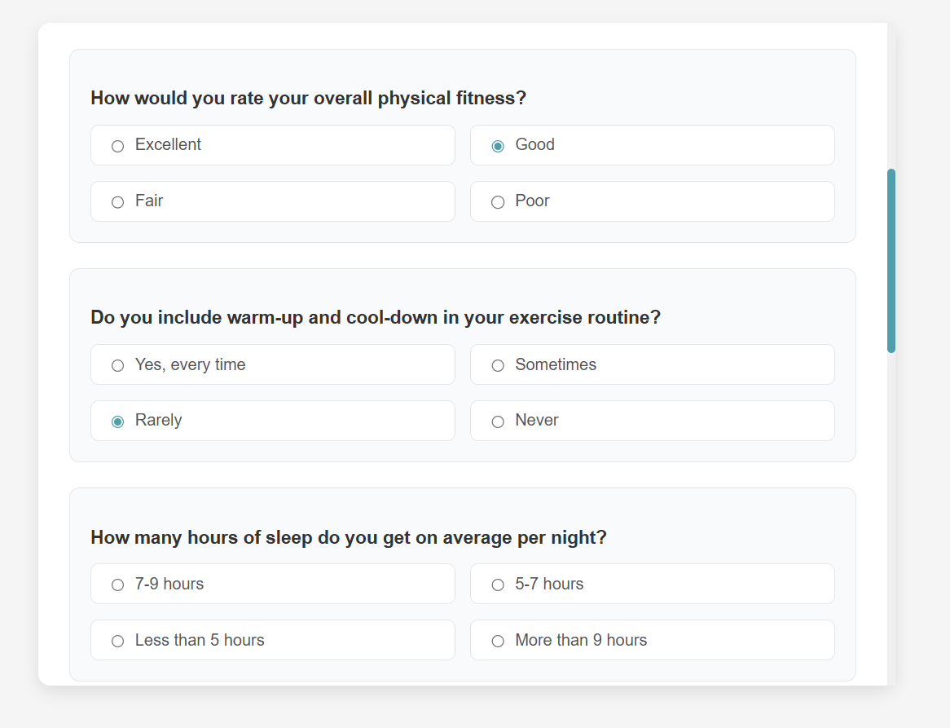
Assessment:
For each category there are 10 questions ,the options selected by user will reflect on overall score.

Slide 13
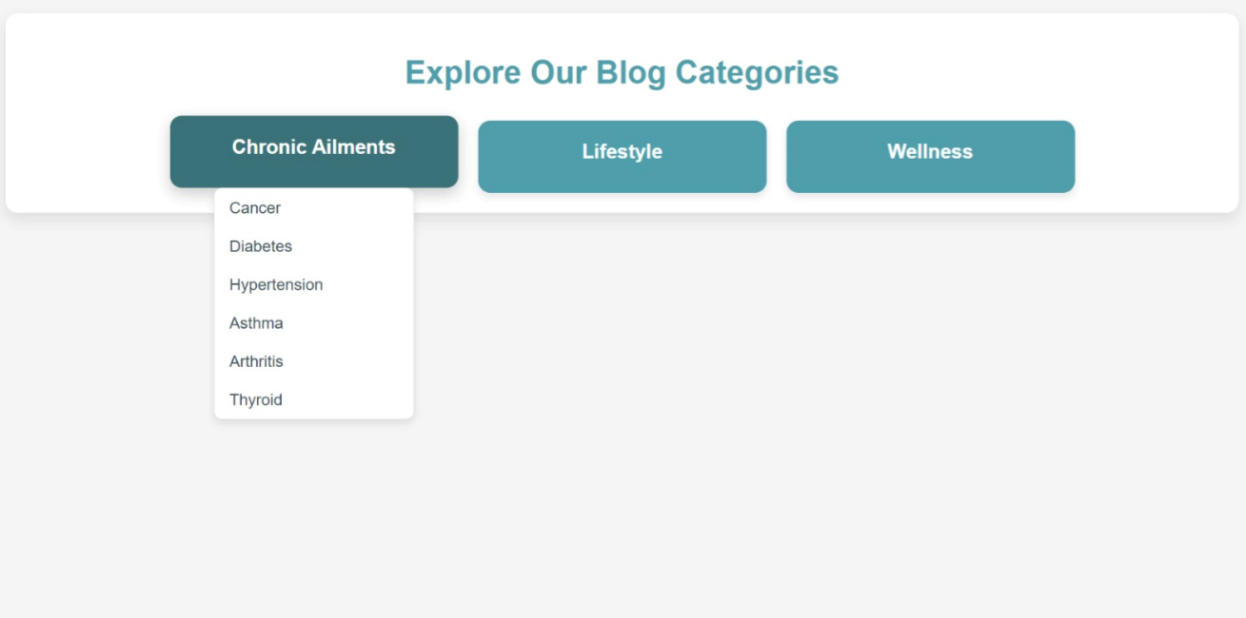
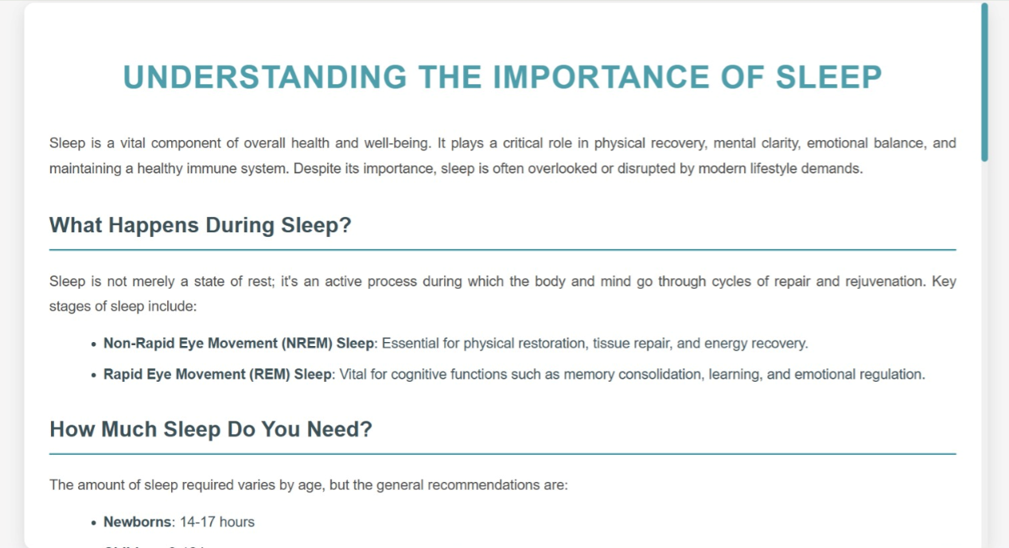
Blog Page:
There are some topics from which user can select an option and can see the required information .

Slide 14
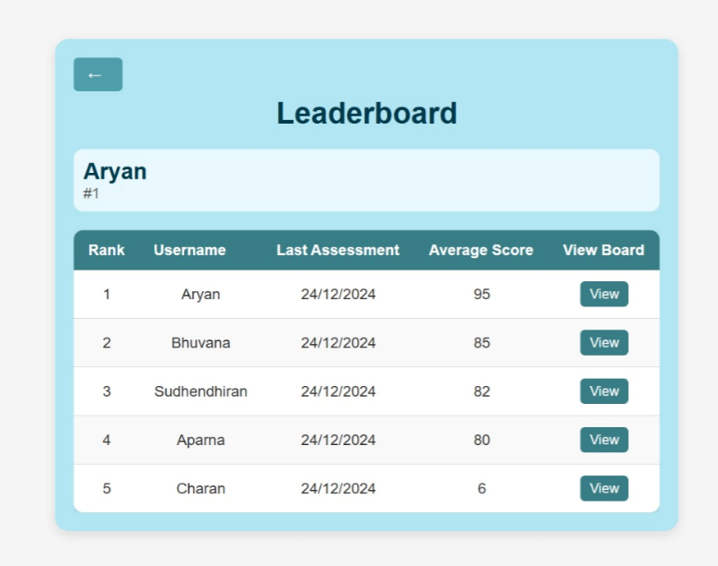
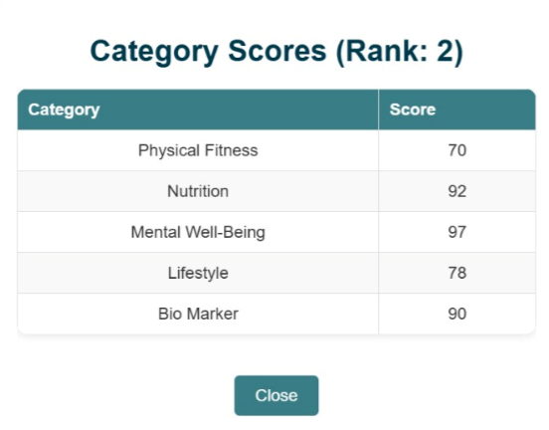
Leaderboard:
User can see there rank and overall score in leaderboard
Username is also displayed

Slide 15
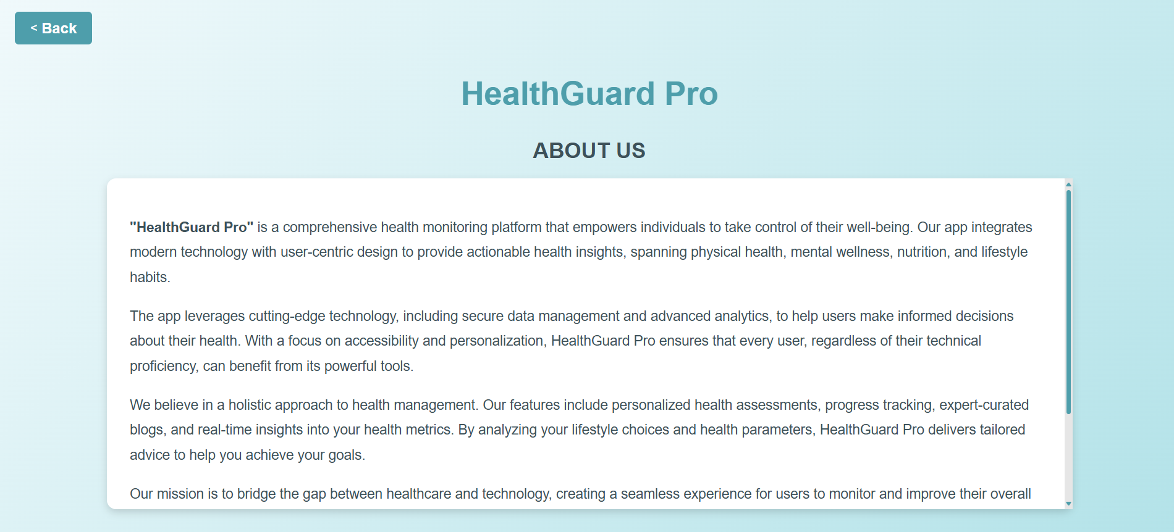
About-Us page:
Here, User can see the details about the app

Slide 16
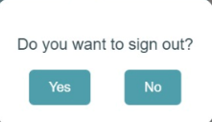
Logout:
This box will appear when user click on logout button
Yes Button: Allows the user to confirm the action of signing out.
No Button: Lets the user cancel the action and remain signed in

Slide 17
Workflow Example:
User fills out the sign-up form with a username, email, and password.
System validates inputs (email format, password strength, etc.).
If any errors exist, the system provides real-time feedback.
Upon successful validation, user clicks "Sign Up.“
User receives a confirmation email to activate their account.

Slide 18
BACKEND

Slide 19
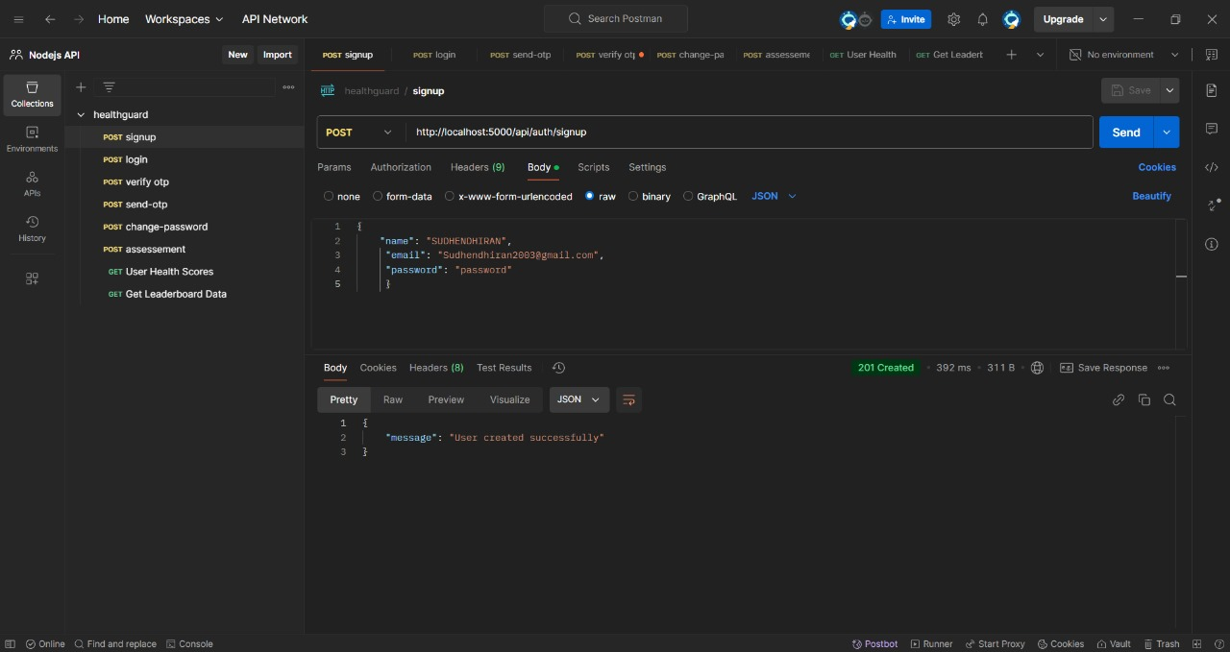
Sign-up:
Database stores every user who had signup in the app.
Endpoint URL: http://localhost:5000/api/auth/login

Slide 20
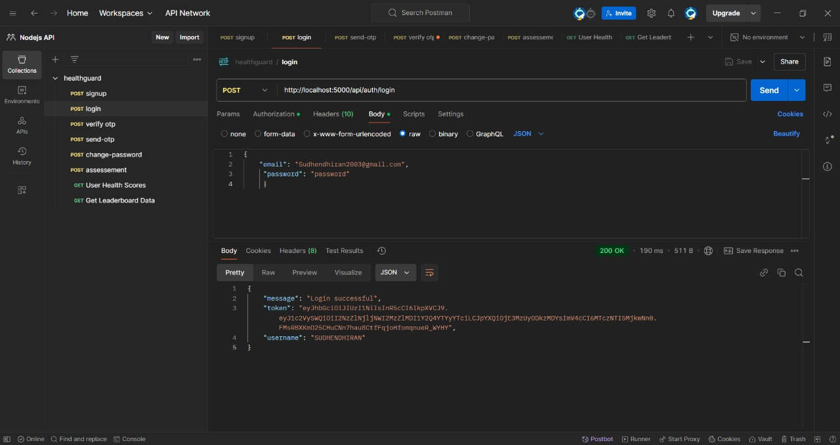
Login:
Authentication System: Implements user authentication using email and password.
JWT Token: Provides a secure way to manage user sessions.

Slide 21
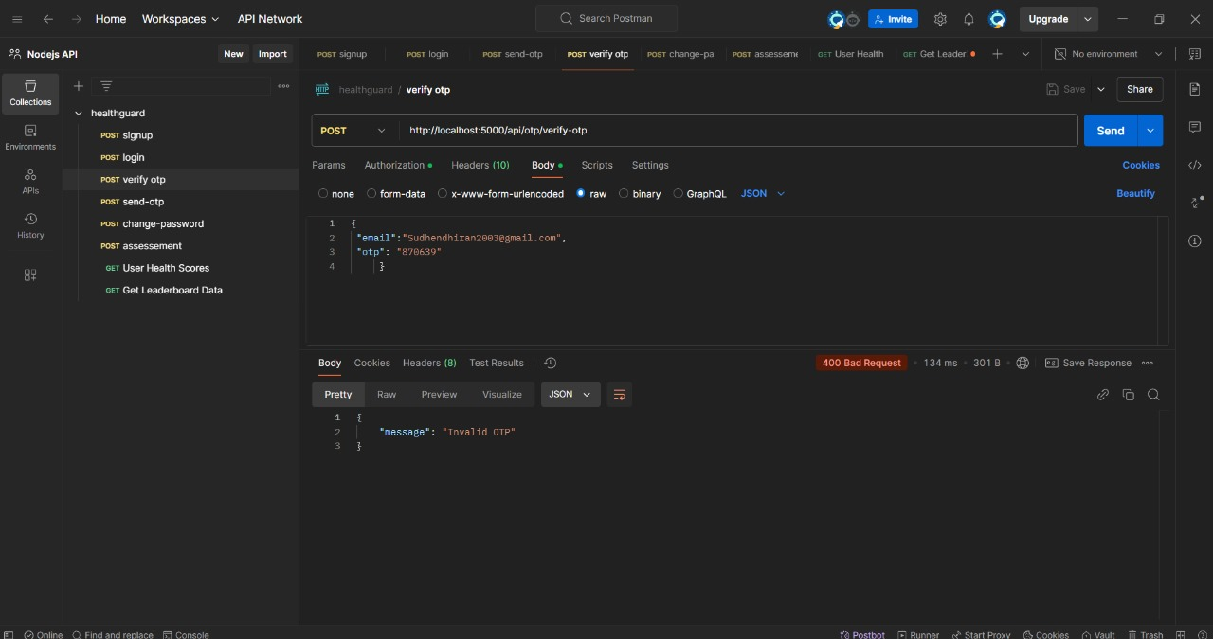
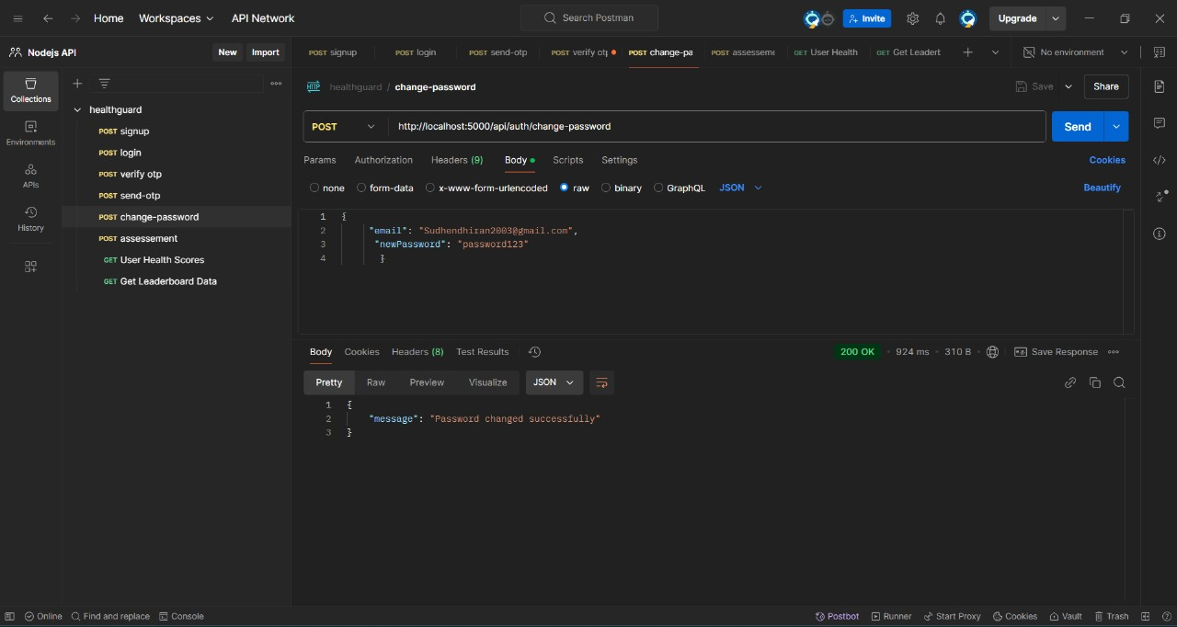
Change password:
OTP is stored here whenever
User want to change password
The changed password is stored here

Slide 22
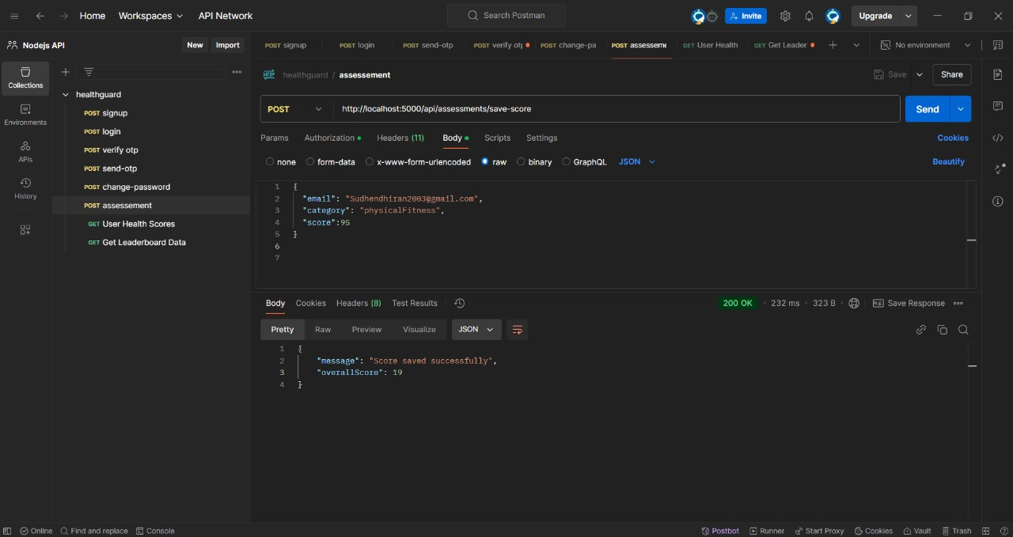
Assessment:
Confirms the score was saved successfully
Categorized by specific metrics (e.g., "physical Fitness").
Scores are stored and contribute to an overall score.

Slide 23
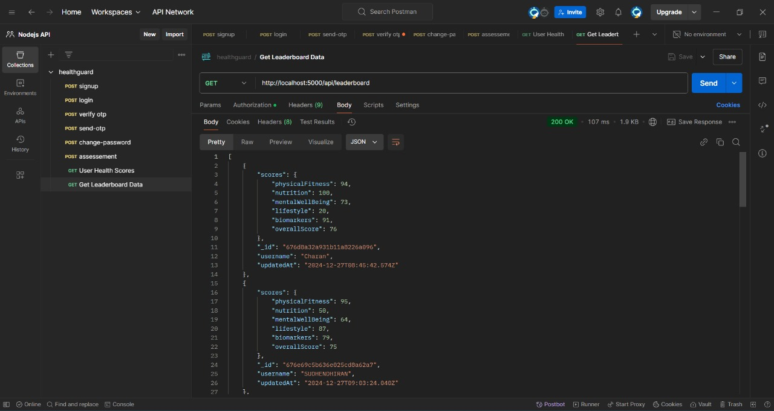
Leaderboard:
The client (frontend) sending a GET request , The server responding with leaderboard data. Represent leaderboard data in a table or bar chart format.

Slide 24
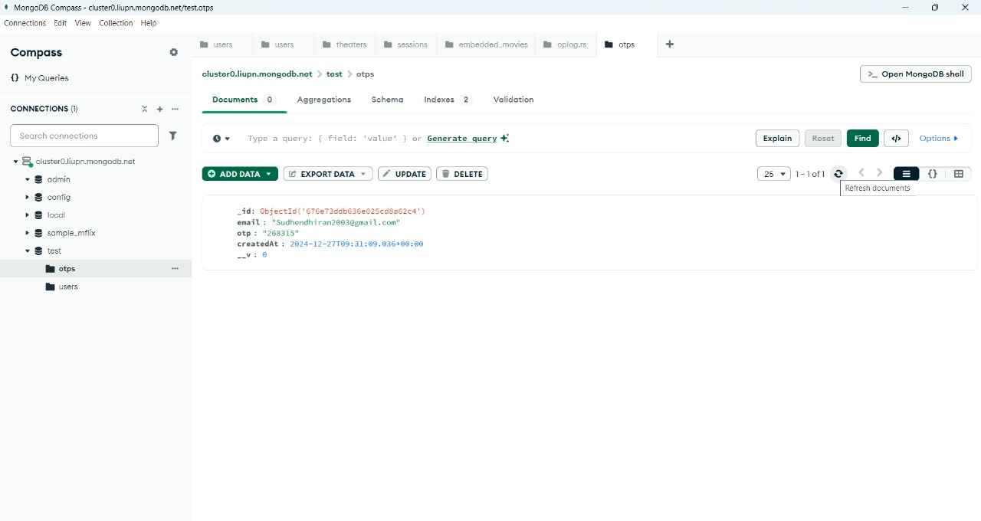
OTP:
Whenever user want to change password the OTP will be stored in the database.

Slide 25
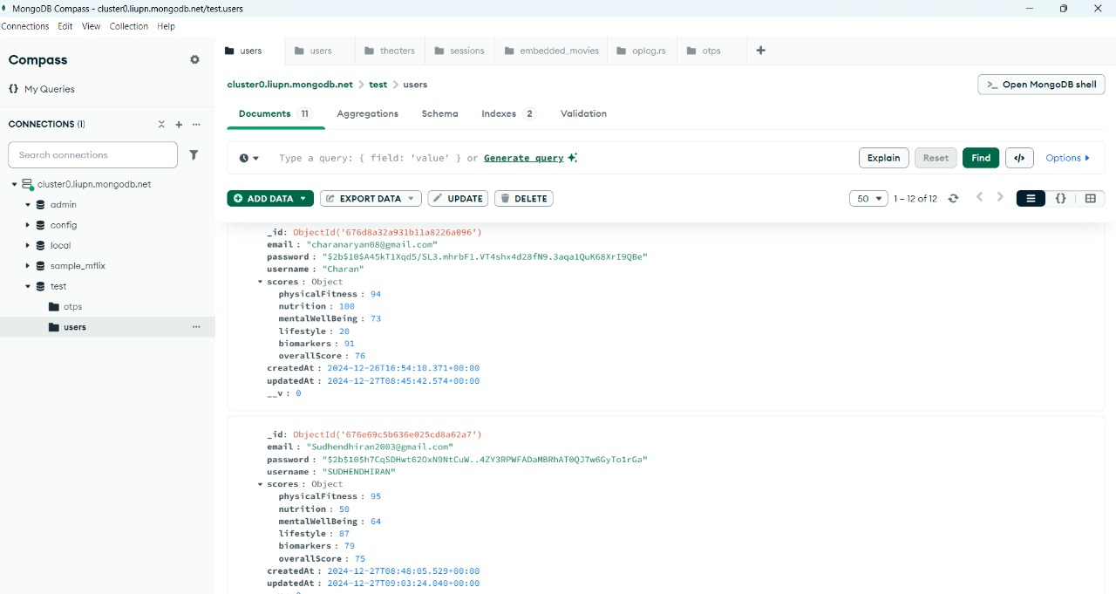
Assessment:
Displays users' scores based on various health metrics. Promotes improvement among users through scores, Leaderboard data is dynamically fetched and displayed.

Slide 26
Frontend Development
Framework/Library:
React.js for building a dynamic and responsive user interface.
Responsive Design:
CSS frameworks like Bootstrap or Tailwind CSS to ensure mobile-friendly layouts.
Backend Development
Programming Language:
Node.js for server-side processing.
API Integration:
APIs to handle user data securely.

Slide 27
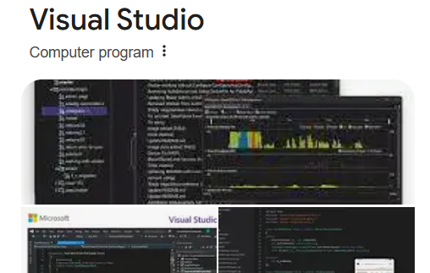
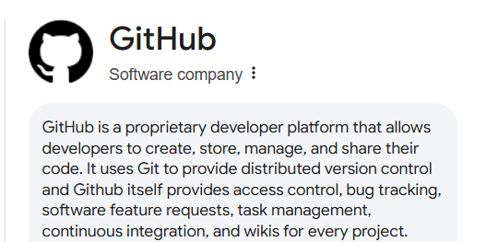
Platform’s we used:

Slide 28
Team Members:
Aryan Charan
Aparna Yallapragada
Sudhendhiran
Thrinadh Matta
Yallapu Bhuvana

Slide 29
THANKYOU

