Slide 1

FinSight
PRO
AI-POWERED FINANCIAL SCREENER INTEGRATION & DEVELOPMENT
Presented by:

Slide 2
The Complexity of Market Data: With over 5000+ listed companies, manual stock screening is highly complex and time-consuming for retail investors.
The Knowledge Gap: Retail investors often lack the deep financial terminology (like EBITDA, Debt-to-Equity) required to navigate traditional screeners.
Rigid UI Limitations: Existing tools rely on rigid, complex drop-down menus that limit intuitive and fast searching.
Why it Matters: Users need a simplified, conversational way to query financial data without a steep learning curve.
Problem
Statement

Slide 3
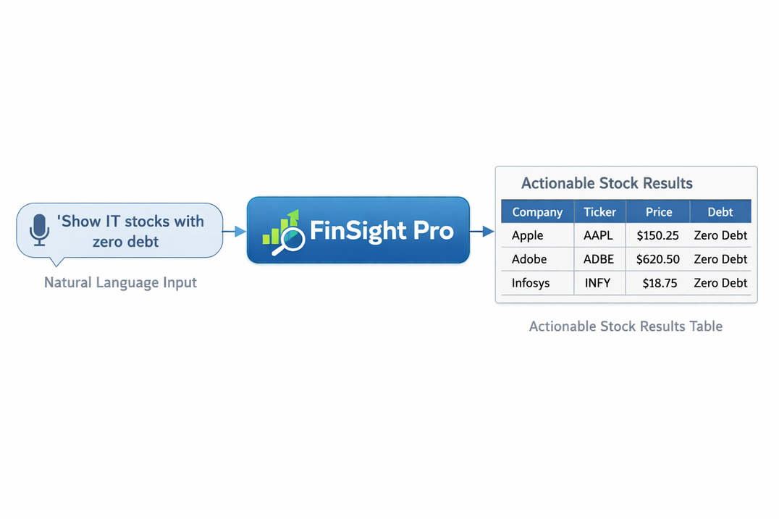
Solution
Overview
End-to-End System: FinSight Pro is a fully integrated, AI-powered stock screener designed for simplicity and power.
NLP to SQL: It seamlessly translates Natural Language queries (plain English) directly into structured, executable SQL queries.
Democratizing Finance: Empowers users to search for stocks using conversational inputs rather than complex, intimidating filters.
Complete Ecosystem: Provides a comprehensive suite including Smart Screening, Dynamic Portfolio Tracking, and Automated Alerts in one platform.

Slide 4
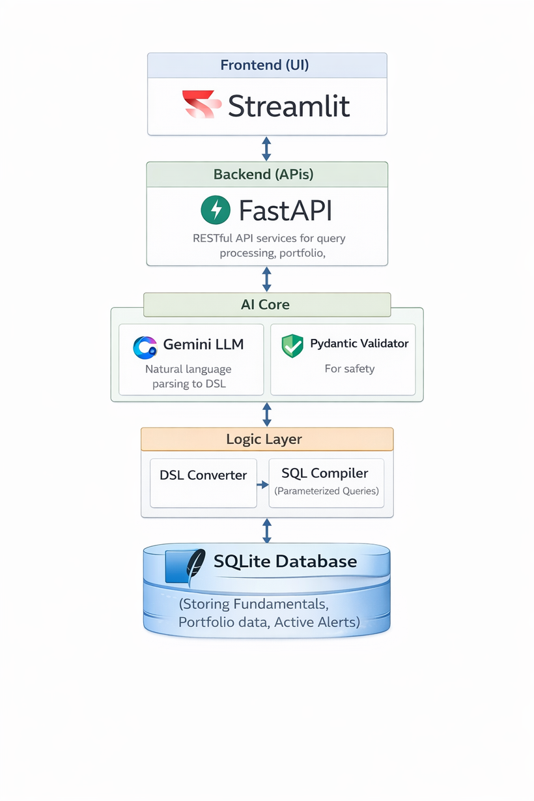
System
Architecture
Frontend (UI): Built using Streamlit for a highly interactive and responsive user interface.
Backend APIs: Powered by FastAPI, ensuring asynchronous, rapid data delivery and secure routing.
AI Core (LLM & DSL Layer): Integrates Gemini LLM to parse natural language into a structured Domain Specific Language (DSL).
Execution Engine: A robust SQL Compiler translates the validated DSL into secure, parameterized queries.
Database: SQLite database managing multi-layered financial data (Fundamentals, Portfolios, Alerts)

Slide 5
Key
Features
Natural Language Querying: Conversational AI interface for instant market research.
Advanced Filtering: Capable of growth-based and quarter-based logic filtering.
Portfolio Management: Real-time tracking of investments with dynamic profit/loss math.
Intelligent Alert System: Automated background monitoring for user-defined stock metrics.
End-to-End Pipeline: A fully integrated, crash-resistant system spanning from UI to Database.

Slide 6
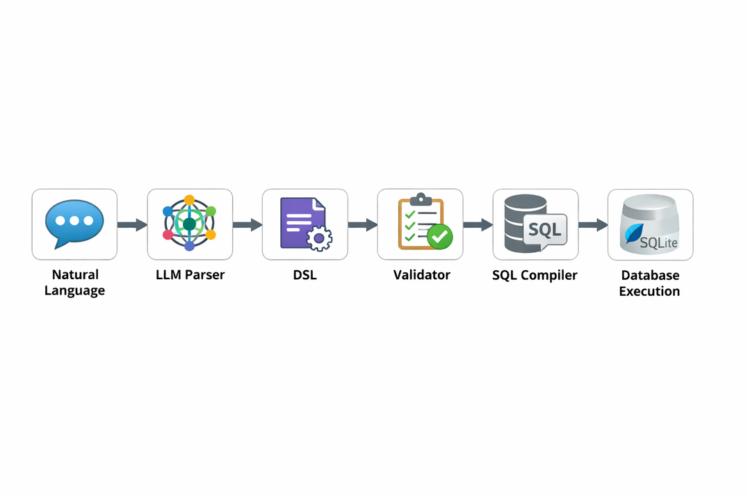
DSL & Query Pipeline
The Pipeline Flow: Natural Language ➔ LLM Parser ➔ DSL ➔ Validator ➔ SQL Compiler ➔ Database Execution.
Sample Input: "Show me IT companies with PE ratio less than 15 and zero debt".
Sample DSL (JSON): {"conditions": [{"field": "pe_ratio", "op": "<", "value": 15}, {"field": "debt", "op": "=", "value": 0}]}.
Sample SQL: SELECT * FROM fundamentals WHERE pe_ratio < ? AND debt = ? LIMIT 50 | Parameters: [15, 0].

Slide 7
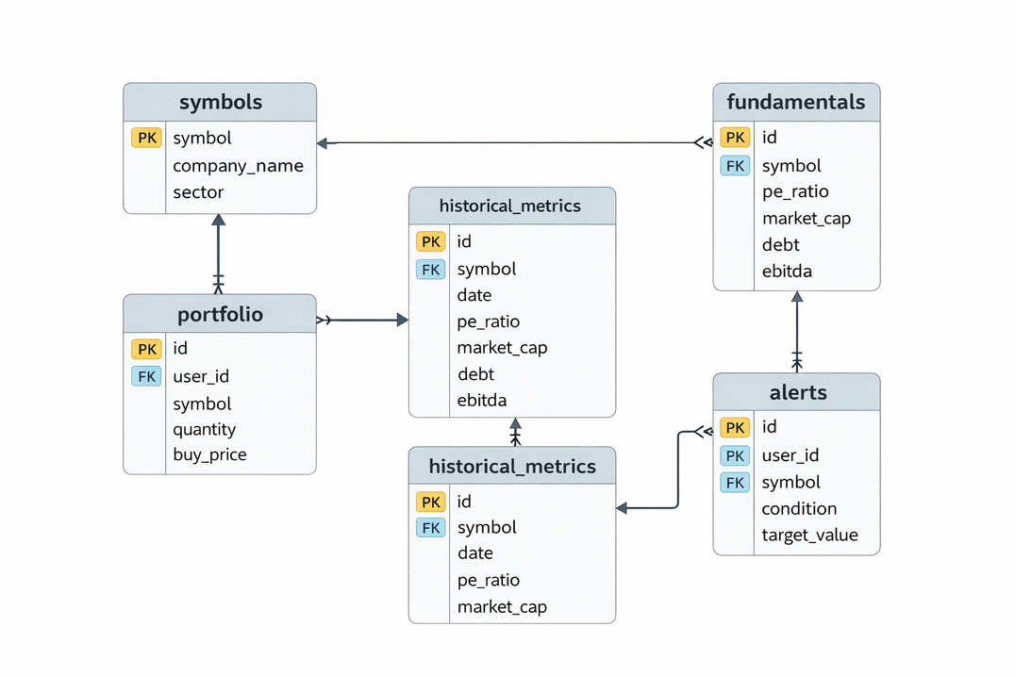
Database
Design
symbols: Master data of all supported companies and sectors.
fundamentals: Core financial metrics (PE, Market Cap, Debt, EBITDA, Promoter Holding).
historical_metrics: Data for time-series and quarter-based analysis.
portfolio: Tracks user_id, symbol, quantity, and buy_price.
alerts: Stores active trigger conditions mapped to specific users.

Slide 8
Computed Values & Growth Calculations:
Advanced
Dynamically calculates YoY growth and quarter-on-quarter trends instead of storing static values
Features
Query-Based Filtering:
Complex logical operations (AND/OR) applied simultaneously across multiple financial parameters
Trend Logic Implementation:
Evaluating historical data to identify upward or downward market trajectories.

Slide 9
Portfolio &
Alerts Logic
Portfolio Logic: Implements "Average Buy Price" algorithms to seamlessly merge duplicate stock entries, ensuring accurate investment tracking.
Profit/Loss Calculation: Dynamically derives Current Value, P&L, and Profit Percentages on the fly.
Alerts Logic: Compares user-defined target thresholds against live database values.
Anti-Spam Mechanism: Auto-deletes alerts immediately after triggering to prevent system overload and user spam.

Slide 10
Database Indexing: Strategic indexes on high-frequency query columns for rapid lookups.
Performance &
Optimization
Query Optimization: Parameterized queries ensure security while maintaining sub-millisecond execution times.
Caching Strategies: Implemented state management in Streamlit to cache session data and reduce redundant backend API calls.

Slide 11
Testing &
Reliability
Unit & API Testing
Error Handling
Verified all FastAPI endpoints (GET, POST, DELETE) for accurate JSON responses and data integrity.
Global Exception Handlers catch Pydantic validation errors (422) and database failures gracefully without exposing stack traces.
System Stability
Strict input validation prevents crashes from empty queries or unusual inputs, ensuring consistent results

Slide 12
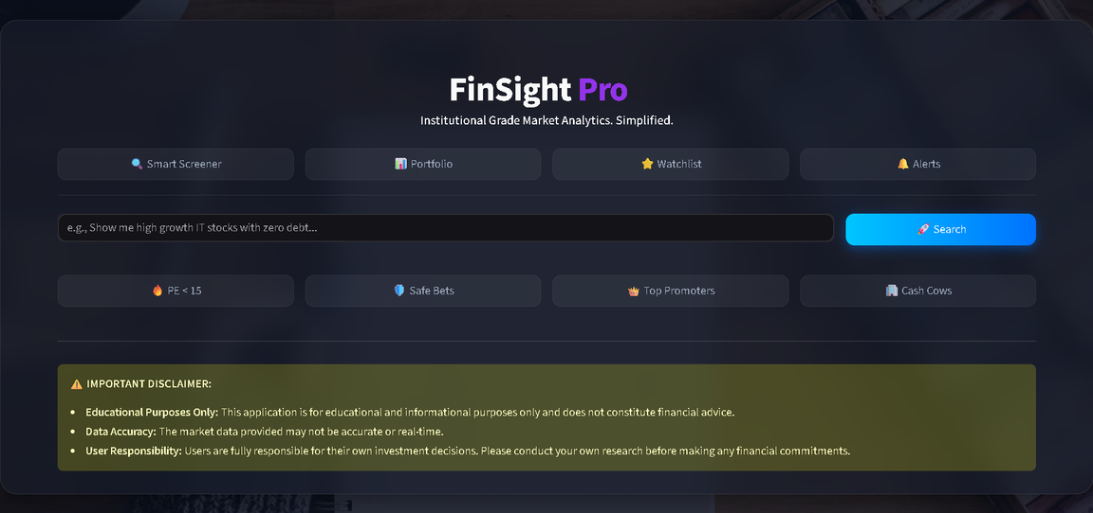
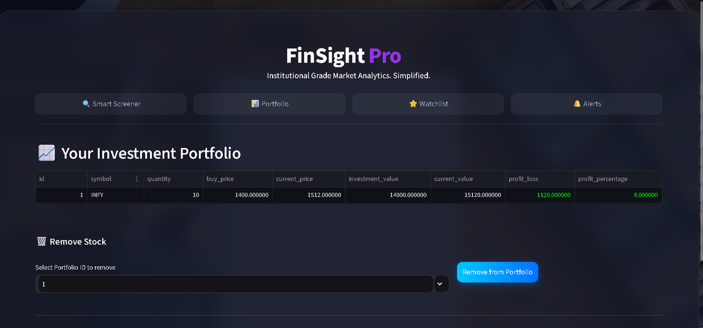
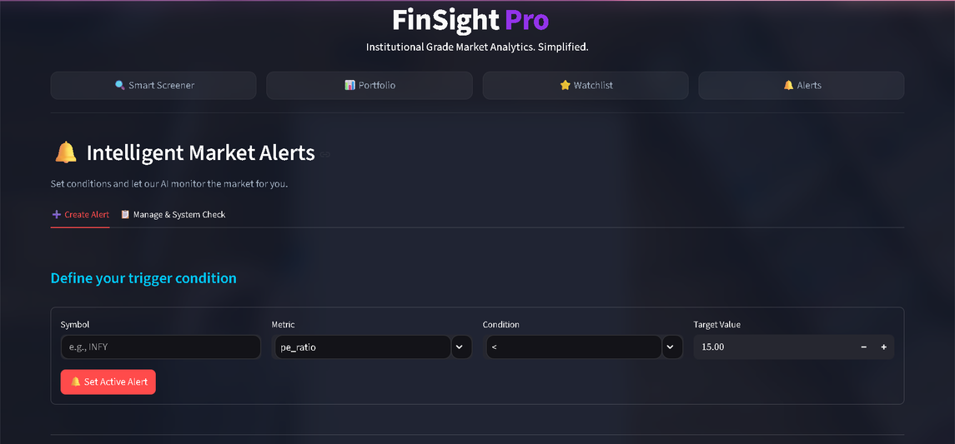
Demo
Representation

Slide 13
Challenges Faced:
Managing LLM inconsistencies/hallucinations, handling SQL compilation complexity, and resolving integration issues between UI and Backend.
Challenges &
Future Scope:
Future Improvements
Integrating Real-Time Market APIs (e.g., NSE/BSE live feeds) for live data updates.
Enhancements:
Implementing advanced technical metrics (RSI, MACD) and upgrading to a more sophisticated UI.

Slide 14
Conclusion
Successfully built a highly stable, end-to-end integrated system demonstrating the power of AI in financial analytics.
Bridged the gap between complex financial databases and natural language querying.
The system is fully functional, crash-resistant, and ready for further scaling.

Slide 15
THANK YOU

