Slide 1

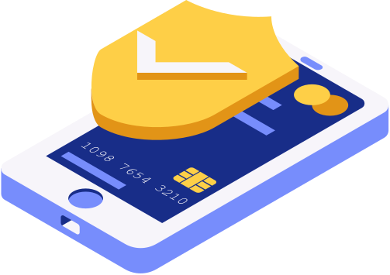
MODERN DIGITAL BANKING
Presented by:
TEAM 3
INFOSYS SPRINGBOARD

Slide 2


TABLE OF CONTENTS
  Project Overview
  Problem Statement & Objectives
  Core Features
  Tech Stack
  8-Week Milestone Plan
  Implementation Highlights
  Challenges & Solutions
  Future Scope
  Conclusion

Slide 3
PROJECT OVERVIEW
The Modern Digital Banking Dashboard is a centralized financial management platform designed to unify multiple banking services into a single intelligent system. It integrates multi-bank accounts, transaction tracking, budgeting tools, bill payments and reminders, rewards monitoring, and financial insights into one seamless interface. Instead of managing finances across different applications and portals, users can access all their financial information in one secure dashboard. This platform provides real-time visibility, smart alerts, and actionable insights, enabling users to make informed financial decisions efficiently and effectively.

Slide 4
PROBLEM STATEMENT
MISSION
KEY FEATURES
  Implement secure JWT-based authentication
  Enable multi-account and transaction management
  Provide budgeting and bill tracking features
  Deliver real-time insights and alerts.
  Build a scalable full-stack solution
Managing finances across
multiple bank accounts,
transactions, bills, and
rewards platforms is complex and fragmented.
Users often lack a centralized system to track spending, monitor budgets, and receive timely financial insights.
To develop a secure and intelligent digital banking dashboard that unifies accounts, transactions, budgeting, bills, rewards, and financial insights into one seamless platform.

Slide 5
TECH STACK
Frontend
  React.js
  Tailwind CSS
Backend
  FastAPI
Authentication
  JWT(Access+ Refresh Tokens)
Database
  PostgreSQL
Integrations
  ExchangeRate API

Slide 6
MILESTONE PLAN
WEEKS 1-2
WEEKS 3-4
WEEKS 5-6
WEEKS 7-8
Foundations & Accounts
Categorization & Budgets
Bills & Rewards
Insights & Alerts
Auth + base schema; Accounts CRUD (manual link for prototype). Transaction ingestion (CSV import first), list & details UI
Category rules (merchant/keywords), manual recategorization.
Monthly budget creation & progress bars
Bills CRUD, reminders (Celery emails/SMS).
Rewards tracking (points balance), currency summaries via ExchangeRate API
Insights (cash flow, top merchants, burn rate), Alerts table. CSV/PDF exports, QA, deployment

Slide 7

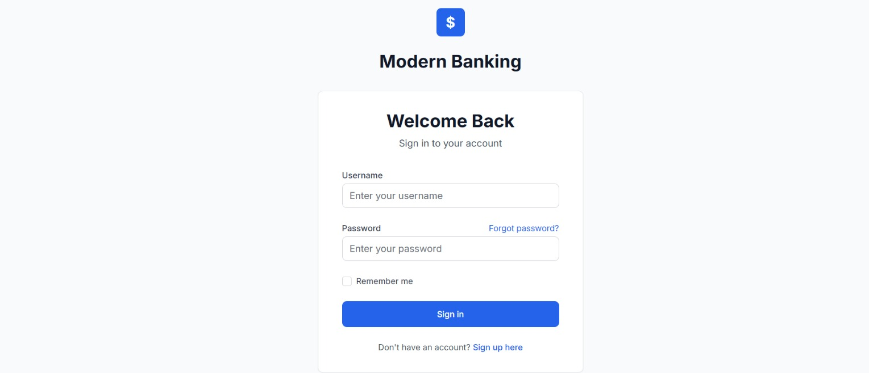

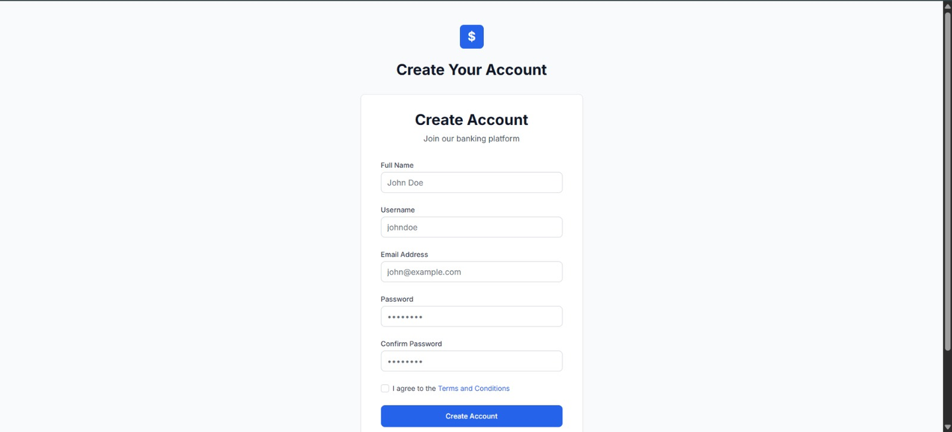
SIGN IN
SIGN UP

Slide 8
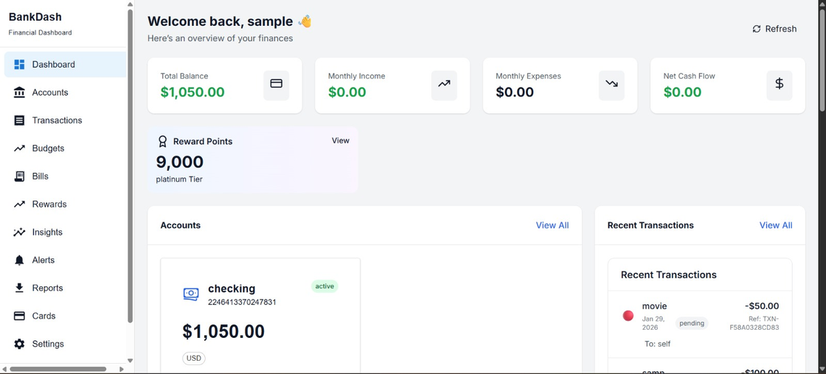
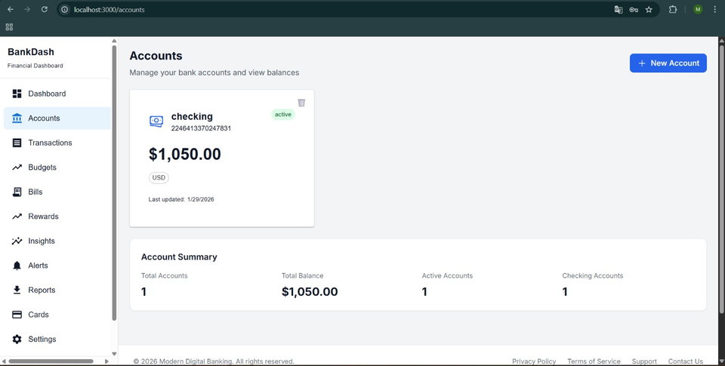
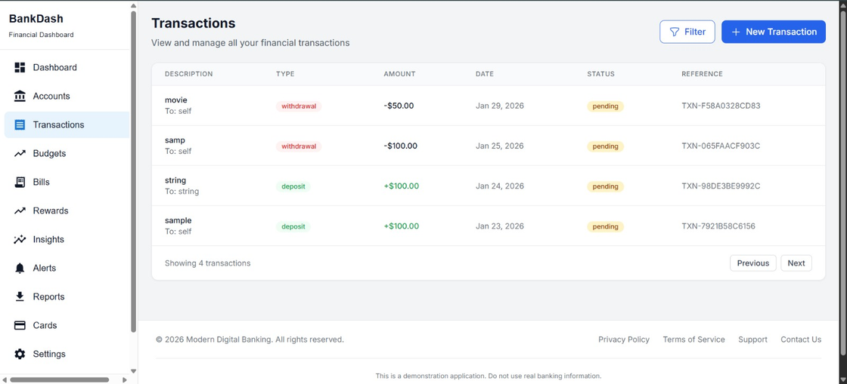
DASHBOARD
ACCOUNTS
TRANSACTIONS

Slide 9
CHALLENGES & SOLUTIONS
  Challenge
Secure API Integration:
Ensuring that only authenticated users can access accounts and transactions APIs.
Solution
Implemented JWT-based authentication with Authorization headers, token storage in browser, and protected backend routes.
  Challenge
Multi-Module Data Flow:
Managing data flow between authentication, accounts, transactions, and budgeting modules without conflicts.
Solution
IDesigned modular frontend components and structured backend services with clear separation of concerns.
  Challenge
Real-Time Data Synchronization:
Keeping dashboard data updated after adding accounts or transactions.
Solution
IImplemented API re-fetching using React hooks (useEffect) and state management for dynamic UI updates.
  Challenge
Data Consistency & Integrity:
Maintaining correct relationships between users, accounts, transactions, and budgets.
Solution
Used foreign key constraints, schema validation, and proper relational database design in PostgreSQL.
.

Slide 10
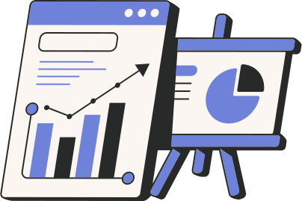
FUTURE SCOPE
->AI-powered financial insights
->Predictive budgeting
->Investment tracking
->Mobile application
->Real-time bank sync
->Advanced analytics dashboard

Slide 11
CONCLUSION
The Modern Digital Banking Dashboard centralizes financial management into one secure and intelligent platform. It simplifies account tracking, budgeting, and transaction monitoring while providing real-time insights and smart automation. This project demonstrates practical full-stack development skills and delivers a scalable foundation for modern digital finance solutions.

Slide 12
Q n A

Slide 13
THANKYOU

