Slide 1
MedTrack DV – Project Presentation Reference
MedTrack DV
Healthcare Operations & Patient Analytics Dashboard
• Interactive Power BI dashboard for hospital operations
• Patient flow, department performance and resource utilization
• Built with Excel, Power Query and DAX
200
Total Admissions
27.0%
Readmission Rate
MedTrack DV | Healthcare Analytics Dashboard 1

Slide 2
Agenda
Problem → solution → proof → next steps
• Problem & objectives
• Approach and technology
• Dashboard features & key results
• Challenges, limitations & future scope
MedTrack DV | Healthcare Analytics Dashboard 2

Slide 3
Problem Statement
Hospital data existed, but operational insights were difficult to obtain quickly.
Before MedTrack DV
Project Need
• Data spread across operational fields
• Manual analysis slows decisions
• Difficult to compare departments
• Patient-flow patterns are harder to spot
• Centralized analytical dashboard
• Interactive filters and navigation
• KPI-driven hospital monitoring
• Department and resource insights
MedTrack DV | Healthcare Analytics Dashboard 3

Slide 4
Objectives & Outcomes
What MedTrack DV was designed to deliver
Objectives
Outcomes
• Monitor hospital performance
• Analyze patient flow
• Compare departments
• Track bed/resource utilization
• Support data-driven decisions
• 4 integrated dashboards
• 6 core KPI measures
• Interactive slicers
• Page navigation + Help/About
• Monthly and department trends
MedTrack DV | Healthcare Analytics Dashboard 4

Slide 5
Approach / Architecture
Data in → cleaning → modeling → analysis → interactive output
SOURCE DATA
Healthcare records
CLEANING
Excel / Power Query
MODEL
Power BI + DAX
ANALYSIS
KPIs + visuals
OUTPUT
4 dashboards
• Core DAX measures drive reusable KPI cards and department comparisons.
• Slicers support department, doctor, gender and date-range exploration.
MedTrack DV | Healthcare Analytics Dashboard 5

Slide 6
Tools & Technology
A focused stack for the analytics workflow
Excel
Power Query
Power BI
DAX
Data preparation
Transformation
Dashboarding
Measures & KPIs
• The current implementation does not depend on SQL.
• Power BI provides interactive navigation, filters and visual analytics.
• Pandas & NumPy — Used to verify data cleaning.
MedTrack DV | Healthcare Analytics Dashboard 6

Slide 7
Key Results & Dashboard Features
Strongest evidence that the dashboard works
200
9.5%
27.0%
7.7
$21.6M
Total Admissions
Occupancy Rate
Readmission Rate
Avg Length of Stay
Total Revenue
Hospital & Patient Insights
Department & Resource Insights
• Monthly admission trends
• Discharge and patient-flow monitoring
• Average stay analysis
• Treatment and demographic views
• Department volume and readmission
• Efficiency comparison
• Bed utilization and availability
• Department-level bed status
MedTrack DV | Healthcare Analytics Dashboard 7

Slide 8
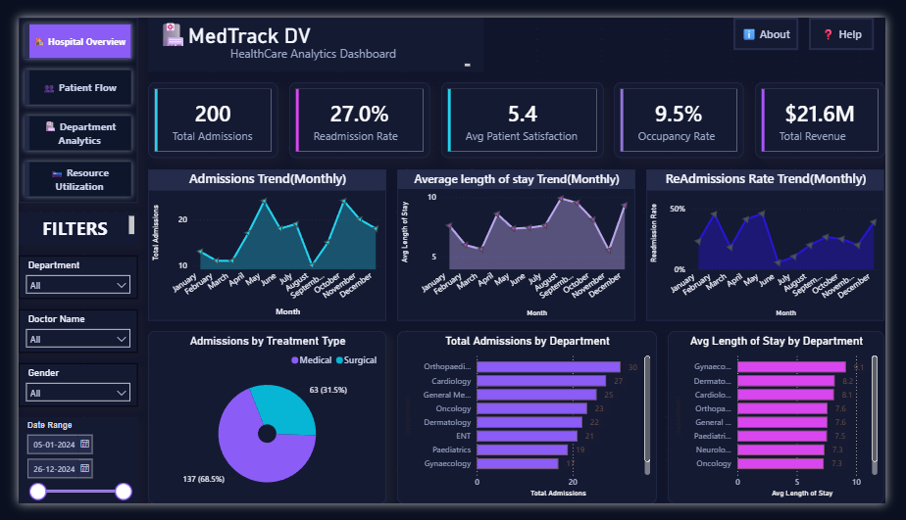
Healthcare Analytics Dashboard
MedTrack DV | Healthcare Analytics Dashboard 8

Slide 9
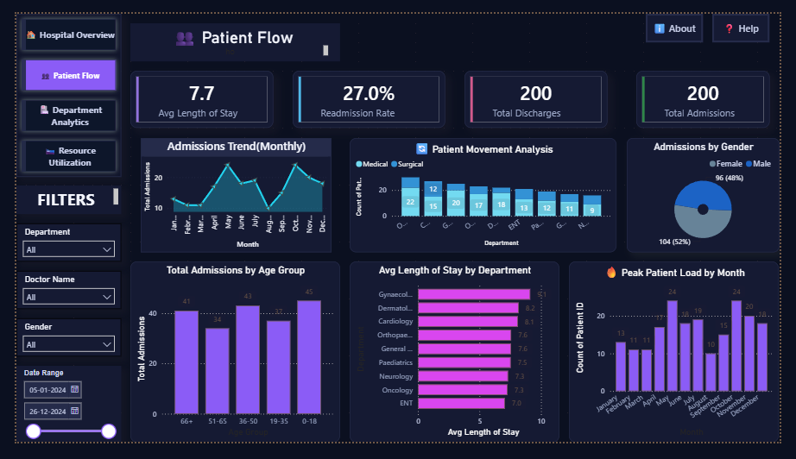
Patient Flow Dashboard
MedTrack DV | Healthcare Analytics Dashboard 8

Slide 10
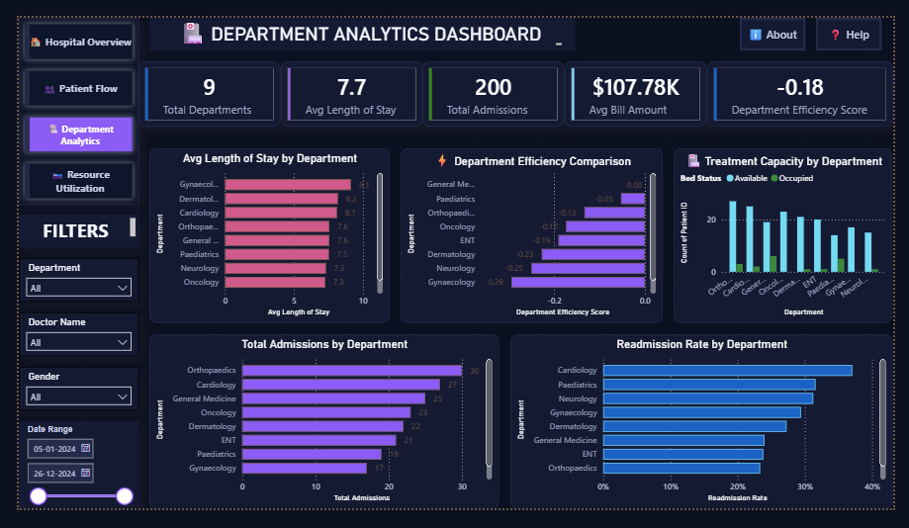
Department Analytics Dashboard
MedTrack DV | Healthcare Analytics Dashboard 8

Slide 11
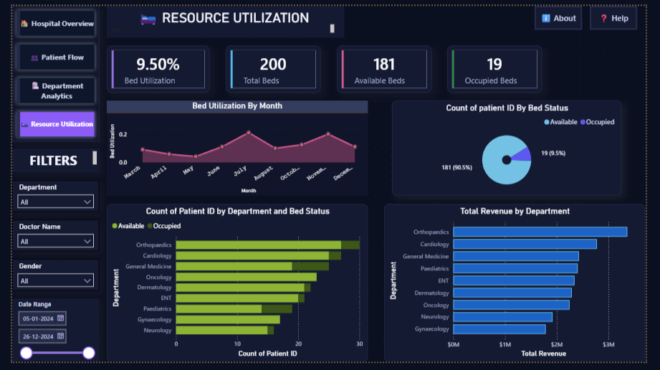
Resource Utilization Dashboard
MedTrack DV | Healthcare Analytics Dashboard 8

Slide 12
Challenges, Learnings & Limitations
What I learned while turning raw records into an analytical product
Challenges & Learnings
Current Limitations
• Cleaning inconsistent raw data
• Handling missing values
• Building reusable DAX measures
• Designing useful, non-redundant visuals
• Creating intuitive page navigation
• No staff allocation data
• No equipment utilization data
• Some resource insights are unavailable
• Efficiency score is project-defined
MedTrack DV | Healthcare Analytics Dashboard 8

Slide 13
Conclusion & Future Scope
MedTrack DV turns hospital records into an interactive decision-support view.
Staff analytics
• Centralizes hospital operations and patient analytics
• Makes department and resource patterns easier to compare
• Provides interactive KPI-driven monitoring
Add staff allocation and workload data
Equipment analytics
Track equipment availability and usage
Advanced analytics
Forecast demand and capacity
MedTrack DV | Healthcare Analytics Dashboard 9

Slide 14
MedTrack DV
From raw healthcare data to actionable hospital insights.
THANK YOU
4
Core dashboards
6+
Core KPI measures
MedTrack DV | Healthcare Analytics Dashboard 10 MOULIKA RUDRARAJU

