Slide 1

MedTrack DV
Hospital Operations & Patient Analytics Dashboard
A 4-page Power BI dashboard suite for hospital administrators, built on 61,619 patient admission records
Presented by: [Your Name] | Batch/Team: [Your Batch]
Notes:
Good [morning/afternoon] everyone. My project is called MedTrack DV — a Hospital Operations and Patient Analytics Dashboard. In short, it's a Power BI dashboard suite that gives hospital administrators one place to see how the hospital is actually running — admissions, occupancy, patient flow, and department performance — instead of piecing it together from separate reports.

Slide 2
Agenda
What we'll cover in the next 5 minutes
01
Problem & Objective
What hospitals struggle with, and what this project sets out to fix
02
Approach & Tools
How the data moved from raw records to a live dashboard
03
Key Results
The 4 dashboards and the KPIs they surface
04
Challenges, Learnings & What's Next
What was hard, what I'd add with more time
Notes:
Here's what I'll walk through: the problem this solves, how I approached building it, the key results across the four dashboards, and then a couple of real challenges I ran into — because I think that's usually the most useful part to talk about.

Slide 3
Problem Statement
Why hospitals need this
Hospital admissions, occupancy, department performance, and resource data typically live in separate systems and separate manual reports. Administrators can't see a unified, real-time picture of how the hospital is performing — so decisions on staffing, capacity, and department efficiency lag behind what's actually happening on the floor.
No single view
Admissions, occupancy, and department data sit in disconnected reports
Delayed decisions
Manual reporting means insights arrive days after the fact
No department comparison
Hard to see which departments are efficient vs. strained
Notes:
So here's the problem. In most hospitals, admissions data, occupancy numbers, and department performance all live in separate systems, and get pulled together manually into reports. That means by the time an administrator sees the numbers, they're already outdated. There's no single, real-time view — and no easy way to compare how different departments are performing against each other. That's the gap this project is built to close.

Slide 4
Objective & Outcomes
What this project set out to build, and what it delivers
OBJECTIVE
4
10
Build a unified, interactive Power BI dashboard suite that lets hospital administrators monitor patient flow, department efficiency, and resource utilization — without waiting on manual reports.
Interconnected dashboards
Hospital KPIs tracked
61,619
2
Admission records analyzed
Years of data (2024–25)
THE 4 DASHBOARDS
Hospital Overview
Patient Flow
Department Analytics
Resource Utilization
Admissions, occupancy & readmission trends
Admission/discharge tracking & peak load
Efficiency comparison across 7 departments
Bed capacity & availability planning
Notes:
The objective was simple to state, harder to build: create one unified, interactive dashboard suite that lets administrators monitor patient flow and department efficiency without waiting on manual reports. What I ended up with is four interconnected dashboards, tracking ten hospital KPIs, built on just over sixty-one thousand patient admission records across two years of data. The four pages are Hospital Overview, Patient Flow, Department Analytics, and Resource Utilization — each one answers a different question an administrator would actually ask.

Slide 5
Approach & Architecture
From raw data to a live dashboard
Raw Data
→
Cleaning
→
KPI Engineering
→
Dashboard Build
→
Validation
Hospital admission
records (.csv)
Python + pandas
(Google Colab)
DAX measures in
Power BI
4 interactive
Power BI pages
KPI accuracy
checked vs. source
Each stage feeds the next: cleaned data grounds the KPI measures, the measures drive every visual, and validation confirms the numbers match the source before delivery.
Notes:
In terms of how it was built — the data moves through five stages. It starts as raw admission records, gets cleaned using Python and pandas in Google Colab, then I engineered ten KPI measures using DAX inside Power BI. From there, I built out the four dashboard pages, and finally validated every KPI against the source data to make sure the numbers were accurate before calling it done.

Slide 6
Tools & Tech Stack
What was used to build this, end to end
Power BI Desktop
Power Query (M)
Python / pandas
Dashboard build, data model, DAX measures
Data load, type fixes, column shaping
Data cleaning & synthetic dataset generation
Google Colab
DAX
Custom Theme (JSON)
Cleaning pipeline notebook, reproducible & shareable
10 KPI measures — Occupancy Rate, Readmission Rate, etc.
Dark navy theme matching the brand palette
Notes:
On the tools side — Power BI Desktop for the dashboard itself and the DAX measures, Power Query for shaping the data on load, Python and pandas for cleaning, and Google Colab so the cleaning process is documented and reproducible, not just something that happened once on my laptop.

Slide 7
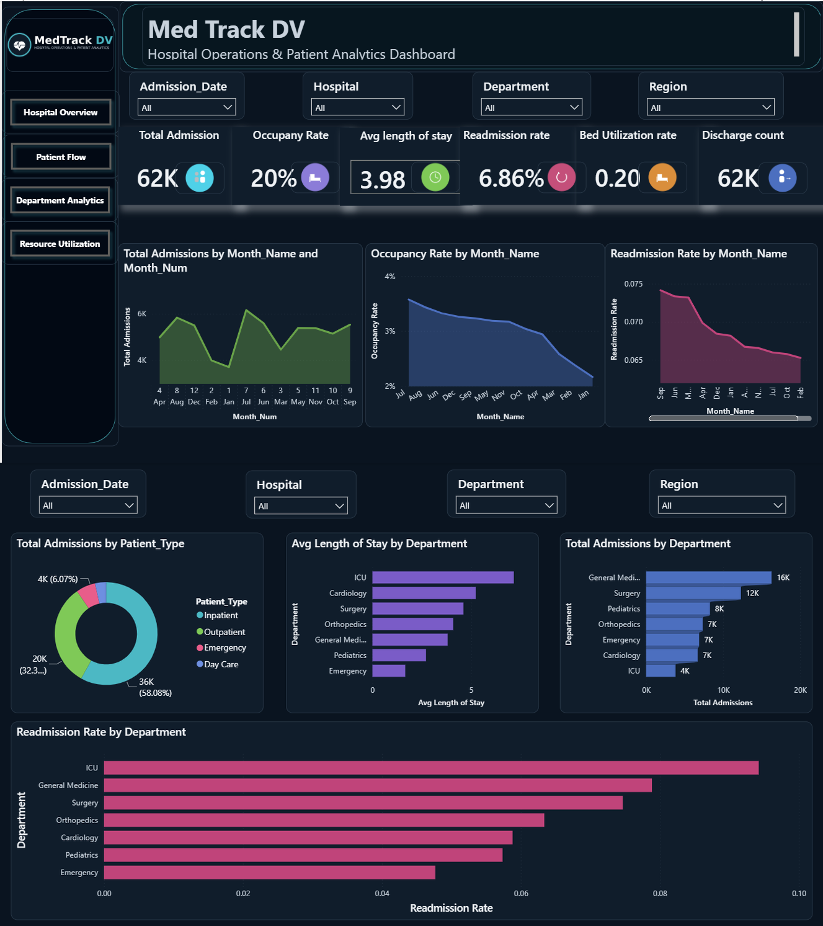
Key Results — Hospital Overview
61,619 total admissions | 3.98 avg length of stay | 6.86% readmission rate
Notes:
This is the Hospital Overview page — the main landing view. Total admissions, occupancy, average length of stay, readmission rate, bed utilization, and discharge count, all filterable by date, hospital, department, and region, with admission and readmission trends underneath.

Slide 8
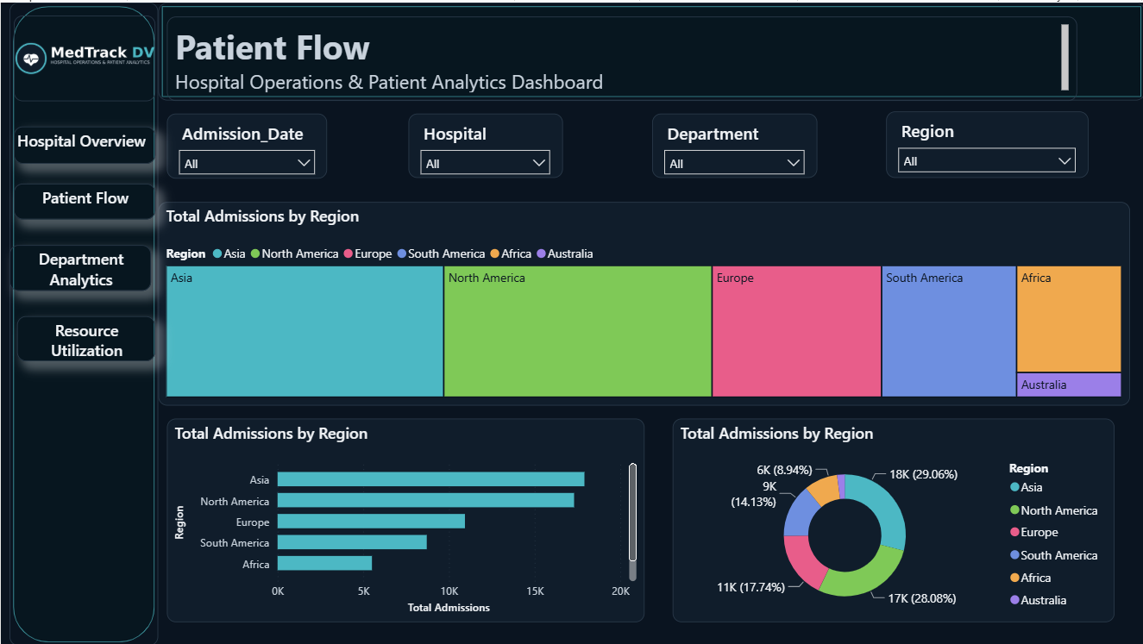
Key Results — Patient Flow
Asia and North America account for over half of all admissions
Notes:
Patient Flow breaks admissions down by region — you can see Asia and North America together make up more than half of all admissions, which is useful for regional resourcing decisions.

Slide 9
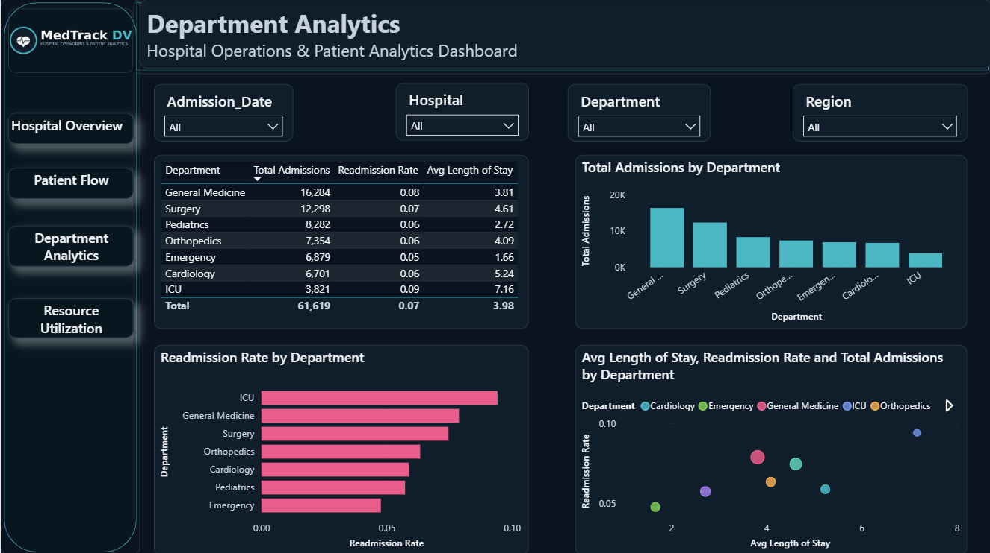
Key Results — Department Analytics
The scatter chart flags ICU as the outlier: longest stay + highest readmission
Notes:
This one's my favorite result — Department Analytics. The scatter chart in the bottom right compares average length of stay against readmission rate for every department, and ICU sits off on its own — longest stay, highest readmission. That's not something you'd catch easily in a table of numbers; the chart makes it immediately obvious.

Slide 10
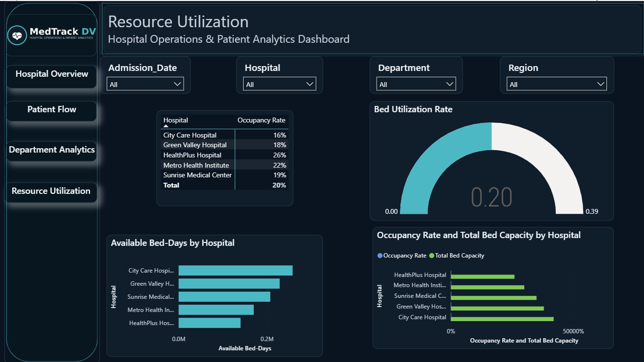
Key Results — Resource Utilization
Bed capacity and occupancy compared across all 5 hospitals
Notes:
And finally, Resource Utilization — bed capacity and occupancy side by side across all five hospitals, so planners can see at a glance where capacity is tightest.

Slide 11
Challenges & Learnings
What actually went wrong, and what fixed it
Canvas space
Dark theme contrast
Problem: 5 KPI cards + 8 charts didn't fit one page
Fix:
Split into a dedicated Patient Flow page; used a treemap instead of a failure-prone map visual
Problem: Axis labels & dropdown text were invisible
Fix:
Explicitly forced label/background colors in the theme JSON instead of relying on defaults
Missing brief fields
Mixed data formats
Problem: Staffing & equipment data don't exist in the source dataset
Fix:
Added them as a documented, rule-based synthetic table instead of fabricating numbers silently
Problem: Raw admission dates arrived in 3 different formats
Fix:
Used pandas' format='mixed' parser, verified output matched source exactly
Notes:
A few real challenges along the way. Fitting six KPI cards and eight charts on one page simply didn't work, so I split the content into a dedicated Patient Flow page instead of cramming it in. The dark theme initially made some axis labels unreadable, so I went back and explicitly set text colors instead of relying on Power BI's defaults. And the raw admission dates came in three different formats — solved with pandas' mixed-format date parser, and I verified the cleaned output matched the source exactly, row for row.

Slide 12
Conclusion & Future Scope
MedTrack DV turns scattered hospital records into a single live view — giving administrators the data to act on patient flow and department efficiency in minutes, not days.
WHAT'S NEXT
Real hospital data
Live staffing & equipment
Forecasting
Swap the synthetic dataset for an actual (anonymized) hospital data feed
Connect the resource table to a real, live-updating source
Use DAX time-intelligence to project next month's admissions and occupancy
Notes:
So to sum up — MedTrack DV takes hospital data that used to be scattered across systems and manual reports, and puts it in one live view, so administrators can act on patient flow and department efficiency in minutes instead of days. If I kept building this, the next steps would be connecting it to a real hospital data feed, wiring the staffing and equipment data to a live source, and layering in a simple forecast for next month's admissions.

Slide 13
Thank You
Questions?
MedTrack DV — Hospital Operations & Patient Analytics Dashboard
[your email] | [project link / repo]
Notes:
Thank you — happy to answer any questions, and I'm glad to walk through the live dashboard now if that's useful.

