Slide 1
Text Classification On Sentiment Dataset
By Lakshita M
Mentor - Sudheer Kumar Y

Slide 2
Agenda
Text classification Intro
Text preprocessing and Text Representation(TF-IFD)
Handling Multi-class Imbalance in the Dataset(Random Oversampling)
Text Classification Algorithms
Conclusions
Coding Part in Jupyter Notebook
Q/A Sessions

Slide 3
Introduction to Text Classification
Text classification is the process of categorizing text documents into predefined classes using artificial intelligence and machine learning systems. It involves assigning predetermined categories to open-ended text documents, enabling organizations to organize, structure, and categorize data for further analysis

Slide 4
Purpose of Text Classification on Sentiment
Sentiment Label - Text classification enables sentiment analysis, allowing organizations to manage their brand effectively by extracting specific words indicating customer sentiments. This helps in predicting purchasing trends accurately and planning marketing campaigns based on qualitative data.
Customer Support - Text classification models can be used to route incoming requests to appropriate personnel in customer support teams. For instance, a text classifier can detect keywords like "exchange" in support tickets and direct them to the relevant department, ensuring timely and accurate responses to customer queries.

Slide 5
Text Preprocessing
Text preprocessing is a method to clean the text data and make it ready to feed data to the model. Text data contains noise in various forms like emotions, punctuation, text in a different case. Some Techniques are:
Expand Contractions
Lower Case
Remove Punctuations
Remove words and digits containing digits
Remove Stopwords
Rephrase Text
Stemming and Lemmatization
Remove White spaces

Slide 6
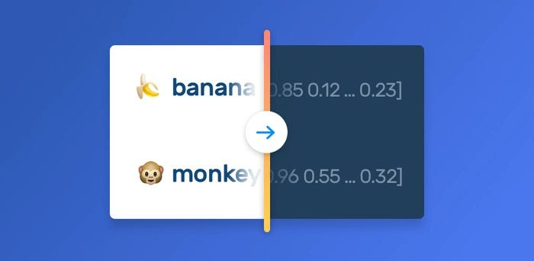
Text Representation
Text representation is the process of converting raw text into a numerical form so that computers can understand and interpret language. It's also known as feature extraction or text vectorization

Slide 7
Some of Common Terms Usage In Text Representation
Corpus - The entire collection of text data you're working with. It can be a collection of documents, articles, reviews, social media posts, or any other textual source. The corpus serves as the source material for extracting features and training models
Vocabulary (Vocab) - This represents the set of all unique words present in your corpus. It's essentially a dictionary of all the distinct words encountered in your text data.
Document (Doc): An individual text unit within your corpus. It could be a single email, a news article, a product review, or any other self-contained piece of text data.
Word (W): The basic unit of text data. Words are the building blocks that make up documents and sentences.

Slide 8

TF-IDF(Term Frequency-Inverse Document Frequency):
Term Frequency :- Measures of how often a particular word appears within a document. It's a simple count of the frequency of each word in a document. Higher TF indicates a word might be more relevant to the document's content.
TF = Number of Repeatition of words in a Sentence
Number of Words In a Sentence
Inverse Document Frequency(IDF): This metric considers how common a word is across the entire corpus. It downplays the importance of very frequent words (e.g., "the," "a") that appear in many documents and focuses on words that are more specific and potentially more informative.
IDF = Number of Sentence
Number of Sentence Containing Words

Slide 9
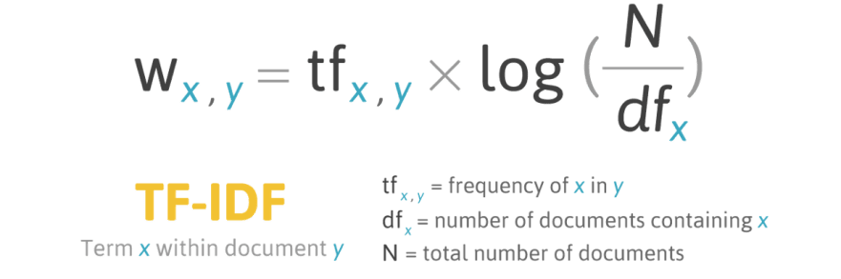
Learnings : https://www.youtube.com/watch?v=D2V1okCEsiE
TF-IDF Formula :
The TF-IDF value increases proportionally to the number of times a word appears in the document and is offset by the number of documents in the corpus that contain the word, which helps to adjust for the fact that some words appear more frequently in general.

Slide 10
Handling Multi-class Imbalance
What is Multi-Class Imbalance ?
When the target classes (two or more) of classification problems are not equally distributed, then we call it Imbalanced data. If we failed to handle this problem then the model will become a disaster because modeling using class-imbalanced data is biased in favor of the majority class.

Slide 11
Resampling Techniques:
Random Over-Sampling: Duplicates data points from the minority class randomly. This is simple but might lead to overfitting.
SMOTE (Synthetic Minority Over-Sampling Technique): Creates synthetic data points for the minority class by interpolating between existing minority class examples. This helps create variations within the feature space and can be more effective than random oversampling.
Undersampling: It involves reducing the number of examples in the majority class. It's generally used in conjunction with other techniques like SMOTE to avoid discarding potentially valuable information from the majority class. There are various methods for undersampling, such as random undersampling, selecting informative samples from the majority class, or using techniques like NearMiss.

Slide 12
Text Classification Algorithms
Text Classification is a machine learning process where specific algorithms and pre-trained models are used to label and categorize raw text data into predefined categories for predicting the category of unknown text.
Some classification Algorithms are :
Support Vector Machines
Naive Bayes Classifier
K Nearest Neighbour
Logistic Regression
Decision Tree
Random Forest
Gradient Boosting classifiers

Slide 13
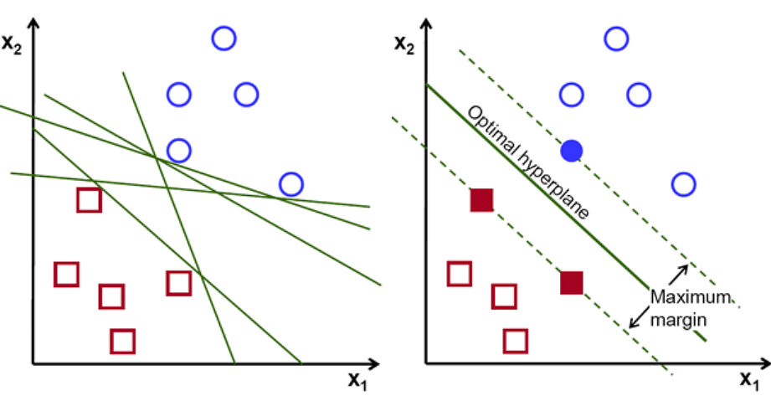
SVM(Support Vector Machine)
Support Vector Machine (SVM) is a supervised machine learning algorithm used for both classification and regression purposes
For the text classification process, the SVM algorithm categorizes the classes of a given dataset by determining the best hyperplane or boundary line that divides the given text data into predefined groups

Slide 14
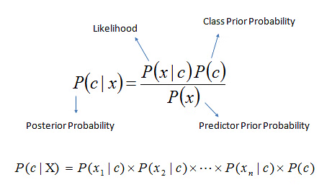
Naive Bayes Classifier
Naive Bayes is the simple algorithm that classifies text based on the probability of occurrence of events. This algorithm is based on the Bayes theorem, which helps in finding the conditional probabilities of events that occurred based on the probabilities of occurrence of each individual event.

Slide 15
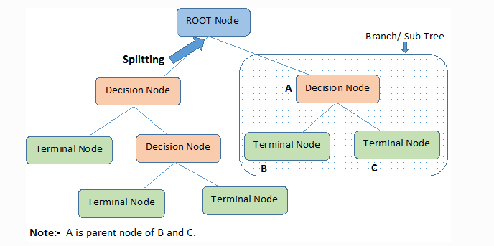
Decision Tree Algorithm
A decision tree is a machine learning algorithm used for both classification and regression tasks. It works by creating a tree-like model of decisions, where each internal node represents a test on a feature, each branch represents an outcome of the test, and each leaf node represents a final decision or prediction.

Slide 16
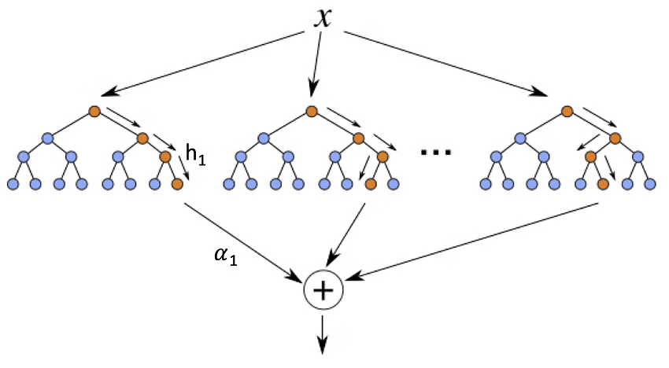
XGBOOST( eXtreme Gradient Boosting)
It works by sequentially building multiple decision tree models, which are called base learners. Each of these base learners contributes to prediction with some vital estimates that boost the algorithm. By effectively combining all the estimates of base learners, XGBoost models make accurate decision.

Slide 17
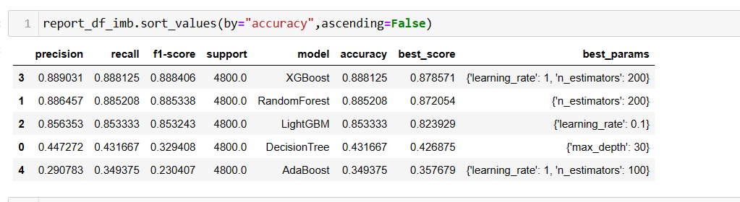
Conclusions
Upon Training the classifiers with the split data of 70% train and 30% test.By using GridSearchCV Obtained the best parameters for the classifiers
Arrived at the result as , from the below XGBoost performs well on the imbalanced data

Slide 18
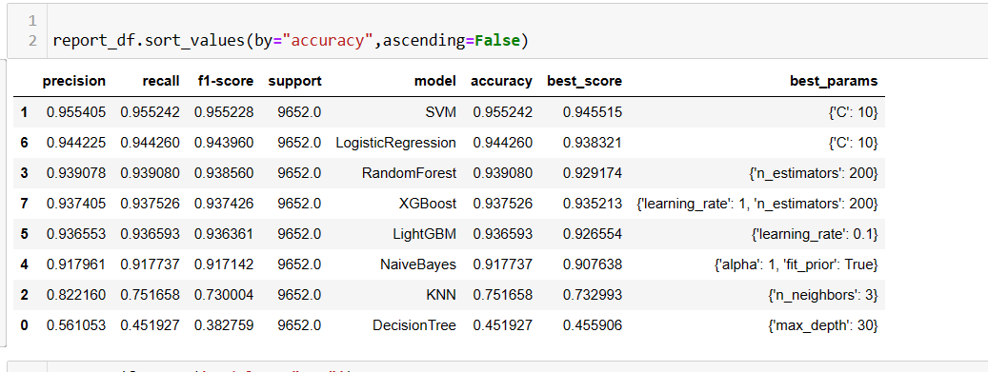
Where as for the Balanced Data , SVM performs well as compared to the other models based on the accuracy score of 95% . With param as Kernel=”linear” , C=10.

Slide 19
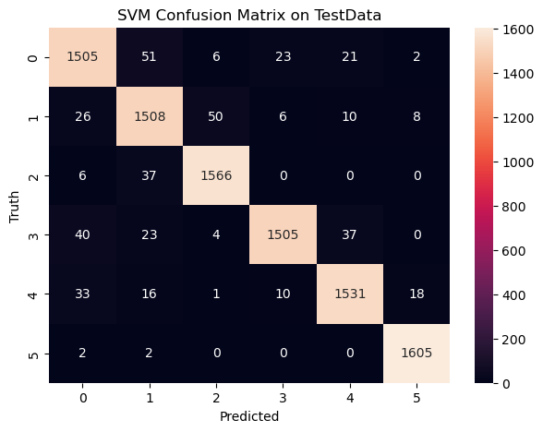
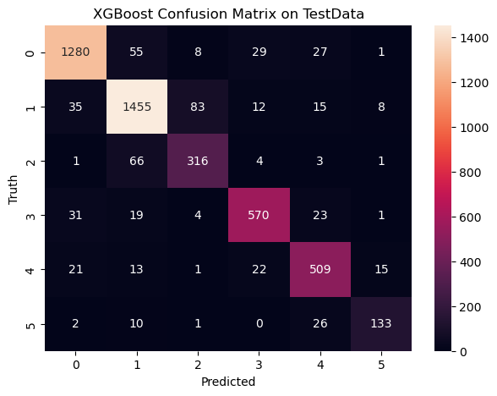
On the Balanced Dataset
On the Imbalanced Dataset

Slide 20
Q/A

