Slide 1
Sentiment Analysis On Social Media Contents
by LAKSHITA.M

Slide 2
Agenda
1. Data Science Process Overview
Setting Research Goal
Data preparation
Data exploration
Modeling
Presentationa and Automation
2. Sentiment Analysis Overview
3. Sentiment Analysis Using lexicon based models
4. References

Slide 3
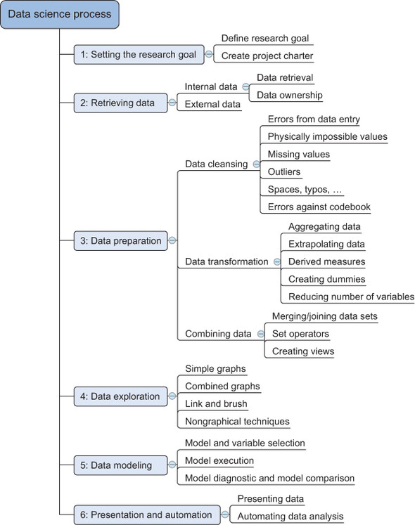
Data Science Process

Slide 4
Step1: Defining research goals and creating a project charter
A project starts by understanding the what, the why, and the how of your project .What does the company expect you to do? And why does management place such a value on your research? Is it part of a bigger strategic picture or a “lone wolf” project originating from an opportunity someone detected? Answering these three questions (what, why, how) is the goal of the first phase, so that everybody knows what to do and can agree on the best course of action.
CREATE A PROJECT CHARTER: Clients like to know upfront what they’re paying for, so after you have a good understanding of the business problem, try to get a formal agreement on the deliverables. All this information is best collected in a project charter. For any significant project this would be mandatory.
A project charter requires teamwork, and your input covers at least the following:
A clear research goal
The project mission and context
How you’re going to perform your analysis
What resources you expect to use
Proof that it’s an achievable project, or proof of concepts
Deliverables and a measure of success
A timeline

Slide 5
Step2: Retrieving data
Internal Data: Start by assessing the existing data within your company. Data may be stored in databases, data marts, data warehouses, or data lakes managed by IT. While some data might be preprocessed and readily available, you might also encounter raw data or data scattered across spreadsheets. Finding and accessing this data can be challenging due to organizational changes, lack of documentation, and data security policies. Securing access might take time and involve navigating company procedures.
External Data: If internal data is scarce, explore external sources. Companies like Nielsen and GFK offer industry-specific data, while platforms like Twitter and Facebook provide data to enrich their services. Governments and organizations are increasingly sharing valuable datasets on various topics, making them excellent resources for enriching projects or honing data science skills.
OpenDataSite URLS: https://data.gov/ , https://open-data.europa.eu/ , Freebase.org , Data.worldbank.org , Aiddata.org .

Slide 6
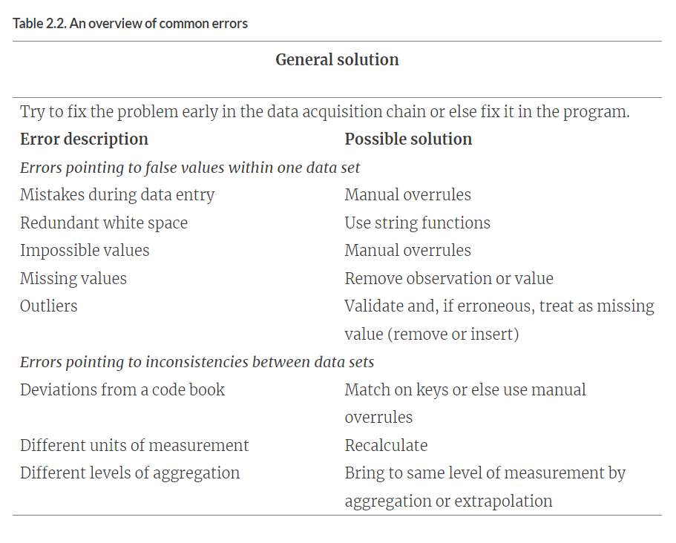
Step 3:Cleansing, integrating, and transforming data
Data cleansing is a subprocess of the data science process that focuses on removing errors in your data so your data becomes a true and consistent representation of the processes it originates from.
Interpretation error : Interpretation errors occur when mistakes or inconsistencies in the data's meaning lead to miscategorization or missed insights (Eg: Age: 30 years old instead entered 300 years old)
Inconsistencies between data : Inconsistencies like missing values, formatting variations (dates, currencies), or conflicting entries for the same entity across different sources

Slide 7
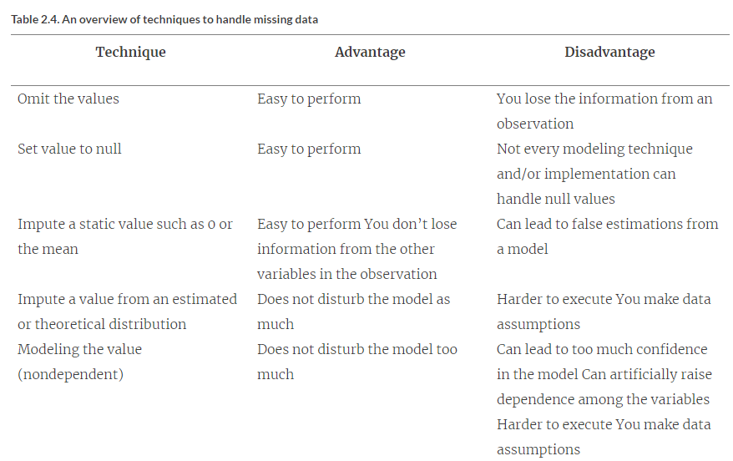
Dealing with missing valuesDea
Dealing with missing values
Missing values aren’t necessarily wrong, but you still need to handle them separately; certain modeling techniques can’t handle missing values. They might be an indicator that something went wrong in your data collection or that an error happened in the ETL process.

Slide 8
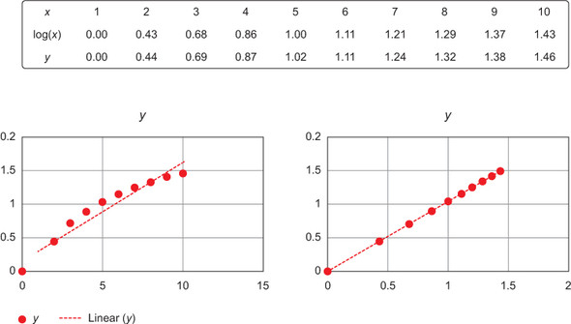
dfsdfTransTr
TRANSFORMING DATA:
Certain models require their data to be in a certain shape. Now that you’ve cleansed and integrated the data, this is the next task you’ll perform: transforming your data so it takes a suitable form for data modeling.

Slide 9
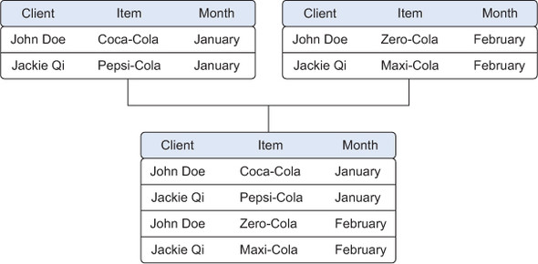
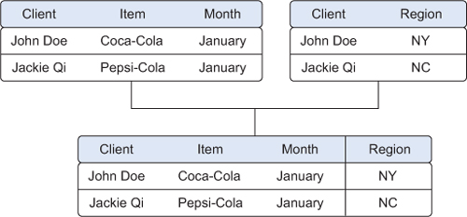
Joining tables allows you to combine the information of one observation found in one table with the information that you find in another table. The focus is on enriching a single observation
Appending or stacking tables is effectively adding observations from one table to another table. The result of appending these tables is a larger one with the observations from January as well as February

Slide 10
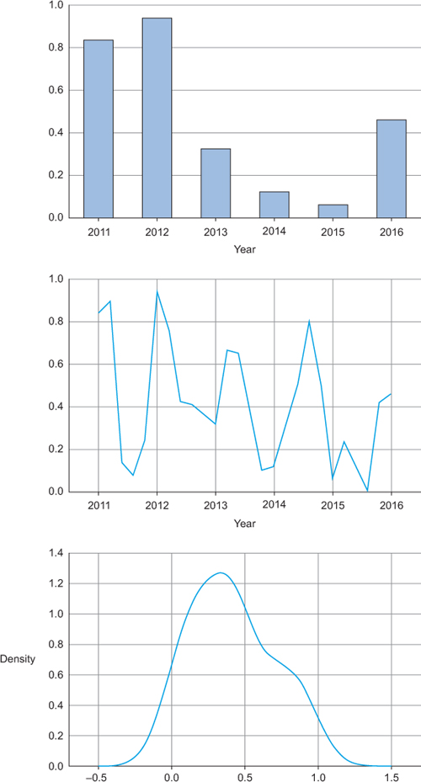
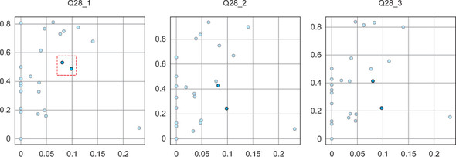
Step 4: Exploratory data analysis
Information becomes much easier to grasp when shown in a picture, therefore you mainly use graphical techniques to gain an understanding of your data and the interactions between variables .The goal isn’t to cleanse the data, but it’s common that you’ll still discover anomalies you missed before, forcing you to take a step back and fix them.
Simple Graphs Like Bar Graph , line graph , histogram graphs to view your data variations
Linked and Brush Graphs to link your features column with others existing columns of your dataset.

Slide 11
Step5: Model and Variable Selection
Building a model is an iterative process. The way you build your model depends on whether you go with classic statistics or the somewhat more recent machine learning school, and the type of technique you want to use. Either way, most models consist of the following main steps:
1. Selection of a modeling technique and variables to enter in the model
2. Execution of the model
3. Diagnosis and model comparison
You’ll need to consider model performance and whether your project meets all the requirements to use your model, as well as other factors:
Must the model be moved to a production environment and, if so, would it be easy to implement?
How difficult is the maintenance on the model: how long will it remain relevant if left untouched?
Does the model need to be easy to explain?

Slide 12
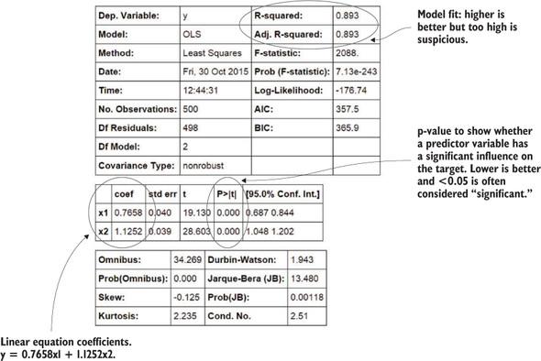
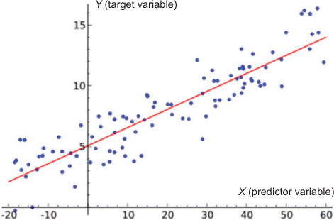
Model Execution and Evaluation
Feed the processed data into our chosen model, allowing it to learn and identify patterns. This training phase is crucial for the model to develop the ability to make predictions or classifications , Finally evaluate your model and compare with other existing models.
Linear regression tries to fit a line while minimizing the distance to each point
The results.summary() outputs the table

Slide 13
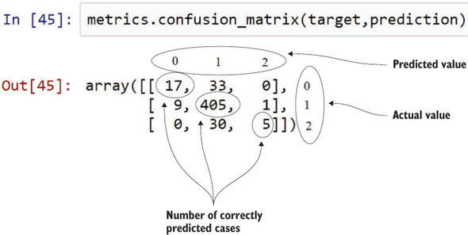
Confusion matrix: it shows how many cases were correctly classified and incorrectly classified by comparing the prediction with the real values. Remark: the classes (0,1,2) were added in the figure for clarification.

Slide 14
Step6: Presenting findings and building applications on top of them
Presentation and automation — Presenting your results to the stakeholders and industrializing your analysis process for repetitive reuse and integration with other tools.Sometimes it’s sufficient that you implement only the model scoring; other times you might build an application that automatically updates reports, Excel spreadsheets, or PowerPoint presentations. The last stage of the data science process is where your soft skills will be most useful.

Slide 15
What is Sentiment Analysis?
Sentiment analysis is the process of extracting emotions and opinions from text data.
Sentiment analysis refers to the method to extract subjectivity and polarity from the text and semantic orientation refers to the polarity and strength of words, phrases, texts.
(eg.Subjective statements contains non-factual information such as personal opinions, predictions and judgements , objective if it contains facts rather than opinions. E.g., The sun rises in the east , for sentiment analysis we are focused only on the subjective statements).
What it analyzes: Text data like reviews, social media posts, surveys, or even news articles.
What it outputs: Classifies the text sentiment as positive, negative, or neutral.
Why is it important?
Understand customer feedback: Analyze customer reviews to see if they're happy or frustrated with your product or service.
Gauge brand perception: Track social media mentions to understand how people feel about your brand.
Inform business decisions: Use sentiment analysis to make data-driven choices about marketing, product development, and customer service.

Slide 16
Pre-process and normalize the text of which we want an analysis.
Removal of punctuation marks and special characters.
Removal of stop words like a, an, and, for etc.
Expansion of word contractions. E.g., They’ll as They will; Haven’t as Have not etc.
Tokenization- Conversion of sentences into words
Maintain case uniformity- Conversion of words into either upper or lower case
Stemming and Lemmatization– Converting a word into it’s base form. E.g., apples -> apple; happiness->happy;
In most cases we prefer Lemmatization over stemming because the former conducts a morphological analysis of words, thus resulting in more accurate word roots.

Slide 17

Sentiment Analysis using Lexicon Based Models
Lexicon means the vocabulary of a person, language or branch of knowledge. Here, in lexicon based sentiment analysis we already have a given set of dictionary of words with each labelled as positive negative, neutral sentiments along with polarity , parts of speech and subjectivity classifiers, mood, modality and the like.A sentence is tokenized and each token is matched with the available words in the model to find out its context and sentiment (if any). A combining function such as sum or average is taken to make the final prediction regarding the total text component.

Slide 18
References:
https://livebook.manning.com/book/introducing-data-science/chapter-2/216
https://medium.com/nerd-for-tech/sentiment-analysis-lexicon-models-vs-machine-learning-b6e3af8fe746
https://www.knime.com/blog/lexicon-based-sentiment-analysis
https://www.ncbi.nlm.nih.gov/pmc/articles/PMC8989068/

