Slide 1
AI Palmistry & Tarot Intelligence Platform

Slide 2
PROBLEM STATEMENT
Traditional palmistry and tarot reading services often lack a single, integrated digital platform that combines personalized readings, spiritual guidance, expert consultations, and reading history.
Users may face difficulties accessing palm and tarot interpretations, tracking previous readings, receiving relevant recommendations, and scheduling sessions with Tarot Readers and Spiritual Consultants. In addition, managing different user roles, protecting user information, and coordinating expert availability can be challenging without a centralized system.
Therefore, there is a need to develop a Palmistry & Tarot Intelligence Platform that integrates palm reading, tarot reading, personalized insights, guidance, recommendations, secure authentication, role-based dashboards, notifications, and expert session scheduling in one web application.

Slide 3
Four Roles & Their Responsibilities
The Platform Has Four User Roles
USER ROLE
Palm & Tarot Readings
Insights & Guidance
Recommendations & History
Consultations & Complaints
TAROT READER
Tarot Workspace
Reading Analytics
Session Tracking
Reports & Requests
SPIRITUAL CONSULTANT
Consultation Requests
Client Trend Analysis
Guidance Effectiveness
Consultation Insights
ADMIN
User Management
Platform Analytics
Reading Statistics
System Reports

Slide 4
High Level System Architecture
FRONTEND
BACKEND API
DATABASE
HTTP / JSON
DB access
React • JavaScript • Router
FastAPI • Python • REST
PostgreSQL

Slide 5
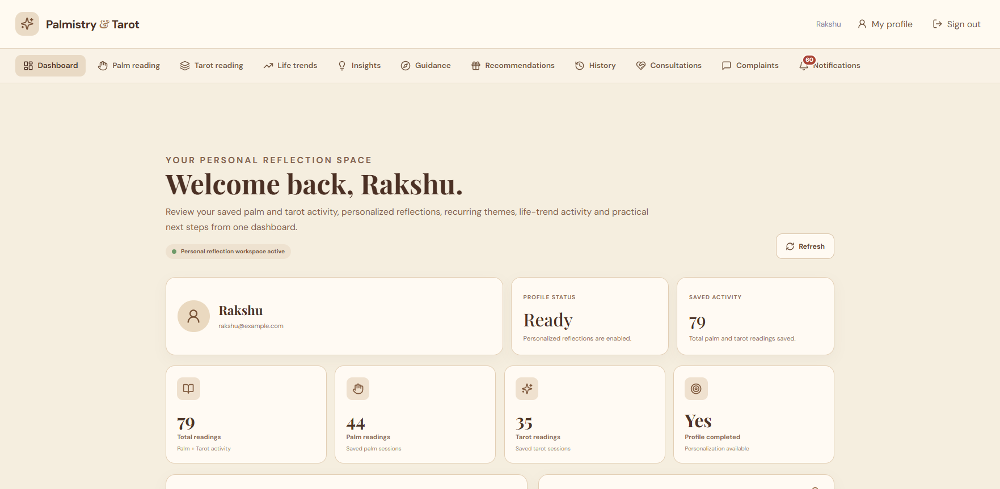
User Role
USER ENGAGEMENT
• Consultation requests
• Notifications & reminders
• Platform announcements
• Feedback/complaints where available
READING FEATURES
• Palm reading & image input
• Tarot spreads and interpretations
• Saved reading history
• Reading reports
PROFILE EXPERIENCE
• Profile and preferences
• Personality-oriented insights
• Life trends and guidance
• Personalized recommendations

Slide 6
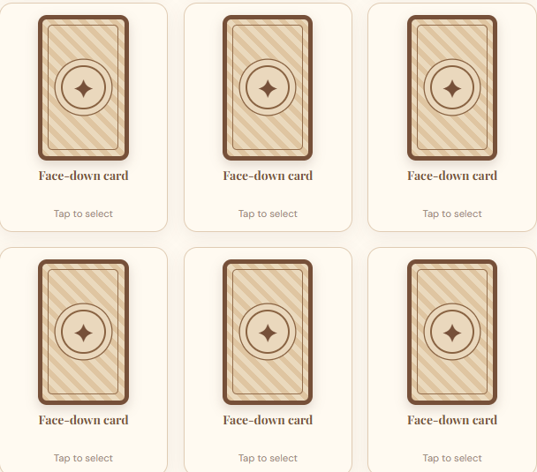

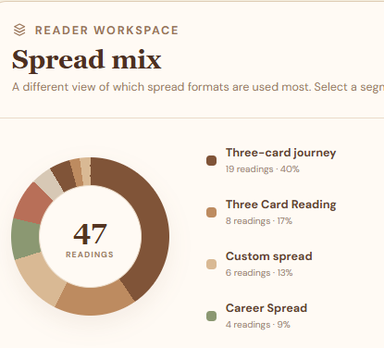
Tarot Reader Role
TAROT WORKSPACE
READING
• Manage tarot-reading activity
• Review assigned/session requests
• Access relevant reading context
• Review and manage reports
• Respond to requests where permitted
• Maintain clear session outcomes
ANALYTICS
• Reading analytics
• Session tracking
• User engagement insights

Slide 7
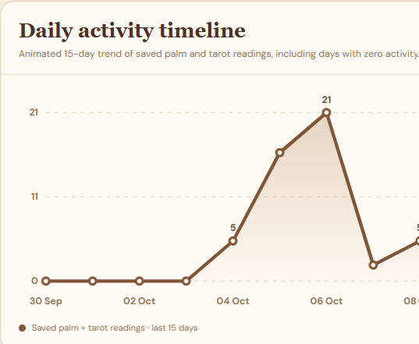
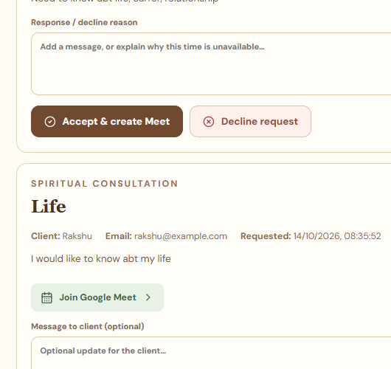
Spiritual Consultant Role
CONSULTATION MANAGEMENT
GUIDANCE EFFECTIVENESS
• View incoming requests
• Review topic and user message
• Accept/reject and provide responses
• Review feedback and outcomes
• Track assigned actions/completion where available
• Improve follow-up
CLIENT TRENDS
• Review client trend information
• Use reading context when available
• Identify follow-up needs

Slide 8
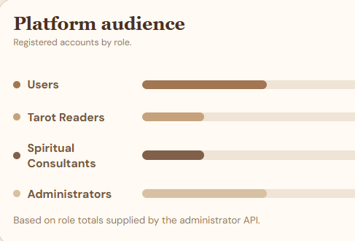
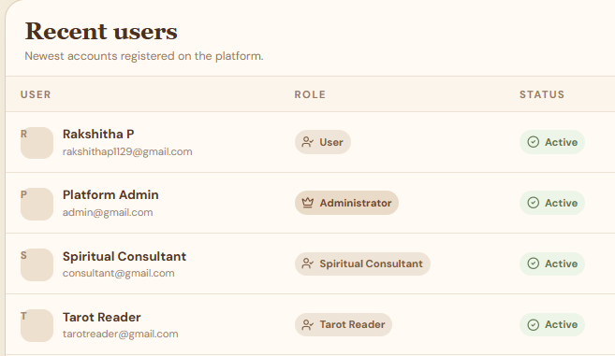
Admin Role
USER & ROLE MANAGEMENT
SYSTEM OPERATIONS
• View/manage platform users
• Maintain role-based access
• Oversee expert accounts and activity
• Review system reports
• Publish platform announcements
• Monitor platform activity
PLATFORM ANALYSIS
• Reading statistics
• User activity and engagement
• Platform-level summaries

Slide 9
Palm Reading Workflow
Converts an uploaded palm image into structured palmistry information
1. CAPTURE
Take a palm photo or upload an image
2. PREPARE
Validate and prepare the image
3. ANALYZE
Extract palm/hand features when the analysis pipeline supports them.
5. SAVE
Keep results in reading history
4. INTERPRET
Present a structured reading and insights

Slide 10
Tarot Reading Workflow
1. CHOOSE SPREAD
The user selects a reading format, such as a one-card draw or multi-card spread, based on available UI options.
2. REVEAL CARDS
Show card imagery, names and positions. Architecture specifies 78 cards: 22 Major Arcana and 56 Minor Arcana
3. INTERPRET & SAVE
Present individual meanings and a combined narrative, with history and related recommendations where implemented.

Slide 11
How Both Engines Work Together
User → User Dashboard → Two Parallel Engines
Palm Reading
Tarot Reading
▼
▼
AI Palm Engine
AI Tarot Engine
▼
▼
Palm Features
Tarot Cards
▼
▼
Question Context + AI Interpretation
▼
Personalized Insights
Life Trends
Recommendations
Personalized Guidance

Slide 12
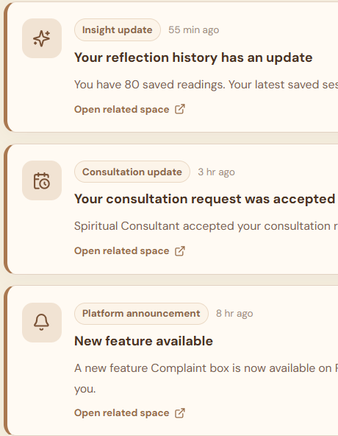

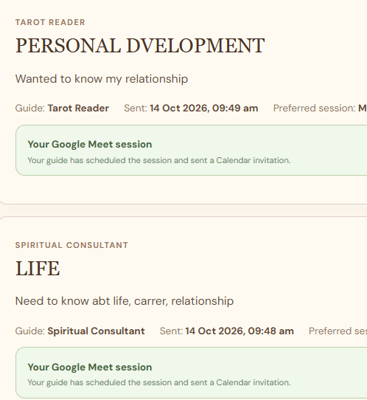

Consultations and Notifications
CONSULTATIONS
1. User selects an expert and submits a request.
2. Expert reviews the topic and message.
3. Expert responds with a decision and optional response.
4. Status and meeting details can be recorded.
NOTIFICATIONS
• Daily guidance and reading reminders
• Insight updates and growth alerts
• Platform announcements
• Consultation event updates
• Preferences and read/unread status

