Slide 1


Supportlytics: Data-Driven Optimization of IT Support Team Performance Using Advanced Analytics
Milestone 3 – Week 5–6
AARMITHA A

Slide 2
Milestone Overview
Objective
The objective of this milestone is to evaluate IT support performance by analyzing ticket resolution trends, identifying operational bottlenecks, and exploring geographic patterns in customer support tickets.
Work Completed
Module 5
Module 6
Analyzed average resolution time by priority and ticket type.
Identified the fastest performing support teams and regions.
Detected unresolved high-priority tickets.
Created geographic heatmaps for ticket concentration.
Visualized issue distribution using latitude and longitude.
Evaluated the relationship between cluster size and performance score.

Slide 3


Slide 4

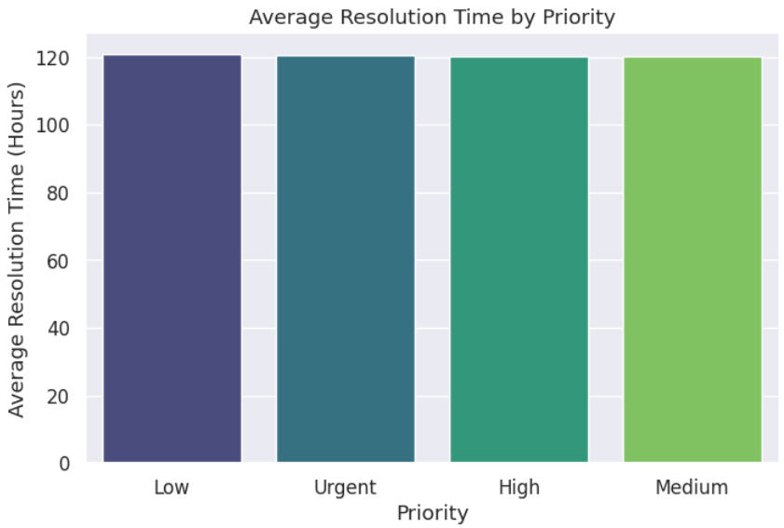
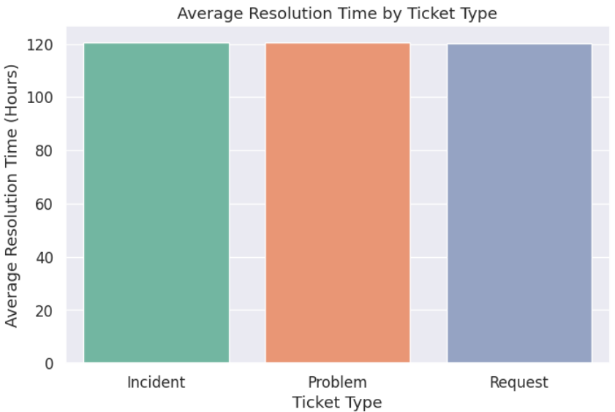

Performance Trend Analysis
Average Resolution Time Analysis
Resolution Time by Priority
Compared average resolution times across Low, Medium, High, and Urgent priorities.
Evaluated whether critical tickets receive faster attention.
Assessed support efficiency and SLA performance.
Resolution Time by Ticket Type
Compared resolution time for Problems, Requests, and Incidents.
Identified ticket types requiring greater effort and longer resolution.

Slide 6
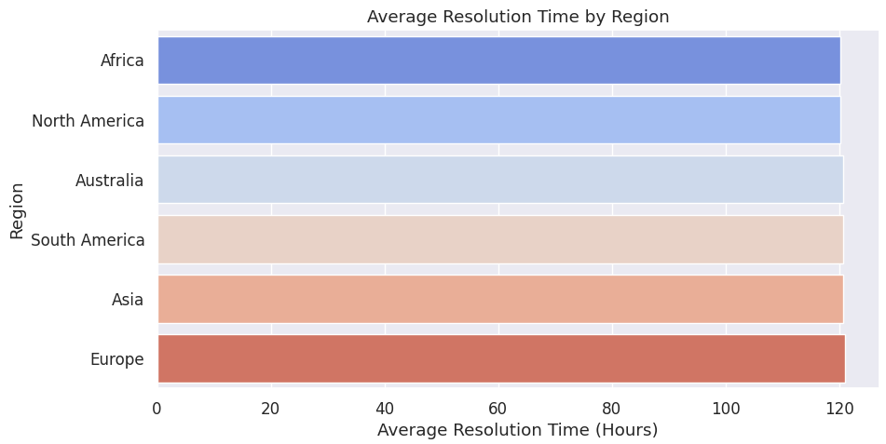
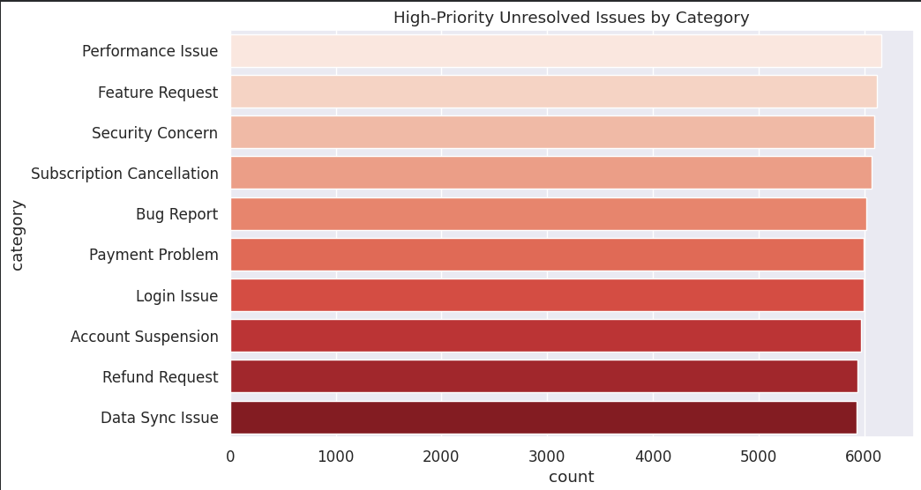
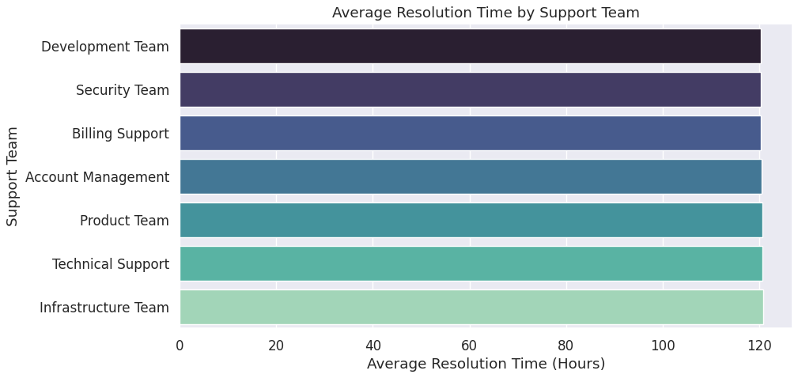
Operational Performance Analysis
Team and Region Performance
Resolution Time by Region
High-Priority Unresolved Issues
Resolution Time by Support Team
Compared average resolution time across different regions.
Identified regions with faster support performance.
Filtered unresolved High and Urgent tickets.
Identified critical categories requiring immediate attention.
Evaluated performance of each support queue.
Compared operational efficiency among support teams.

Slide 7


Slide 8
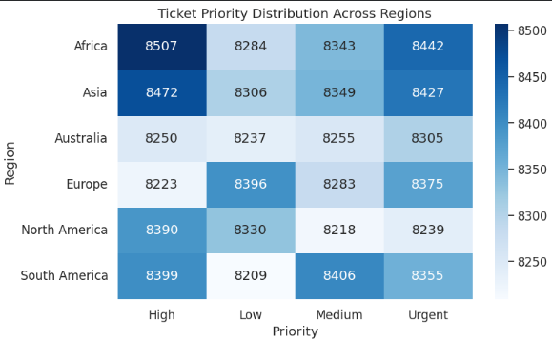
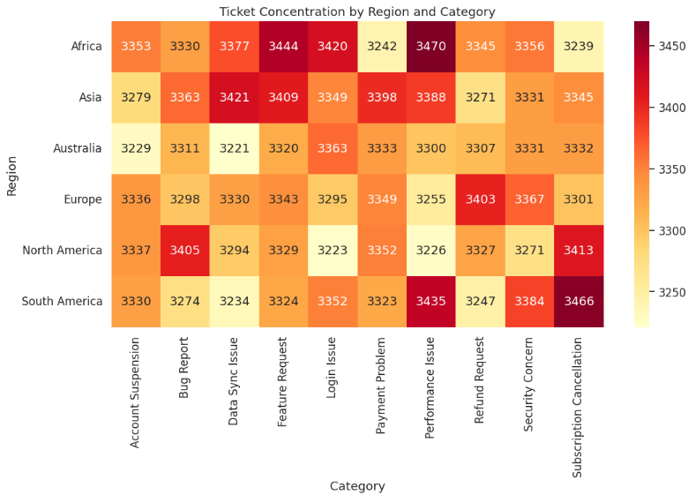
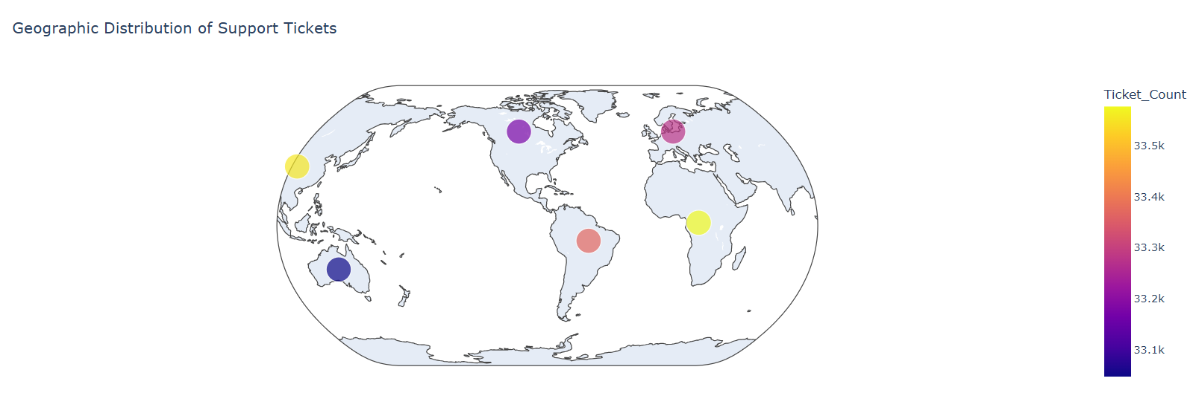
Category Distribution by Region
Geographic and Category-Level Insights
Compared issue categories across geographic locations.
Identified region-specific support patterns.
Geographic Analysis
Ticket Concentration Heatmap
Visualized ticket density across different regions.
Identified regions generating higher support demand.
Geographic Ticket Map
Displayed ticket distribution using representative latitude and longitude coordinates.
Highlighted regional service demand visually.

Slide 9
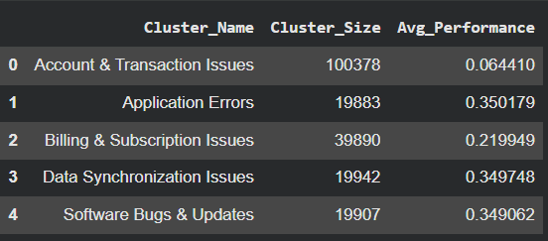
Cluster Performance Analysis
Cluster Size vs Performance Score
Analysis
Performance Score
The performance score was calculated using:
Compared cluster size with average performance score.
Evaluated whether larger ticket clusters impact operational efficiency.
Identified clusters requiring process improvement.
Customer Satisfaction Score
Similarity Score
Resolution Time
First Response Time
SLA Compliance

Slide 10




Key Findings
Performance Insights
Geographic Insights
Cluster Insights
Larger ticket clusters tend to exhibit lower operational performance.
Smaller clusters generally achieve better performance scores.
Cluster-level analysis helps prioritize improvement initiatives.
Resolution time varies across ticket priorities and ticket types.
Some support teams and regions resolve tickets more efficiently than others.
High-priority unresolved tickets indicate operational bottlenecks.
Ticket concentration differs across regions.
Regional analysis highlights varying customer support demands.

Slide 11
Milestone Deliverables
Completed Deliverables
Module 5
Module 6
✔ Resolution Time Analysis by Priority
✔ Resolution Time Analysis by Ticket Type
✔ Region Performance Analysis
✔ Support Team Performance Analysis
✔ High-Priority Unresolved Ticket Analysis
✔ Ticket Concentration Heatmaps
✔ Geographic Ticket Visualization
✔ Cluster Size vs Performance Score Analysis
✔ Comparative Performance Charts

