Slide 1

Supportlytics
Data-Driven Optimization of IT Support Team Performance Using Advanced Analytics
Milestone 1: Project Initialization & Dataset Setup
Presented by AARMITHA A

Slide 2

Project Overview
Major Objective
Minor Objectives
Analyze customer support ticket data using advanced analytics to evaluate IT support team performance, identify operational bottlenecks, optimize ticket resolution efficiency, and provide data-driven recommendations for improving service quality.
Understand dataset structure and quality
Perform data preprocessing and cleaning
Engineer analytical features
Analyze ticket distribution
Evaluate support performance using KPIs

Slide 3
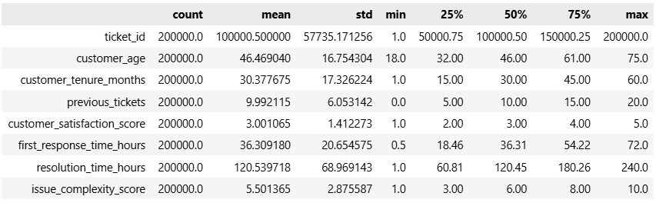
Dataset Overview
Dataset Source
Kaggle – Customer Support Tickets Dataset
Key Attributes
Product · Category · Priority · Status · Region · Resolution Time · Customer Satisfaction · SLA Breach
200,000
30
3
33
Records
Original Features
Engineered Features
Final Features

Slide 4

Data Understanding & Quality Assessment
Completed Analysis
Issues Identified
Browser column contained 40,023 missing values
Date columns required conversion to DateTime format
Dataset lacked a predefined Type column
Loaded dataset using Pandas
Explored schema and data types
Positive Findings
Checked missing values
Analyzed ticket distribution
No missing values in other text fields
Consistent categorical values across columns
Balanced ticket distribution observed

Slide 5
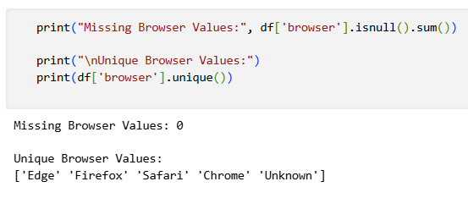
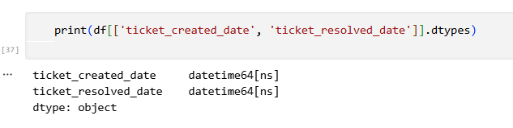
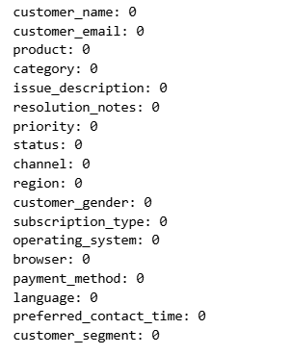

Data Cleaning & Feature Engineering
Data Cleaning Steps
01
Filled missing Browser values with "Unknown"
02
Converted ticket dates to DateTime format
03
Trimmed whitespace from text fields
04
Preserved all 200,000 records
All original records were retained — no data was lost during preprocessing.

Slide 6



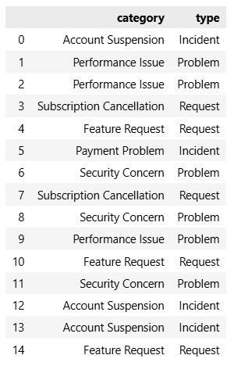
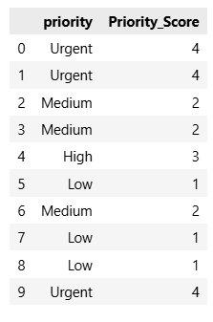
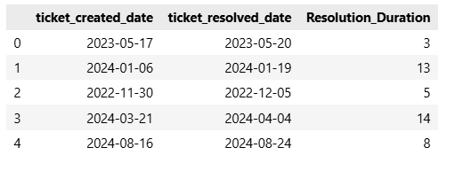
Feature Engineering Summary
Type
Resolution_Duration
Priority_Score
Classifies tickets into Request, Incident, and Problem categories for structured analysis.
Calculates the precise duration taken to resolve each ticket, enabling time-based KPIs.
Converts categorical priority levels into numerical values for quantitative performance modeling.
Benefits
Better performance analysis
Easier KPI calculation
Improves dashboard visualization
Supports clustering

Slide 7
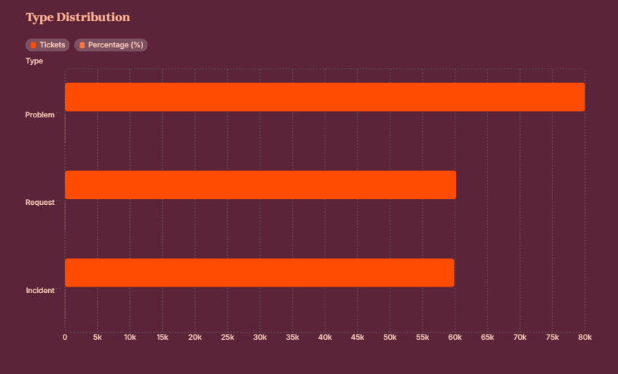
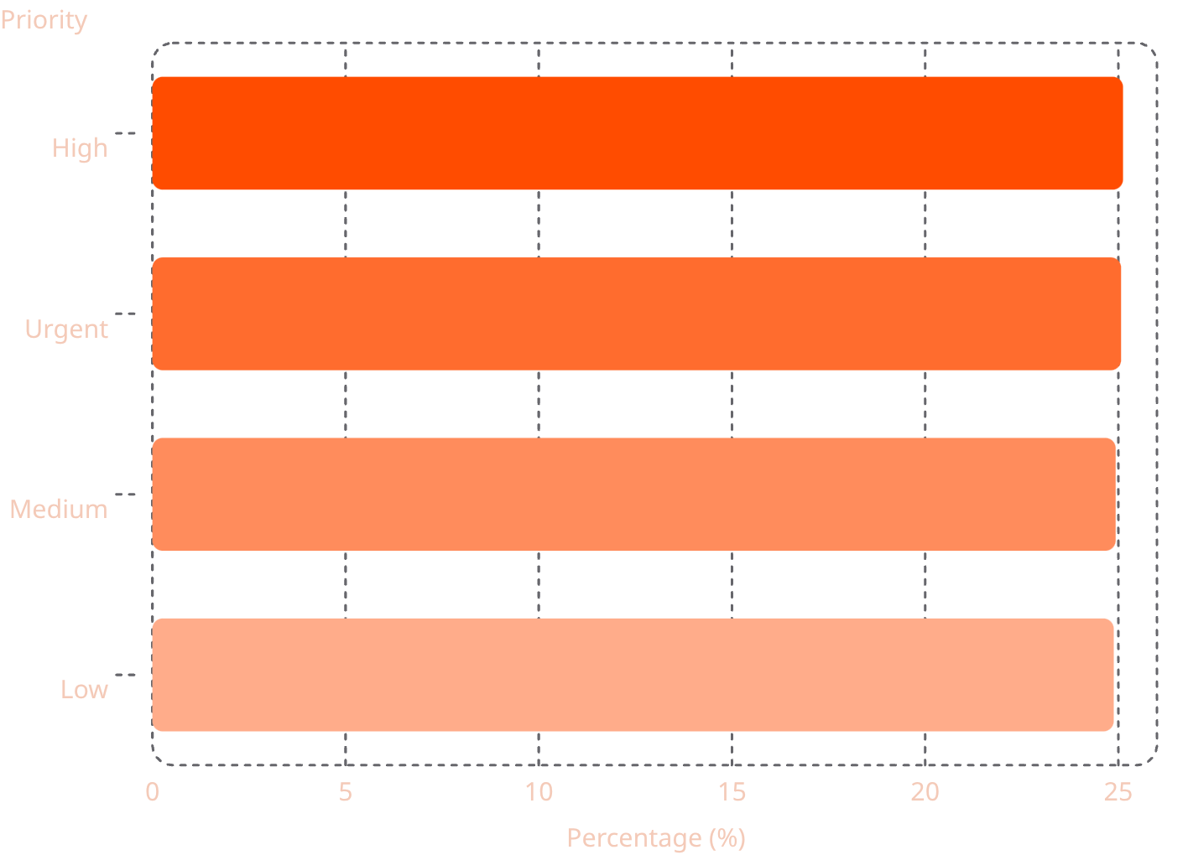


Initial Ticket Distribution
Priority Distribution
Top 3 Categories
Feature Request
10.08%
Subscription Cancellation
10.05%
Performance Issue
10.04%
Ticket distribution is well-balanced across priorities, categories, statuses, and support channels — confirming the dataset's suitability for robust performance analysis.

Slide 8
Milestone 1 — Summary
Completed Deliverables
01
02
Project Objectives & KPIs Defined
Workflow Definition
03
04
Dataset Loading & Understanding
Schema & Missing Value Analysis
05
06
Initial Ticket Distribution
Data Cleaning
07
08
Feature Engineering
Processed Dataset Saved
Output Files
customer_support_tickets_processed.csv
Feature Engineering Summary
Data Dictionary
Documentation
Reference Guide
Processed Dataset

