Slide 1


INFOSYS SPRINGBOARD 7.0 INTERNSHIP · SUPPORTLYTICS
Milestone 2: Week 3–4
Exploratory Visualization & Cluster Insights
Module 3: Exploratory Visualization
Module 4: Similarity & Cluster Insights
Deliverables: Minimum 8 Visualizations · Summary of Key Patterns & Problem Clusters
Presented by: Yona Gochipathala
Infosys Springboard 7.0 Internship | Supportlytics | Milestone 2

Slide 2

Milestone Overview
What Module 3 and Module 4 set out to accomplish
Module 3
Module 4
Exploratory Visualization
Similarity & Cluster Insights
Plot ticket type distribution
Identify top categories and clusters by frequency
Visualize tickets by priority and queue
Analyze average similarity scores within clusters
Compare cluster size vs. issue type
Visualize performance gaps using boxplots and scatter plots
Deliverables
Minimum 8 visualizations • Summary of key patterns and problem clusters
Infosys Springboard 7.0 Internship | Supportlytics | Milestone 2

Slide 3
Ticket Type Distribution
Module 3 · Plotting the spread of tickets across types
Observations
Incident tickets lead at 1,705 (34.1%)
Request tickets close behind at 1,656 (33.1%)
Problem tickets are 1,639 (32.8%)
Distribution is nearly even — no single type dominates ticket volume
Infosys Springboard 7.0 Internship | Supportlytics | Milestone 2

Slide 4
Top Categories & Clusters by Frequency
Module 3 · Identifying which categories and clusters generate the most tickets
By Category
By Cluster
Infosys Springboard 7.0 Internship | Supportlytics | Milestone 2

Slide 5
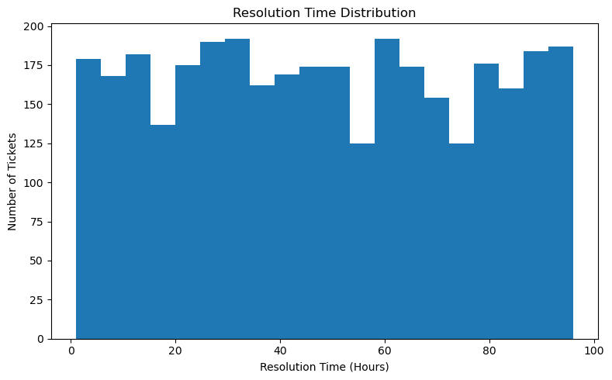
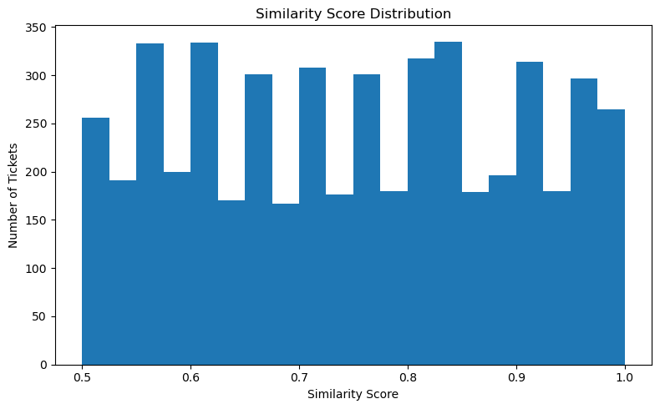
Resolution Time & Similarity Score
Module 3 · Distribution shapes behind ticket resolution and clustering quality
Infosys Springboard 7.0 Internship | Supportlytics | Milestone 2

Slide 6
Priority & Queue Distribution
Module 3 · How tickets spread across priority levels and support queues
By Priority
By Queue
Infosys Springboard 7.0 Internship | Supportlytics | Milestone 2

Slide 7
Priority vs Queue
Module 3 · Cross-tabulating ticket priority against assigned support queue
Infosys Springboard 7.0 Internship | Supportlytics | Milestone 2

Slide 8
Average Similarity Score by Cluster
Module 4 · How tightly grouped tickets are within each cluster
Observations
Software cluster is most cohesive (0.762 avg similarity)
Email cluster is least cohesive (0.741 avg similarity)
All clusters sit in a narrow 0.74–0.76 band — clustering quality is consistent
Infosys Springboard 7.0 Internship | Supportlytics | Milestone 2

Slide 9
Cluster Size vs Issue Type
Module 4 · Comparing ticket type composition within each cluster
Infosys Springboard 7.0 Internship | Supportlytics | Milestone 2

Slide 10
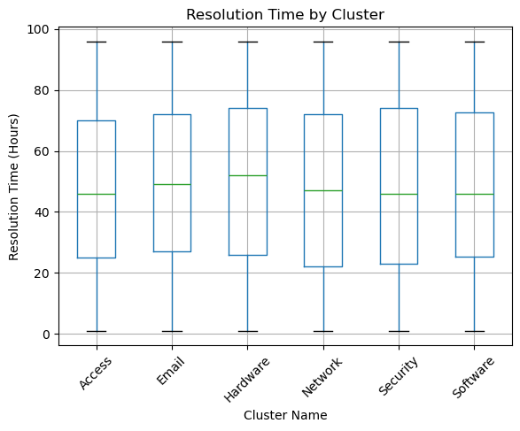
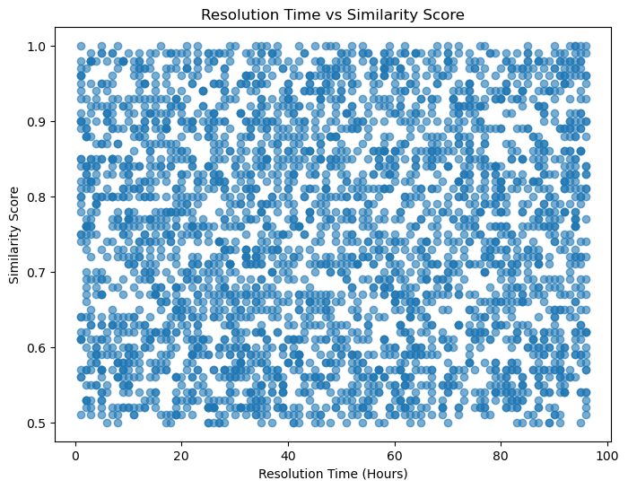
Visualizing Performance Gaps
Module 4 · Resolution time spread by cluster, and its relationship with similarity
Infosys Springboard 7.0 Internship | Supportlytics | Milestone 2

Slide 11




Key Patterns & Problem Clusters
Summary of insights across Module 3 and Module 4
Balanced Ticket Mix
Network Leads Categories
Email Cluster is Largest
Incident, Request, and Problem tickets are nearly evenly split (~33% each).
Network (867) and Hardware (857) categories generate the most tickets.
The Email cluster holds the most tickets (872) but the lowest similarity score.
Software Cluster Most Cohesive
Queues Are Well Balanced
Email Flagged for Review
Highest average similarity score (0.762) — a well-defined problem cluster.
Security queue is busiest (1,045) but no queue is overloaded relative to others.
Largest volume + lowest similarity marks Email as the priority problem cluster.
Infosys Springboard 7.0 Internship | Supportlytics | Milestone 2

Slide 12
Milestone 2 — Delivered
12 visualizations across Module 3 & Module 4 — exceeding the 8-chart minimum
✓
Ticket type distribution
✓
Top categories & clusters by frequency
✓
Resolution time & similarity distributions
✓
Priority & queue distribution
✓
Priority vs queue cross-tab
✓
Average similarity score by cluster
✓
Cluster size vs issue type
✓
Resolution time boxplot by cluster
✓
Resolution time vs similarity scatter
Next: Module 5 — Dashboard Development & Final Recommendations
Infosys Springboard 7.0 Internship | Supportlytics | Milestone 2

