Slide 1
INFOSYS SPRINGBOARD 7.0 INTERNSHIP · SUPPORTLYTICS
Optimizing IT Support Team Performance Using Analytics
Milestone 3: Module 5–6
Performance Trends & Geographic Insights
Deliverables: Performance Metrics Summary · Geo-Visualizations & Comparative Charts
Presented by:
Yona Gochipathala
Infosys Springboard 7.0 Internship | Supportlytics | Milestone 3

Slide 2



Milestone Overview
What Module 5 and Module 6 set out to accomplish
Module 5
Module 6
Performance Trend Analysis
Geographic & Category-Level Insights
Analyze average resolution times by priority and type
Determine which countries or teams handle tickets fastest
Identify high-priority unresolved issues
Create heatmaps of ticket concentration by region
Map issue categories geographically
Evaluate cluster size vs. performance score
Deliverables
Performance metrics summary • Geo-visualizations and comparative charts
Infosys Springboard 7.0 Internship | Supportlytics | Milestone 3

Slide 3
Average Resolution Time
Module 5 · By priority level and by ticket type
By Priority
By Ticket Type
Infosys Springboard 7.0 Internship | Supportlytics | Milestone 3

Slide 4
Fastest Countries & Teams
Module 5 · Average resolution time, sorted fastest to slowest
By Country (hrs)
By Team (hrs)
Infosys Springboard 7.0 Internship | Supportlytics | Milestone 3

Slide 5
High-Priority Unresolved Issues
Module 5 · Open High and Critical priority tickets awaiting resolution
1,643
828
815
Total Unresolved (High + Critical)
High Priority Open
Critical Priority Open
Observations
1,643 High/Critical tickets remain open — a meaningful backlog to track
High and Critical counts are close (828 vs. 815) — both need attention
These tickets are prime candidates for SLA escalation review
Infosys Springboard 7.0 Internship | Supportlytics | Milestone 3

Slide 6
Unresolved High-Priority Tickets by Team
Module 5 · Optional analysis — where is the open backlog concentrated?
Observations
Security carries the largest backlog (337 tickets)
Infra has the smallest open backlog (320 tickets)
Spread across teams is fairly even — no single team is overwhelmed
Infosys Springboard 7.0 Internship | Supportlytics | Milestone 3

Slide 7
Regional Ticket Distribution
Module 6 · Where ticket volume concentrates across regions
Observations
Europe (1,994) and APAC (1,989) generate nearly equal volume
North America is notably lower (1,017) — roughly half the others
Europe and APAC together drive ~80% of total ticket volume
Infosys Springboard 7.0 Internship | Supportlytics | Milestone 3

Slide 8
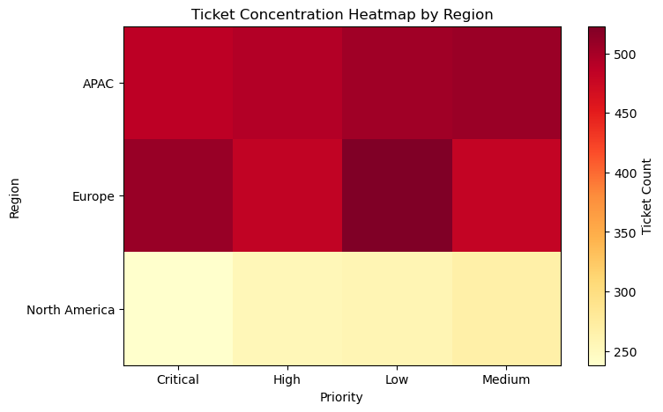
Ticket Concentration Heatmap
Module 6 · Ticket volume by region and priority level
Reading the Heatmap
Darker cells indicate higher ticket concentration
Built from a Region × Priority pivot table
Helps spot which region needs priority-specific staffing
Infosys Springboard 7.0 Internship | Supportlytics | Milestone 3

Slide 9
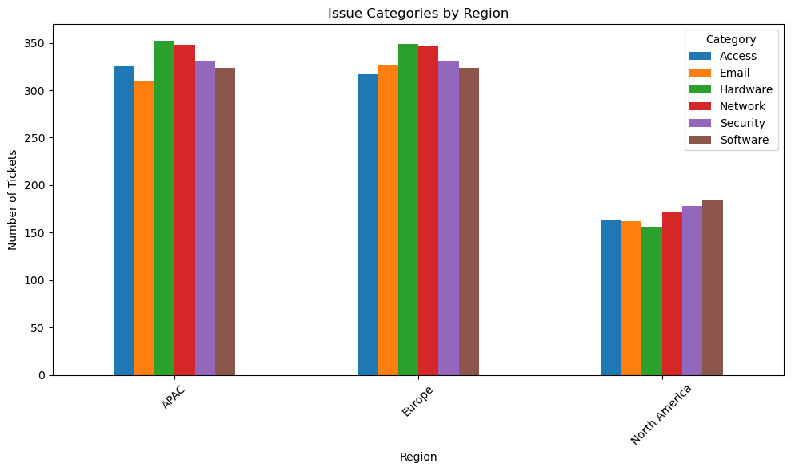
Issue Categories by Region
Module 6 · Mapping issue categories geographically
Why It Matters
Shows which issue categories dominate in each region
Supports regional staffing and skill-mix decisions
Built from a Region × Category cross-tabulation
Infosys Springboard 7.0 Internship | Supportlytics | Milestone 3

Slide 10
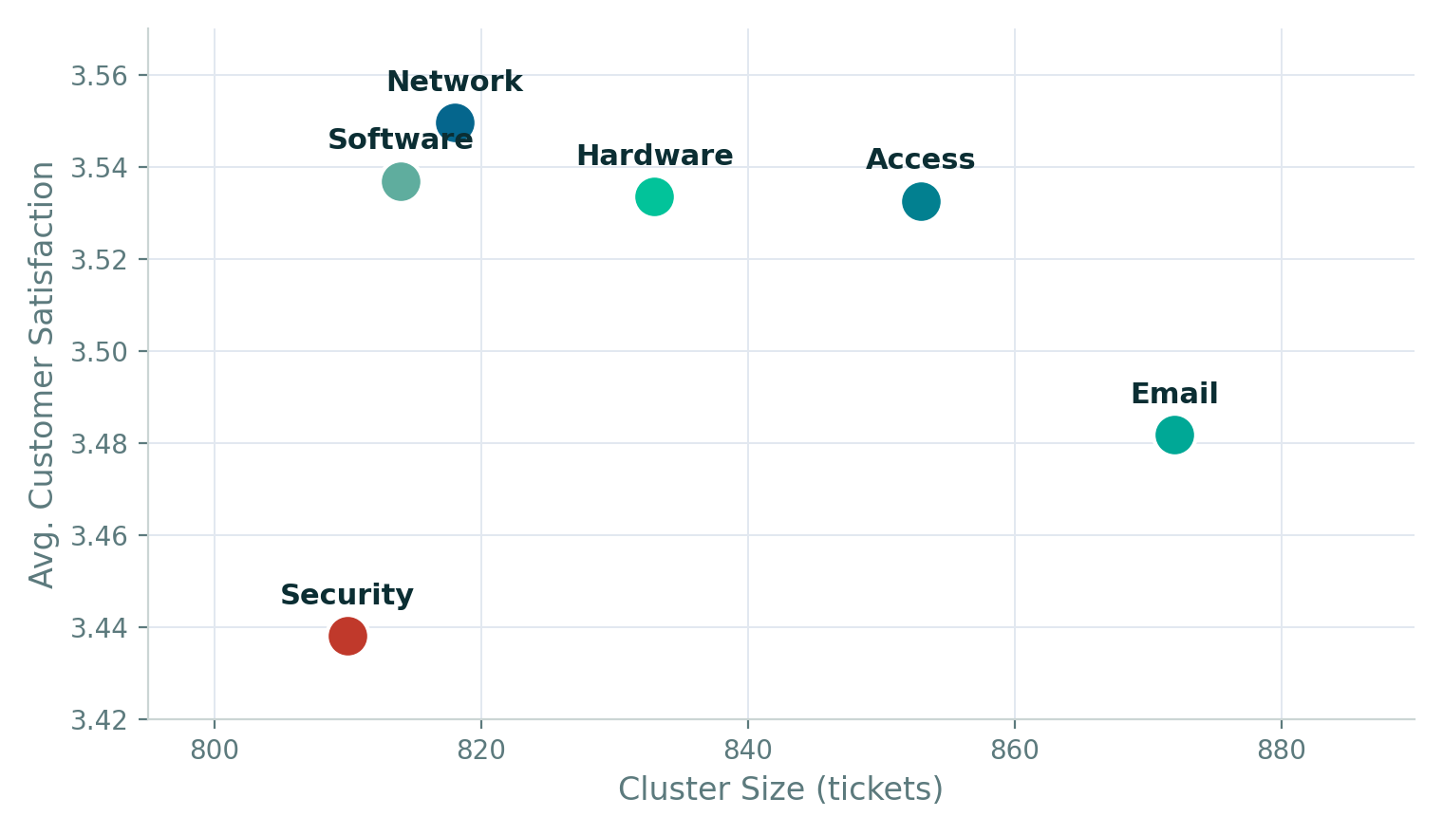
Cluster Size vs Performance Score
Module 6 · Does a larger cluster mean better customer satisfaction?
Observations
Network scores highest satisfaction (3.55) at mid-range size
Email is the largest cluster (872) but scores lowest (3.48)
No clear correlation — cluster size doesn't predict performance
Infosys Springboard 7.0 Internship | Supportlytics | Milestone 3

Slide 11





Key Performance Insights
Summary of findings across Module 5 and Module 6
Medium Priority Lags
Australia Resolves Fastest
1,643 Tickets Still Open
Medium tickets take longest to resolve (49.4 hrs) — even slower than Critical (47.6 hrs).
Australia leads at 46.9 hrs; India is slowest at 50.0 hrs on average.
High and Critical priority tickets awaiting resolution — a backlog worth escalating.
Security Team's Backlog
Europe & APAC Drive Volume
Size ≠ Performance
Security holds the largest share of unresolved high-priority tickets (337).
Together they account for ~80% of tickets; North America trails at 1,017.
Email is the largest cluster but has the lowest satisfaction score — flagged for review.
Infosys Springboard 7.0 Internship | Supportlytics | Milestone 3

Slide 12
Milestone 3 — Delivered
Performance metrics, geo-visualizations, and comparative charts complete
✓
Avg. resolution time by priority & type
✓
Fastest countries & teams comparison
✓
High-priority unresolved issue tracking
✓
Unresolved backlog by team
✓
Regional ticket distribution
✓
Ticket concentration heatmap by region
✓
Issue categories mapped by region
✓
Cluster size vs. performance score
Next: Module 7 — Predictive Modeling & Final Recommendations
Infosys Springboard 7.0 Internship | Supportlytics | Milestone 3

