Slide 1



INFOSYS SPRINGBOARD 7.0 INTERNSHIP · SUPPORTLYTICS
Optimizing IT Support Team Performance
Using Analytics
Power BI Dashboard — Final Presentation
5,000 Tickets
6 Dashboard Pages
5 Countries, 3 Regions
Overview · Tickets · Cluster · Geography · Performance · Reports
Presented by:
Yona Gochipathala
Infosys Springboard 7.0 Internship | Supportlytics | IT Support Analytics Dashboard

Slide 2




About the Dashboard
A 6-page Power BI report built on the Supportlytics dataset
Overview
Tickets
Cluster
Headline KPIs, ticket status, priority split
Category, product, channel, and trend analysis
Similarity scores and cluster performance
Geography
Performance
Reports
Regional map and resolution comparison
Resolution time, satisfaction, SLA tracking
Summary table and business recommendations
Built in Power BI Desktop, connected to Supportlytics_Cleaned_Dataset.xlsx (5,000 tickets, 30 fields)
Infosys Springboard 7.0 Internship | Supportlytics | IT Support Analytics Dashboard

Slide 3
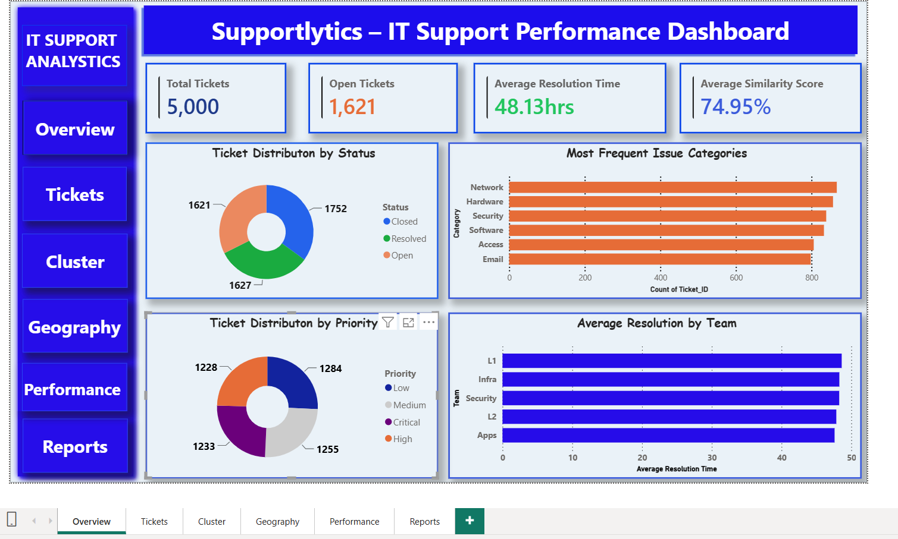
Overview
Page 1 of 6 · Headline performance at a glance
5,000 total tickets, 1,621 still open, 48.13 hrs average resolution time, and a 74.95% average similarity score across clusters.
Infosys Springboard 7.0 Internship | Supportlytics | IT Support Analytics Dashboard

Slide 4
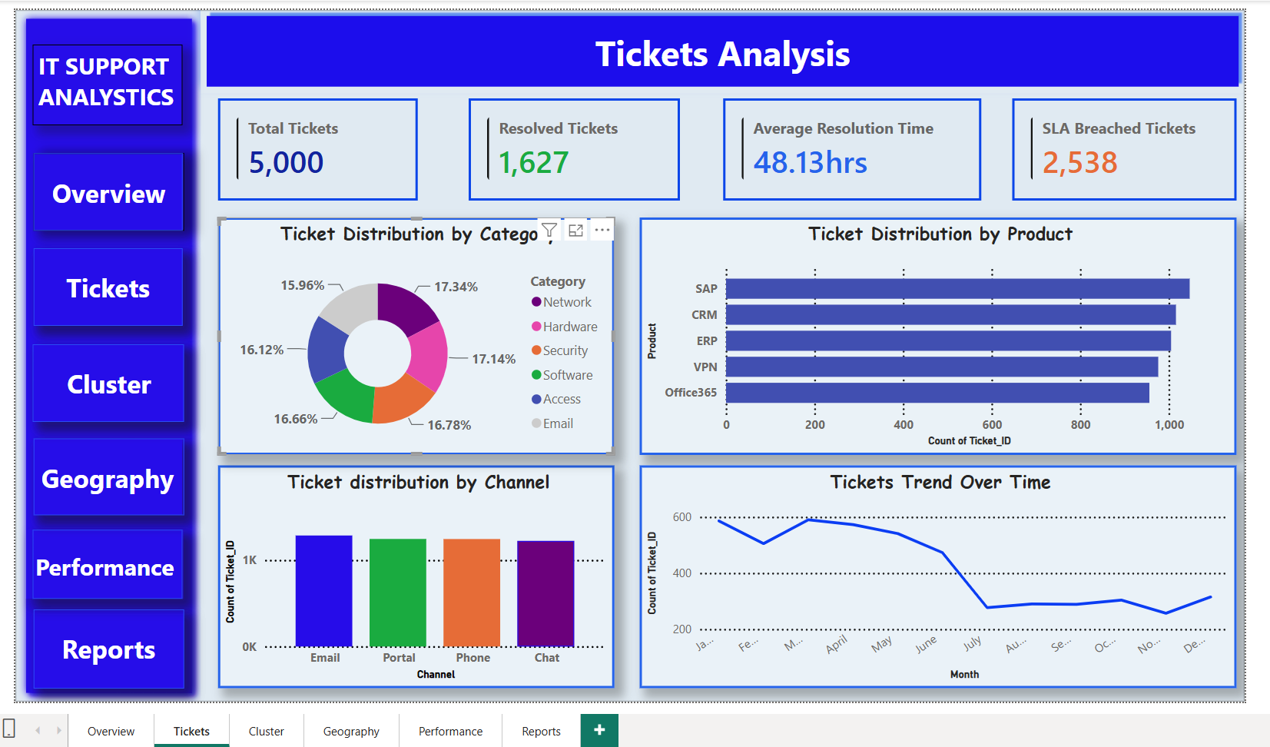
Tickets Analysis
Page 2 of 6 · Where tickets come from and how volume trends
1,627 tickets resolved; 2,538 breached SLA. Email is the top channel, SAP the top product, and volume has trended downward since April.
Infosys Springboard 7.0 Internship | Supportlytics | IT Support Analytics Dashboard

Slide 5
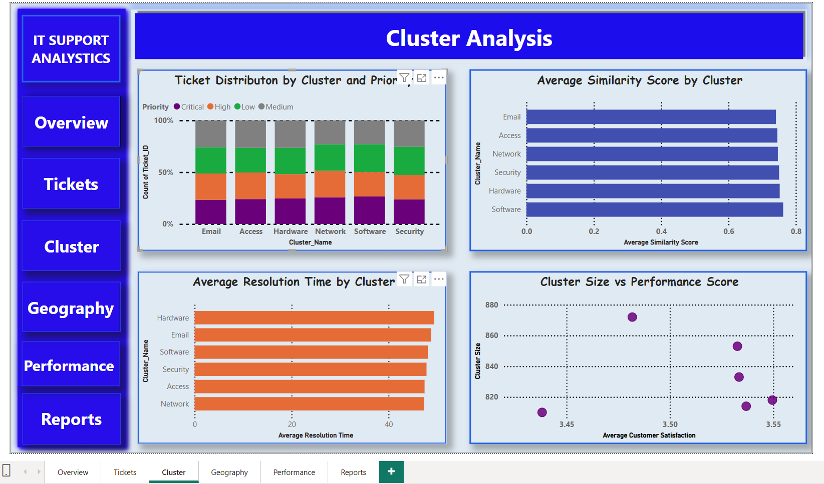
Cluster Analysis
Page 3 of 6 · Similarity scores and cluster-level performance
Software cluster shows the highest similarity score; cluster size does not consistently predict performance score.
Infosys Springboard 7.0 Internship | Supportlytics | IT Support Analytics Dashboard

Slide 6
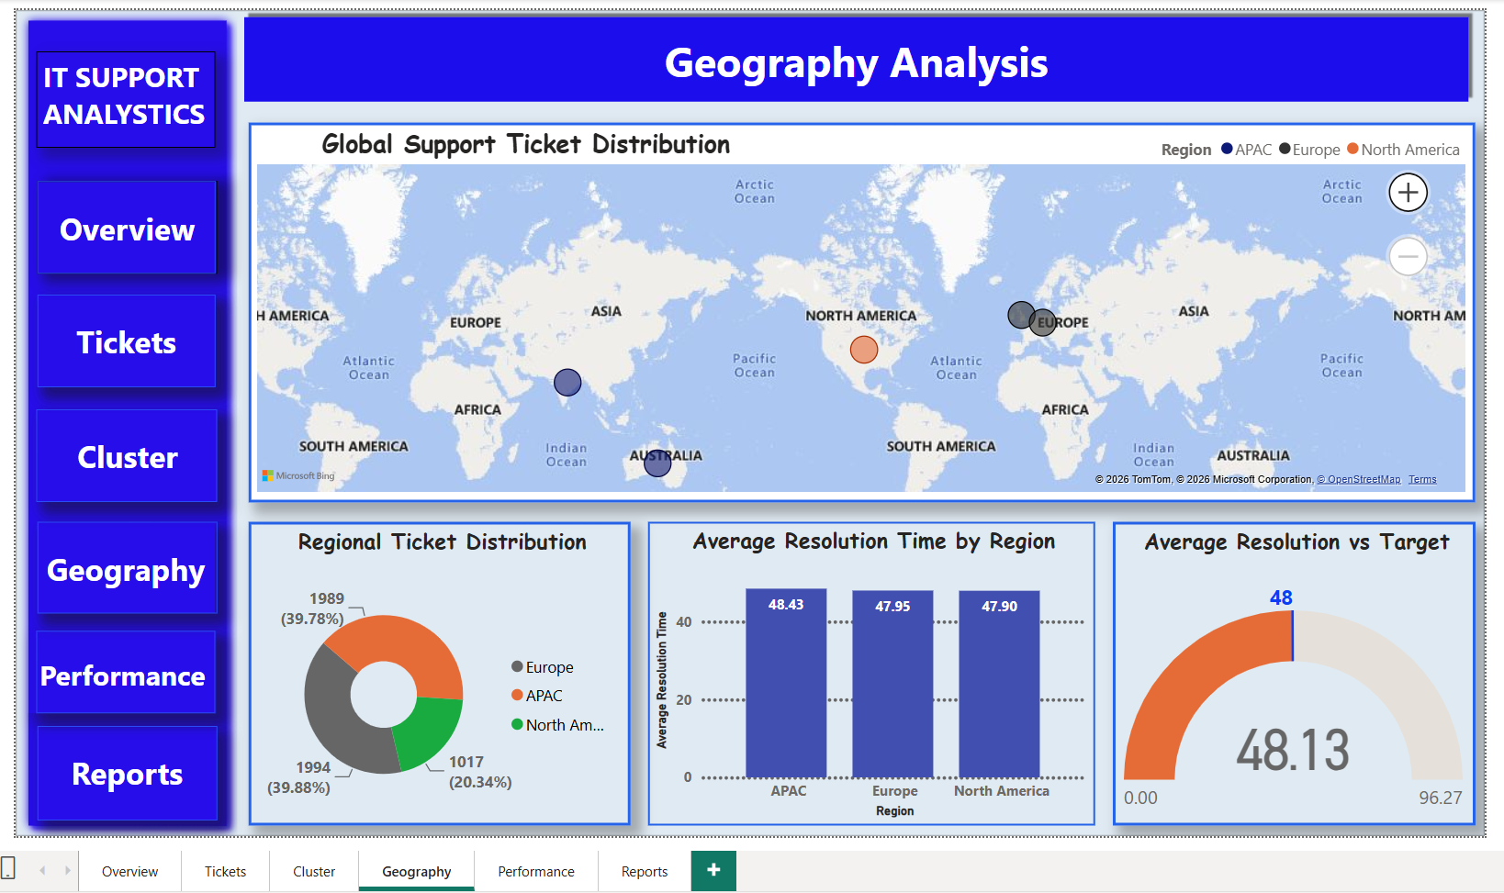
Geography Analysis
Page 4 of 6 · Regional ticket distribution and resolution speed
Europe (39.9%) and APAC (39.8%) drive most ticket volume; North America resolves fastest at 47.90 hrs, just under the 48-hr target.
Infosys Springboard 7.0 Internship | Supportlytics | IT Support Analytics Dashboard

Slide 7
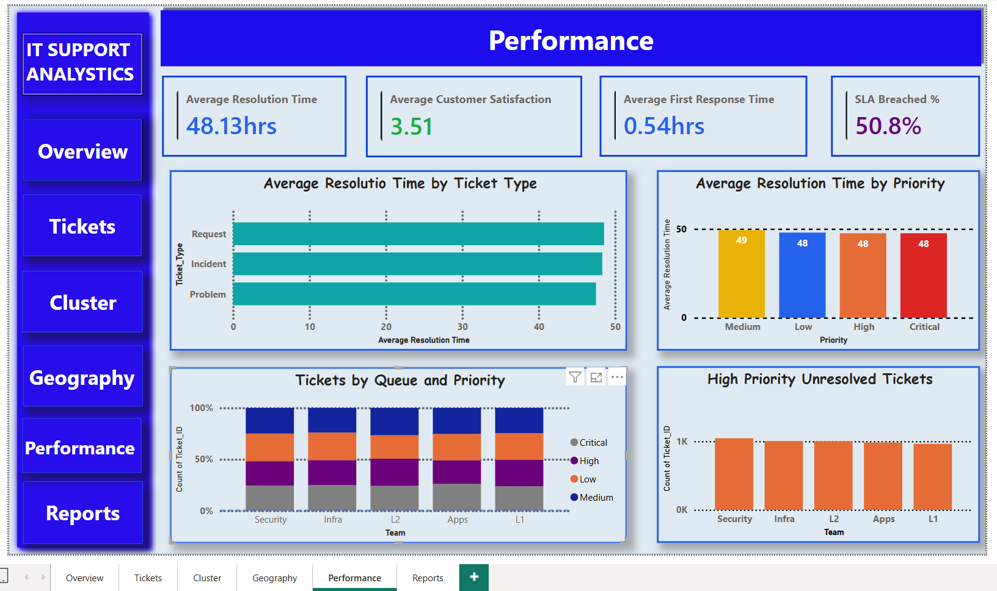
Performance
Page 5 of 6 · Resolution time, satisfaction, and SLA health
Average customer satisfaction sits at 3.51/5; SLA breach rate is 50.8% — the clearest area flagged for improvement.
Infosys Springboard 7.0 Internship | Supportlytics | IT Support Analytics Dashboard

Slide 8
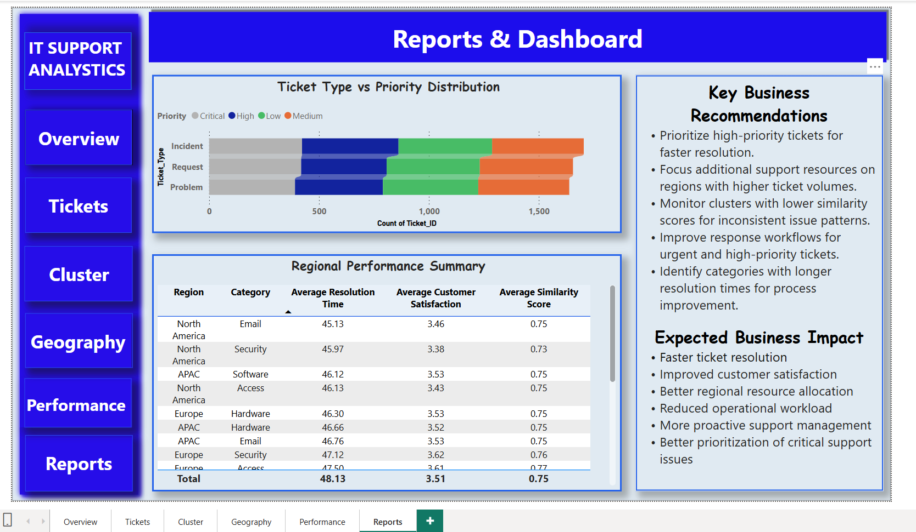
Reports & Dashboard
Page 6 of 6 · Regional summary table and business recommendations
Combines a region × category performance summary with five key recommendations and their expected business impact.
Infosys Springboard 7.0 Internship | Supportlytics | IT Support Analytics Dashboard

Slide 9


Key Business Recommendations
From the Reports page of the live dashboard
Prioritize high-priority tickets for faster resolution.
Focus additional support resources on regions with higher ticket volumes.
Monitor clusters with lower similarity scores for inconsistent issue patterns.
Improve response workflows for urgent and high-priority tickets.
Identify categories with longer resolution times for process improvement.
Infosys Springboard 7.0 Internship | Supportlytics | IT Support Analytics Dashboard

Slide 10


Expected Business Impact
What acting on these recommendations should deliver
Faster Ticket Resolution
Improved Customer Satisfaction
Better Regional Resource Allocation
Reduced Operational Workload
More Proactive Support Management
Better Prioritization of Critical Issues
Infosys Springboard 7.0 Internship | Supportlytics | IT Support Analytics Dashboard

Slide 11
Dashboard — Delivered
IT_Support_Analytics.pbix — 6 pages, live and ready to present
✓
Overview KPI summary
✓
Ticket volume & trend analysis
✓
Cluster similarity & performance
✓
Geographic ticket distribution
✓
Resolution time & SLA tracking
✓
Business recommendations & impact
Thank You
Infosys Springboard 7.0 Internship | Supportlytics | IT Support Analytics Dashboard

