Slide 1
Supportlytics: Milestone 3
Performance Trend Analysis & Geographic Insights
Module 5
Module 6
Performance Trend Analysis — resolution times, team efficiency, and unresolved ticket escalation
Geographic & Category-Level Insights — regional distribution, heatmap clustering, and cluster efficiency

Slide 2

MODULE 5
Performance Trend Analysis
Module 5 systematically examines support operations data to surface actionable insights about resolution efficiency, team performance, and backlog risk. The analysis covers four core objectives:
1
2
Resolution Time by Priority & Type
Team Speed Benchmarking
Analyze average resolution hours segmented by ticket priority level and issue category to identify where bottlenecks form.
Determine which support teams resolve tickets fastest and how volume affects their throughput and efficiency.
3
4
High-Priority Backlog Identification
Deliverables
Surface unresolved High and Critical tickets across teams to flag escalation risk and capacity strain.
Performance metrics summary and comparative charts supporting data-driven resource allocation decisions.

Slide 3
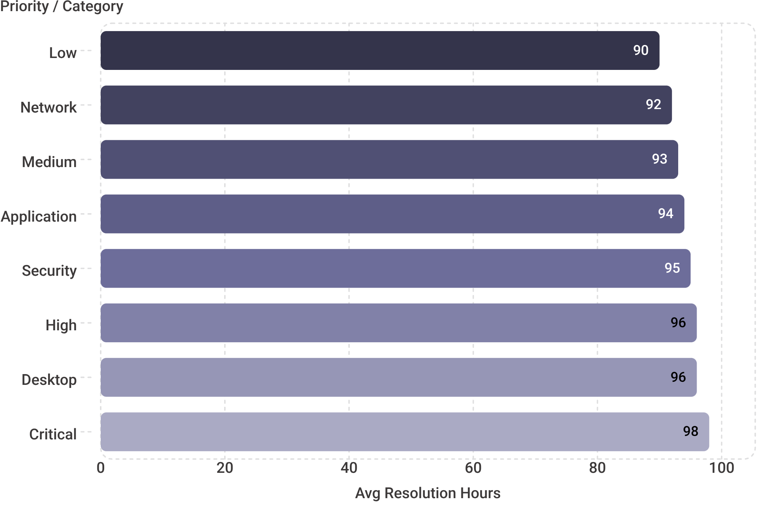


Average Resolution Time by Priority & Category
By Priority
Critical and High tickets require similar resolution times across all priority levels — the spread from Low (90 hrs) to Critical (98 hrs) is narrow, suggesting priority escalation alone does not accelerate resolution.
By Category
Resolution times vary significantly by issue type. Network issues resolve fastest at 92 hrs while Desktop tickets lag at 96 hrs.
Key Insight
Category type and team expertise matter more than priority level alone. Resource routing strategy should weight issue category alongside ticket priority.

Slide 4
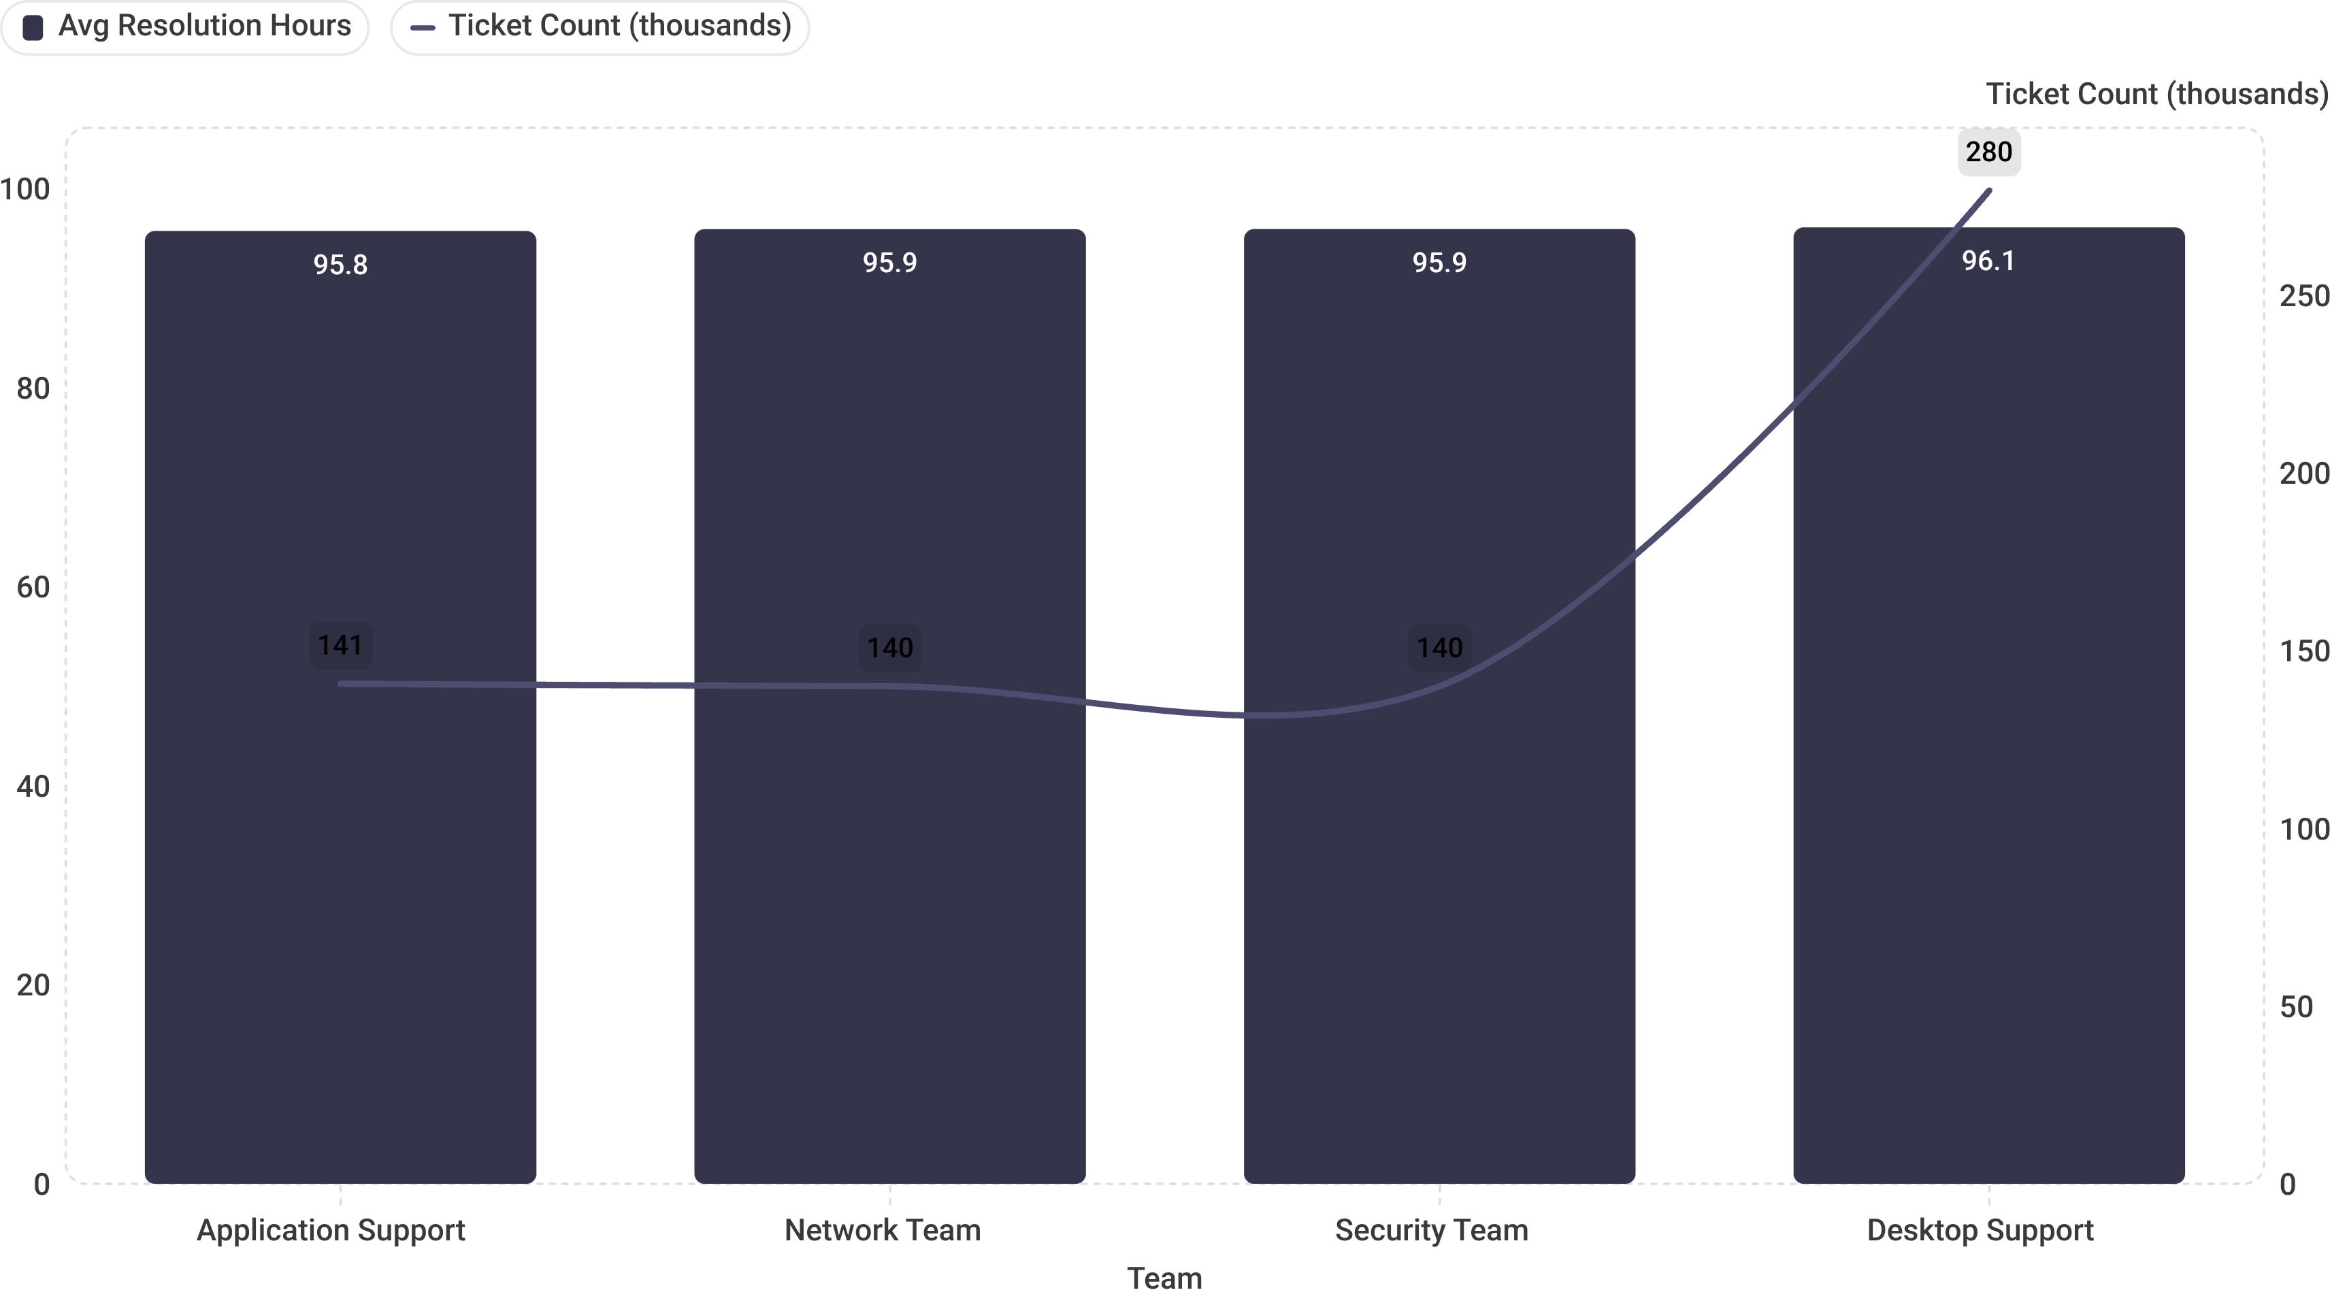
Team Performance: Who Resolves Fastest?
🥇 Application Support
Network Team
95.75 hrs avg — Fastest team
140,666 tickets handled
95.93 hrs avg
139,950 tickets handled
Security Team
Desktop Support
95.94 hrs avg
139,966 tickets handled
96.11 hrs avg — Highest volume
279,475 tickets handled
Performance gap of only 0.36 hours between the fastest and slowest team — operations are well-standardized across all support functions.

Slide 5
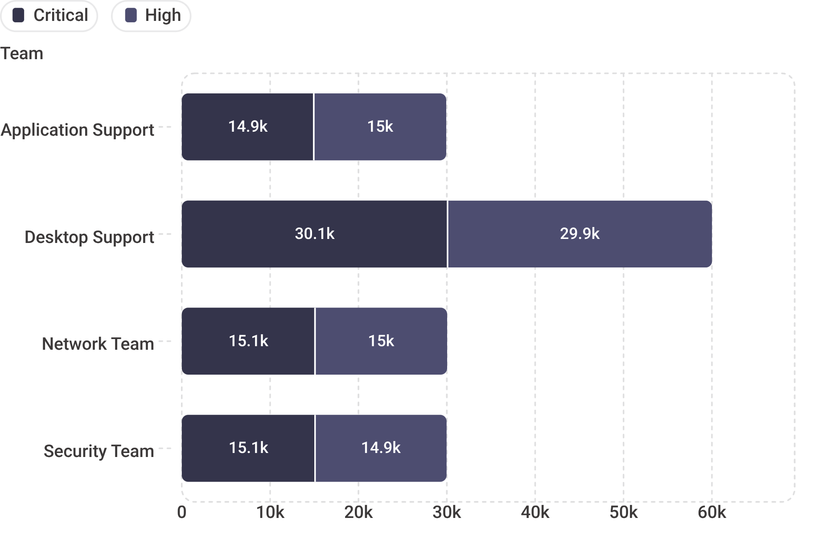


High-Priority Unresolved Issues: Critical Alert
Total Unresolved
Desktop Support
149,952 High/Critical tickets — 15% of all tickets remain unresolved and require immediate action.
60,019 unresolved — 30% of their total backlog. The most severely impacted team by a significant margin.
App / Network / Security
Recommendation
Prioritize Desktop Support backlog reduction and implement formal escalation protocols for High/Critical queues.
Each carries approximately ~30,000 unresolved tickets, representing 21% of their respective backlogs.

Slide 6
CHAPTER 2
Module 6: Geographic & Category-Level Insights
Having established team-level performance baselines in Module 5, Module 6 shifts the lens to geography and ticket taxonomy — examining how ticket volume, resolution performance, and issue categories are distributed across regions and structured clusters.
01
02
03
Regional Ticket Distribution
Region × Category Heatmap
Cluster Performance Analysis
Analyze volume and resolution performance across South, North, West, East, and Central regions.
Identify which issue categories dominate each region and where infrastructure differences drive concentration.
Evaluate the relationship between ticket cluster size and operational efficiency to assess scalability.

Slide 7
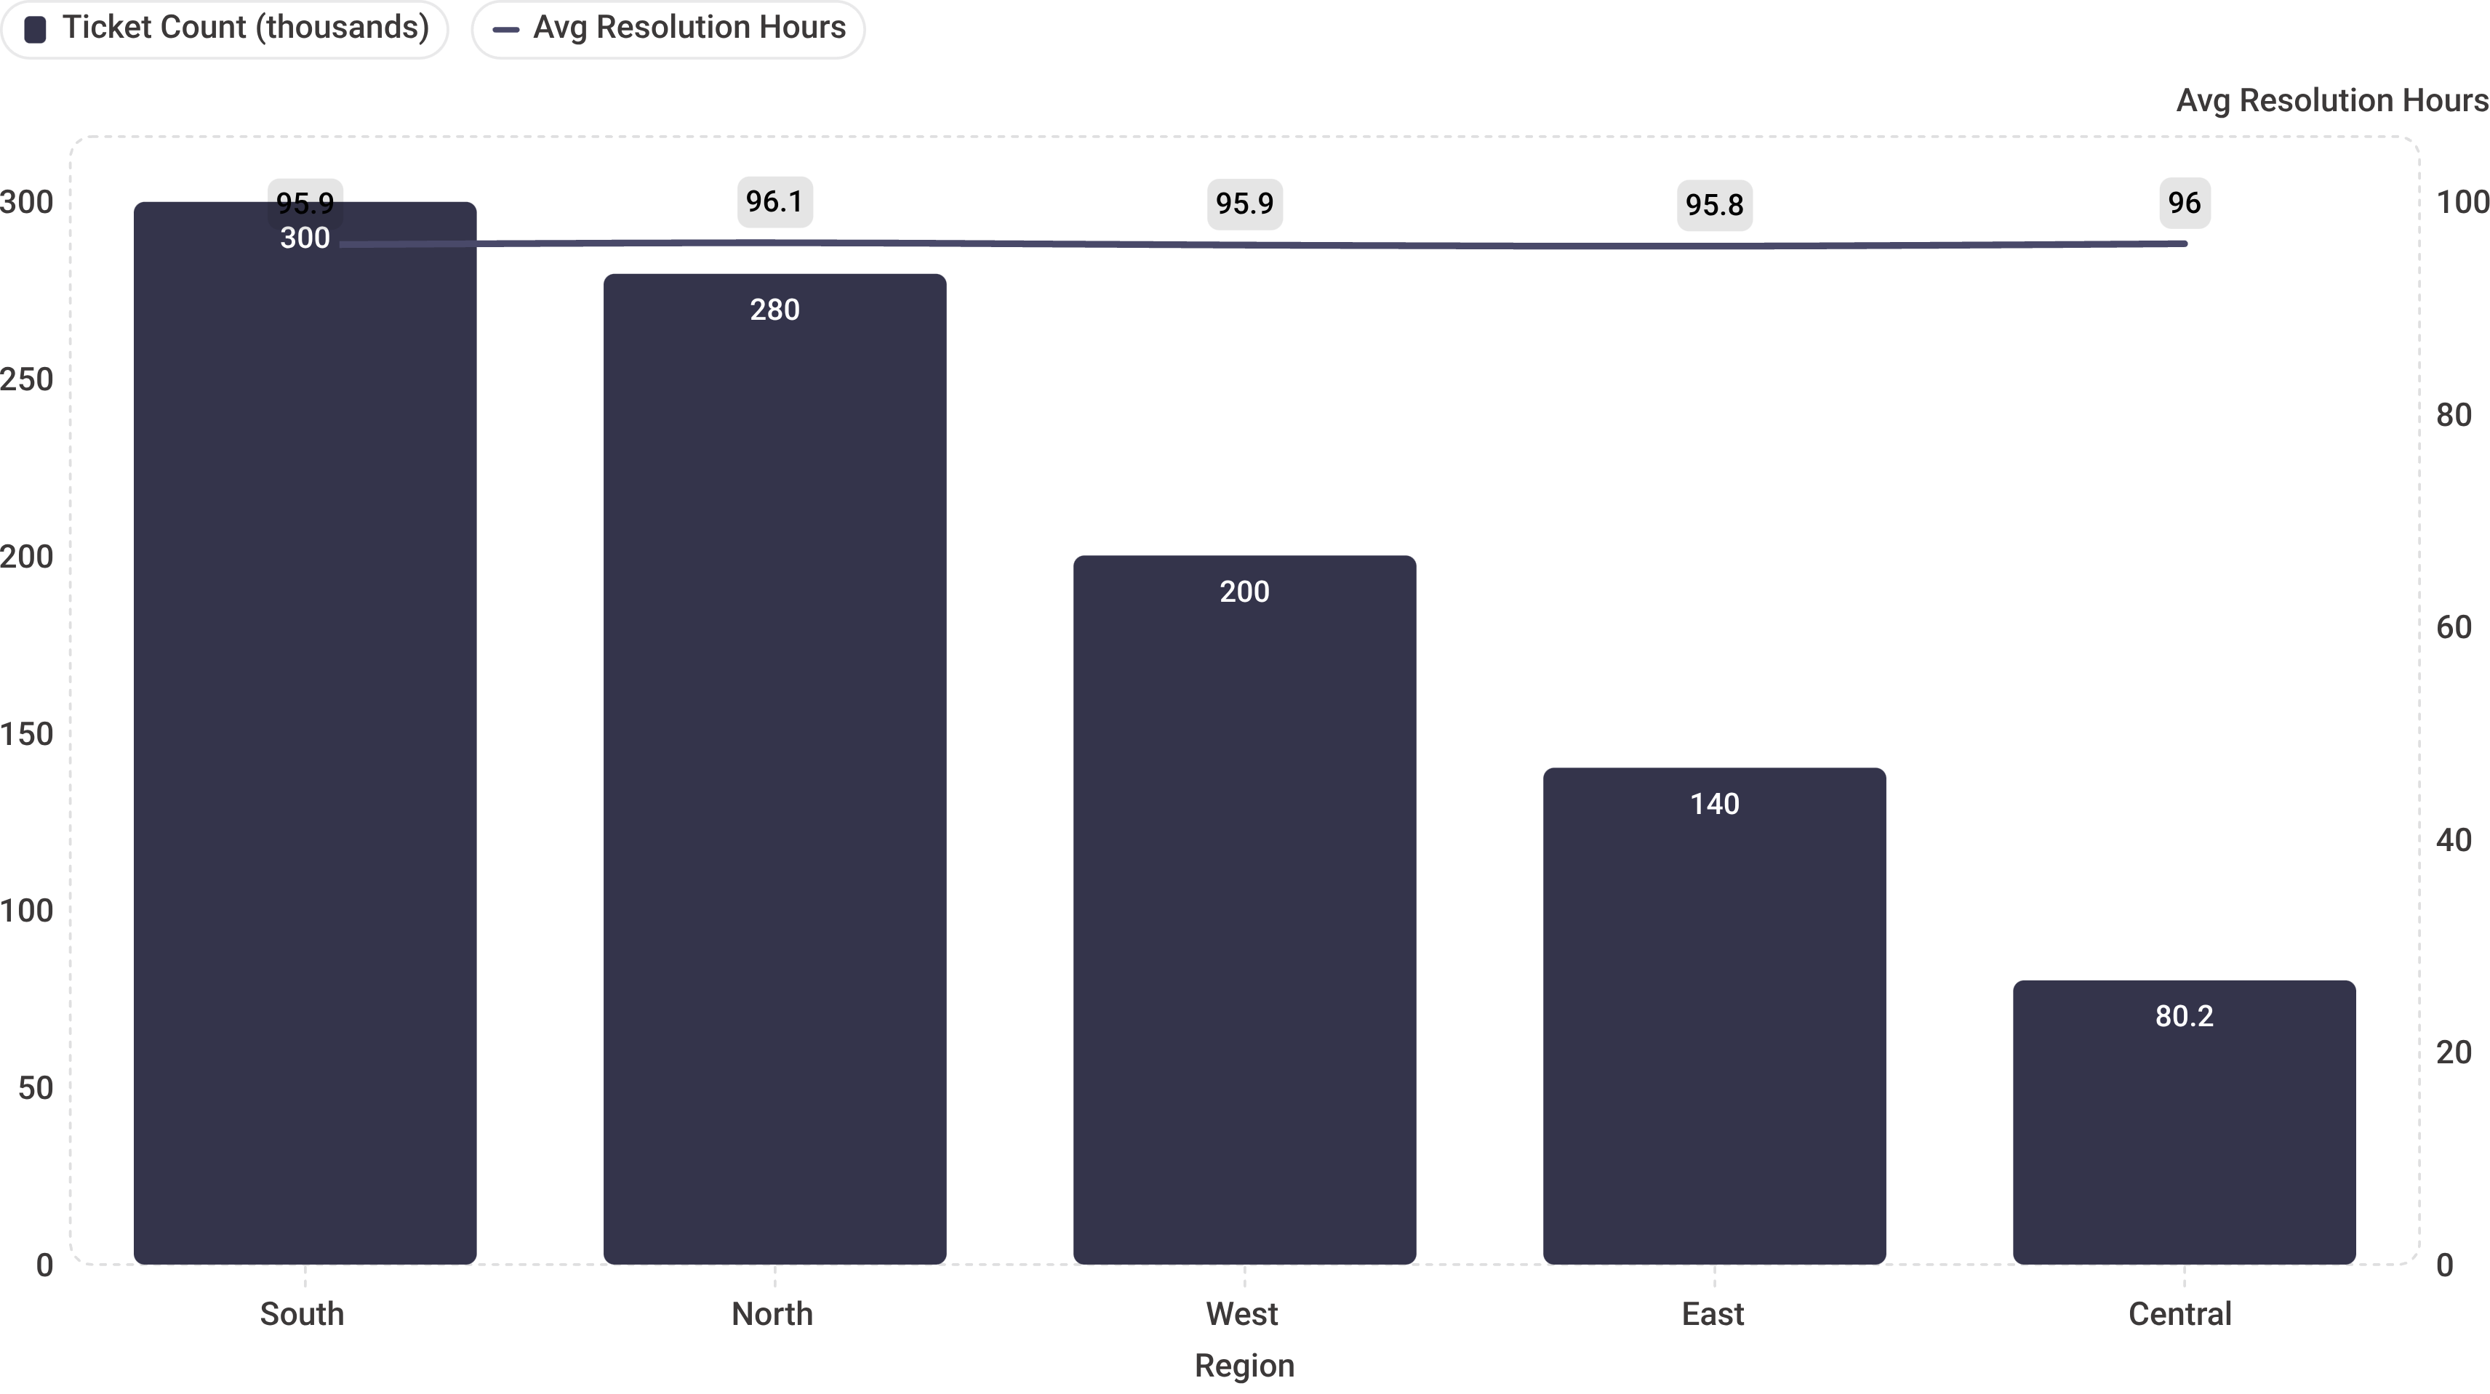
Regional Ticket Distribution & Performance
South — 30%
North — 28%
West — 20% 🏆
299,916 tickets
95.93 hrs avg
279,600 tickets
96.12 hrs avg
200,112 tickets
95.90 hrs — Fastest
East — 14%
Central — 8%
140,170 tickets
95.80 hrs avg
80,202 tickets
96.03 hrs avg
All regions maintain consistent performance scores (1.4/3.0) and escalation rates (0.5) — geographic variation does not meaningfully impact service quality.

Slide 8
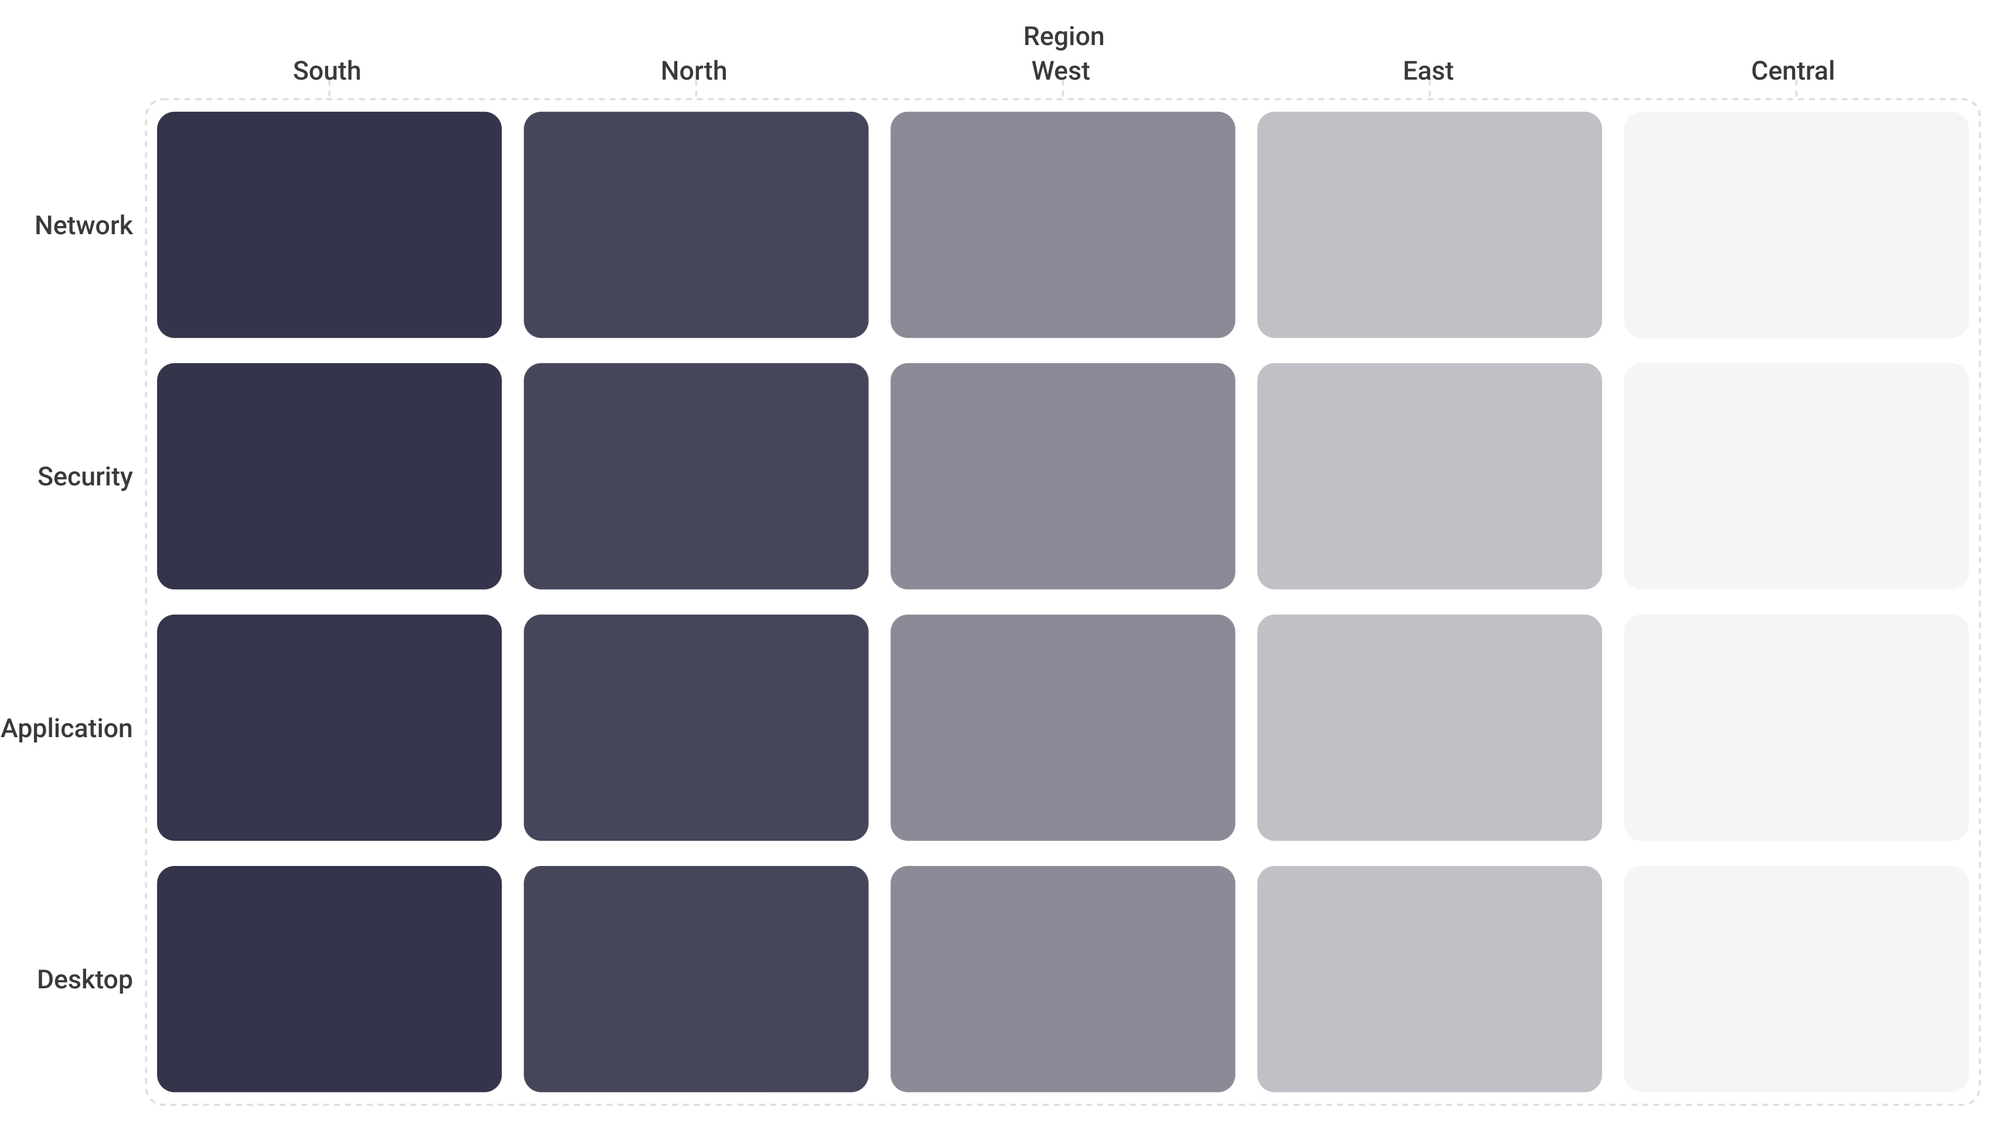

Ticket Concentration: Region × Category Heatmap
South & North Dominance
Central Region
Resource Allocation Implication
South and North regions show the highest concentration across all categories, accounting for 58% of total ticket volume. Infrastructure scale and user base density are likely drivers.
Lowest ticket volume but maintains consistent category distribution — proportional representation across all issue types despite smaller absolute numbers.
Geographic clustering patterns suggest that resource allocation should reflect regional ticket concentration, not uniform distribution across all five regions.

Slide 9
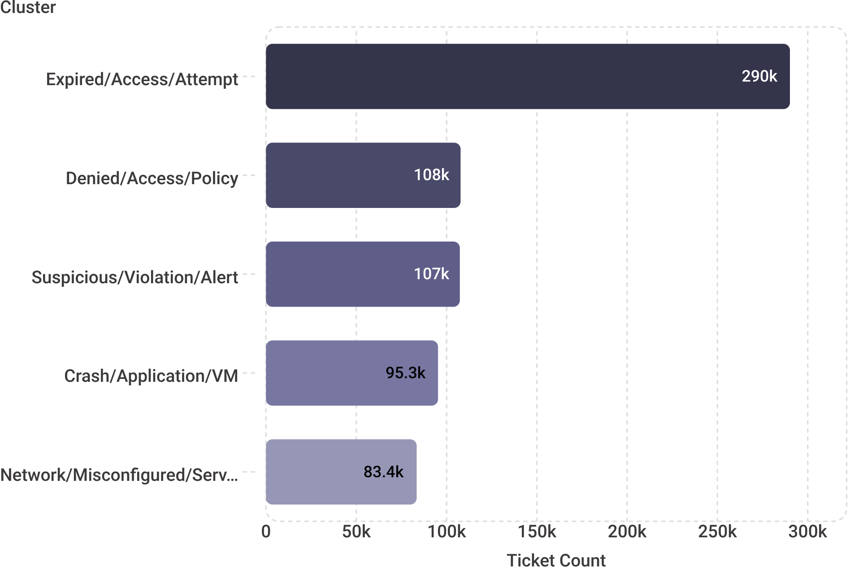


Cluster Performance Analysis: Size vs. Efficiency
Cluster 1 — Largest
Cluster 10
290,149 tickets
Expired/Access/Attempt
1.40 performance score | 95.96 hrs avg
107,764 tickets
Denied/Access/Policy
1.40 performance score | 96.27 hrs avg
Cluster 0
Key Finding
107,358 tickets
Suspicious/Violation/Alert
1.40 performance score | 95.97 hrs avg
Correlation between cluster size and performance = 0.075 (weak). Larger clusters do not perform worse — process efficiency is independent of volume, indicating strong scalability.

Slide 10

Key Findings & Recommendations
Performance Consistency
Critical Backlog Gap
All teams and regions maintain similar resolution times ranging 95.8–96.1 hrs. This narrow band confirms that support processes are well-standardized across the organization.
149,952 unresolved High/Critical tickets require immediate escalation — Desktop Support alone holds 60,019 (30% of its backlog). This is the most urgent operational risk identified.
Regional Balance
Cluster Scalability
South and North regions handle 58% of total ticket volume. Current resource distribution appears appropriate, but allocation models should be reviewed against regional concentration heatmaps.
Weak correlation of 0.075 between cluster size and performance score confirms that the support operation scales efficiently — volume growth does not degrade resolution quality.
Next Steps
1
2
3
Escalation Protocols
Desktop Backlog Reduction
Regional Monitoring
Implement formal escalation workflows for High/Critical tickets to prevent unresolved backlog accumulation.
Prioritize Desktop Support capacity expansion or ticket redistribution to address the 30% unresolved rate.
Establish ongoing dashboards tracking regional performance trends and category concentration shifts over time.

