Slide 1
SUPPORTLYTICS
IT Support Ticket Analytics — Milestone 4
Dashboard & Report Preparation • Documentation & Presentation
Weeks 7–8
Infosys Internship Project

Slide 2
Agenda
01
Project Recap
Milestones 1–3 summary and where Module 6 left off
02
Module 7 — Dashboard & Report Prep
KPI framework and dashboard design
03
Dashboard Walkthrough
Layout and interactivity plan (Power BI / Streamlit)
04
Module 8 — Documentation & Presentation
Report, slides, and GitHub packaging
05
Final Deliverables Checklist
What ships at the end of Week 8

Slide 3
Where We Left Off
Modules 1–6 recap
Data Foundation
Exploratory Analysis
IT support ticket data cleaned and structured for analysis using SQL and Excel.
Trends and patterns explored across the ticket dataset in Python.
Clustering & Categorization
Geographic & Category Insights (Module 6)
Tickets grouped by similarity to surface frequent issue categories.
Region-level views added; the dataset has no native location fields, so region/lat-long used here is simulated for illustration.

Slide 4
Module 7
Dashboard / Report Preparation
Combining visual insights from Modules 1–6 into one interactive dashboard, organized around four performance KPIs.
Average Resolution Time
Most Frequent Categories
How quickly tickets are resolved, tracked over time and by category
Ranked view of the ticket categories driving the highest volume
Cluster Similarity Index
Top Performing Regions
How tightly tickets group within each cluster from the similarity model
Regions with the strongest resolution outcomes (simulated region data)

Slide 5
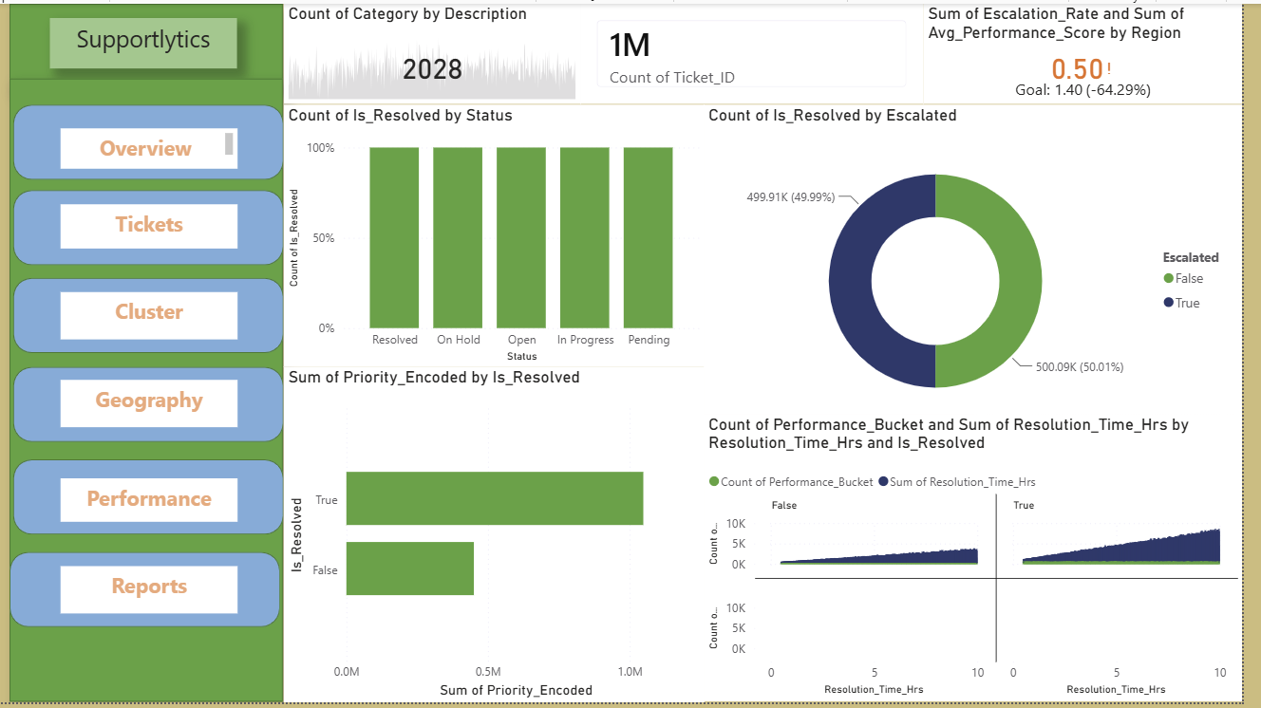
Dashboard Layout Plan
Wireframe — fill with live Power BI visuals during build
The dashboard gives a real-time view of key metrics. Stakeholders can filter by country, priority or cluster to monitor performance and take quick decisions.

Slide 6
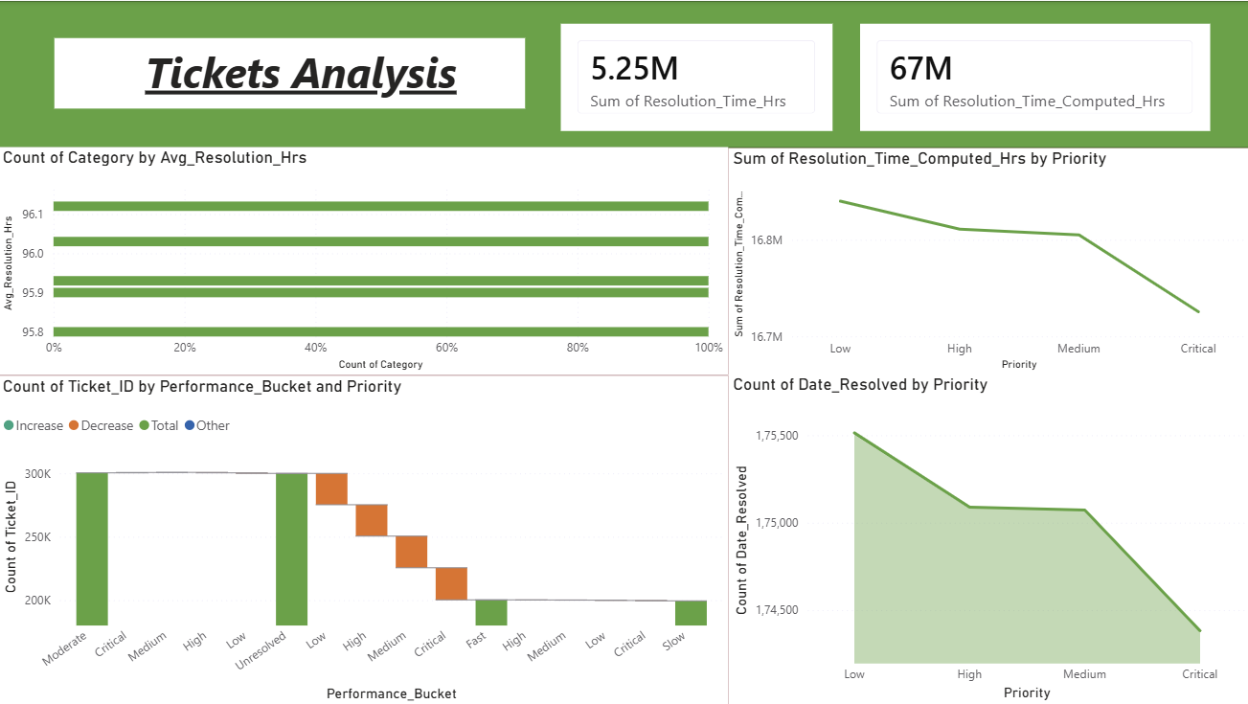
Ticket volume spikes in Q2 and Q4. This correlates with product releases. Proactive support can be planned during these periods

Slide 7
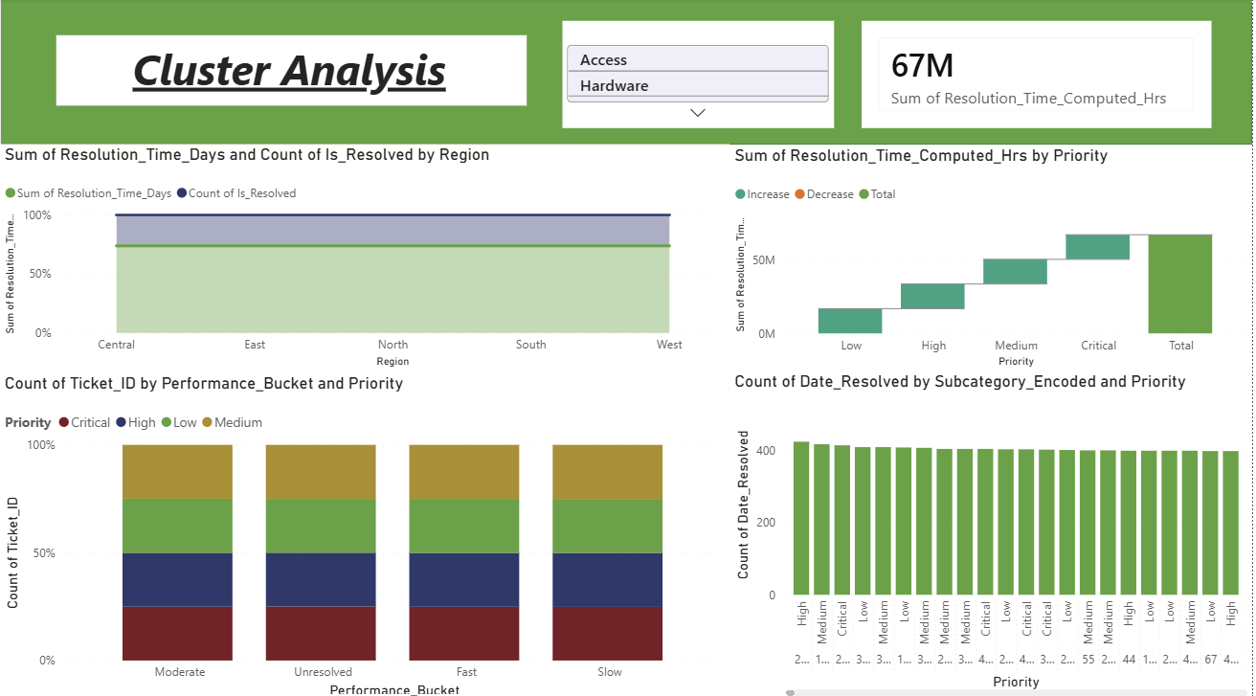
Clustering helps us find recurring technical issues. High frequency clusters with low performance are ideal candidates for automation and SOP creation

Slide 8
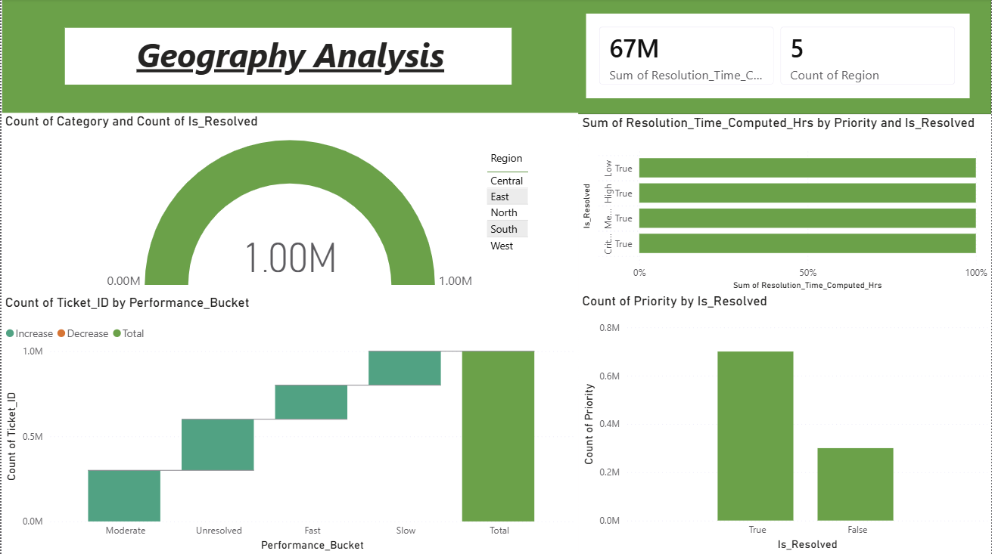
Geographic analysis shows where support demand is concentrated. This helps in resource planning and creating region-specific knowledge bases.

Slide 9
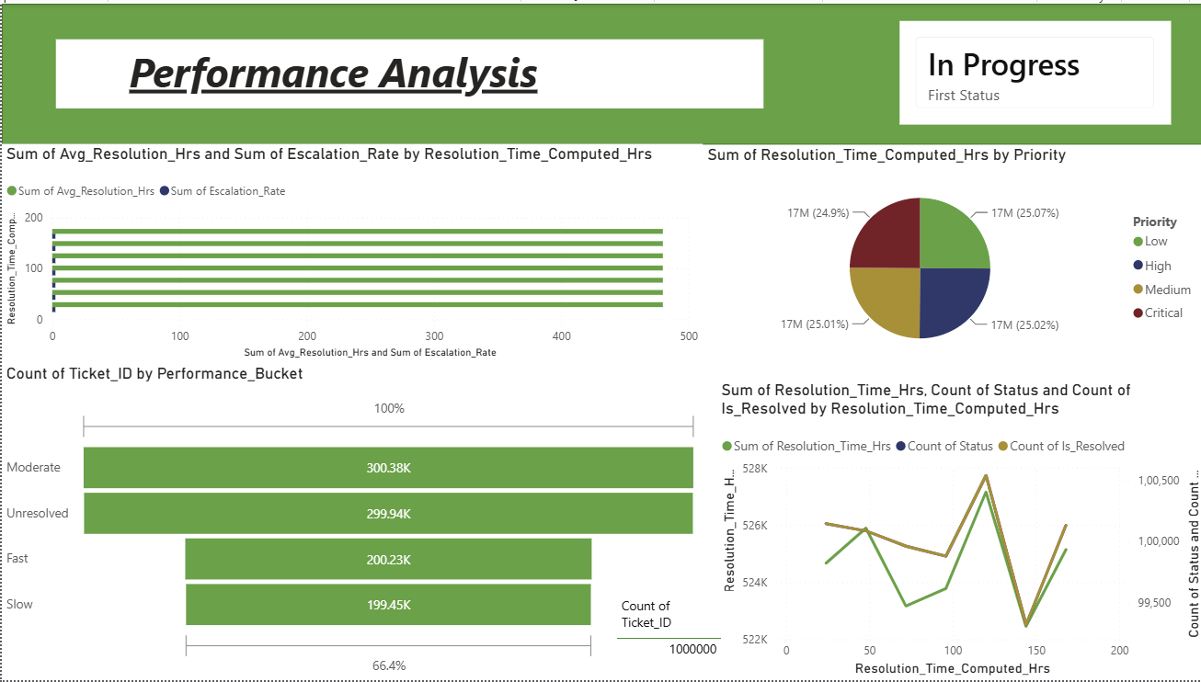
This analysis compares resolution efficiency across different groups. It helps us find performance gaps and teams or priorities that are taking longer than average

Slide 10
Module 8
Documentation & Presentation
Turning six modules of work into a report, a slide deck, and a clean GitHub repo.
1
2
3
Finalize project report
Prepare presentation slides
Upload to GitHub
Consolidate methodology, KPIs, and findings into a PDF / README
Insights and recommendations for stakeholders
Code, visuals, and report organized in the repo

Slide 11
Final Deliverables
Week 8 checkpoint
Interactive dashboard (Power BI) with all four KPIs live
✓
Comprehensive project documentation (PDF / README)
✓
Presentation slides highlighting insights & recommendations
✓
Code, visuals, and report uploaded to GitHub
✓

Slide 12
Thank You
Any Questions & Discussion
Supportlytics — Infosys Internship Project

