Slide 1
SUPPORTLYTICS
Optimizing IT Support Team Performance
Using Analytics
MILESTONE 2 · Exploratory Data Analysis & Cluster Insights (Modules 3 & 4)
Presenter Hema Sundar
Mentor Shanmukha Priya

Slide 2
MILESTONE 2
Agenda & Scope
MODULE 3
MODULE 4
Exploratory Visualization
Similarity & Cluster Insights
Ticket Volume Distribution by Type
Cluster Similarity & Cohesion
Top Support Categories by Frequency
Cluster Size vs. Issue Type Composition
Priority Distribution Across Queues
Performance Gap Analysis
02

Slide 3
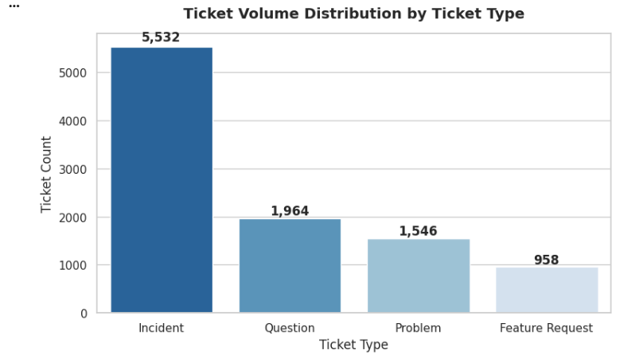
MODULE 3
Ticket Volume Distribution by Type
Key Focus: Incidents vs. Requests Volume Split
03

Slide 4
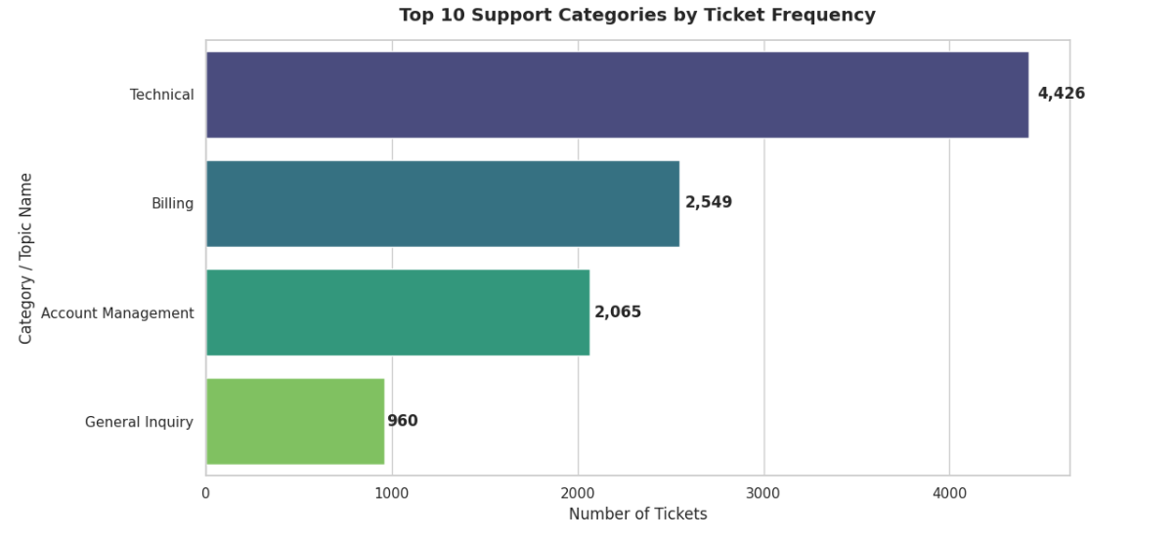
MODULE 3
Top Support Categories by Frequency
Key Focus: Top 10 Categories and Pareto (80/20) Analysis
04

Slide 5
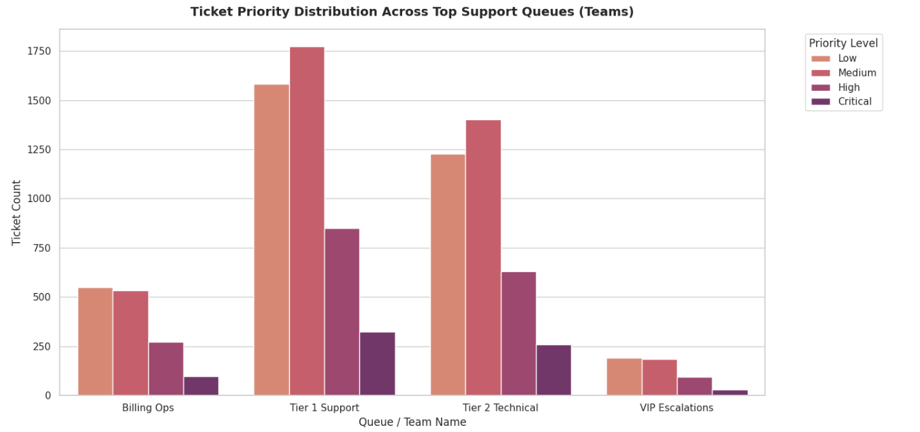
MODULE 3
Priority Distribution Across Queues
Key Focus: Workload Pressure and Queue Severity Breakdown
05

Slide 6
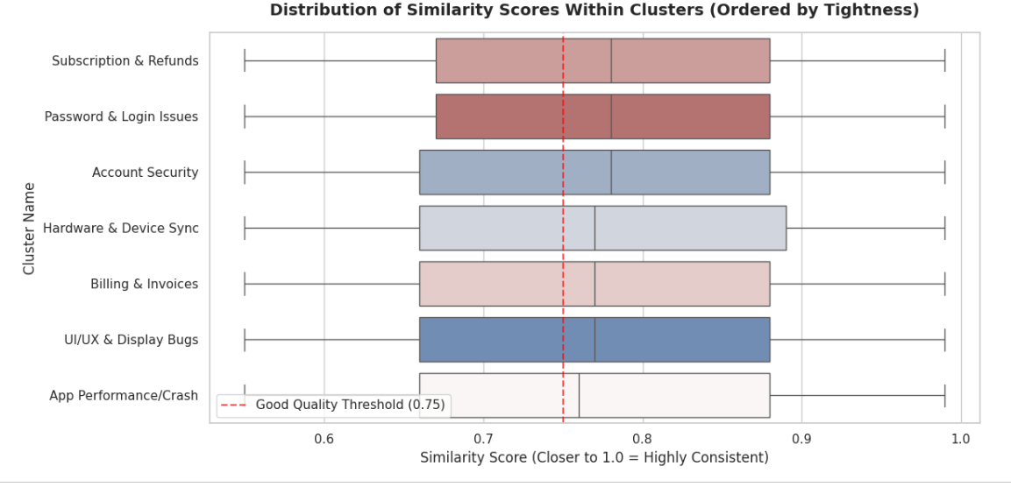
MODULE 4
Cluster Similarity & Cohesion
Key Focus: Average Similarity Scores vs. 0.75 Quality Threshold
06

Slide 7
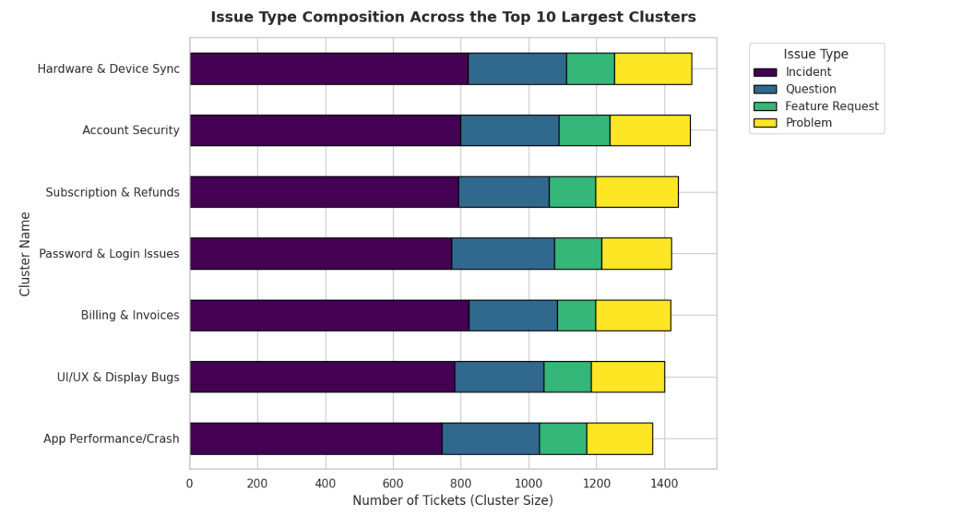
MODULE 4
Cluster Size vs. Issue Type Composition
Key Focus: Stacked Issue Type Breakdown across Top Clusters
07

Slide 8
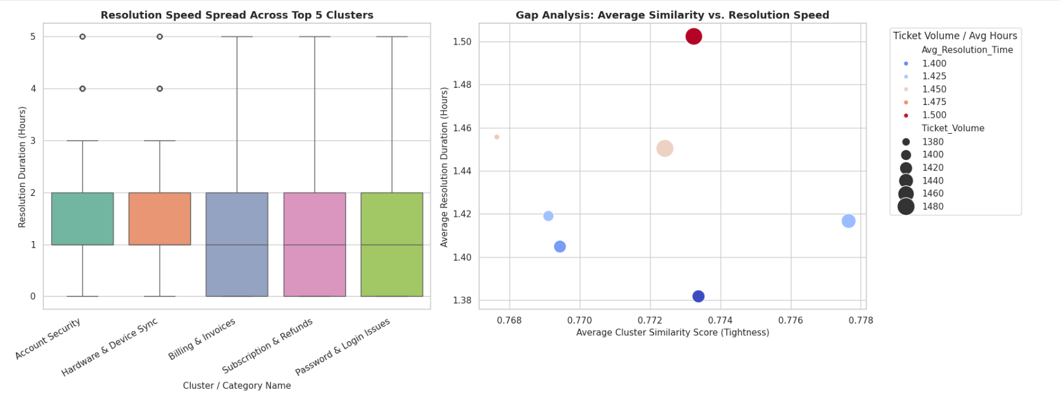
MODULE 4
Performance Gap Analysis
Key Focus: Resolution Duration Spreads & High-Wait Bottlenecks
08

Slide 9
MILESTONE 2 · CLOSING
Key Takeaways & Strategic Recommendations
01
02
03
Automated Deflection
Template Standardization
Queue Optimization
Incidents dominate ticket volume — deploy self-service and automated triage to absorb high-frequency, low-complexity issues before they reach an agent.
Top clusters share consistent issue compositions — standardized response templates for these categories can cut resolution time and improve consistency.
Tier 1 Support carries the heaviest load across all priority levels — rebalancing queue assignments can relieve bottlenecks and speed up high-priority resolution.
09

