Slide 1
SUPPORTLYTICS
Optimizing IT Support Team Performance
Using Analytics
MILESTONE 3 · Performance Trends & Geographic Insights (Modules 5 & 6)
Presenter Patta Hema Sundar
Mentor Shanmukha Priya

Slide 2
MILESTONE 3
Agenda & Scope
MODULE 5
MODULE 6
Performance Trend Analysis
Geographic & Category Insights
Avg. Resolution Time by Priority & Ticket Type
Ticket Concentration Heatmap by Region & Category
Fastest Support Teams / Queues by Resolution Speed
Cluster Size vs. Customer Satisfaction
High-Priority Unresolved Tickets Across Queues
Performance Metrics Summary by Country
02

Slide 3
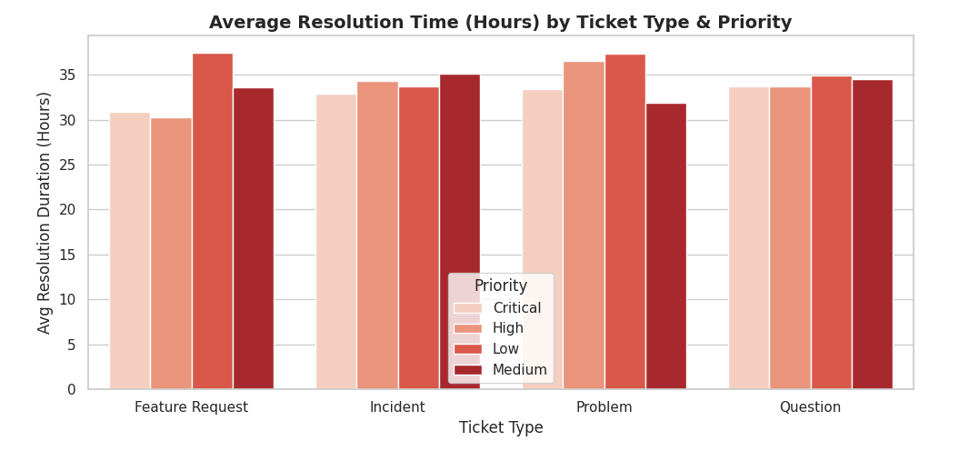
MODULE 5
Avg. Resolution Time by Type & Priority
Key Focus: Resolution Duration Spread Across Ticket Type & Severity
03

Slide 4
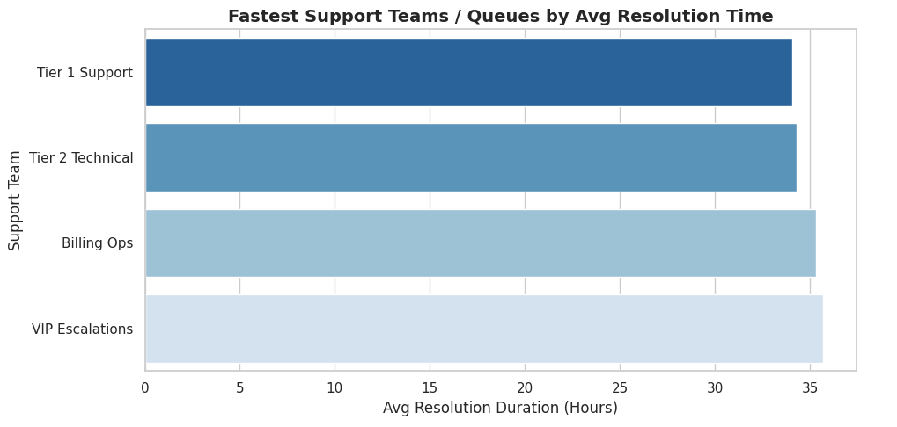
MODULE 5
Fastest Support Teams / Queues
Key Focus: Queue-Level Resolution Efficiency Ranking
04

Slide 5
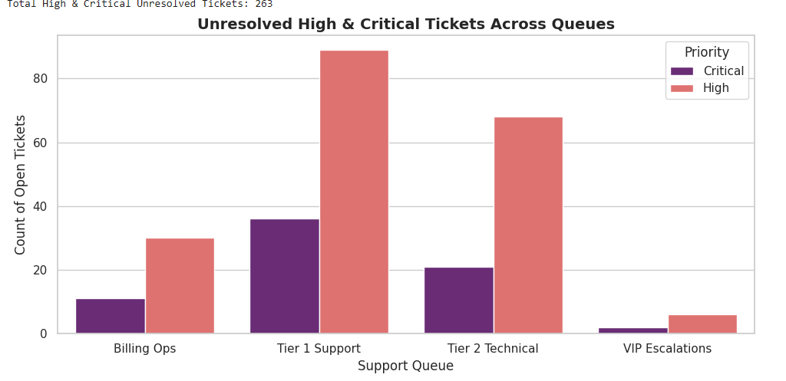
MODULE 5
Unresolved High & Critical Tickets
Key Focus: 263 Total High & Critical Tickets Still Open Across Queues
05

Slide 6
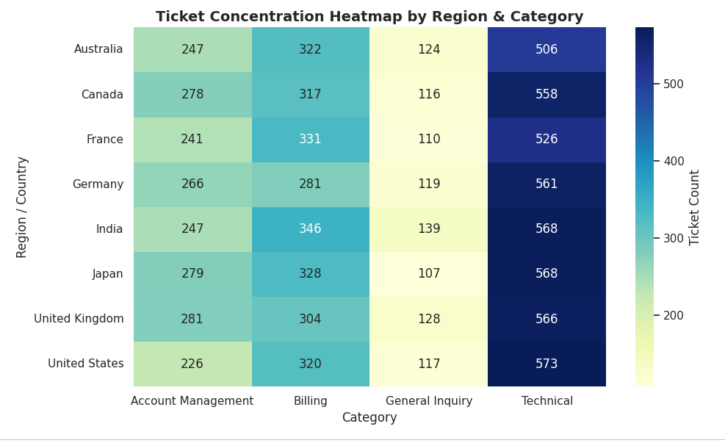
MODULE 6
Ticket Concentration Heatmap
Key Focus: Regional Category Load Distribution
06

Slide 7
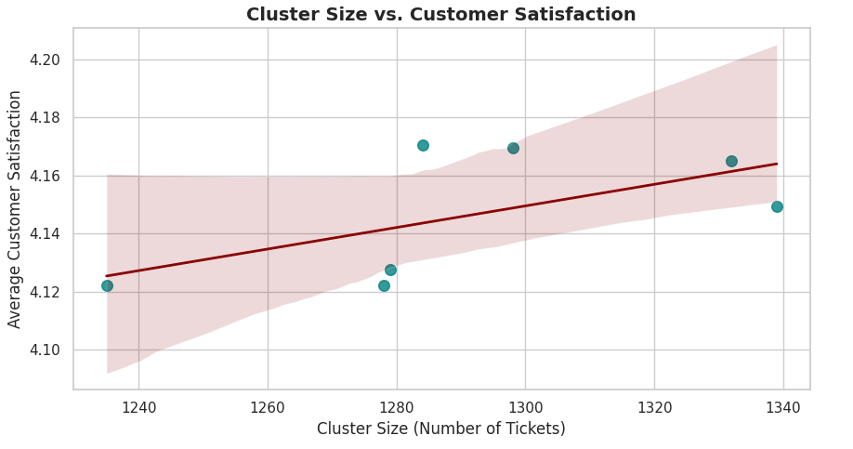
MODULE 6
Cluster Size vs. Customer Satisfaction
Key Focus: Larger Clusters Trend Toward Higher Satisfaction
07

Slide 8
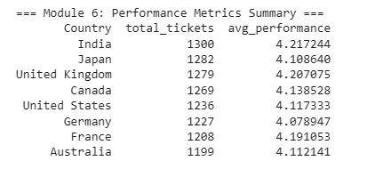
MODULE 6
Performance Metrics Summary by Country
Key Focus: India Leads in Volume; UK Leads in Avg. Performance Score
08

Slide 9
MILESTONE 3 · CLOSING
Key Takeaways & Strategic Recommendations
01
02
03
VIP Escalation Bottleneck
Critical Backlog Clearance
Region-Agnostic Tech Investment
Despite carrying the highest-severity tickets, VIP Escalations posts the slowest average resolution time (~35.7 hrs) of any queue — audit escalation handoffs and on-call staffing.
263 High/Critical tickets remain unresolved, concentrated in Tier 1 Support (89) and Tier 2 Technical (68) — prioritize a focused backlog-clearance sprint.
Technical issues dominate ticket volume in every region (500+ tickets each) — centralize technical support tooling and staffing rather than regionalizing it.
09

