Slide 1
SUPPORTLYTICS
Optimizing IT Support Team Performance
Using Analytics
MILESTONE 4 · Dashboard & Executive Reporting (Module 7)
Presenter Patta Hema Sundar
Mentor Shanmukha Priya

Slide 2
MILESTONE 4
Agenda & Scope
KPI OVERVIEW
PRIORITY VIEWS
Executive KPI Framework
Dashboard Views by Priority Tier
Average Resolution Time across all queues
Low & Medium Priority queue snapshots
Most Frequent Ticket Category by volume
High & Critical Priority queue snapshots
Cluster Similarity Index & alignment quality
Top Performing Regions by CSAT, tier by tier
02

Slide 3
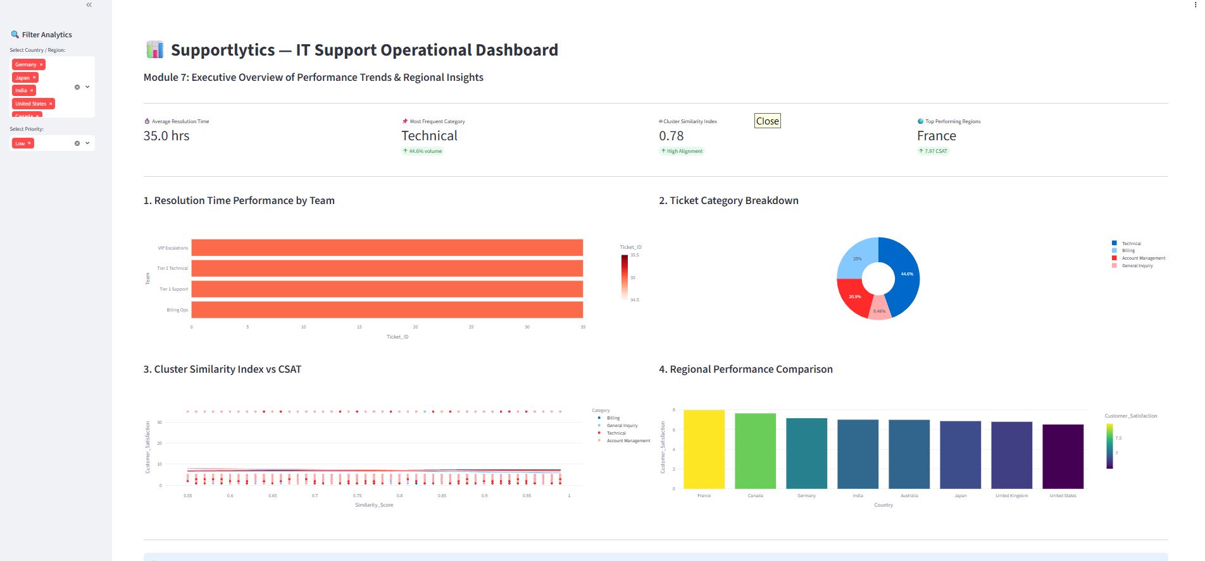
MODULE 7
Low Priority Queue — Baseline KPI View
Key Focus: Executive Dashboard Filtered to Low-Priority Tickets
03
Notes:
Welcome to the Supportlytics IT Support Operational Dashboard. Today, we are going to evaluate our organization’s performance, SLA adherence, and customer satisfaction through a macro-level lens by exploring our global ticket priorities using the sidebar filters.
Low Priority Operations: When we isolate Low priority tickets globally, we examine our baseline operational volume. As shown in the metrics, Technical issues form the largest share of our incoming requests. We can track our standard resolution speeds across teams and monitor baseline customer satisfaction, where regions like France frequently lead our regional performance benchmarks.

Slide 4
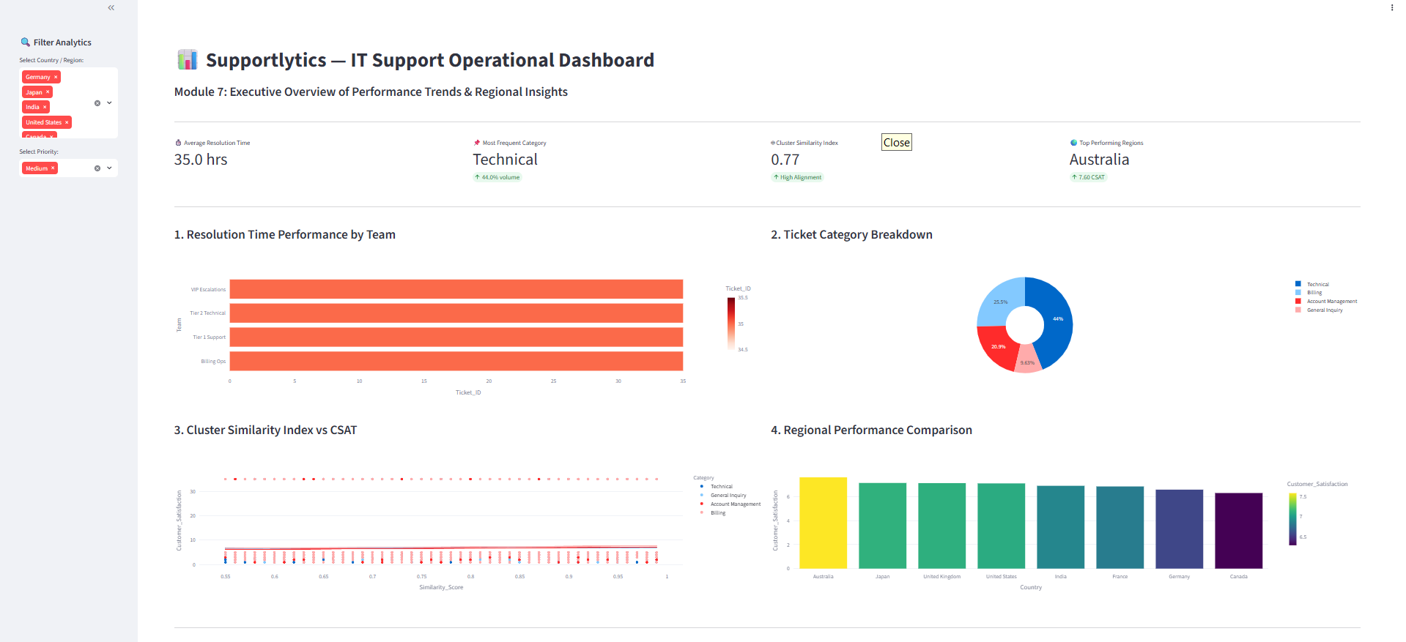
MODULE 7
Medium Priority Queue — Regional Shift
Key Focus: Australia Leads Regional Performance at 7.60 CSAT
04
Notes:
Medium Priority Shift: Switching our filter to Medium priority shows how our queues handle standard, day-to-day operational friction. The ticket category breakdown updates dynamically—reflecting minor shifts in Billing and Account Management volumes—while our Cluster Similarity Index measures how reliably our automated machine learning models match incoming routine issues to historical patterns.

Slide 5
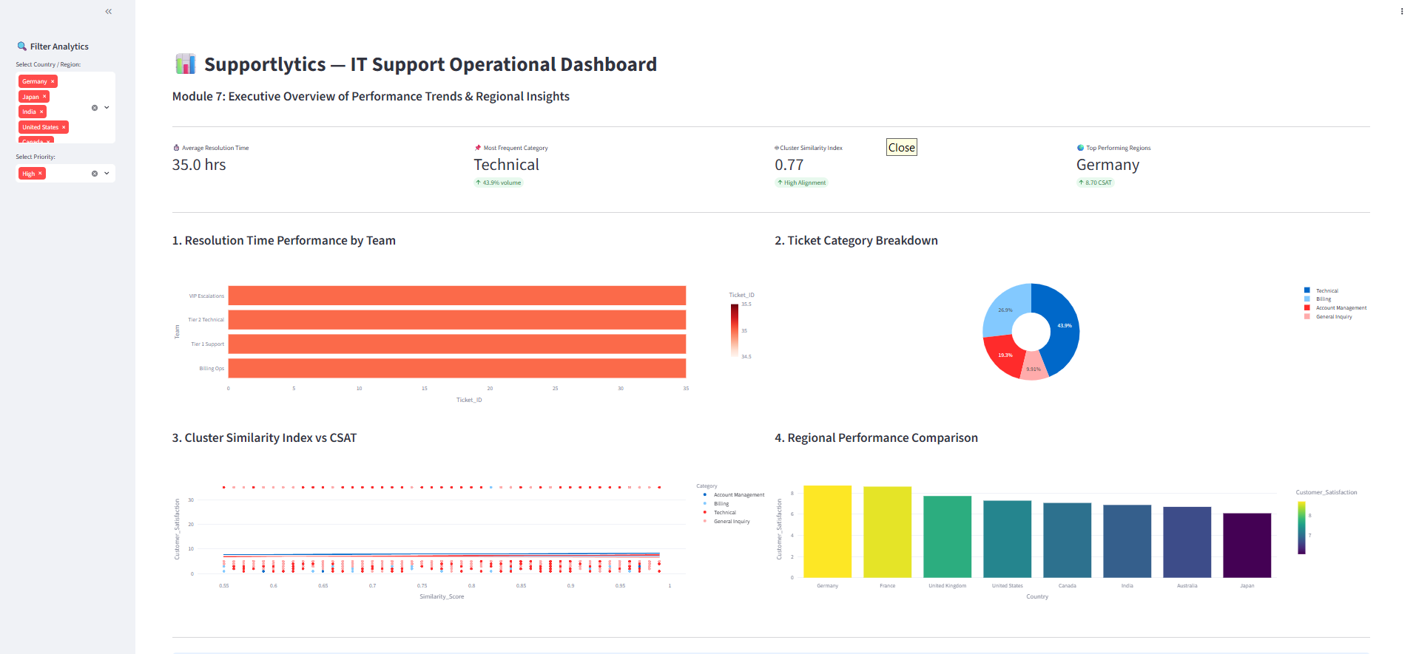
MODULE 7
High Priority Queue — Satisfaction Peak
Key Focus: Germany Achieves Highest Satisfaction at 8.70 CSAT
05
Notes:
High Priority Focus: When we escalate our view to High priority tickets, leadership gains a targeted look at our rising operational pressure points. Here, the KPIs adjust to highlight top performers under pressure—such as Germany leading with an impressive 8.70 CSAT score—allowing us to monitor team bottlenecks and ensure mid-to-high urgency workloads are tightly managed.

Slide 6
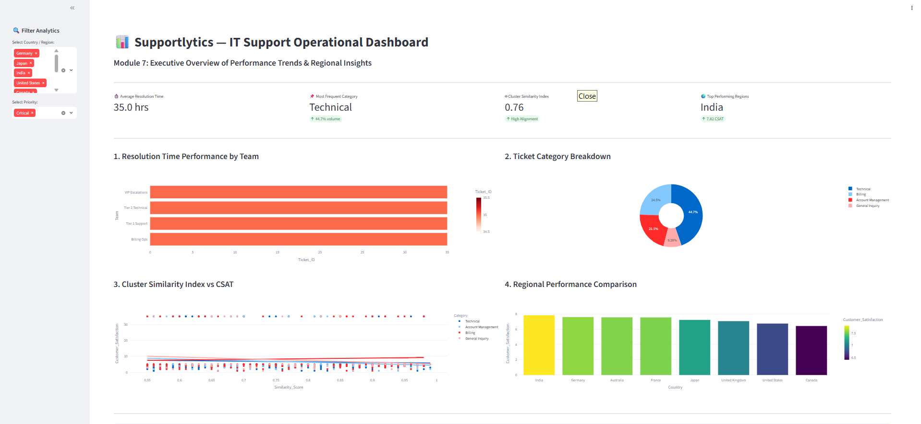
MODULE 7
Critical Priority Queue — Cohesion Dip
Key Focus: India Tops Critical Queues; Cluster Similarity Falls to 0.76
06
Notes:
Critical Priority View: Finally, when we select Critical priority, we lock in directly on our most severe operational emergencies and critical SLA thresholds. In this view, leadership can instantly review how effectively our support teams triage major escalations globally. We track a strong Cluster Similarity Index of 0.76 indicating high pattern alignment for major incidents, while India emerges as our top-performing region under extreme pressure with a 7.82 CSAT score.
Ultimately, this dynamic priority filtering gives executive stakeholders the power to transition seamlessly from routine workload analysis to emergency triage, ensuring total operational transparency across the enterprise.

Slide 7
MILESTONE 4 · CLOSING
Key Takeaways & Strategic Recommendations
01
02
03
Technical Dominates Every Tier
Critical Cluster Cohesion Dip
Regional Leadership Rotates
Technical tickets hold ~44% share across Low, Medium, High, and Critical queues alike — plan support capacity around Technical first, regardless of priority mix.
Cluster Similarity Index slides from 0.78 (Low) to 0.76 (Critical) — high-urgency tickets may be triaged into looser, less-cohesive clusters; review Critical-queue routing.
Top-performing region shifts by priority — France (Low), Australia (Medium), Germany (High), India (Critical) — resource regional support around priority mix, not a single ranking.
07

