Slide 1



DATA ANALYTICS PROJECT
IT Support Tickets:
Exploratory Data Analysis
Exploring Schema, Data Types, and Missing Values in a 100K Synthetic IT Support Ticket Dataset
Varsha B O
B.E. Computer Science & Engineering (Data Science)
Bapuji Institute of Engineering and Technology, Davangere

Slide 2
Introduction
IT support teams handle a large number of customer support tickets every day. Analyzing these tickets helps organizations understand common issues, measure support performance, and improve service quality. This project uses data analytics techniques to clean, analyze, and visualize IT support ticket data, enabling faster issue resolution, better resource allocation, and data-driven decision-making.

Slide 3
Problem Statement
IT support organizations generate large volumes of support tickets containing information about customer issues, priorities, and resolutions. However, the raw data often contains missing values, inconsistent formats, and unstructured text, making analysis difficult. This project focuses on cleaning and preparing the dataset, creating meaningful features, and establishing a reliable foundation for analyzing IT support performance and improving operational efficiency.
PROPOSED SYSTEM
The proposed system analyzes IT support ticket data using data analytics techniques. It cleans and preprocesses the dataset, creates useful features such as Resolution Duration and Priority Score, and performs analysis to identify ticket trends, measure support team performance, and improve service efficiency through interactive dashboards and data-driven insights.

Slide 4
Objectives
Analyze IT support ticket data to identify trends and patterns.
Improve ticket resolution time and support team efficiency.
Evaluate support performance using key performance indicators (KPIs).
Build interactive dashboards for performance monitoring.
Provide data-driven recommendations to enhance IT support services.

Slide 5
Tools & Technologies
Python
Pandas
NumPy
Matplotlib
Seaborn
Jupyter Notebook
Power BI

Slide 6
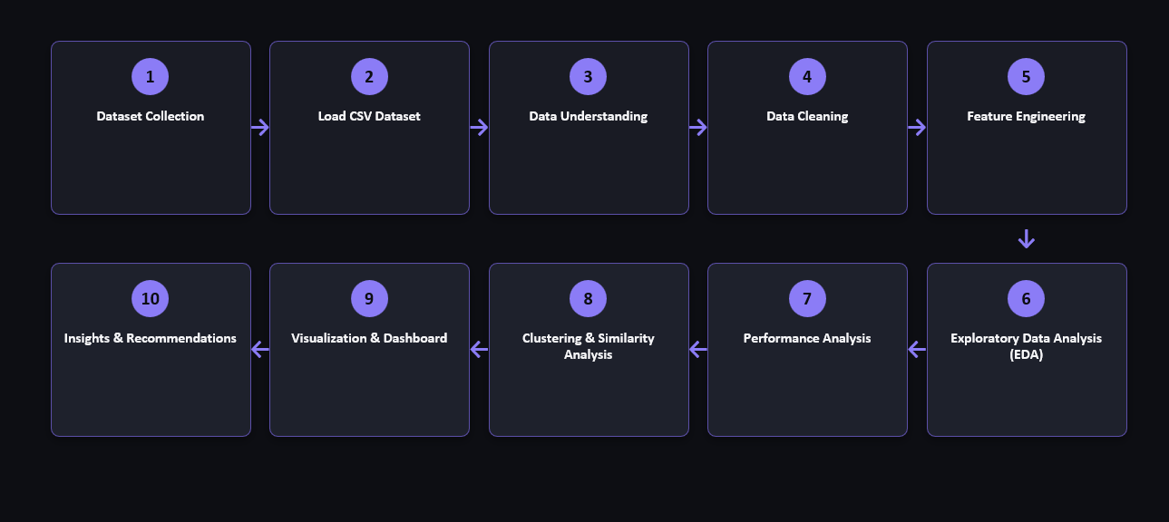
Workflow

Slide 7
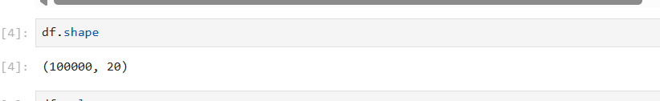
Dataset Overview
Dataset Name: Synthetic IT Support Tickets Dataset
Source: Kaggle – Synthetic IT Support Tickets Dataset
Dataset Size:
Total Records: 100,000
Total Columns: 20
File Format: CSV (.csv)
Purpose of the Dataset: The dataset contains synthetic IT support ticket records generated to simulate real-world help desk operations. It includes information related to customer issues, ticket priorities, support channels, resolution details, customer satisfaction, and regional distribution. This dataset is used to analyze IT support performance and identify opportunities for improving service quality.

Slide 8
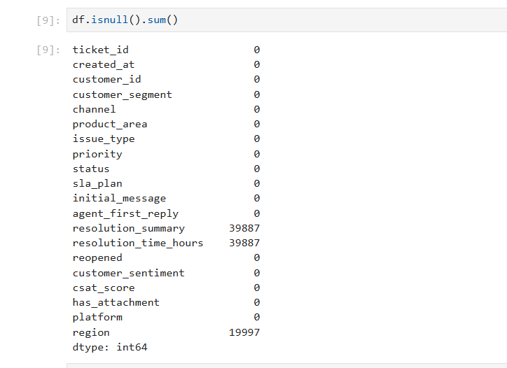
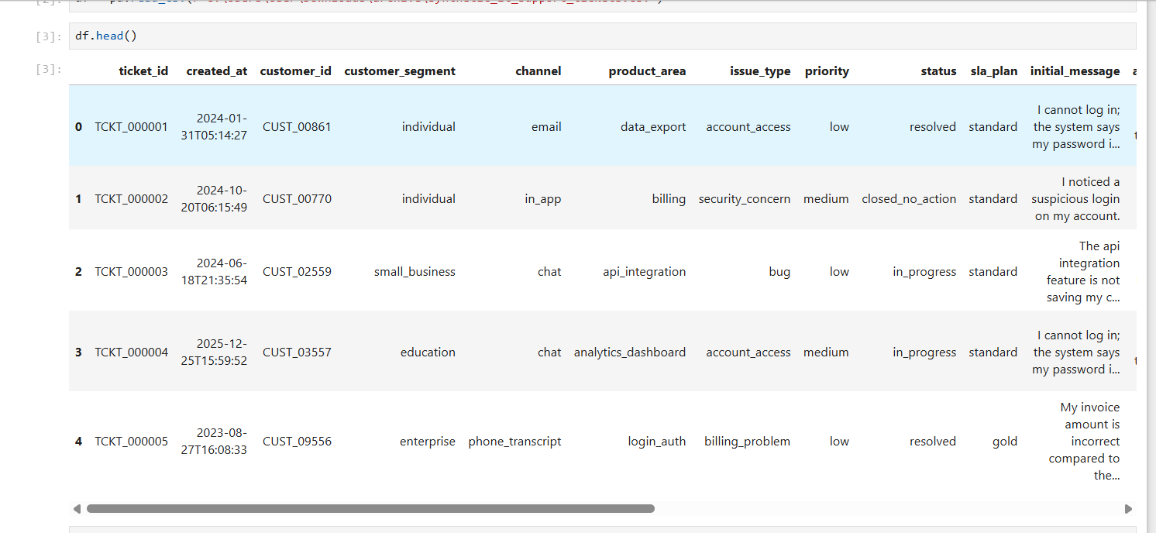
Project Initialization
Loaded CSV using Pandas.
Explored dataset schema.
Checked data types.
Identified missing values.
Calculated ticket distributions by issue type, priority, and product area.

Slide 9
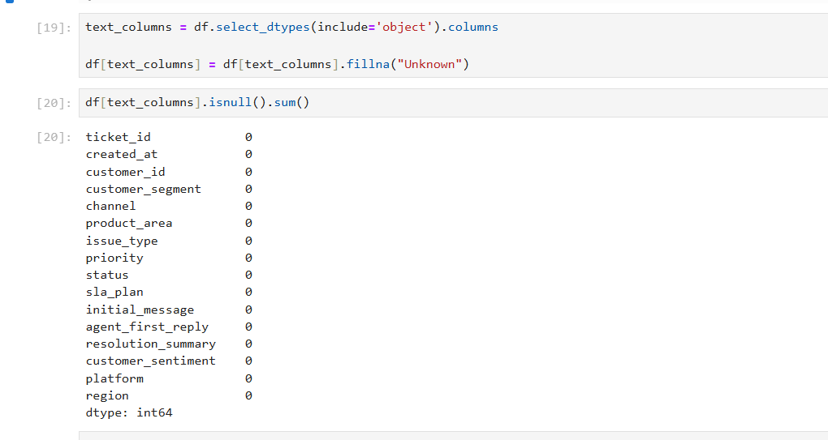
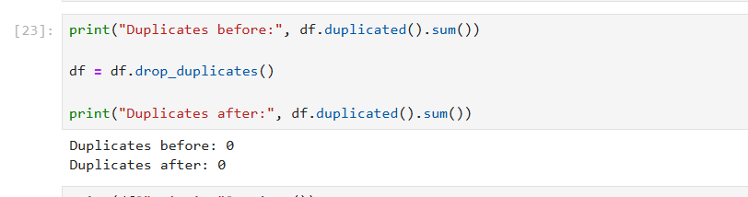
Data Cleaning & Feature Engineering
Removed duplicates.
Handled missing values.
Standardized text.
Created:
Resolution_Duration
Priority_Score
Saved processed dataset.

Slide 10
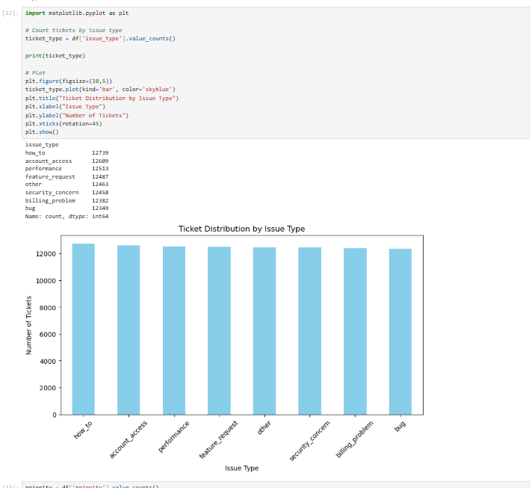
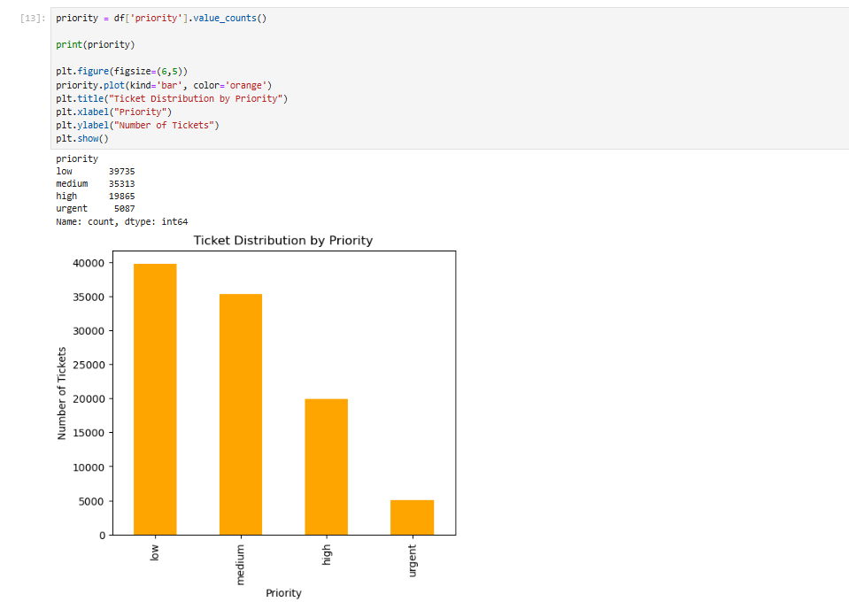

Slide 11
