Slide 1



DATA ANALYTICS PROJECT
IT Support Tickets:
Exploratory Data Analysis
Exploring Schema, Data Types, and Missing Values in a 100K Synthetic IT Support Ticket Dataset
Varsha B O
B.E. Computer Science & Engineering (Data Science)
Bapuji Institute of Engineering and Technology, Davangere

Slide 2
Work Completed
Week 3
Exploratory Data Visualization
Ticket Distribution Analysis
Category Analysis
Queue Analysis
Priority Analysis
Week 4
Cluster Analysis
Similarity Score Analysis
Performance Gap Analysis
Resolution Time Analysis
Customer Satisfaction Analysis

Slide 3
Module 3 – Exploratory Visualization
Activities Performed
Analyzed ticket distribution by issue type.
Identified top product categories.
Created Queue column using business rules.
Generated Cluster and Cluster Description columns.
Visualized ticket priority and queue distribution.

Slide 4
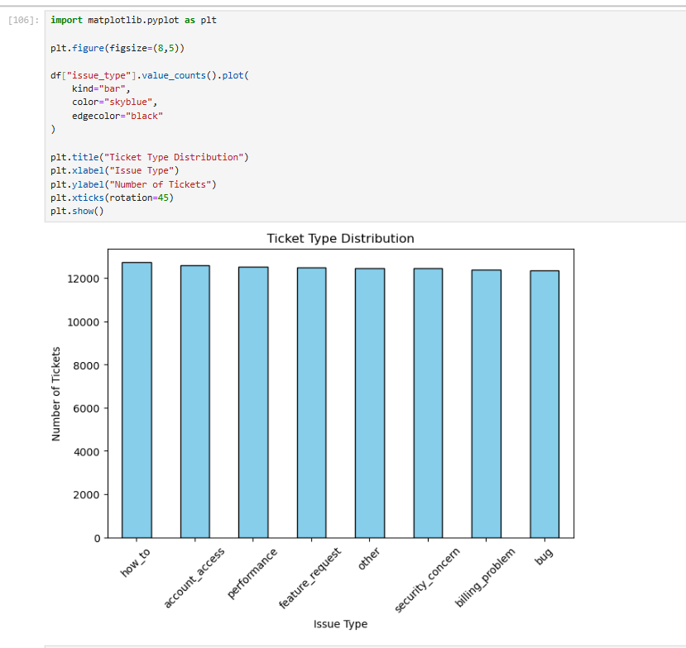
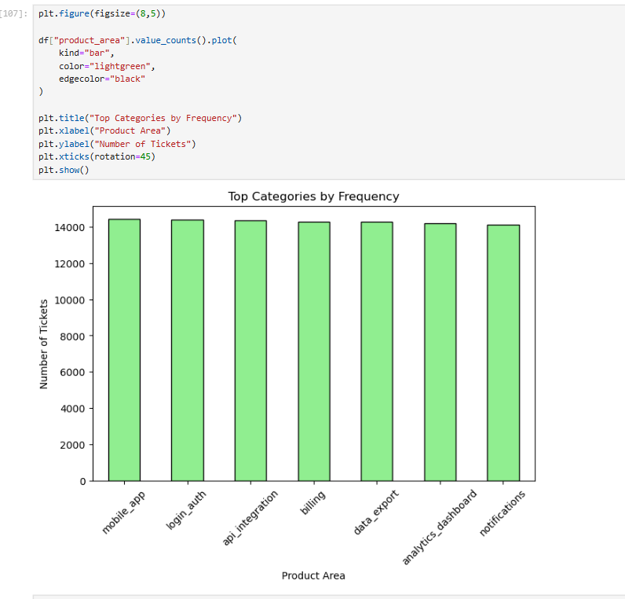

Slide 5
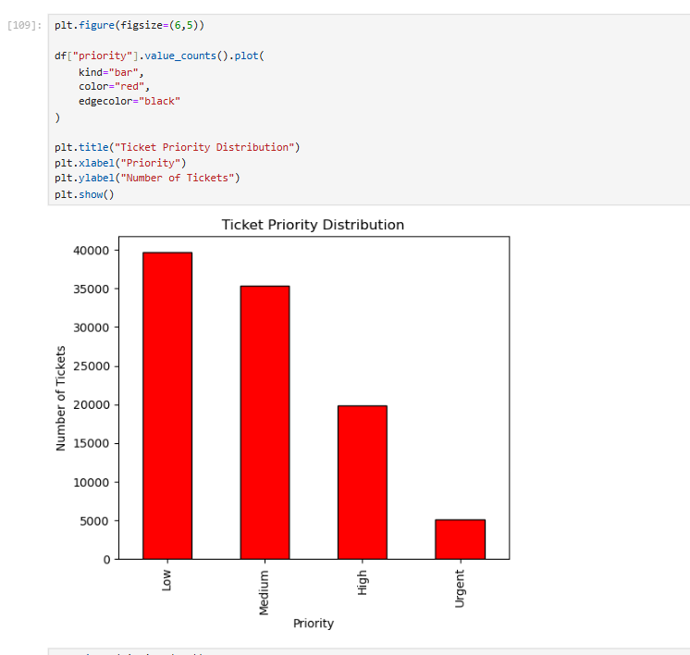
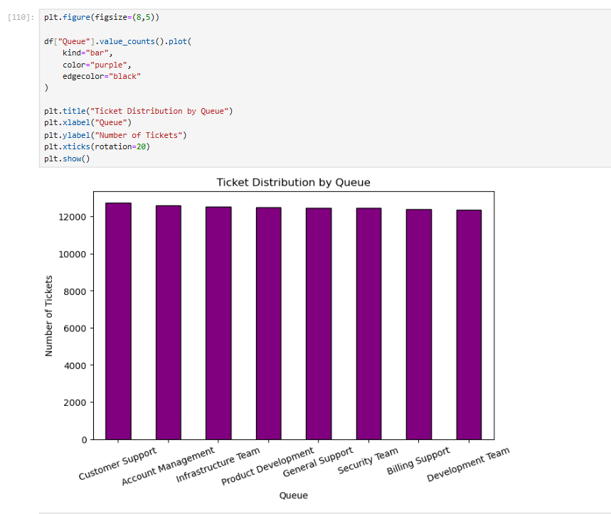

Slide 6
Module 4 – Similarity & Cluster Insights
Activities Performed
Created Similarity Score.
Compared clusters by frequency.
Analysed issue types across clusters.
Compared queue distribution.
Evaluated performance gaps.
Studied customer satisfaction by cluster.

Slide 7
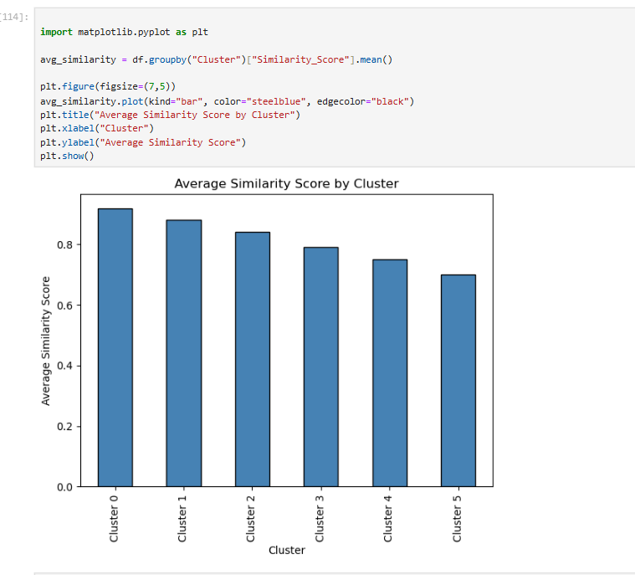
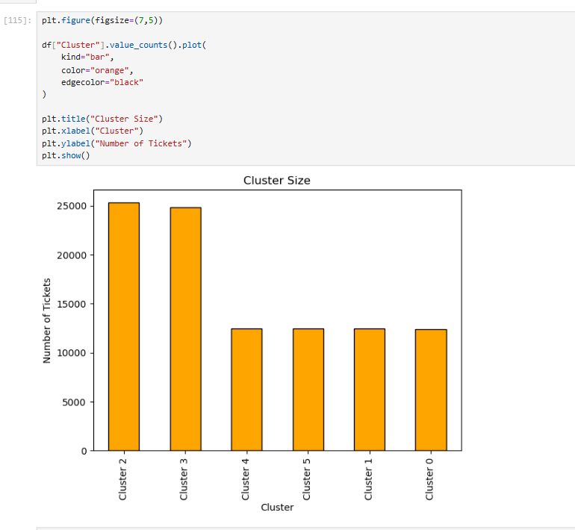
Similarity Analysis

Slide 8
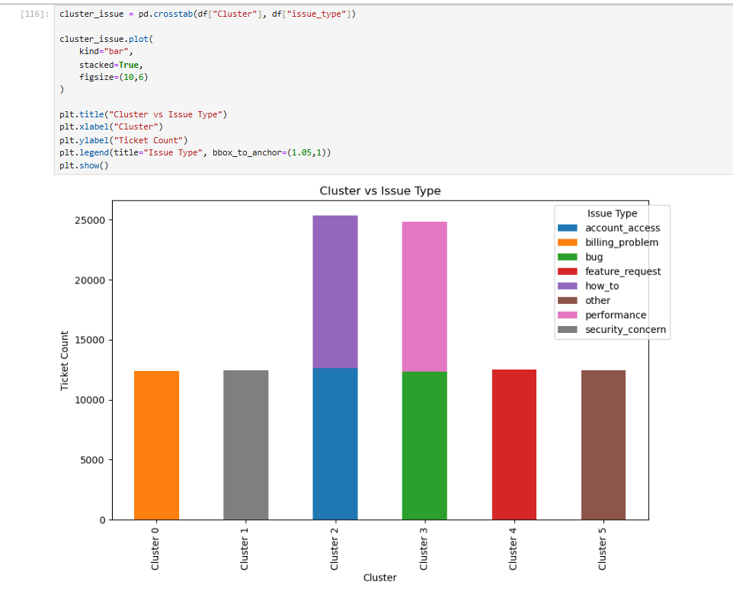
Cluster Analysis

Slide 9
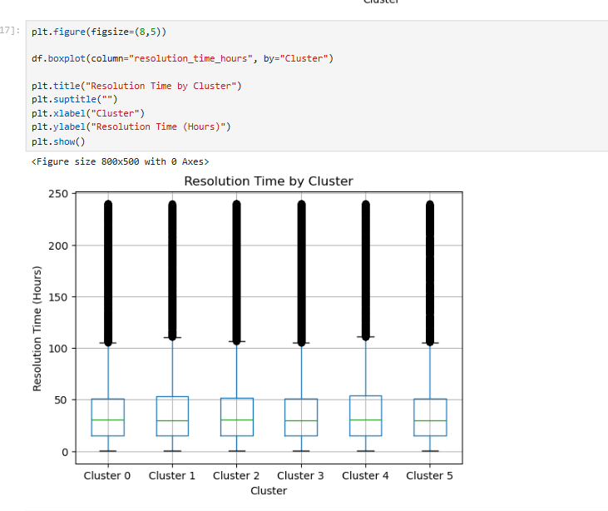
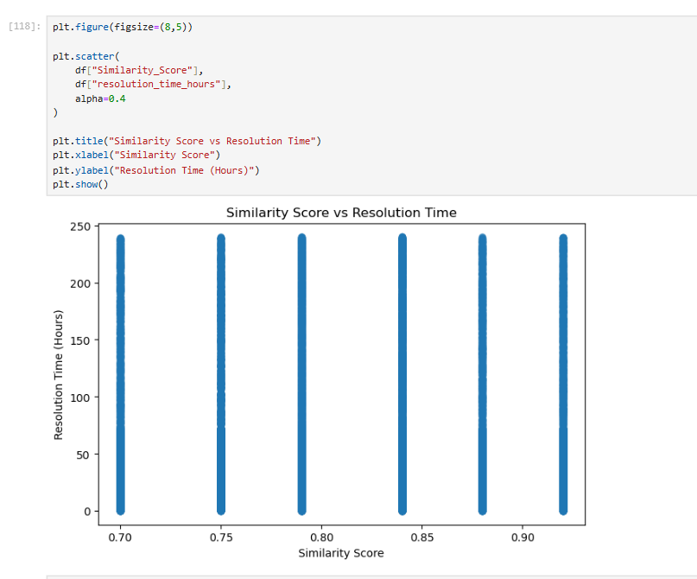
Performance Gap Analysis

Slide 10
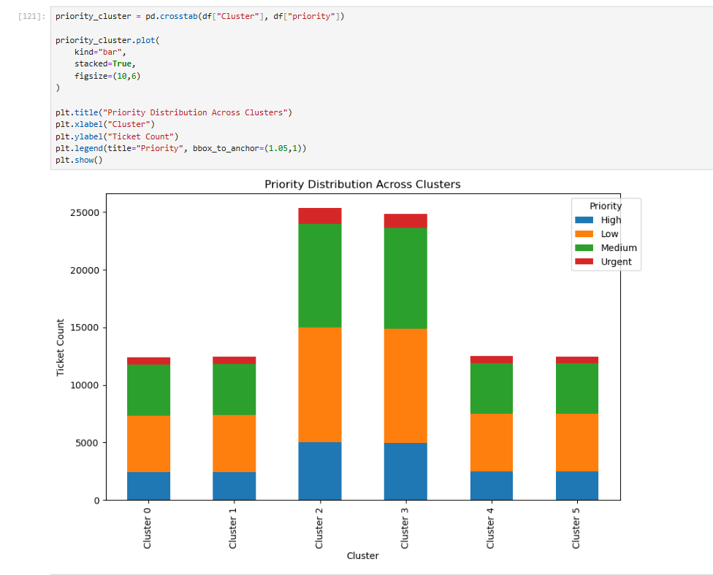
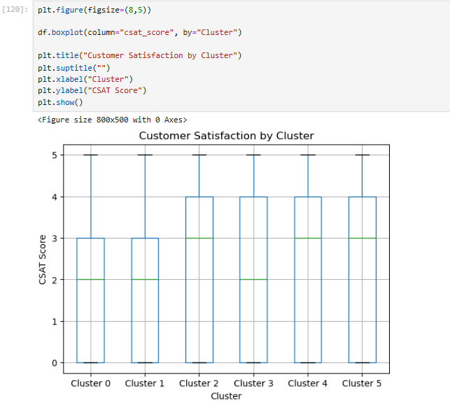
Customer Satisfaction

