Slide 1



C:\Users\User\Downloads\Title_Slide.pptxIT Support Tickets:
Exploratory Data Analysis
DATA ANALYTICS PROJECT
IT Support IT Support Tickets:
Exploratory IT Support Tickets:
Exploratory IT Support Tickets:
Exploratory Data Analysis
Tickets:
Exploratory Data Analysis
IT Support Tickets:
Exploratory Data Analysis
Exploring Schema, Data Types, and Missing Values in a 100K Synthetic IT Support Ticket Dataset
Varsha B O
B.E. Computer Science & Engineering (Data Science)
Bapuji Institute of Engineering and Technology, Davangere

Slide 2
Module 5 – Performance Trend Analysis
Objective
Analyse the performance of the IT support team by evaluating:
Average resolution time
Ticket priority
Issue types
Regional performance
Queue performance
High-priority unresolved tickets

Slide 3
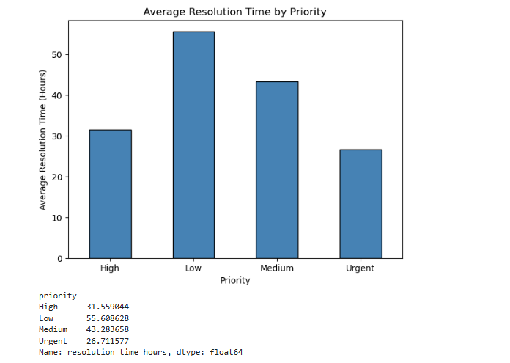
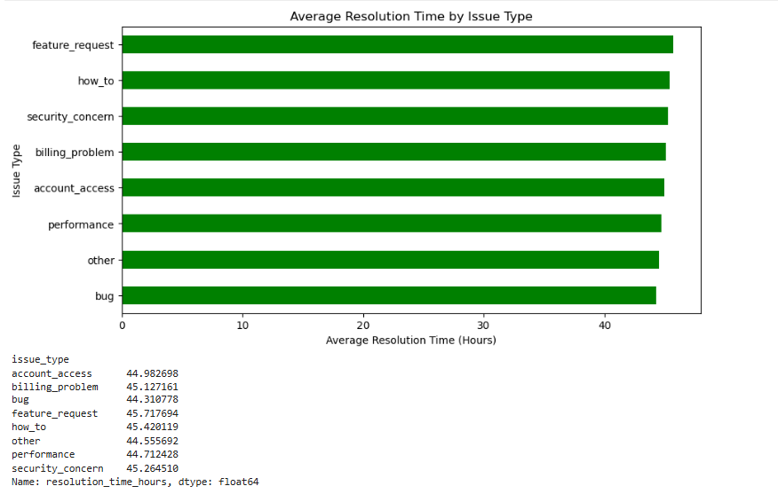
Performance Analysis
Key Findings
High-priority tickets require more attention.
Performance-related issues take longer to resolve.
Some issue types have consistently higher resolution times.

Slide 4
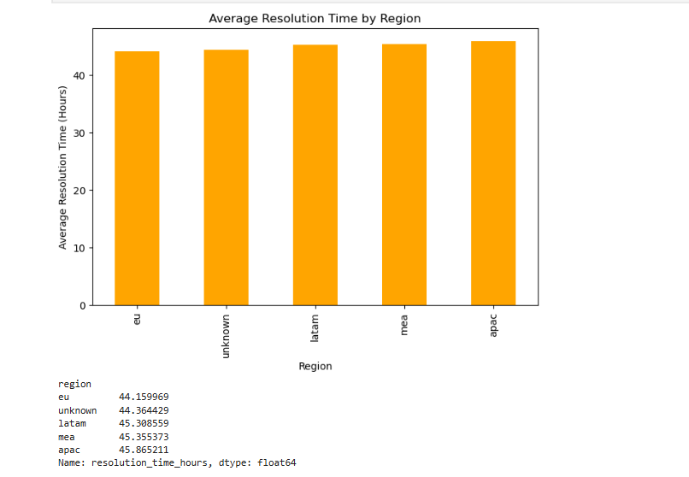
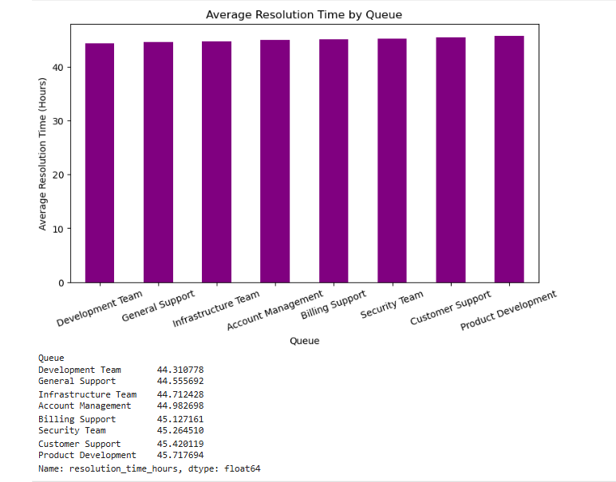
Regional & Queue Performance

Slide 5
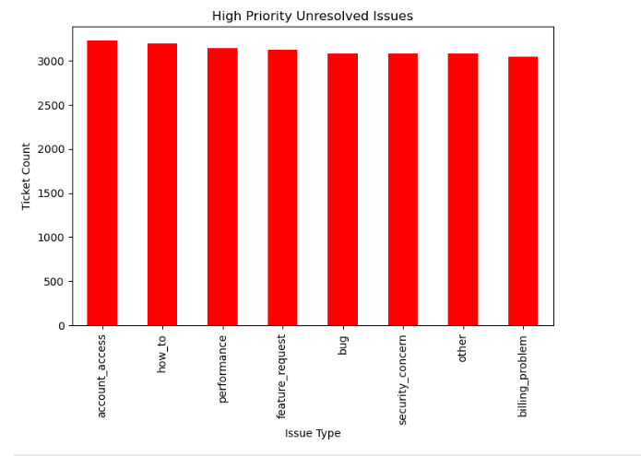
High-Priority Ticket Analysis
Key Findings
Critical tickets requiring immediate attention.
Ticket backlog analysis.
Areas where SLA improvement is needed.

Slide 6
Module 6 – Geographic & Category-Level Insights
Objective
Analyze ticket distribution geographically.
Compare issue categories across regions.
Evaluate cluster performance.
Generate geographic visualizations.

Slide 7
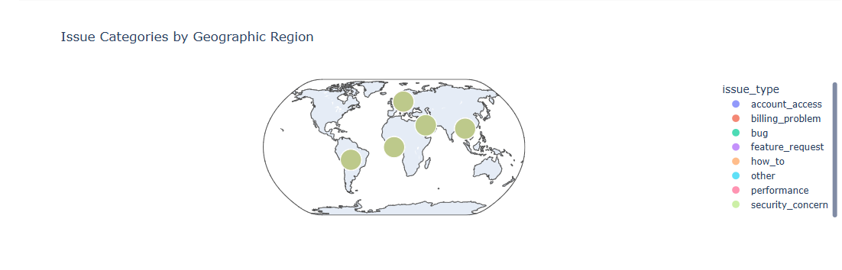
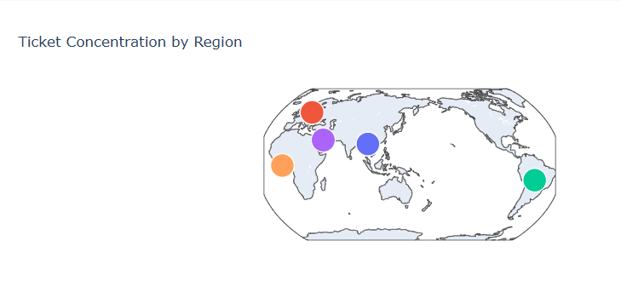
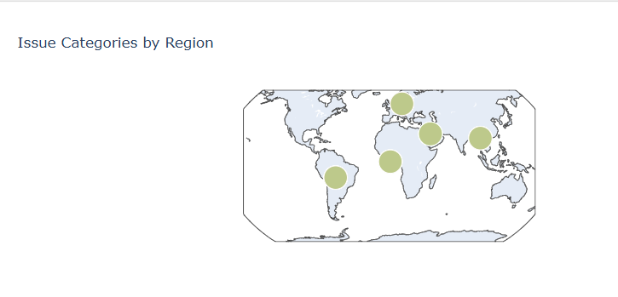
Geographic Visualizations

Slide 8
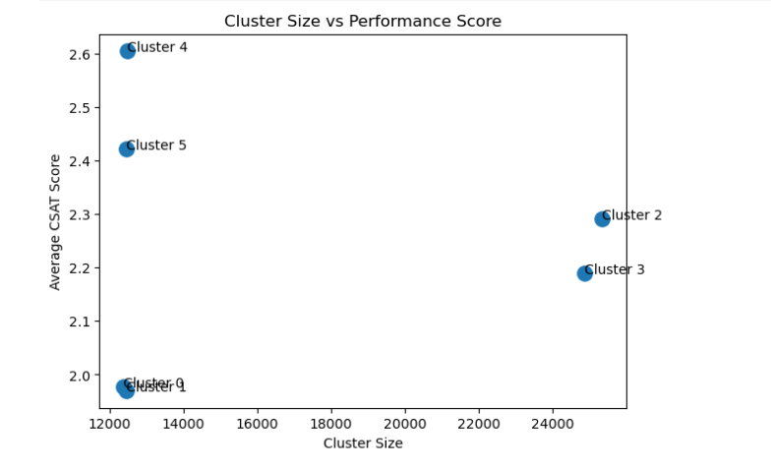
Comparative Charts

