Slide 1



DATA ANALYTICS PROJECT
IT Support Tickets:
Exploratory Data Analysis
Exploring Schema, Data Types, and Missing Values in a 100K Synthetic IT Support Ticket Dataset
Varsha B O
B.E. Computer Science & Engineering (Data Science)
Bapuji Institute of Engineering and Technology, Davangere

Slide 2
Project Overview
What is Supportlytics?
Supportlytics is an analytics-driven IT support performance system that analyzes support tickets to identify patterns in ticket volume, priority, resolution time, customer satisfaction, geographical distribution, and issue clusters.
Technologies
Python
Pandas / NumPy
Machine Learning / Clustering
Power BI
Data Visualization

Slide 3
Problem Statement
IT support teams handle large numbers of tickets with different priorities, issue types, customer segments, regions, and resolution times. Without centralized analytics, it is difficult to:
Identify high-volume issues
Detect high-priority unresolved tickets
Measure support performance
Compare regional performance
Identify similar issue groups
Monitor customer satisfaction
Goal
Build an interactive analytics dashboard that converts raw support-ticket data into actionable business insights.

Slide 4
Project Objectives
Analyze IT support ticket patterns.
Identify the most common issue types.
Measure ticket resolution performance.
Analyze priority and unresolved tickets.
Identify similar ticket clusters.
Compare regional performance.
Analyze customer satisfaction.
Build an interactive Power BI dashboard.
Generate actionable recommendations.

Slide 5
Project Scope
📊 Data Preprocessing – Clean and prepare IT support ticket data
🔍 Exploratory Analysis – Analyze ticket trends, priorities and categories
🎯 Cluster Analysis – Identify similar issues and problem clusters
🌍 Geographic Analysis – Analyze regional ticket distribution and performance
⏱️ Performance Analysis – Evaluate resolution time, priority and CSAT
📈 Interactive Visualization – Develop interconnected Power BI dashboards
📋 Executive Reporting – Present key insights and recommendations
Analytical Coverage
Data preprocessing
Exploratory analysis
Cluster analysis
Geographic analysis
Performance analysis
Interactive visualization
Executive reporting

Slide 6
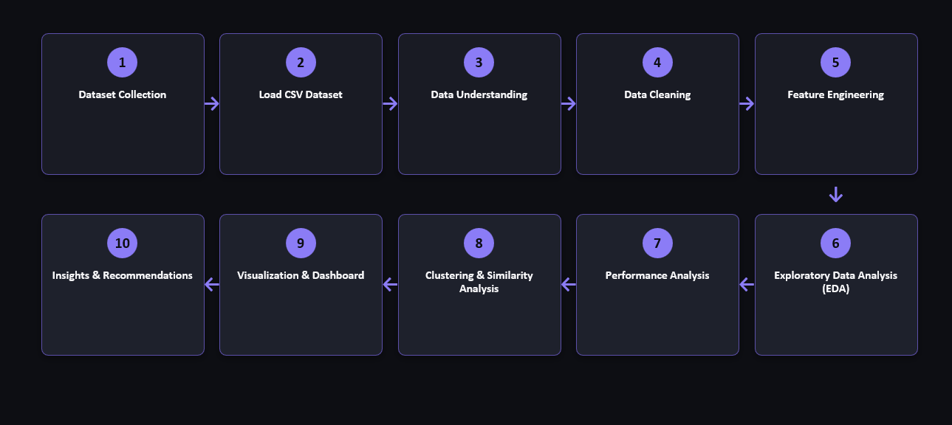
Project Workflow

Slide 7
Dataset Overview
Dataset Name: Synthetic IT Support Tickets Dataset
Source: Kaggle – Synthetic IT Support Tickets Dataset
Important fields:
Category | Examples
Ticket Information | ticket_id, created_at
Customer | customer_id, customer_segment
Issue | issue_type, product_area
Priority | priority, Priority_Score
Status | status, reopened
Performance | resolution_time_hours, Resolution_Duration
Satisfaction | csat_score, customer_sentiment
Geography | region, Latitude, Longitude
ML Features | Cluster, Similarity_Score

Slide 8
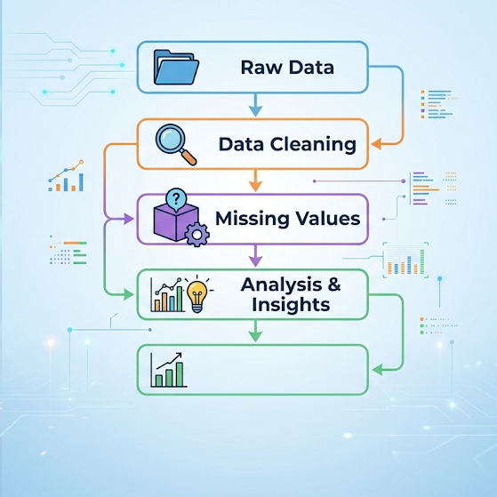
Data Preparation
Important engineered fields:
Resolution_Duration
Priority_Score
Cluster
Similarity_Score

Slide 9
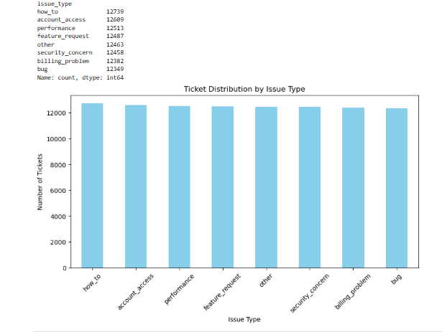
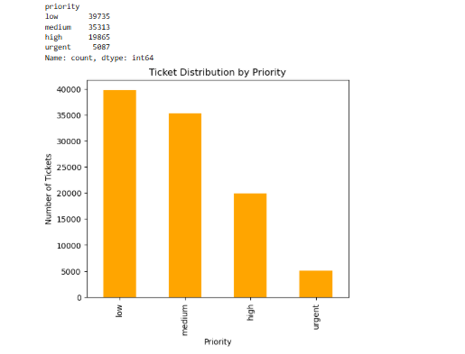
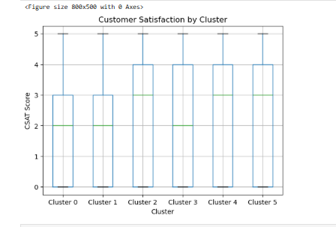
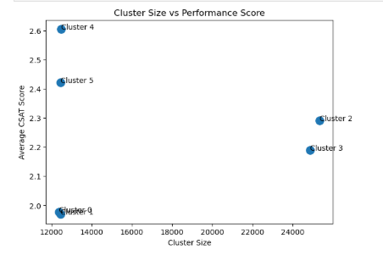
Exploratory Data Analysis

Slide 10
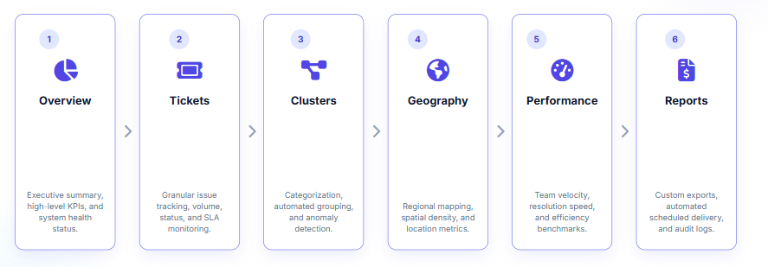
Dashboard Architecture

Slide 11
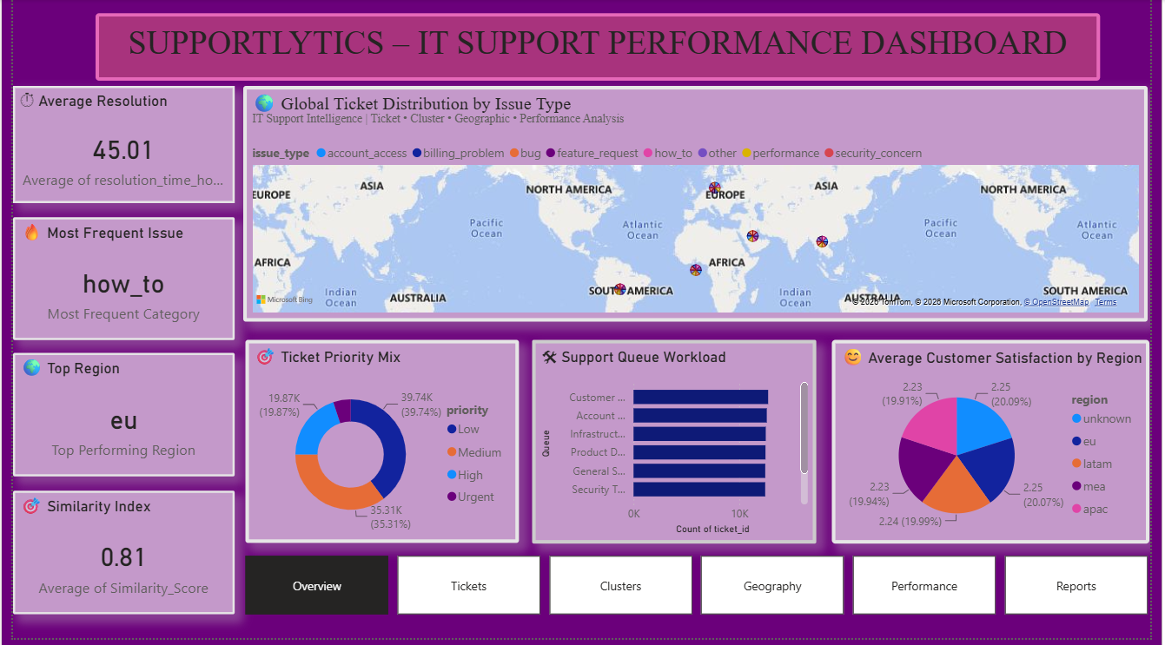
Overview Dashboard

Slide 12
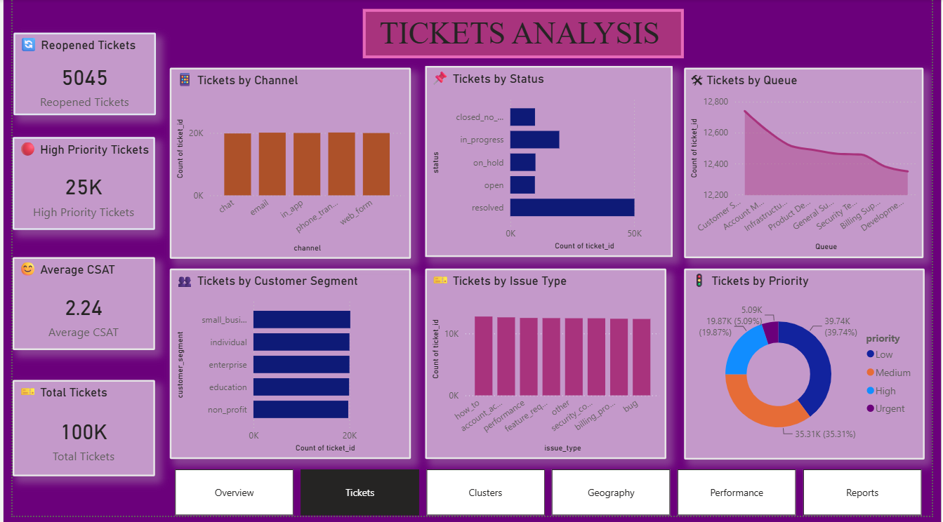
Tickets Analysis

Slide 13
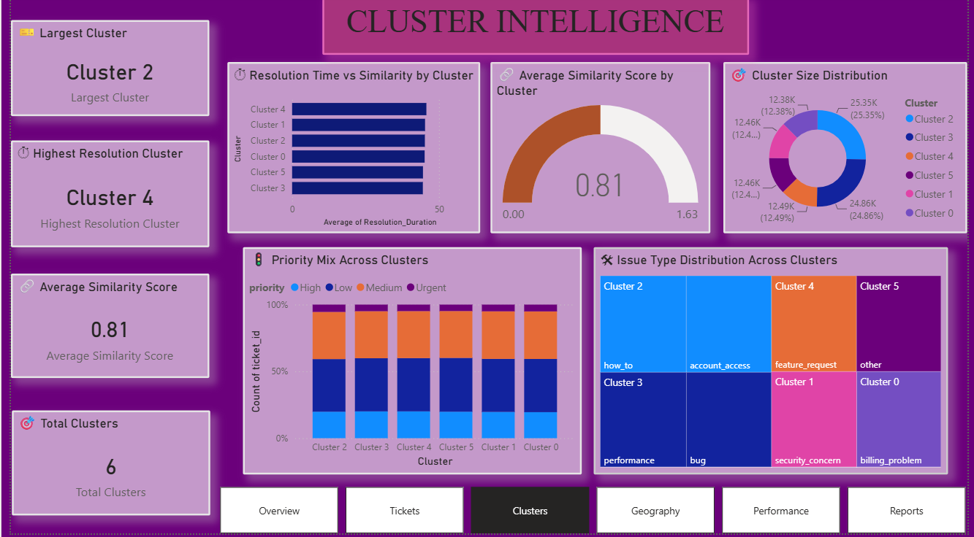
Cluster Intelligence

Slide 14
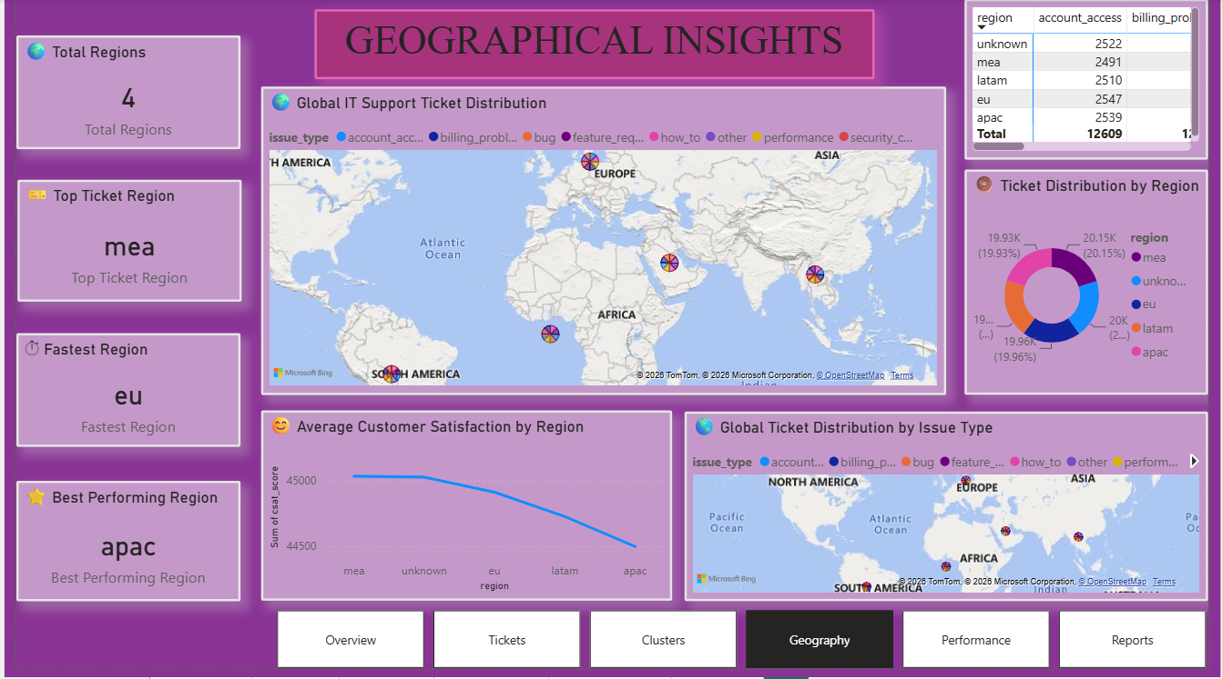
Geographical Insights

Slide 15
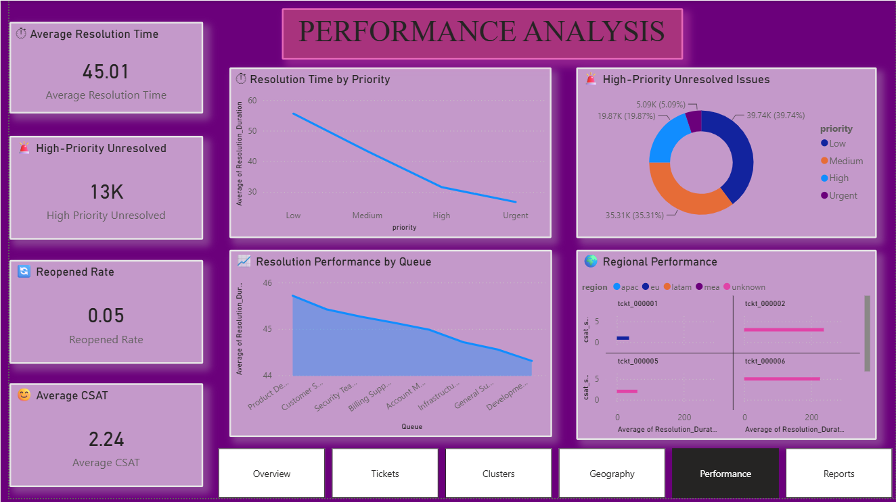
Performance Analysis

Slide 16
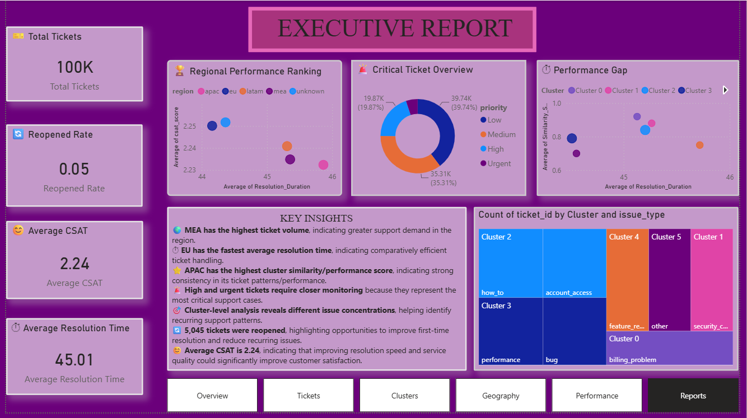
Executive Report

Slide 17
Recommendations
Finding | Recommendation
MEA has highest ticket volume | Allocate additional support resources
High/urgent unresolved tickets | Create priority escalation and monitoring
EU has faster resolution | Study and replicate effective practices
APAC has strong cluster performance | Identify successful support practices
Different cluster issue concentrations | Create specialized support workflows
CSAT is relatively low | Analyze customer feedback and improve resolution quality
Queue performance varies | Optimize workload distribution

Slide 18
Business Impact
1. Operational Efficiency
Better workload allocation
Faster resolution
2. Customer Experience
Improved CSAT
Better handling of priority issues
3. Management
Data-driven decision making
Regional performance monitoring
4. Support Team
Better queue management
Identification of recurring issues

Slide 19
Conclusion
Supportlytics successfully transforms raw IT support ticket data into an interactive analytical solution. The dashboard provides insights into ticket workload, priorities, issue clusters, geographical performance, resolution efficiency, and customer satisfaction. These insights can support better resource allocation, priority management, and continuous improvement of IT support operations.
Future Scope
Real-time ticket monitoring
Automated alerts for high-priority tickets
Predictive ticket resolution time
Ticket escalation prediction
Sentiment-based support prioritization
Automated monthly performance reports
Integration with live IT service-management systems

Slide 20


