Slide 1
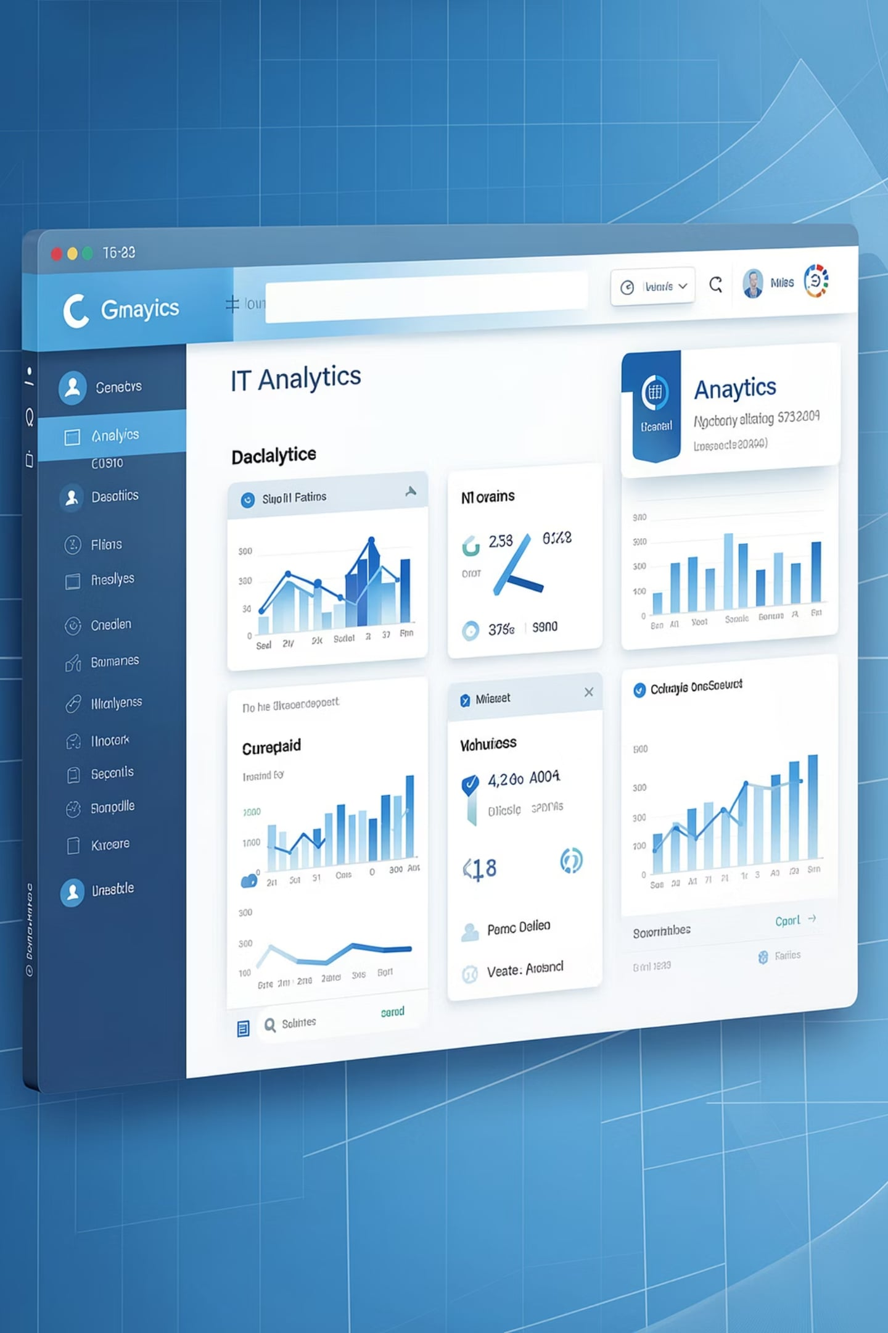
Supportlytics –
Milestone 2: Exploratory Visualization & Similarity Analysis
Presented By : Ayush Gupta

Slide 2
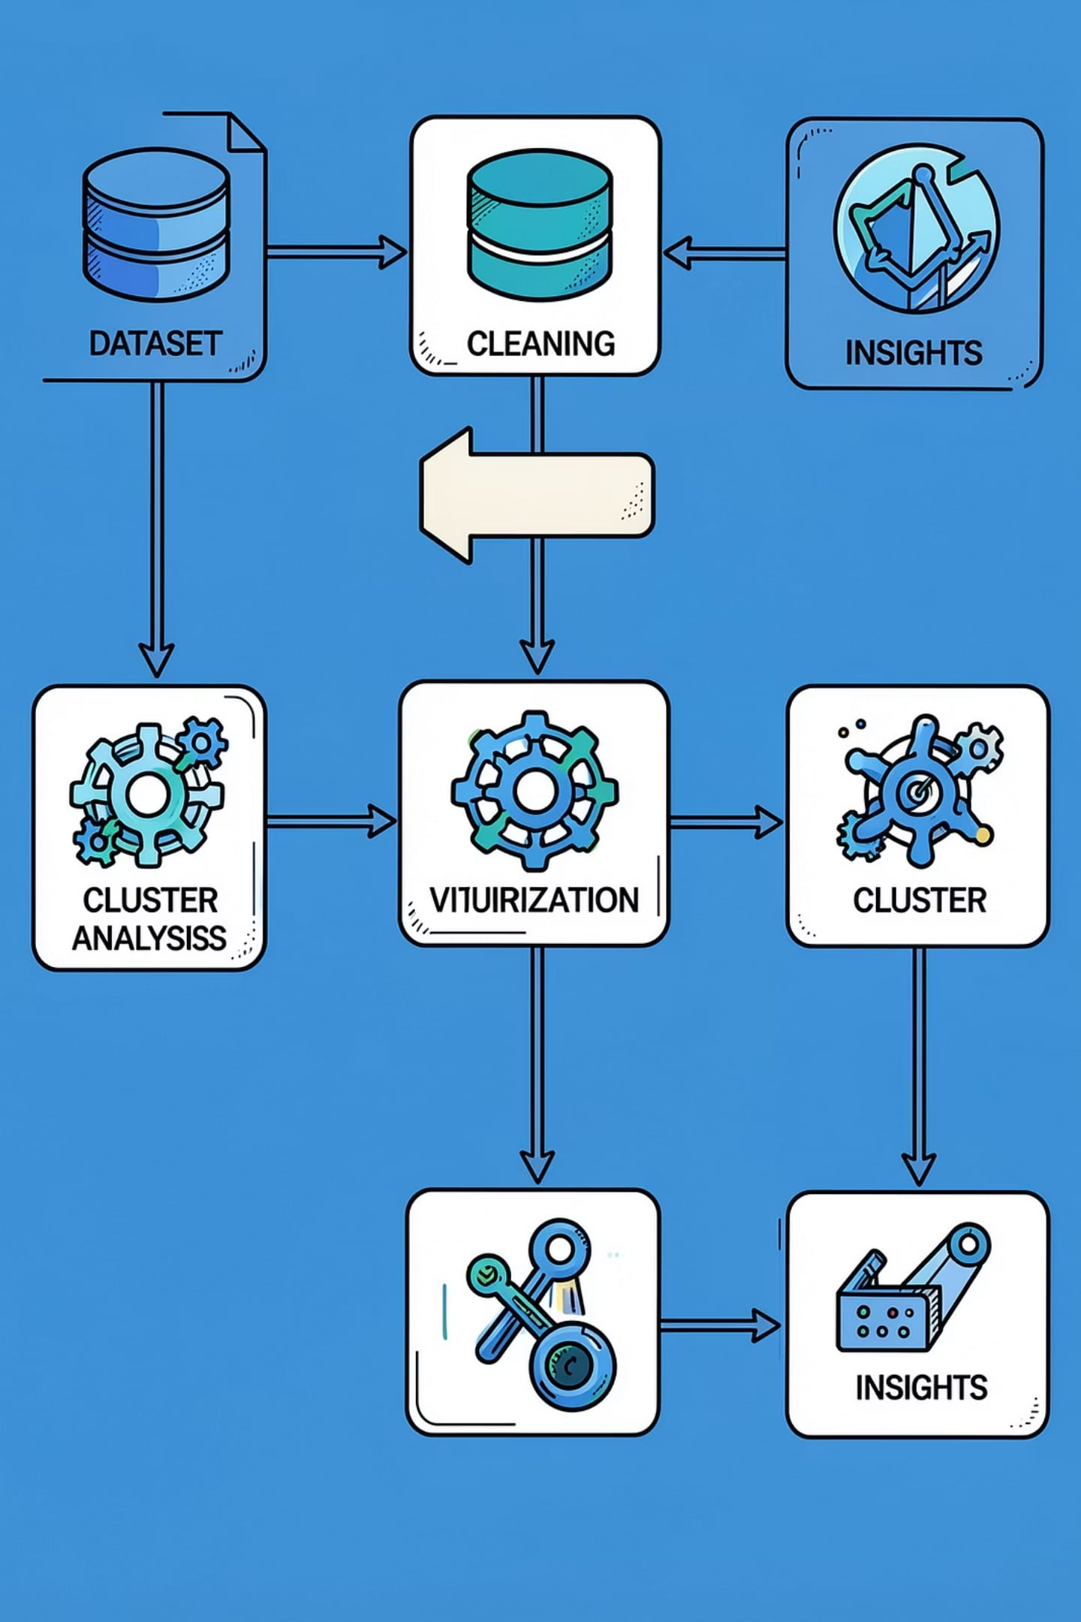
Milestone Objectives
Perform comprehensive Exploratory Data Analysis (EDA) on 10k ticket records
Visualize temporal and categorical ticket patterns to surface trends
Analyze ticket categories and priority distributions
Compute similarity scores and identify issue clusters
Assess cluster performance and identify operational gaps
Deliver actionable insights for support process improvements

Slide 3
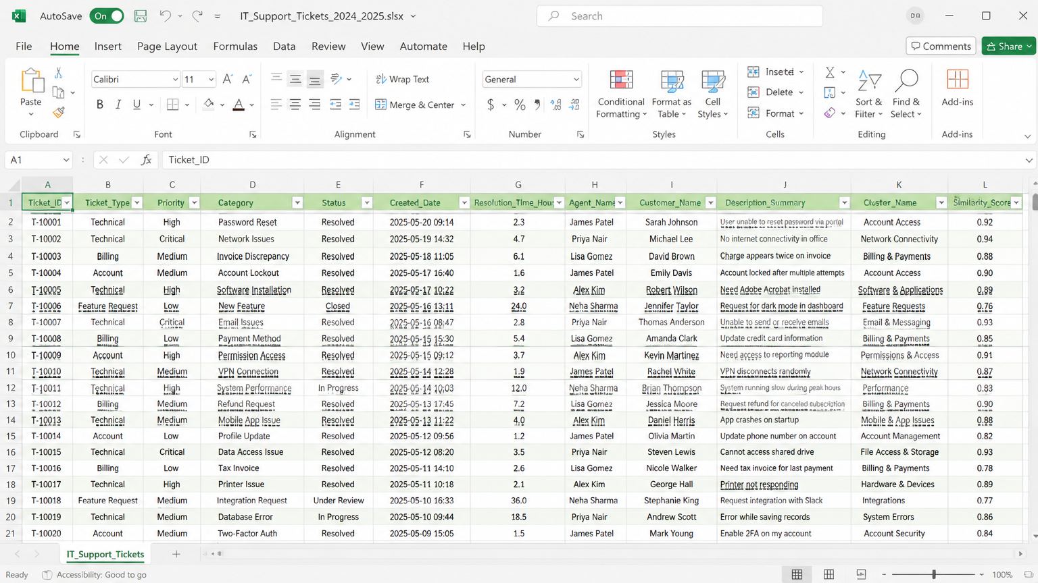
Dataset Overview
Key Metrics
Total tickets: 10,000 • Features: 32+
Ticket Types: Technical, Billing, Account, Feature Request
Priorities: Low / Medium / High / Critical
Geography: Multiple countries / locales
Derived: Clusters & Similarity Scores
Important Columns
Ticket_ID
Ticket_Type
Priority
Category
Cluster_Name
Similarity_Score
Resolution_Duration

Slide 4
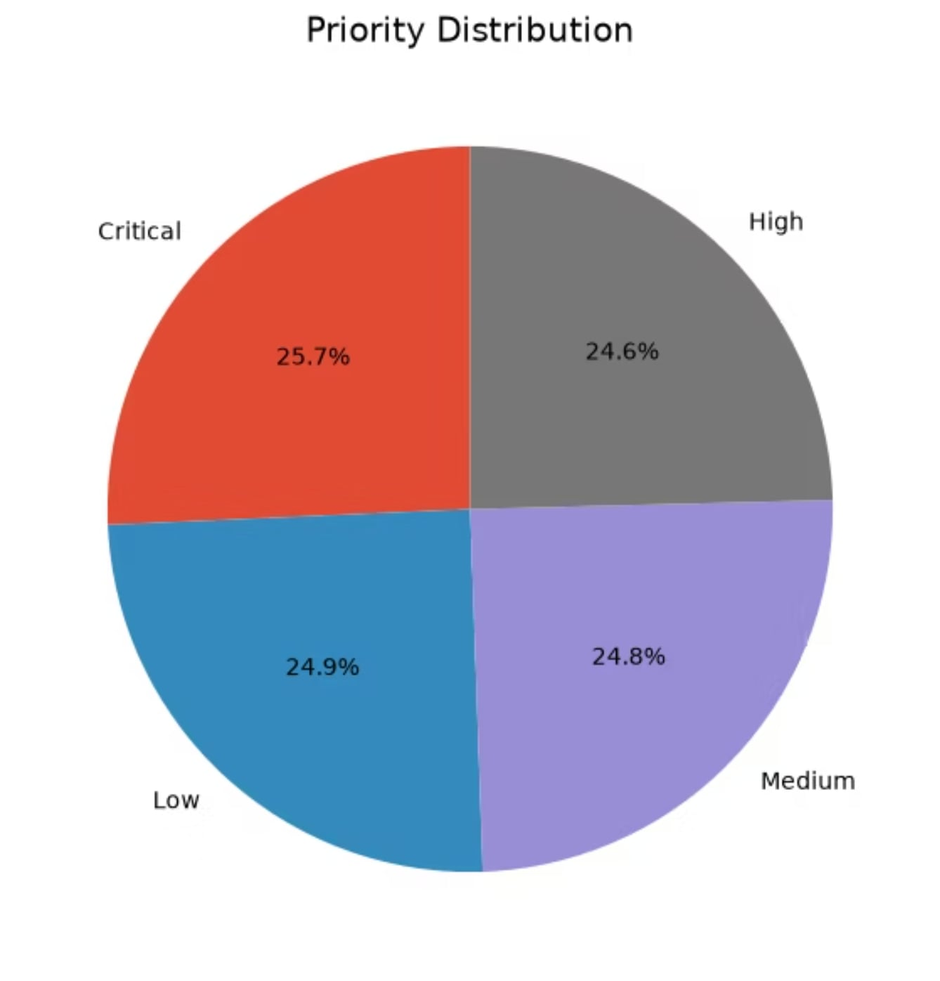
Module 3 — Exploratory Visualization
Approach:
Data wrangling with Pandas (cleaning, null handling, feature engineering)
Visualizations with Matplotlib and Seaborn for distribution, time series, and category frequency
Created standard analytic views: type/priorities, category frequency, cluster counts

Slide 5
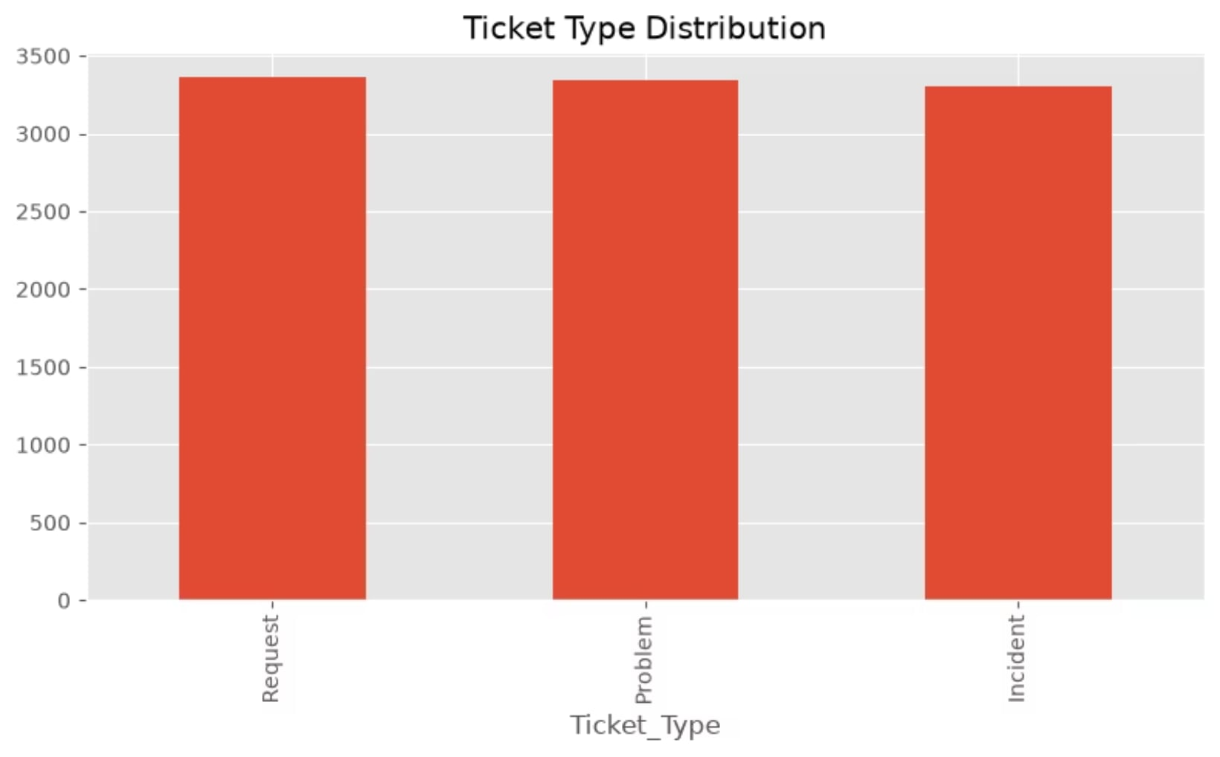
Ticket Distribution Analysis
Sample Observations
Technical Support receives the highest volume of tickets — primary workload driver
Medium priority tickets are the most frequent, suggesting steady operational demand
Billing queue shows repeated requests — candidate for FAQ/automation
Speaker note: Use these distributions to size teams and prioritize automation opportunities.

Slide 6
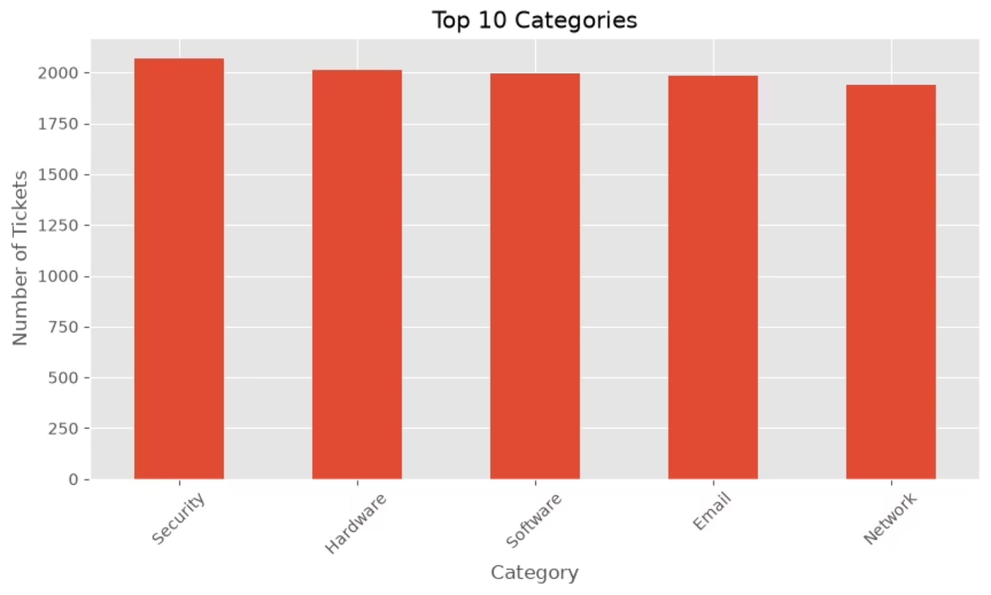
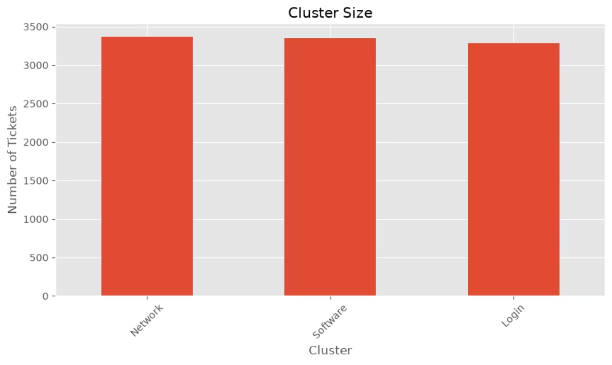
Category & Cluster Insights
Top categories and clusters were validated against ticket text and metadata — clusters map closely to recurring operational themes and help prioritize interventions.

Slide 7
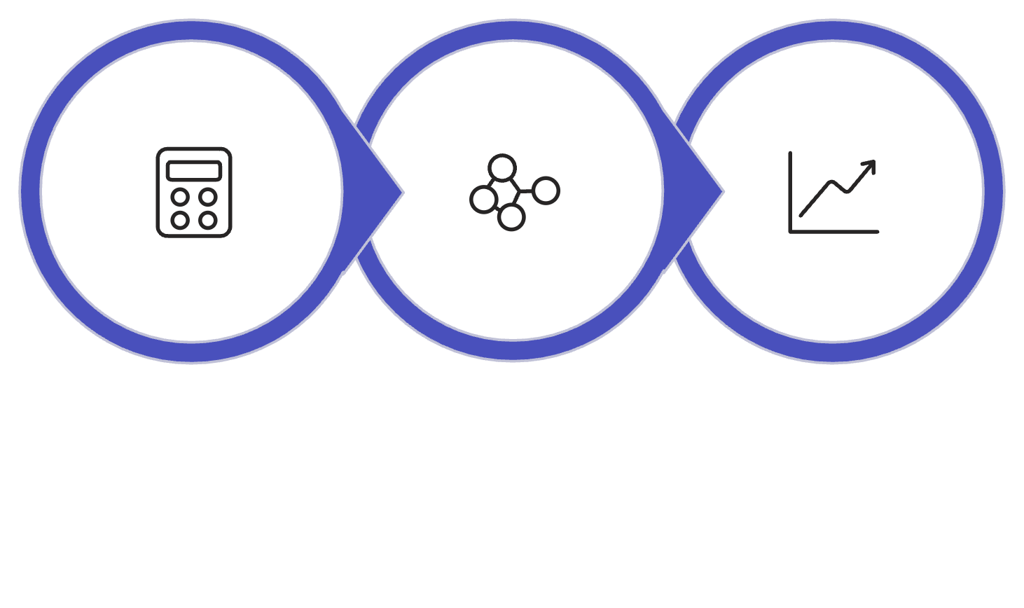

Module 4 — Similarity & Cluster Analysis
Methodology:
Vectorized ticket text (TF-IDF / sentence embeddings)
Pairwise similarity → thresholding to assign tickets to clusters
Cluster-level metrics: average Similarity_Score, Cluster_Size, mean Resolution_Duration
Compute Similarity
Cluster Tickets
Evaluate Clusters
Similarity thresholds tuned to balance precision/recall for meaningful clusters.

Slide 8
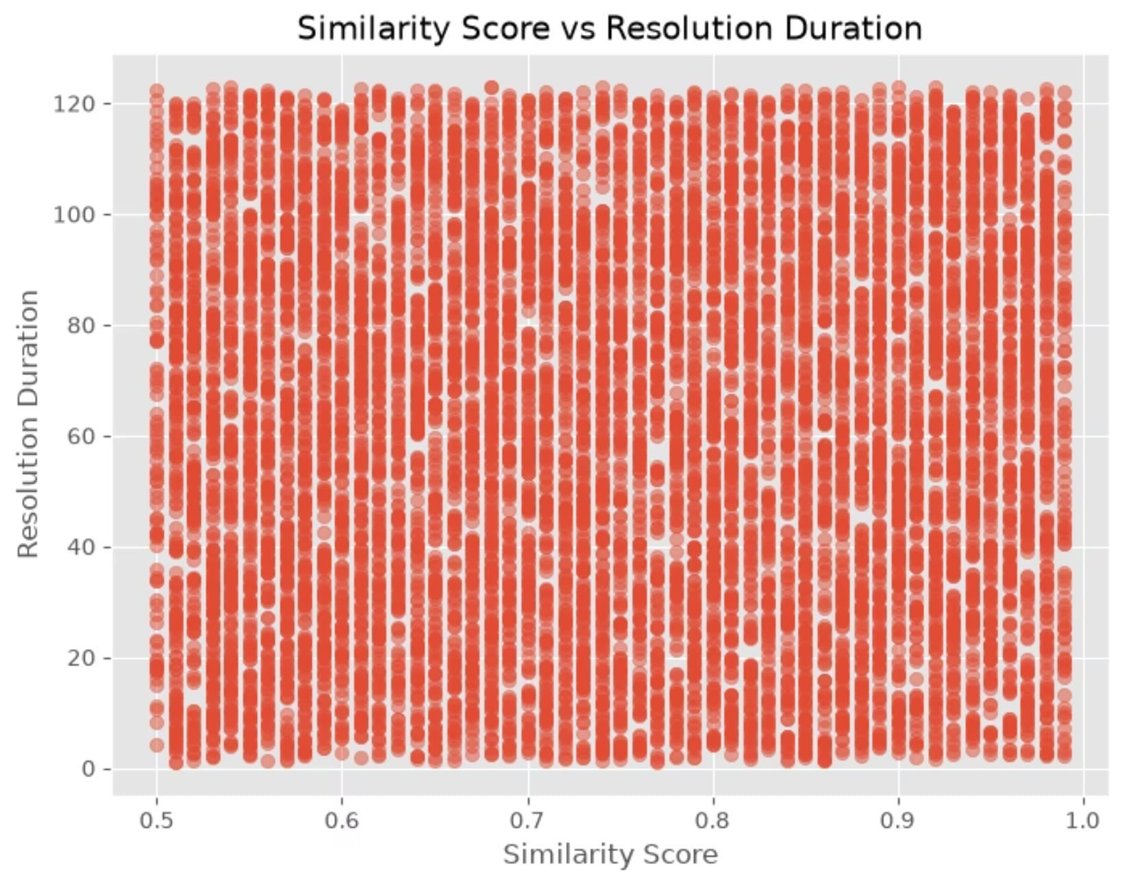
Performance Gap Analysis
Comparisons Conducted
Cluster Size vs Average Similarity Score (scatter)
Resolution Duration distribution by Cluster (box plot)
Outlier detection to find clusters with long tails in resolution time
Key Observations
Larger clusters tend to have slightly lower average similarity (more heterogeneous issues)
Specific clusters show long resolution tails — prioritize process optimization
Some low-similarity clusters still have fast resolution; others need knowledge-base updates

Slide 9
Key Findings
Volume Drivers
Priority Mix
Technical and account-management tickets dominate — focus staffing accordingly.
Medium priority comprises the majority; reserving high-priority responders improves SLAs.
Clusters to Target
Similarity Scores
Billing and Security clusters are largest and show repeat demand — automation candidates.
Most clusters maintain average similarity > 0.80, indicating coherent grouping for templated responses.
Visualization confirmed operational bottlenecks and surfaced targeted opportunities for automation, KB expansion, and routing optimization.

Slide 10
Next Steps & Recommendations
Analytic Roadmap
Refine similarity models (embedder tuning) and re-evaluate cluster stability
Add time-series analysis for seasonality and SLA forecasting
Integrate ticket metadata (agent, channel) for routing optimization
Planned deliverable: Updated dashboards with KPI cards (Cluster Size, Avg Similarity, Median Resolution Time) and automated alerts.

Slide 11
Thank You

