Slide 1
Supportlytics – IT Support Ticket Analytics System
Milestone 1 (Week 1–2)
Student: Ayush Gupta — B.Tech Computer Science Engineering
Deliverables: Cleaned dataset, Feature engineering summary, Data dictionary

Slide 2

Project Overview
What is IT Support Analytics: structured analysis of ticket data to surface operational insights.
Why analyze tickets: identify root causes, prioritize work, and improve resource allocation.
Importance: turns operational logs into measurable KPIs for SLA, capacity planning, and trend detection.
Business benefits: faster resolution, lower costs, improved user satisfaction, and data-driven decisions.

Slide 3
Problem Statement
High ticket volume overwhelms teams and obscures patterns.
Monitoring often manual — inconsistent prioritization and reporting.
Slow resolution times cause SLA breaches and user frustration.
Limited visibility into categories and repeat issues → missed improvement opportunities.
Need: automated analytics pipeline to produce reliable insights for action.

Slide 4
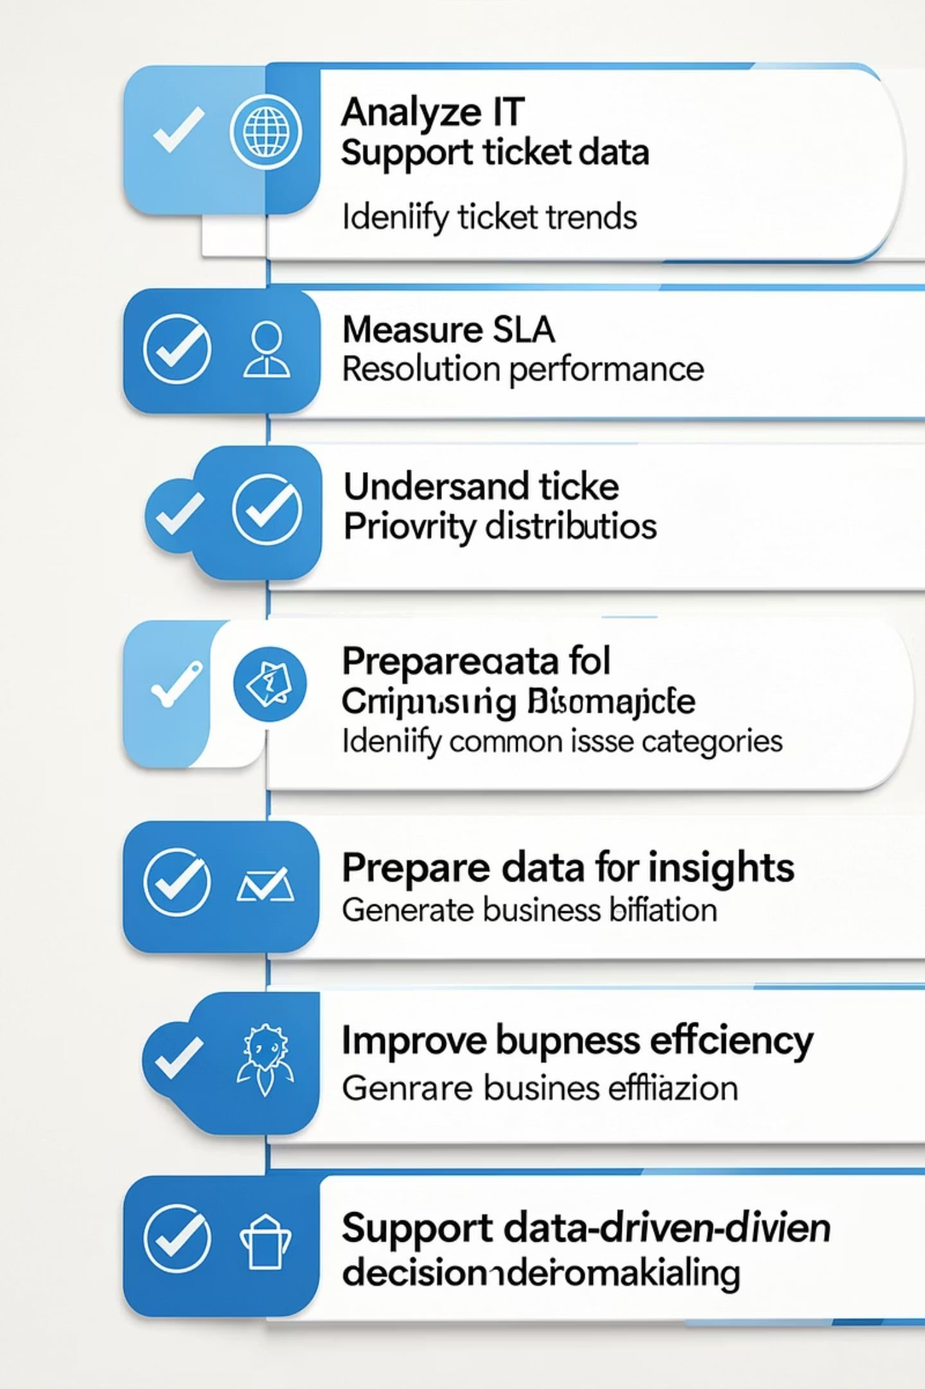
Project Objectives
Analyze IT support ticket data.
Identify ticket trends.
Measure resolution performance.
Analyze SLA compliance.
Understand ticket priority distribution.
Identify common issue categories.
Prepare data for visualization.
Generate business insights.
Improve support efficiency.
Support data-driven decision making.

Slide 5
Key Performance Indicators (KPIs)
Total Tickets
Average Resolution Time
Priority Distribution
Volume over time — daily, weekly, monthly trends.
Mean/median hours from created to resolved; SLA target comparisons.
Counts and share of Critical/High/Medium/Low tickets.
Category & Status
Customer Satisfaction
Breakdown by category, status, and top recurring issues.
Survey scores or proxies where available; trend monitoring.
Other KPIs: Open vs Resolved, First Response Time, SLA Compliance.

Slide 6
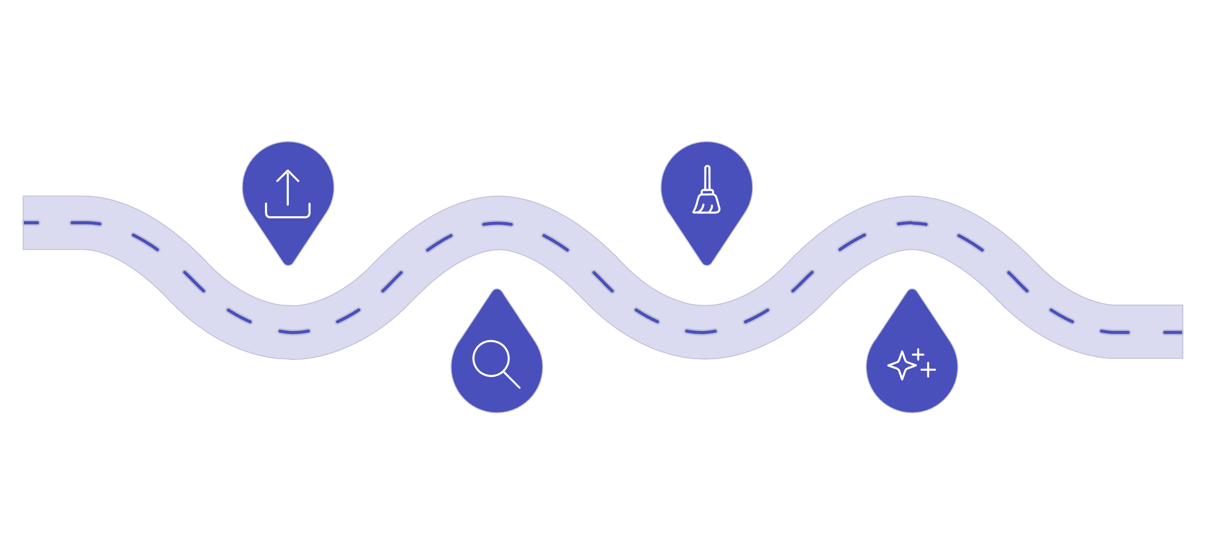
Project Workflow
Load Data
Clean Data
Ingest CSV dataset into system
Handle missing values and errors
Explore
Feature Eng
Initial validation and profiling
Create features for analytics
This workflow defines the Milestone 1 pipeline: data ingestion, validation, cleaning, and feature creation to produce analytics-ready outputs.

Slide 7
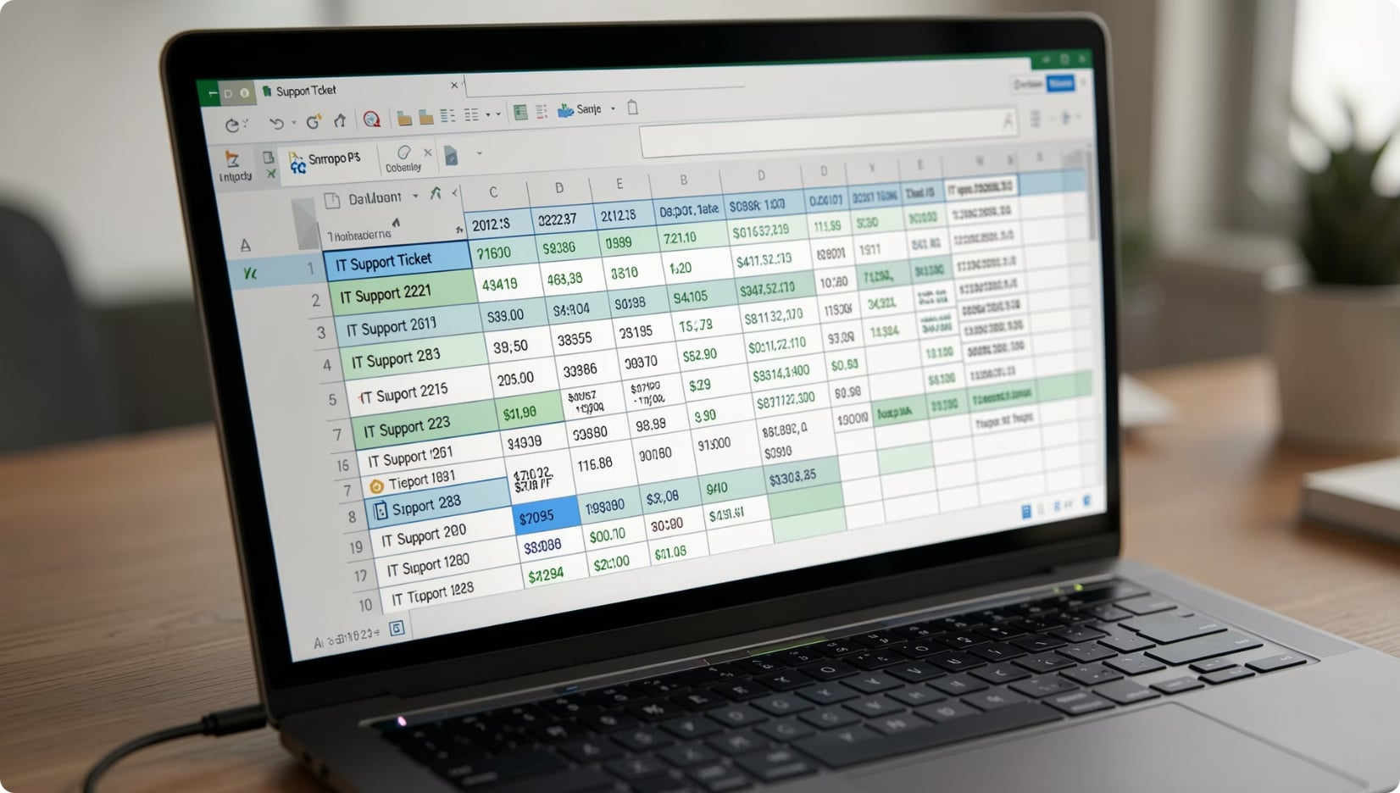
Dataset Overview
File: IT_Support_Tickets.csv
Approx. records: 10,000+
Approx. columns: 25–30
Key columns (sample):
Ticket_ID
Unique ticket identifier
Created_Date
Timestamp ticket opened
Resolution_Date
Timestamp ticket closed/resolved
Status
Open, In Progress, Resolved, Closed
Priority
Low/Medium/High/Critical
Ticket_Type
Incident/Request/Change
Category
Network/Software/Hardware/Security/Email
Country
Origin of request

Slide 8
Sample Dataset
Ticket_ID
Priority
Status
Category
Country
T0001
High
Open
Network
India
T0002
Low
Closed
Software
USA
T0003
Medium
In Progress
Hardware
UK
T0004
Critical
Resolved
Security
Germany
T0005
High
Closed
Email
Canada
Each column explained: Ticket_ID (ID), Priority (severity), Status (life cycle), Category (issue type), Country (location).

Slide 9

Module 1 — Implementation
Tasks completed:
Project initialization: defined objectives, KPIs, and workflow.
Dataset loading and schema exploration using Pandas.
Initial checks: data types, missing values, duplicates.
Code sample:
import pandas as pd
df = pd.read_csv("../data/IT_Support_Tickets.csv")
df.head()

Slide 10
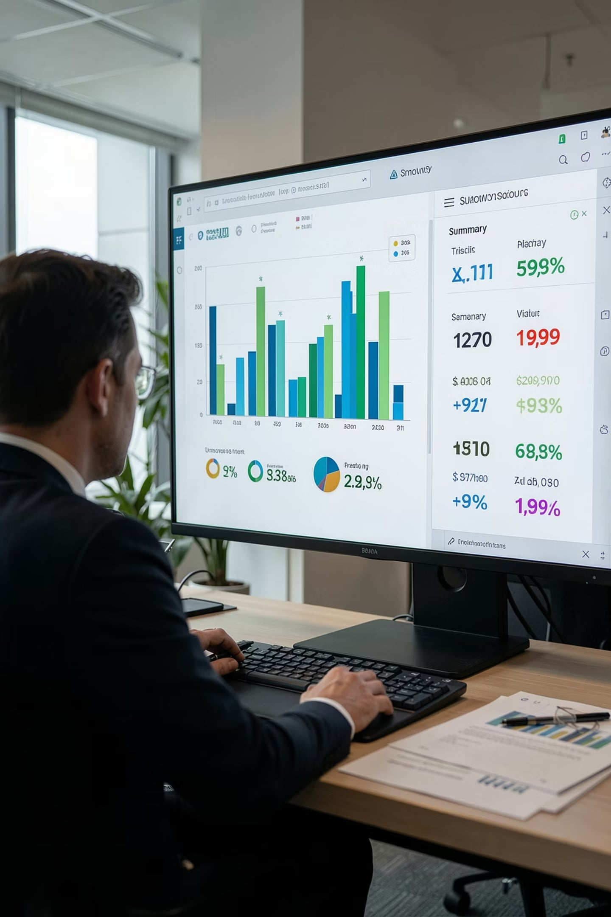
Data Exploration & Initial Analysis
Overview metrics: dataset shape, column listing, and data types.
Missing value counts and duplicate detection to guide cleaning scope.
Exploratory aggregates: ticket counts by Type, Priority, Category, Country, Status.
Code snippets for repeatability:
df.info()
df.describe()
df.isnull().sum()
Placeholders: Bar charts for distributions, pie charts for category share, count plots for status.

Slide 11
Conclusion
Achievements
Next Steps
Successfully completed Milestone 1
Dataset loaded and explored
Data cleaned successfully
Features engineered
Processed dataset created
Ready for Milestone 2 (Exploratory Data Analysis)
Conduct exploratory data analysis (EDA)
Generate visualizations and insights
Prepare for advanced analytics and modeling
THANK YOU

