Slide 1
AirFly Insights
Data Visualization and Analysis of Airline Operations
Name: Adduri Nikhil
Mentor : Priya
Date: 09-04-2026

Slide 2
Project Overview
Objective: To analyze large-scale airline data to identify patterns in flight delays and cancellations.
Goal: Provide actionable insights that help carriers improve scheduling and help passengers understand travel risks.
Scope: Temporal analysis (time/season), spatial analysis (routes/hubs), and causal analysis (types of delays).

Slide 3
Dataset Overview
Source: Kaggle Airline Dataset.
Data Size: Processed over 3 million flight records.
Key Attributes:
Flight Info: Airline Carrier, Flight Number.
Temporal: Scheduled Departure/Arrival, Actual Times.
Geographic: Origin and Destination Airports.
Disruptions: Delay reasons (Weather, Carrier, NAS, etc.) and Cancellation status.

Slide 4
Workflow
Start: Load Dataset
Data Exploration
Data Cleaning & Preprocessing
Feature Engineering
Univariate & Bivariate Analysis
Delay Cause Analysis
Route & Airport Level Analysis
Seasonal & Cancellation Insights
Dashboard / Report Preparation

Slide 5
Data Preprocessing
Data Integrity (The Cleanup)
Result: Handled missing values in delay-cause columns without losing row count.
Impact: Maintained a complete dataset of 3.1 Million records for 100% accuracy.
2. System Optimization (The Performance)
Result: Converted data types
Impact: Reduced memory footprint significantly, enabling high-speed analysis in the Python environment.
3. Feature Engineering (The Expansion)
New Insights:
Time: Extracted Month, Day of Week, and Departure Hour.
Space: Generated Flight Routes (Origin-to-Destination city pairs).

Slide 6
EDA
Analysis was performed to understand overall flight distribution
Top airlines were identified based on number of flights operated
Busiest airports and routes were determined
Flight patterns across different days and time periods were explored

Slide 7
Visual Analysis
Monthly Trends: Line charts showing delay patterns across months, revealing seasonal peaks in winter and summer travel periods.
Airline Comparison: Bar charts comparing average delays by carrier, highlighting performance differences between major airlines.
Time Patterns: Heatmaps displaying delay frequency by hour and day, identifying peak congestion periods.

Slide 8
Delay Analysis
Different types of delays were analyzed:
Carrier delays → caused by airline operations
Weather delays → due to external environmental conditions
NAS delays → caused by air traffic congestion
Carrier delays were found to be the most frequent
Peak delays were observed during busy travel hours

Slide 9
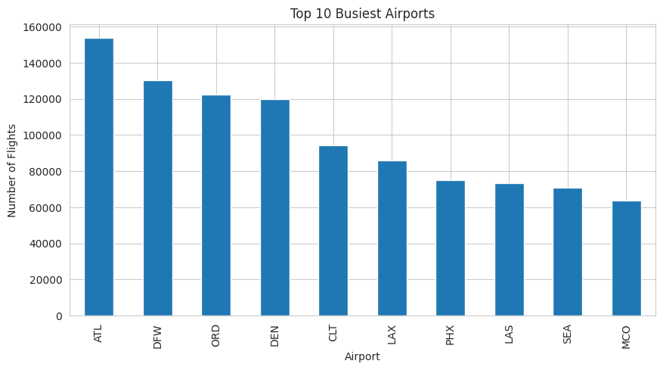
Route & Airport Analysis
Top origin-destination routes were identified based on traffic volume
Some routes showed higher congestion and delay frequency
Airport-level analysis revealed that certain airports consistently experience higher delays
This indicates the impact of traffic density and operational load

Slide 10
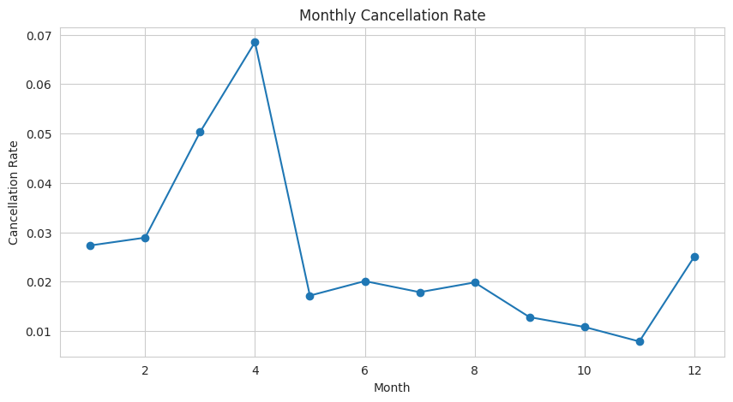
Route & Airport Analysis
Cancellation trends were analyzed across different months
Types of cancellations include carrier, weather, NAS, and security
Seasonal patterns were observed with higher cancellations during winter months
Weather conditions play a significant role in flight cancellations

Slide 11
Cancellation Analysis
• Types of cancellations
• Monthly trends
• Seasonal impact

Slide 12
Key Insights
• Peak delay times
• Underperforming airlines
• Seasonal patterns

Slide 13
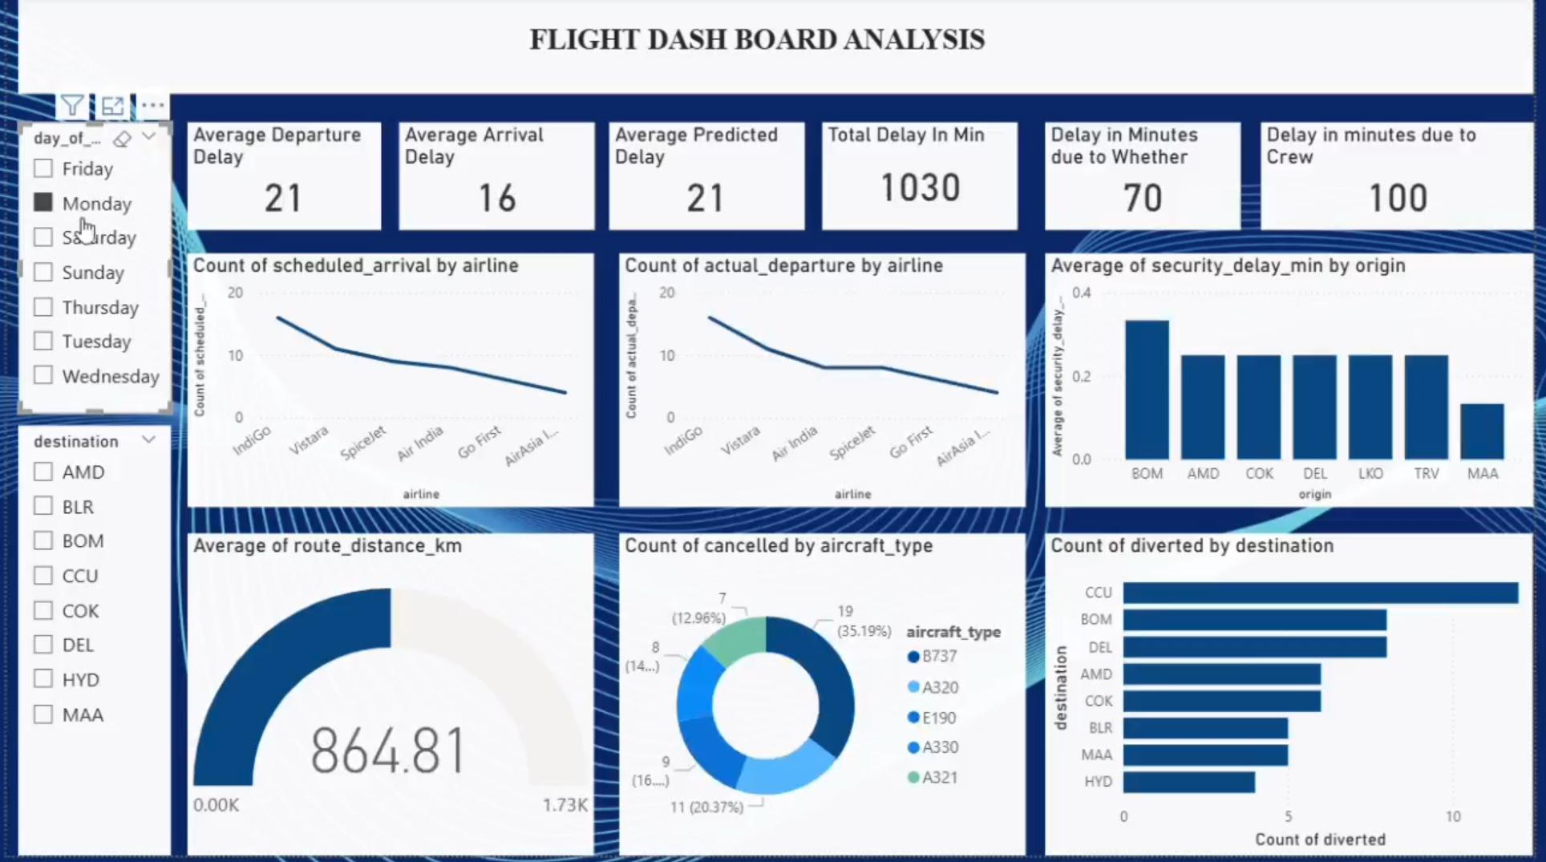
Dashboard

Slide 14
Challenges
Handling large-scale dataset efficiently in Colab environment
Managing missing and inconsistent data values
Designing meaningful and interpretable visualizations
Ensuring clarity while presenting complex data

Slide 15
Future Scope
Develop machine learning models to predict flight delays
Implement real-time delay prediction systems
Build interactive dashboards using tools like Power bi
Extend analysis with additional real-time data sources

Slide 16
Conclusion
Flight delays are influenced by multiple factors including airline operations and external conditions
Seasonal trends and congestion play a major role in delays
Data-driven analysis helps in identifying patterns and improving decision-making
The project successfully provides meaningful insights into airline performance

Slide 17
Thank You

