Slide 1

Exoplanet Habitability Prediction System
Infosys Springboard Internship — Batch 11
Divyanshu Kumar Raj

Slide 2

Problem Statement
Discovery Volume
Complex Analysis
Our Goal
Thousands of exoplanets discovered — manual review is slow and inconsistent.
Scientific habitability assessment combines many interacting planetary and stellar variables.
Automate ranking of habitability using a robust ML system that produces interpretable scores.

Slide 3
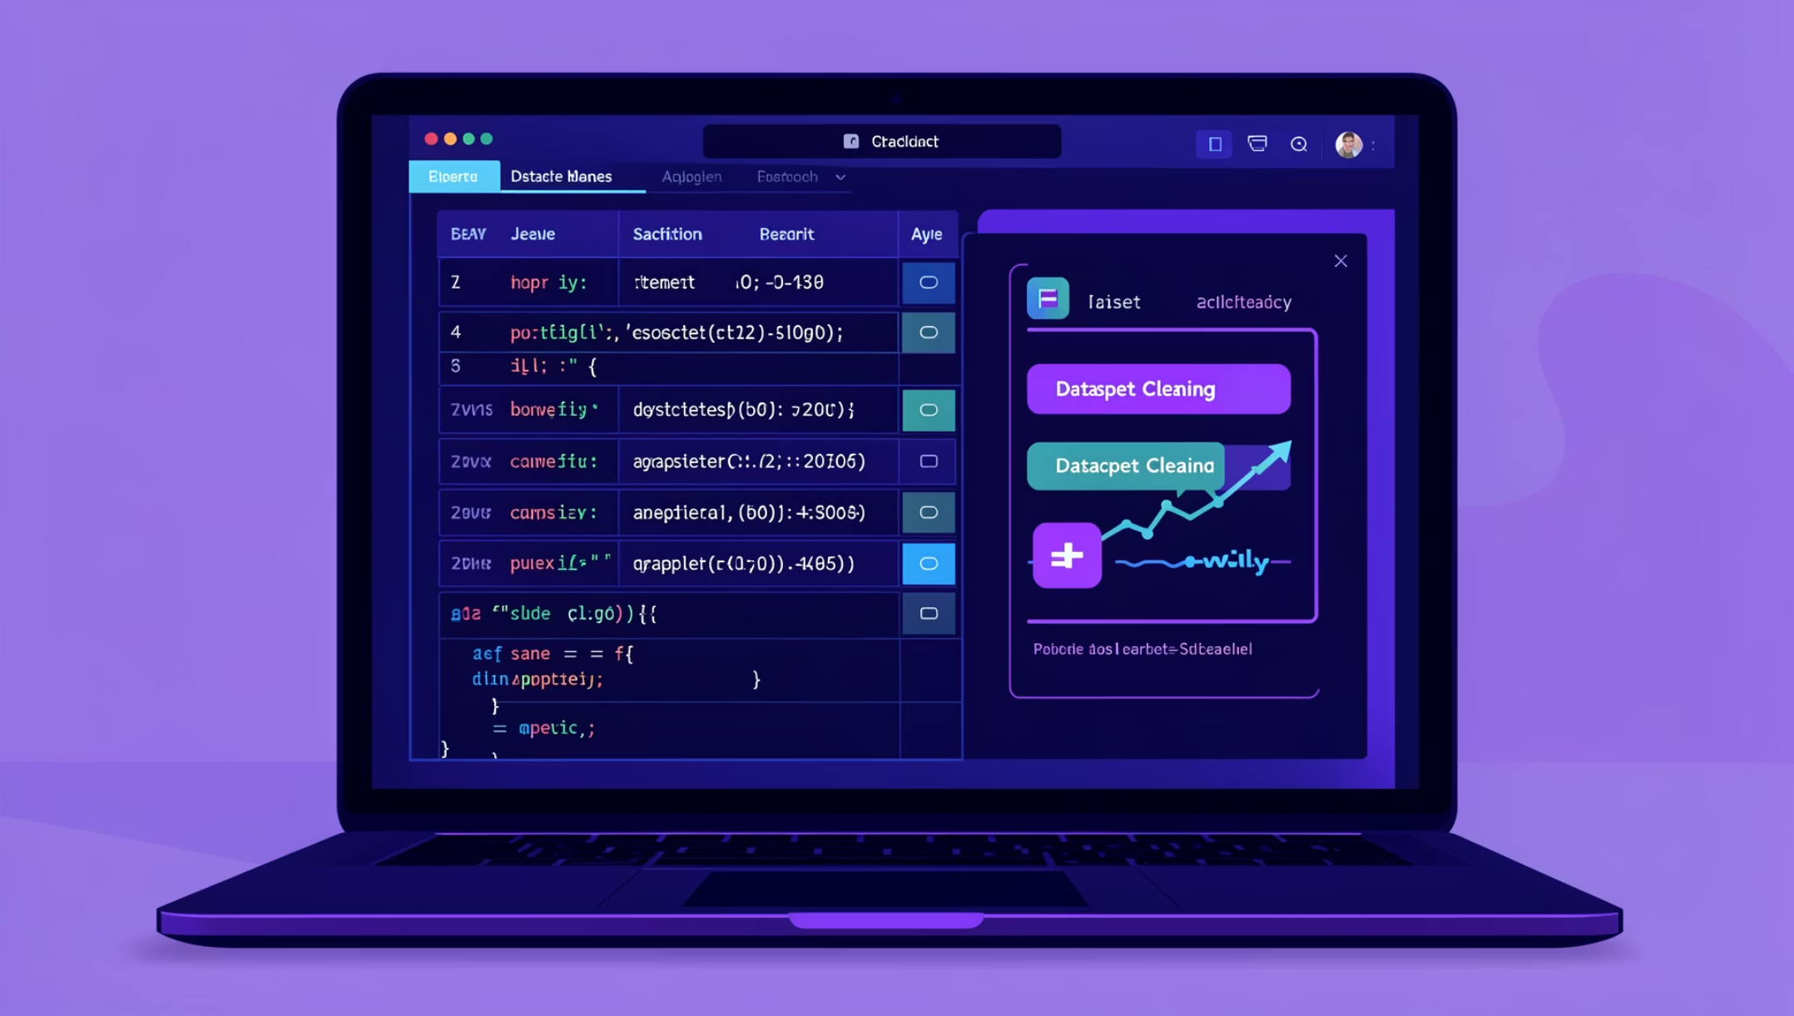
Dataset & Features
I used 40,000+ NASA exoplanet records with six core features (planet radius, mass proxy, orbital period, equilibrium temperature, stellar temperature, stellar luminosity). Data pipeline: cleaning → scaling → feature engineering.
Preprocessing: outlier handling, imputation, standard scaling
Split: 80% train / 20% test
Result: balanced classes via stratified sampling

Slide 4
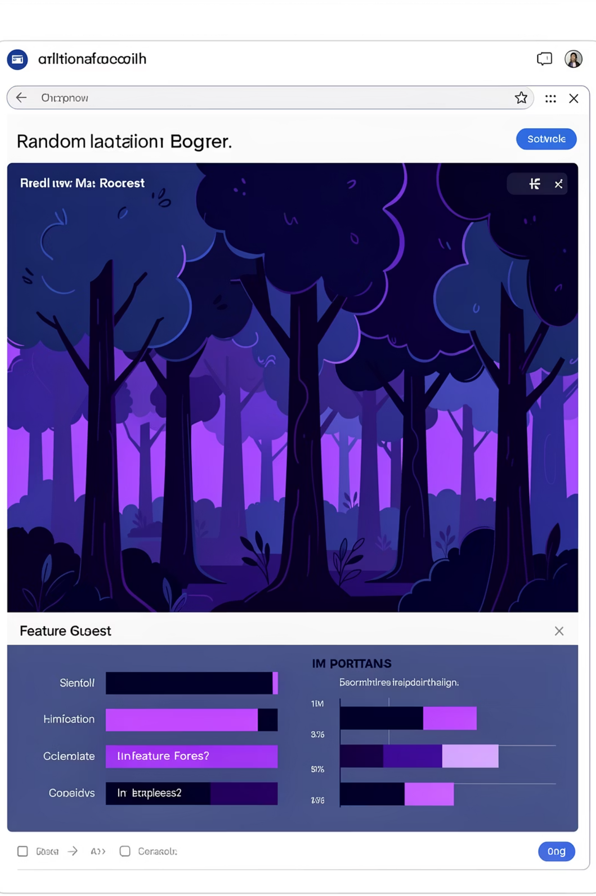
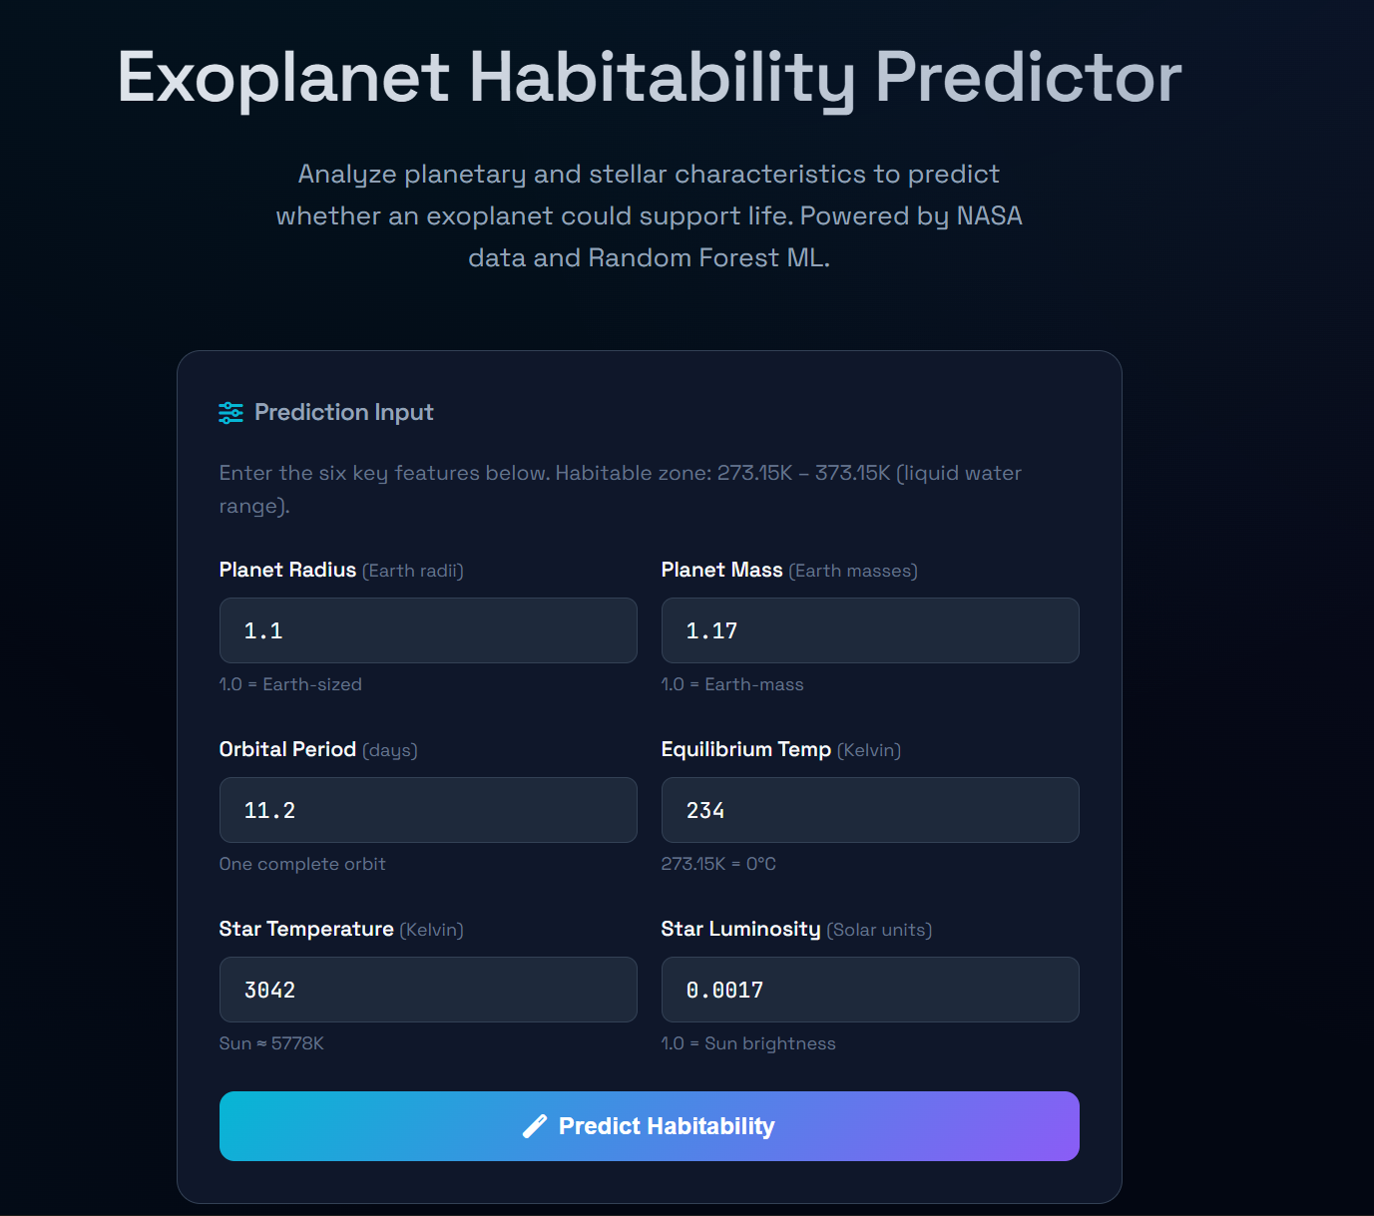



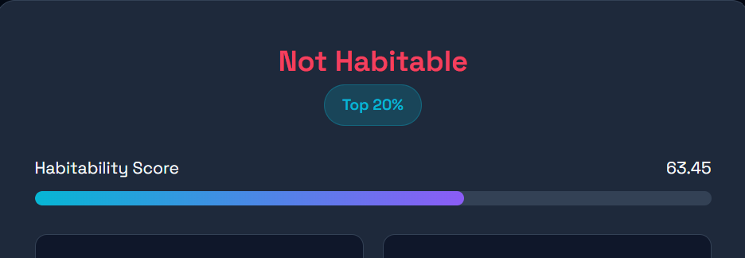
Machine Learning Approach
Model: Random Forest classifier (100 estimators) for binary habitability prediction. Focus on robustness, generalization, and interpretability.
Performance
Test accuracy ≈ 94% with consistent validation metrics.
Explainability
Feature importance analysis highlights temperature and stellar luminosity as top predictors.
Reliability
Cross-validation and calibration checks applied to avoid overconfidence.
Included: small screenshot of feature-importance chart for review.

Slide 5

Habitability Scoring Logic
I converted the model's probability into a 0–100 habitability score with domain-aware adjustments:
Start with model probability (0–1)
Apply temperature influence to reward Earth-like equilibrium ranges
Normalize and rescale to a 0–100 score
Map score to 4 tiers: Non-habitable, Potential, Habitable, Highly Habitable
Design principle: keep scoring transparent and easy to interpret for reviewers.

Slide 6

System Architecture
Dashboard & Storage
Frontend UI
User input & visualization
Visualize, export data
Prediction Service
Real-time Prediction Pipeline
REST API
HTTP requests to backend
Serve & format results
Random Forest Model
Flask Backend
Request handling & routing
Feature inference
This architecture supports real-time predictions, batch processing, and a dashboard for visualization and export (PDF/CSV). Components are container-ready for scalable deployment.

Slide 7
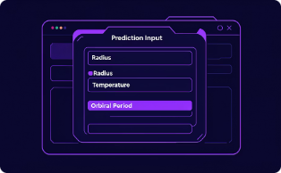
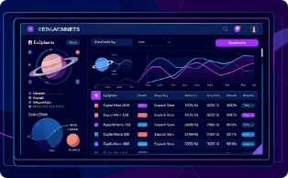
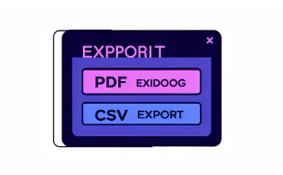
Web Application
Prediction Page
Dashboard
Export
Enter planetary parameters and receive a habitability score with explanatory feature contributions.
Visualize population-level trends, filter by score tier, and inspect individual predictions.
One-click export of reports (PDF) and data (CSV) for sharing and offline review.

Slide 8


Demo Instructions (Presenter Notes)
Enter Earth-like values on the prediction page (radius ~1 R⊕, temp ~288K).
Show the resulting "Highly Habitable" score and feature contributions.
Open the dashboard and highlight filters + population chart.
Display the feature-importance visualization and calibration plot.
Export a PDF report to demonstrate reporting capability.
This slide is for presenter backup; skip during the public demo if time is limited.

Slide 9
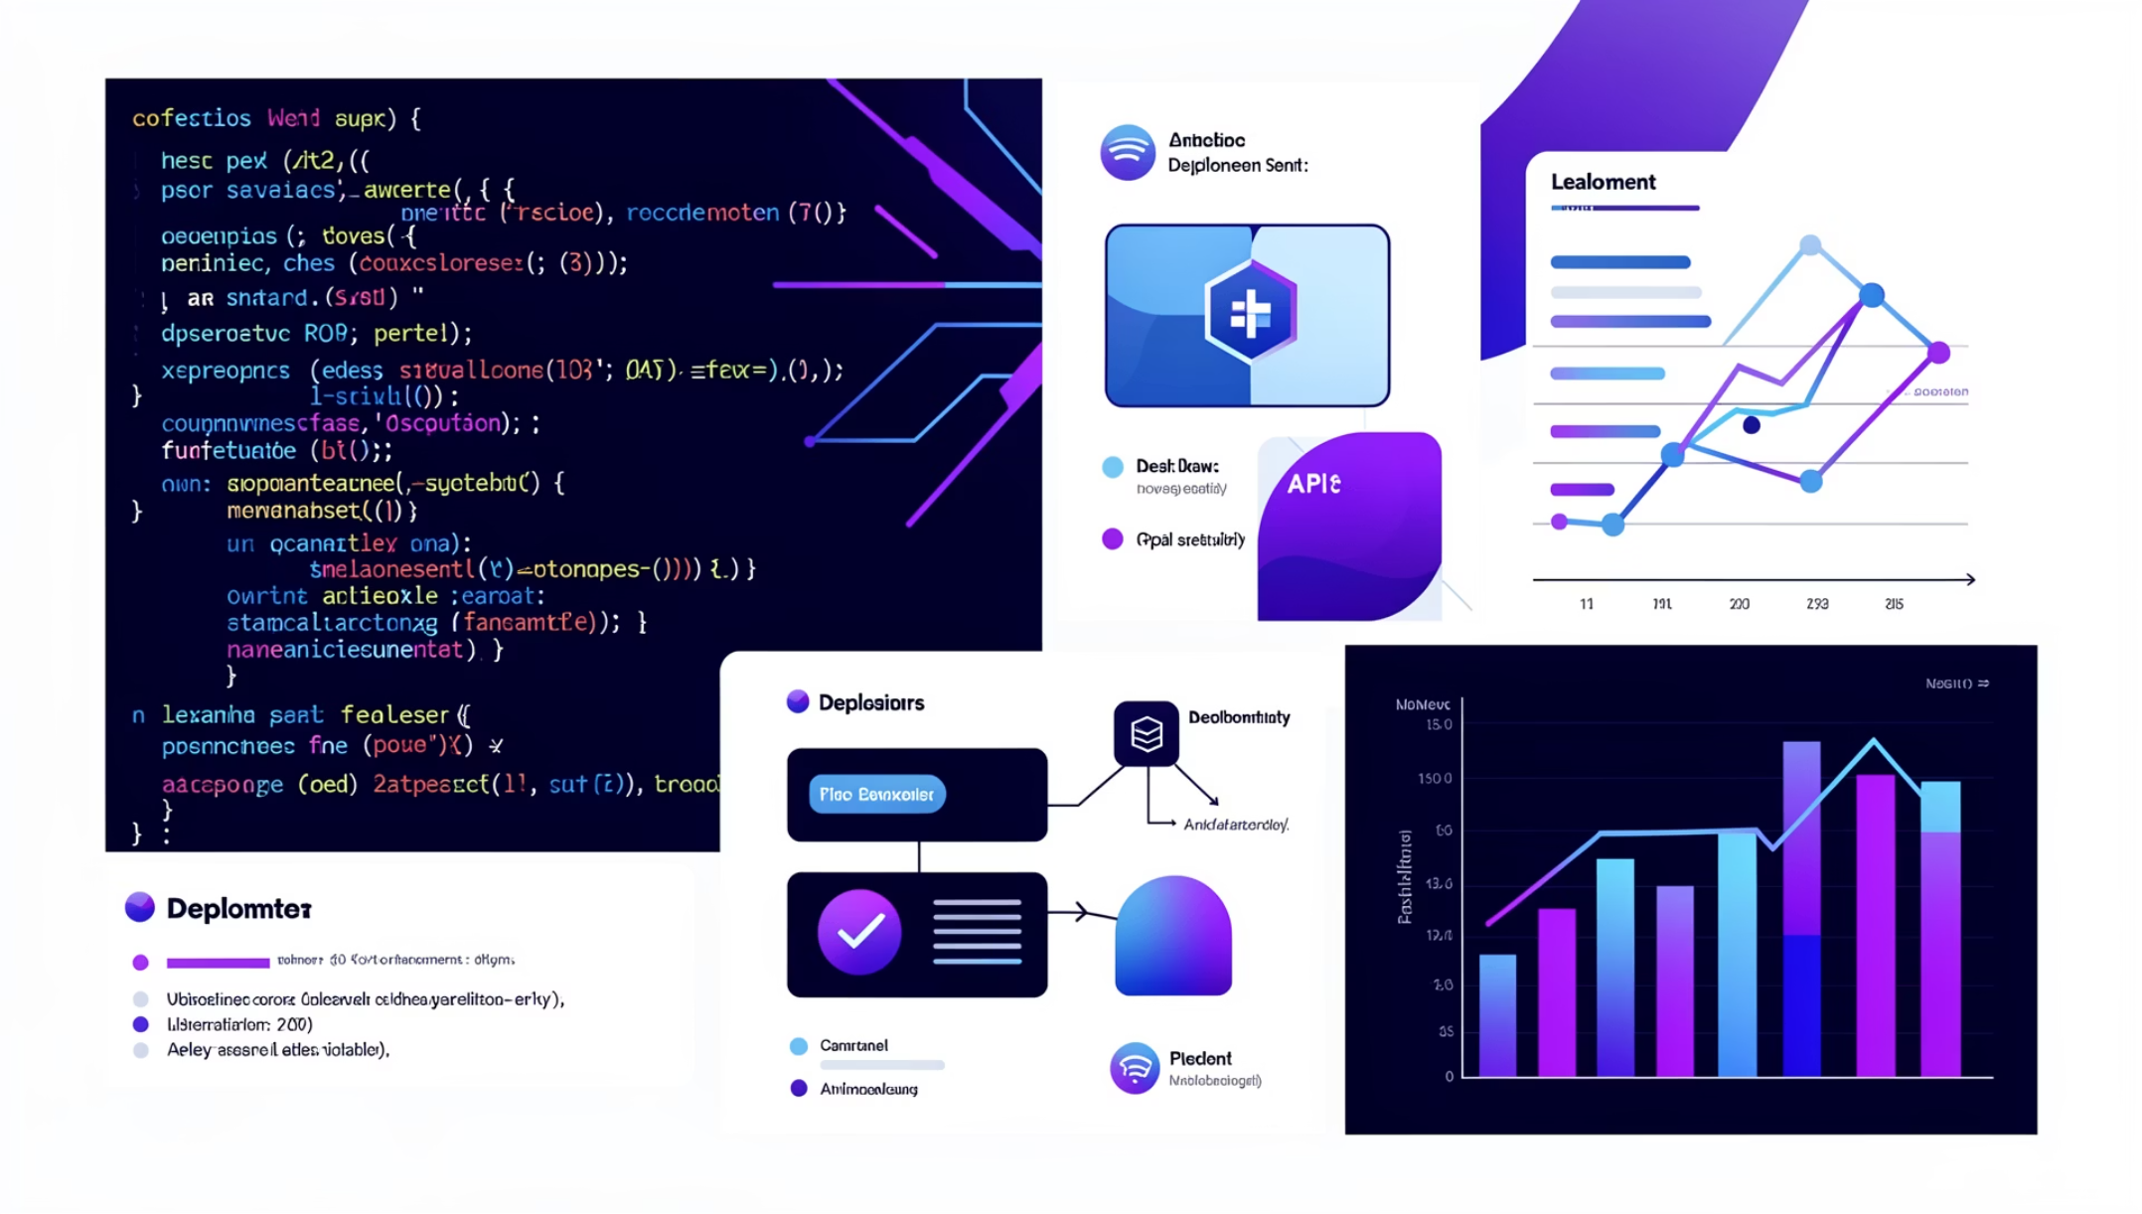
Key Learnings
Built an end-to-end ML pipeline: data → model → deployment.
Deployed model with Flask and a REST API for real-time inference.
Implemented data visualization (Chart.js) for interpretability.
Practiced full-stack ML integration and container-friendly architecture.
These outcomes strengthened both ML engineering and practical web-dev skills in a production-like workflow.

Slide 10

Conclusion
I delivered a production-style habitability prediction system using a real NASA dataset, a Random Forest model, and a Flask-backed web app with visualization and export features. Architecture is scalable and ready for further extension.
Thank you.

