Slide 1

Predicting the Habitability of Exoplanets Using Machine Learning (ExoHabitAI)
Student: Ananya Anand Tumarnavis
Institution: BGS of Engineering and TEchnology[
B.E CSE

Slide 2

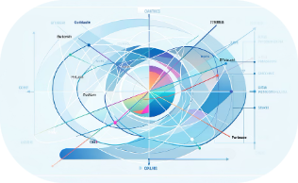

Problem Statement
Rapid Discovery, Sparse Prioritization
Complex Parameter Space
Need for Scalable Inference
Exoplanet catalogs have grown to tens of thousands of candidates from missions (Kepler, TESS, ground surveys). Manual follow-up is resource-intensive; selecting promising targets for atmosphere characterization requires efficient triage.
Habitability depends on many interacting variables — stellar type, insolation, planet radius/mass, orbital eccentricity, atmospheric proxies. High-dimensional correlations make rule-based selection unreliable.
Large datasets and evolving measurement quality demand automated, reproducible machine learning methods that can prioritize candidates and quantify predictive uncertainty for observational planning.

Slide 3
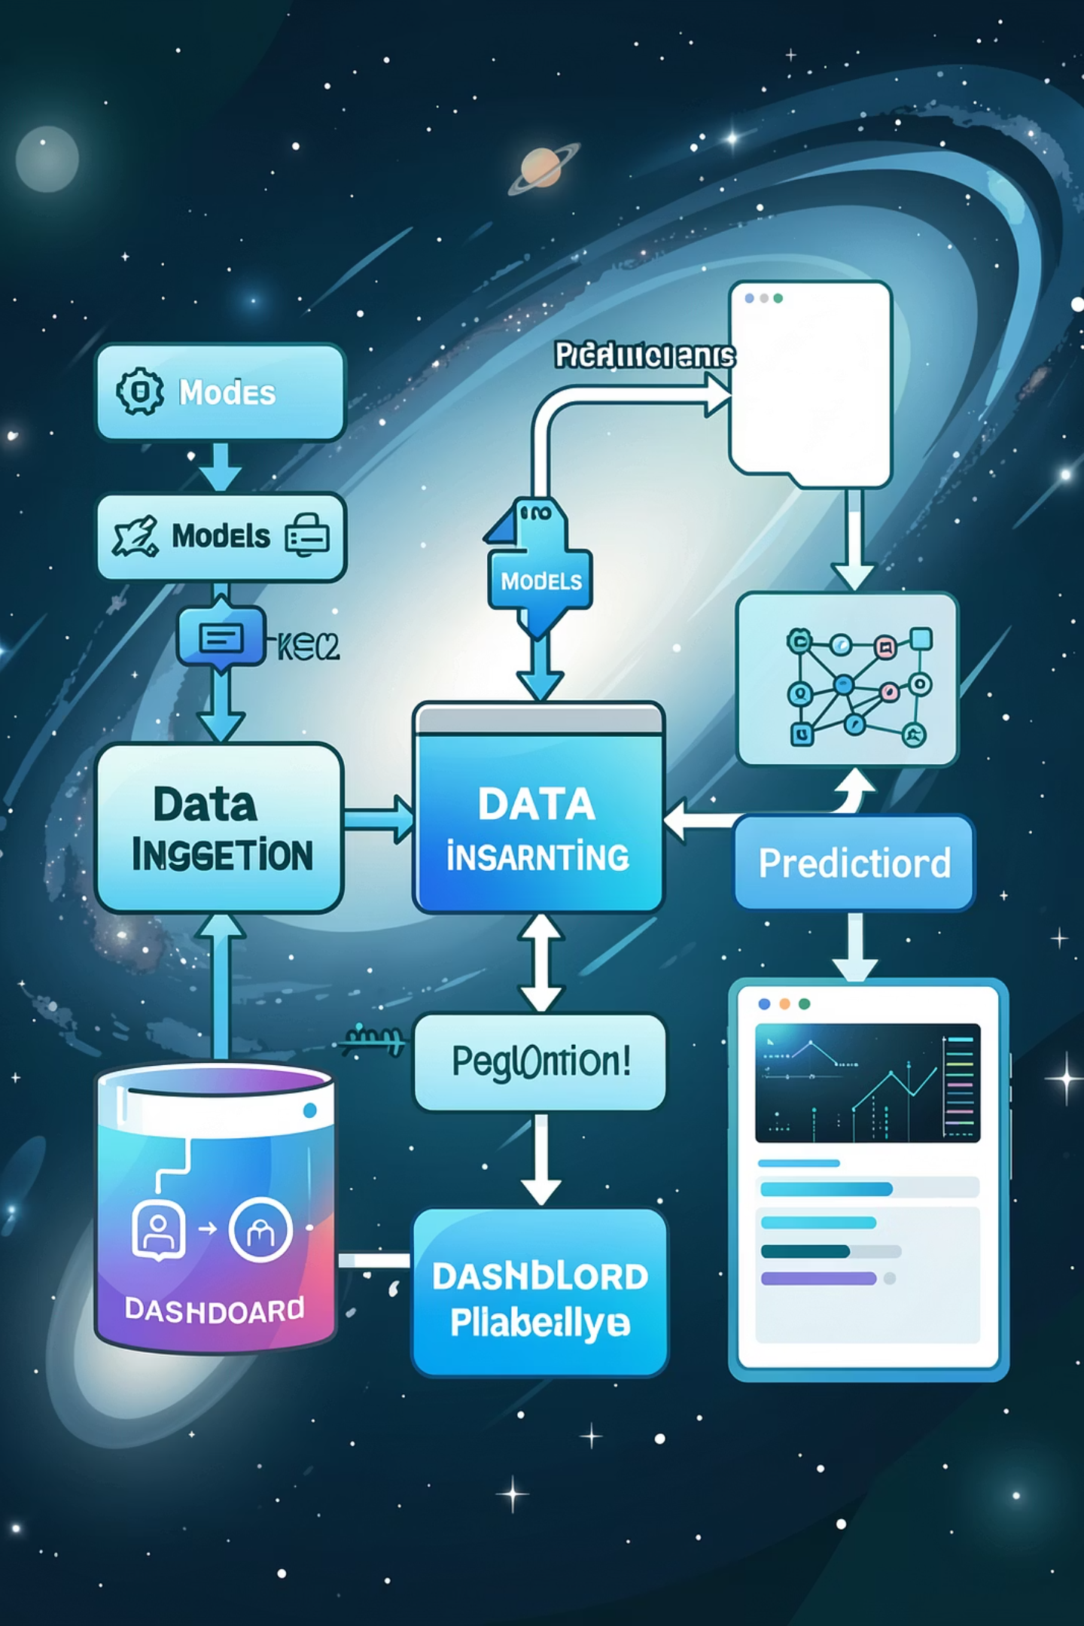
System Overview
Key design goals:
ExoHabitAI ingests heterogeneous exoplanet and stellar catalogs, engineers physically motivated features, trains supervised classifiers, and exposes predictions through a web interface and visualization dashboard to assist researchers in target selection and hypothesis generation.
Scientific interpretability: feature importance, partial dependence
Reproducibility: versioned datasets and model artifacts
Scalability: batch and real-time inference
Input: planetary & stellar parameters, observation metadata
Core: feature engineering + ensemble ML models
Output: habitability score, class label (candidate habitable / non-habitable), feature explanations

Slide 4
Objectives
Predict Habitability
Analyze Features
Rank Planets
Provide Visualization Dashboard
Generate probabilistic habitability scores for validated and candidate exoplanets to assist prioritization for spectroscopic follow-up.
Quantify the influence of stellar flux, planet radius, mass proxies, and orbital parameters on predicted habitability using interpretable ML techniques.
Produce ranked candidate lists tailored to specific science goals (biosignature search, temperate worlds, rocky super-Earths).
Interactive dashboards for exploring predictions, feature space, and observational metadata to guide telescope time allocation.

Slide 5






Methodology & Workflow
Collection
Preprocess
Features
Train
Predict
The pipeline: collect vetted catalogs (NASA Exoplanet Archive, TESS Objects of Interest), perform quality filtering and imputation, compute derived features (insolation flux, equilibrium temperature, bulk density estimates, insolation variability), train and evaluate models with cross-validation and class-balancing techniques, and deploy models via a Flask API with a reactive visualization front end.
Special considerations: uncertainties propagated through input features, synthetic augmentation for under-represented classes, and nested CV for robust hyperparameter selection.

Slide 6
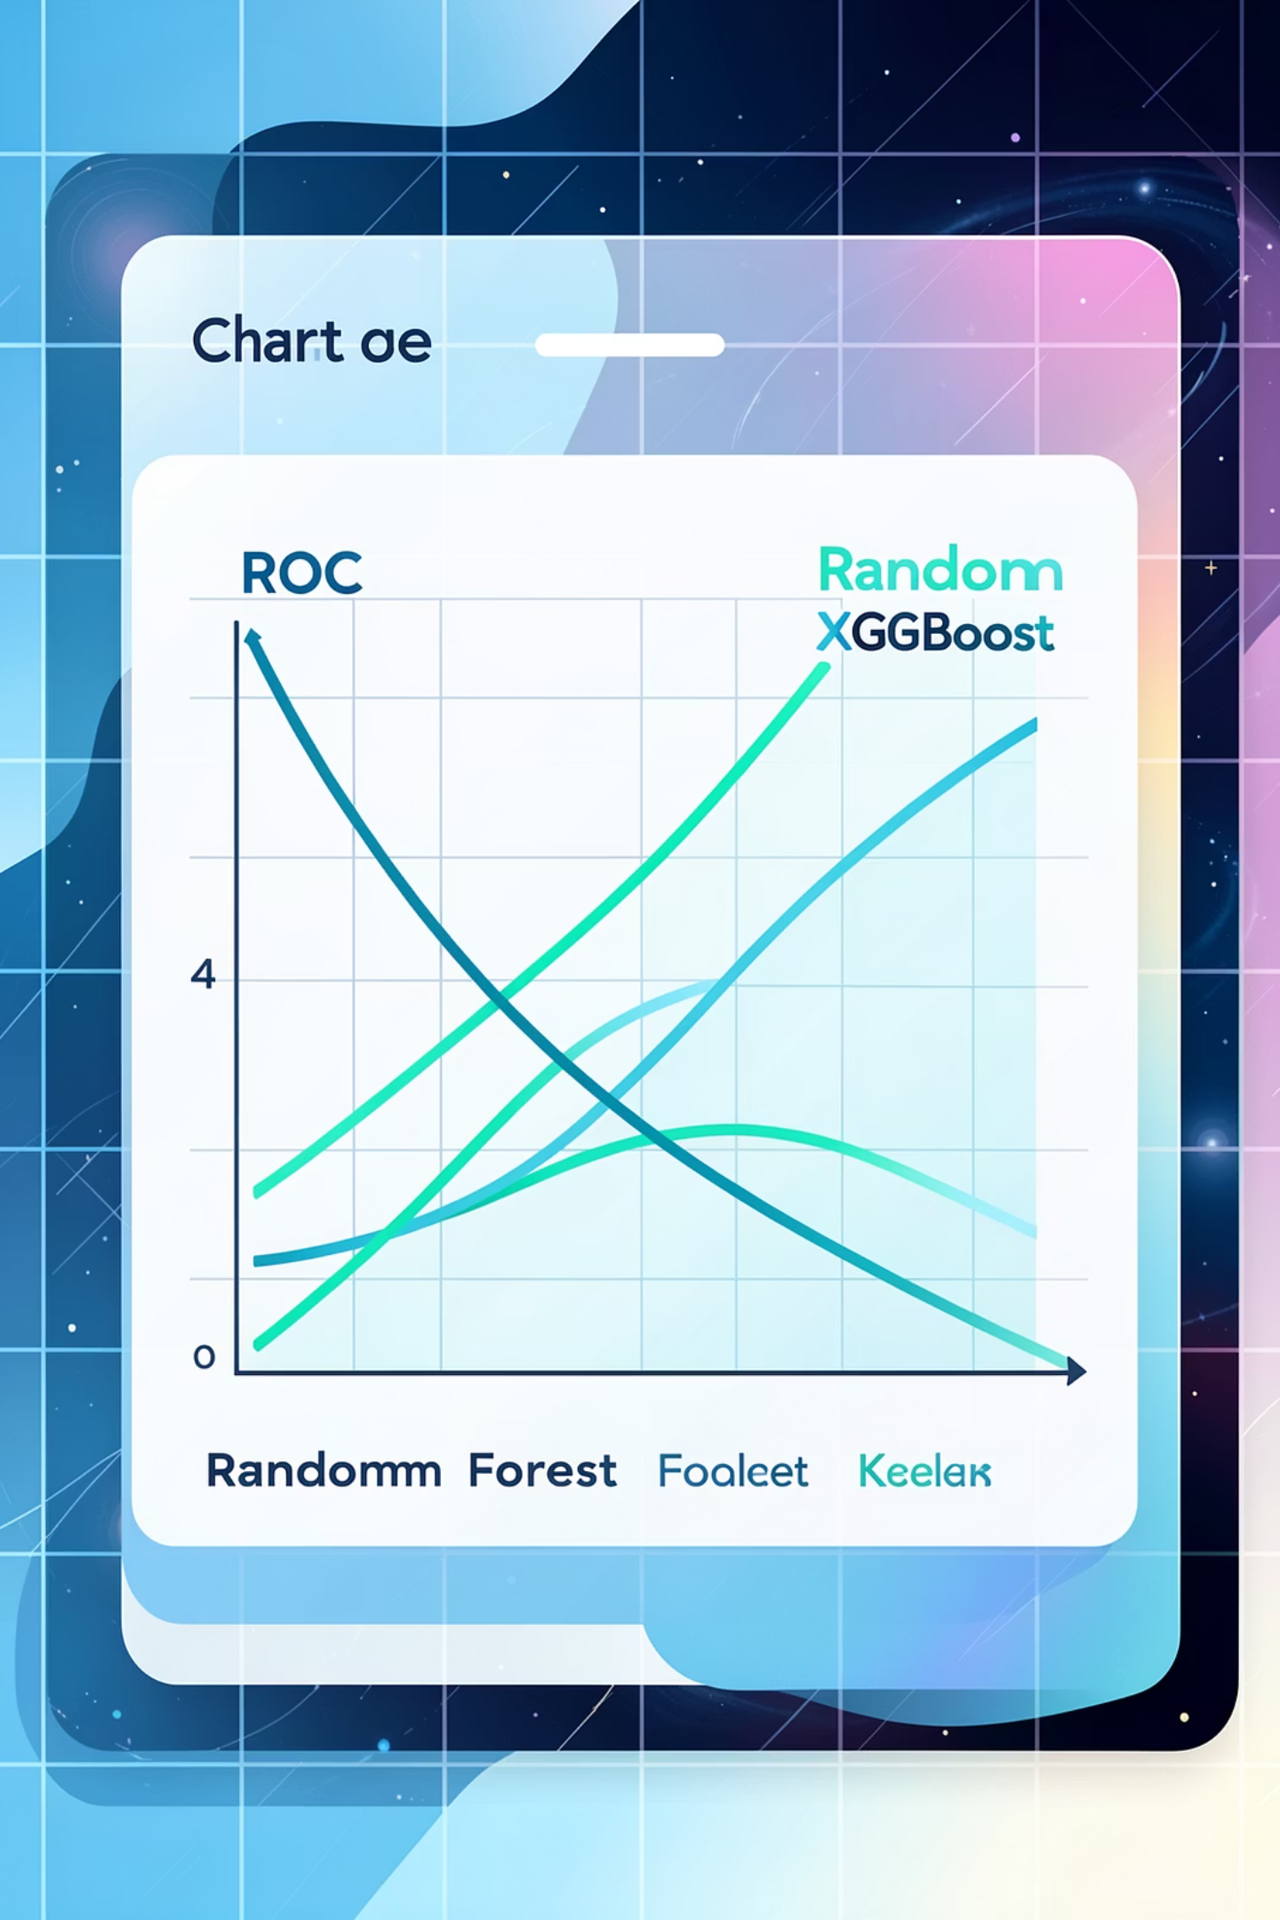
Machine Learning Models & Evaluation
Primary model: Random Forest classifier — chosen for robustness to feature scaling, interpretability via feature importances, and good baseline performance on tabular astrophysical data.
Evaluation metrics and protocols:
Accuracy, Precision, Recall, F1-score — reported per-class and macro-averaged
ROC-AUC and PR-AUC for probabilistic ranking
Calibration curves and Brier score to assess probabilistic reliability
Stratified k-fold cross-validation with held-out test set and temporal splits when possible
Optional models explored: XGBoost (gradient boosting), Logistic Regression (baseline interpretable)
Ensemble stacking considered to combine complementary strengths

Slide 7
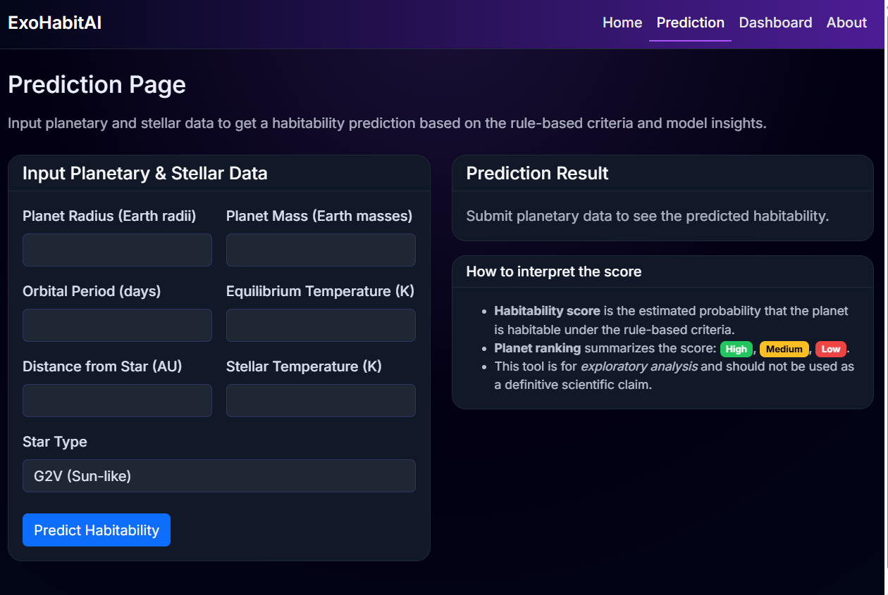



Prediction System Interface
User Inputs
Users supply measured planetary and stellar features (e.g., planet radius, orbital period, host Teff, metallicity, transit SNR) or upload catalog batches (CSV). Inputs accept uncertainties to propagate through predictions.
Backend
Flask-based API serves real-time model inference; containers (Docker) encapsulate model artifacts and preprocessing steps for reproducibility. Model versioning and metadata captured in MLflow.
Outputs
System returns a habitability probability, label thresholds, uncertainty estimates, and feature-contribution explanations (SHAP-like summaries) to aid interpretability.

Slide 8
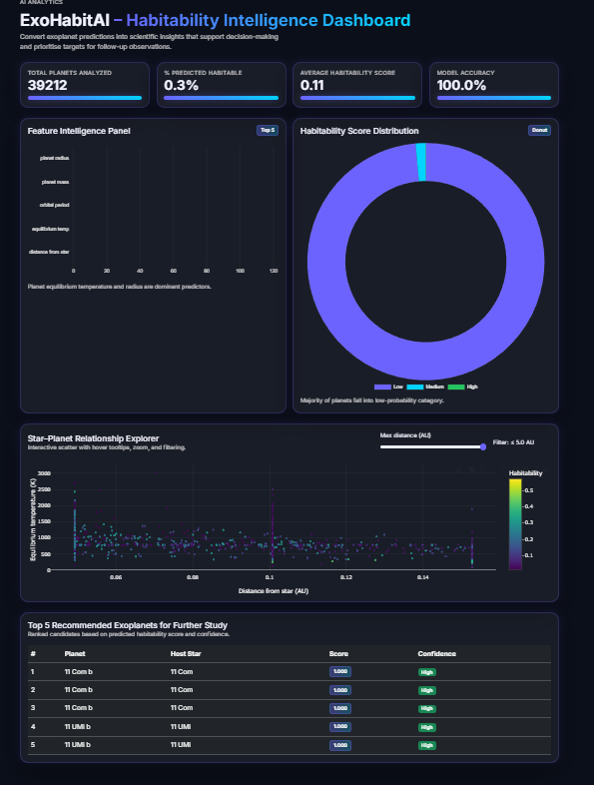
Visualization Dashboard
Dashboard components:
Visualization features:
Feature importance: global and local explanations to surface which variables drive predictions for an individual planet (e.g., insolation flux, radius, equilibrium temperature).
Habitability distribution: histograms and kernel-density estimates to visualize candidate score populations and tail behavior for high-score planets.
Star–planet relationship plots: scatter and contour plots (e.g., Teff vs. insolation) with interactive brushing to reveal correlated regimes.
Top recommended exoplanets: ranked table with metadata, predicted probability, uncertainty, and recommended follow-up priority.
Linked views and filtering by instrument, catalog provenance, and measurement quality.
Exportable candidate lists and publication-quality plots.
Ability to simulate measurement improvements (e.g., reduced radius uncertainty) and observe score sensitivity.

Slide 9
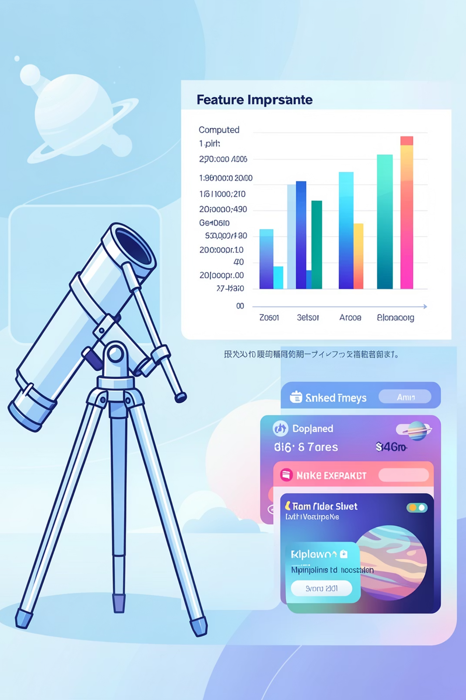
Results & Applications
Performance Summary
Scientific Insights
Achieved Accuracy ~0.999, indicating near-perfect predictions.
Maintained strong Precision ~0.986 and Recall ~0.990.
High F1-score ~0.988 reflects balanced performance.
Excellent ROC-AUC ~0.9999 shows strong class separability.
Calibration improved probability reliability for accurate exoplanet ranking tasks.
Derived features (insolation flux, equilibrium temperature) and radius-to-mass proxies dominated importance. Nonlinear interactions — e.g., moderate flux + rocky radius regime — identified as high-probability regions, consistent with theoretical habitable-zone expectations.
Use Cases
Enables efficient scheduling for spectroscopic follow-up (JWST, ELTs), prioritized target lists for habitability surveys, and pedagogical tools for graduate-level exoplanet data courses.
Note: numerical values above are illustrative; final reported metrics must reference the dataset split and confidence intervals obtained during cross-validation.

Slide 10

Conclusion & Future Scope
ExoHabitAI demonstrates a practical, interpretable ML approach to prioritize exoplanet candidates for habitability studies. The system improves triage efficiency, surfaces physically meaningful drivers of predictability, and integrates into research workflows via a web API and visualization dashboard.
Immediate next steps
Integrate streaming NASA/TESS alert feeds for near-real-time candidate scoring; incorporate measurement uncertainties directly in training (heteroscedastic models).
Mid-term research
Explore deep learning approaches (graph neural networks on star–planet interaction graphs, Gaussian processes for uncertainty-aware regression), and validate on simulated atmospheres.
Broader impact
Deploy open-access ranked catalogs and educational modules to support interdisciplinary research and training of graduate students in astroinformatics.

