Slide 1




BEYOND EARTH THE QUEST FOR HABITABILITY
Assessing Life-Sustaining Potential in the Cosmos

Slide 2
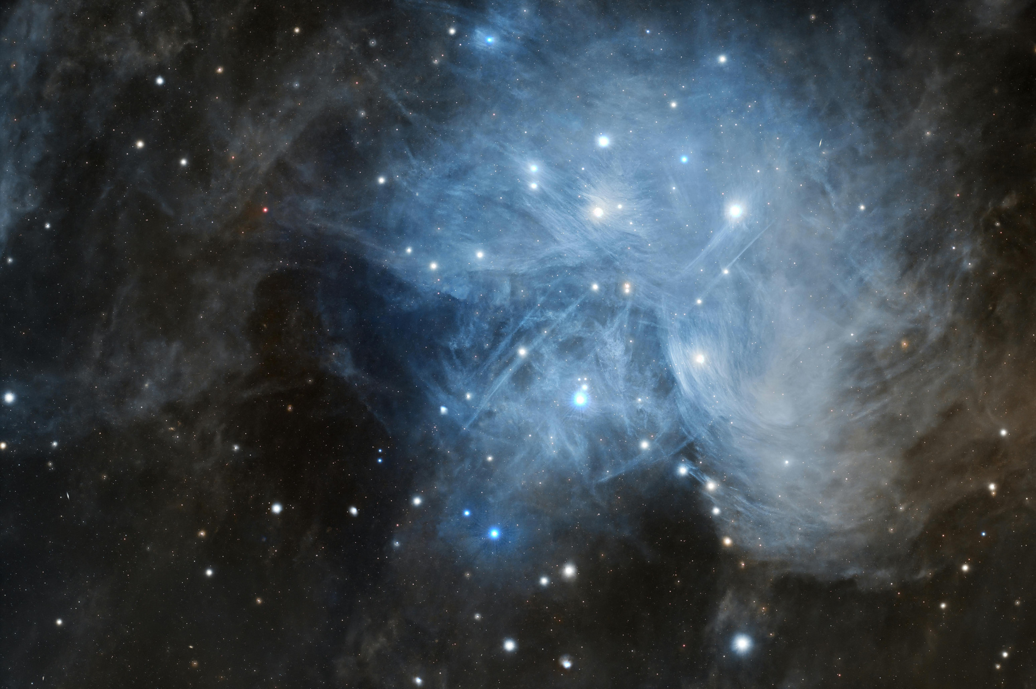

THE CORE CHALLENGE: FINDING "EARTH 2.0"
Page 02
The Search for Life: Humanity seeks to answer if we are alone, but the sheer scale of the universe makes targeting the right planets difficult.
Data Overload: With thousands of exoplanets discovered, identifying which ones possess the right conditions requires sophisticated filtering.
Distance Barriers: We cannot visit these worlds yet, so we must rely on remote sensing and atmospheric modeling.

Slide 3

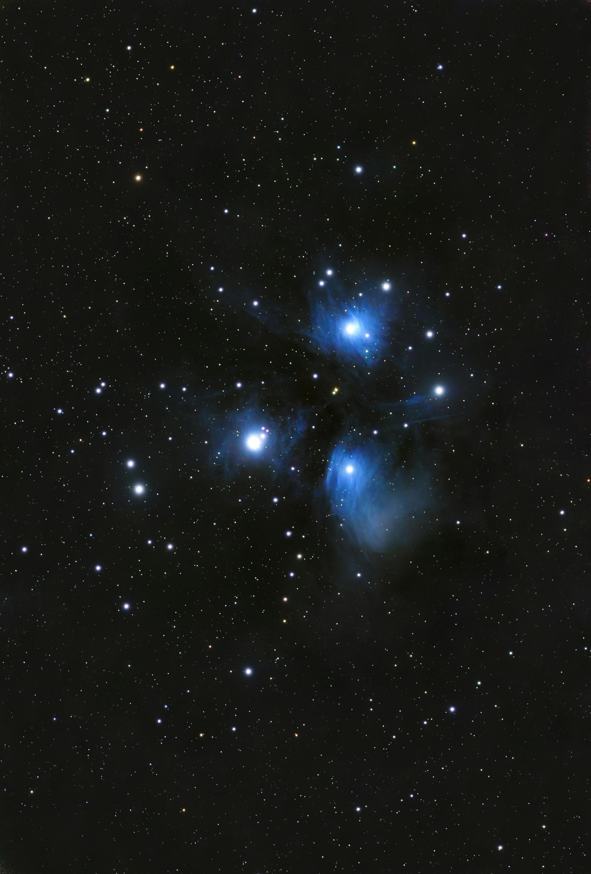
Page 03
THE "HABITABILITY STACK": DEFINING THE CRITERIA
Liquid Water: The primary solvent for life as we know it.
Energy Source: Stable radiation from a parent star or internal tidal heating.
Chemical Building Blocks: Presence of carbon, hydrogen, nitrogen, oxygen, phosphorus, and sulfur (CHNOPS).
Stable Environment: A protective atmosphere and magnetic field.

Slide 4
Page 04
THE STELLAR CONTEXT
(THE "SERVER" OF LIFE)
G-Type Stars (Sun-like)
01
Offer a balanced lifespan and radiation levels but are less common.
F-Type Stars (Hyper-Scale Hosts)
03
These stars are larger and hotter than the Sun, providing an expansive habitable zone.
M-Dwarf Stars (Red Dwarfs)
The Goldilocks Zone
02
Most common stars in the galaxy; however, they often feature violent flares that could strip atmospheres.
04
This is the specific orbital range where temperatures allow liquid water to exist on a surface, serving as the "core environment" required for habitability.

Slide 5
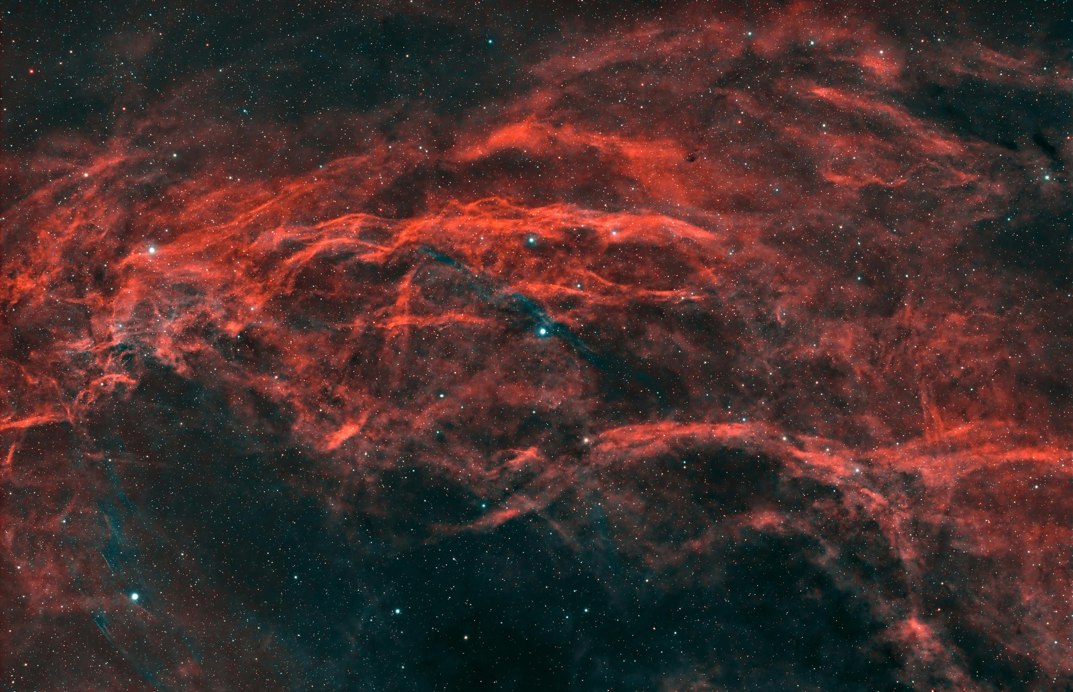
Fradel and Spies
Page 05
Random Forest Classifier: This ensemble learning method serves as our primary model for predicting if a distant world is habitable.
Data Sourcing: The system is trained on extensive NASA exoplanet datasets to ensure high-fidelity results.
Predictive Power: The framework is built to handle 11 distinct input features for every planet analyzed.
Deployment: The application utilizes a modern interface to make complex astrophysical data accessible to users.
TECHNOLOGY STACK: THE ML FRAMEWORK EXPLAINED

Slide 6
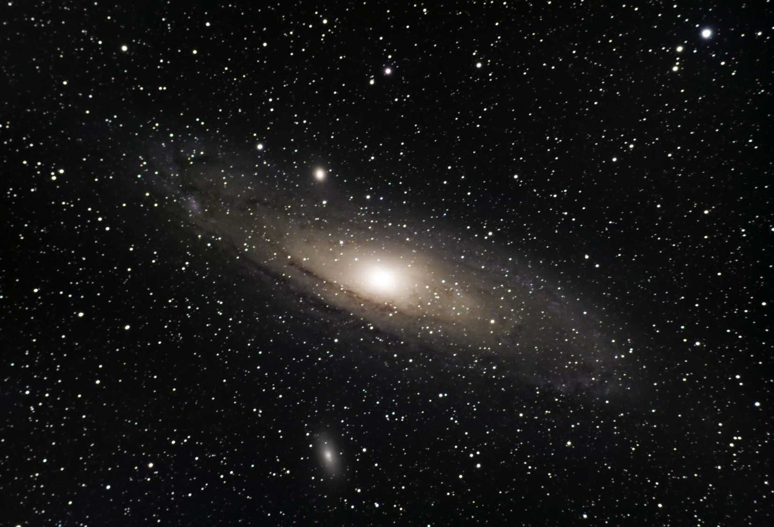
Page 06
CORE FEATURES OF THE EXOHABIT PLATFORM
Real-Time Prediction: Users can input specific planet parameters to get an immediate habitability score.
Interactive Rankings: A centralized leaderboard displays the most promising candidates ranked by probability.
Detailed Analytics: A comprehensive dashboard provides insights into model logic and data distribution.
Massive Dataset Handling: The platform efficiently processes tens of thousands of individual planetary entries.
Lunar Diversity

Slide 7
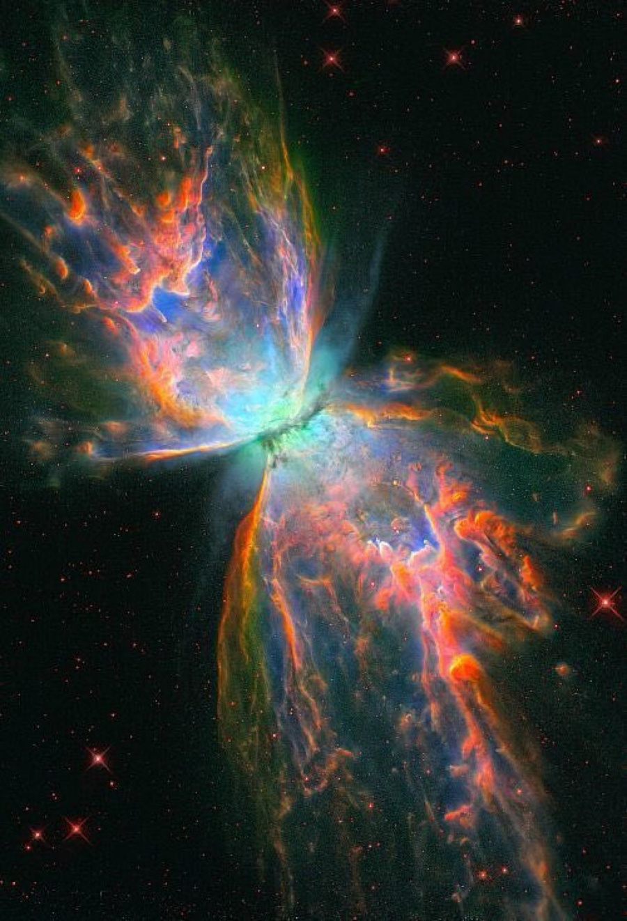
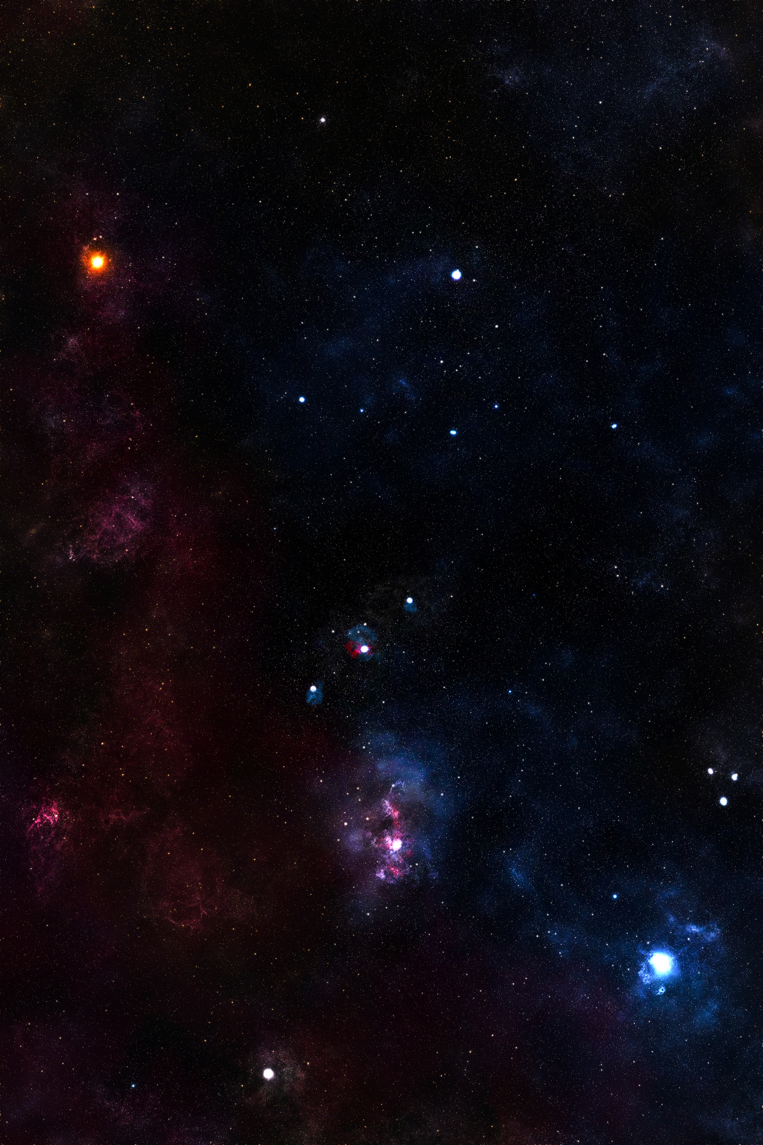
CHALLENGES IN EXOPLANET ANALYSIS
Page 07
Data Complexity: Analyzing diverse planetary systems involves managing inconsistent metrics across thousands of light-years.
Manual Inefficiencies: Traditional methods of identifying habitable worlds rely on manual processes that are slow and prone to human error.
Information Disconnect: There is often a lack of centralized, real-time data for astronomers to prioritize targets.
Solution: Implementing an AI-driven platform facilitates streamlined data management and more accurate filtering.

Slide 8
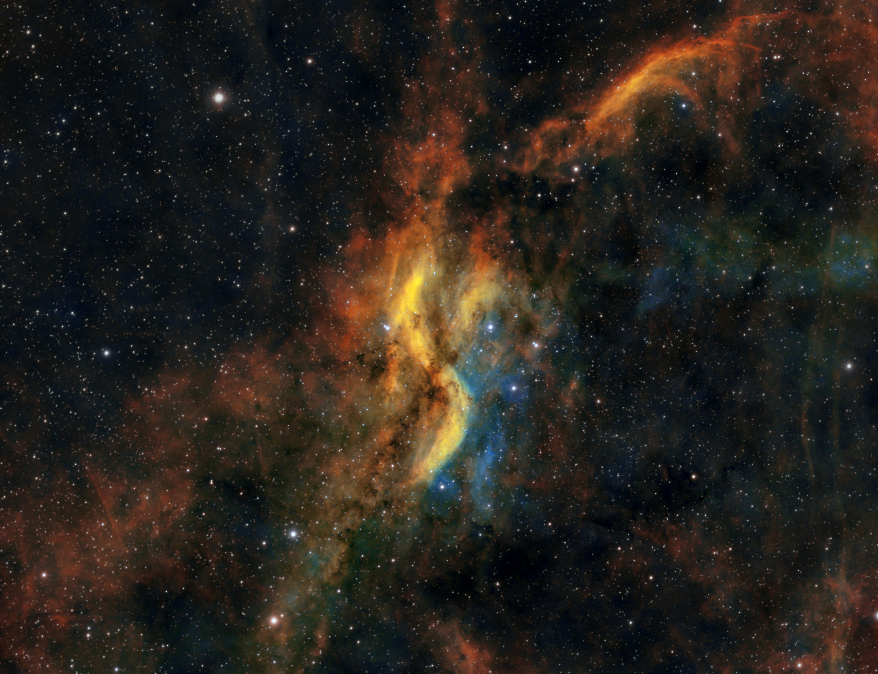

Page 08
SYSTEM ARCHITECTURE OVERVIEW
Modular Design: Each feature—from prediction to analytics—operates as an independent module for easy updates.
Secure API Integration: RESTful APIs facilitate communication between the machine learning backend and the user interface.
Data Integrity: Implementation of secure protocols ensures that research data remains consistent and protected.
Scalability: The architecture supports the addition of millions of new data points as future space missions uncover more planets.

Slide 9
Page 09
HOME PAGE: THE PROJECT AT A GLANCE
01
02
03
Total Scope:
High Performance
Diverse Categorization
Our model has successfully analyzed 39,212 exoplanets from the NASA archive.
We have achieved an impressive ~95% model accuracy during testing phases.
Planets are classified across 7 different spectral classes of stars.

Slide 10
Page 10
PREDICT PAGE: INTERACTIVE HABITABILITY TESTING
01
02
03
Seamless Onboarding
Stellar Context
Immediate Feedback
The interface allows users to easily enter planetary data points for instant analysis.
Users also provide details on the host star, such as its Temperature and Metallicity.
Clicking "Predict Habitability" generates a score based on the Random Forest decision trees.

Slide 11
Page 11
RANKINGS: THE HABITABILITY LEADERBOARD
01
02
03
Prioritized Results
Comparative View
Efficiency
The ranking system identifies the worlds with the highest probability of life-sustaining conditions.
Researchers can compare Orbital Periods and Star Types side-by-side to find trends.
This leaderboard reduces manual coordination by highlighting the "best" targets immediately.

Slide 12
Page 12
ANALYTICS DASHBOARD DEEP DATA INSIGHTS
01
02
03
Analytics Dashboard:
Score Distribution
Interactive Visuals
Equilibrium Temperature and Planet Radius are identified as the most critical factors for our model.
The dashboard visualizes that while thousands of planets exist, only a fraction fall into the 0.9-1.0 habitability range.
Comparative scatter plots help identify clusters where habitability is most likely.

Slide 13
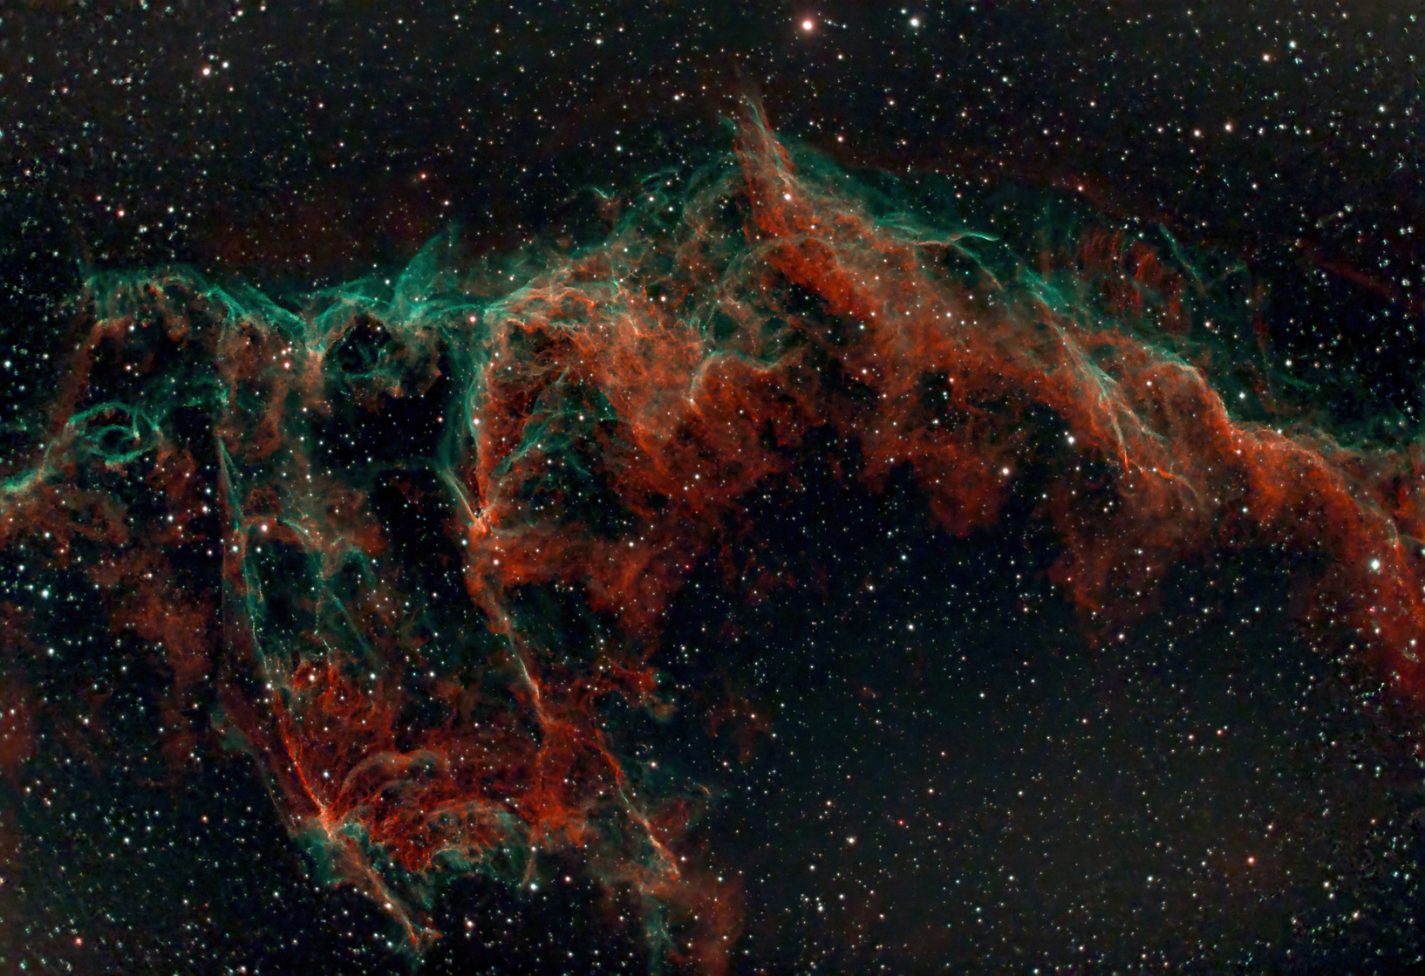
Page 13
FUTURE ENHANCEMENTS FOR EXOHABIT
Predictive Atmosphere Modeling: Future versions will forecast the likelihood of oxygen or methane based on mass and temperature.
AI Recommendations: We plan to utilize AI to suggest similar planets to users based on their search history and interests.
Smart Reminders: The platform could notify researchers when new telescope data for a high-probability planet becomes available.
Continuous Learning: The system will refine its suggestions through a continuous feedback loop from the scientific community.

Slide 14
Page 14
THANK YOU FOR JOINING US

