Slide 1

🪐 EXOHABIT-AI: EXOPLANET HABITABILITY PREDICTION
SYSTEM

Slide 2
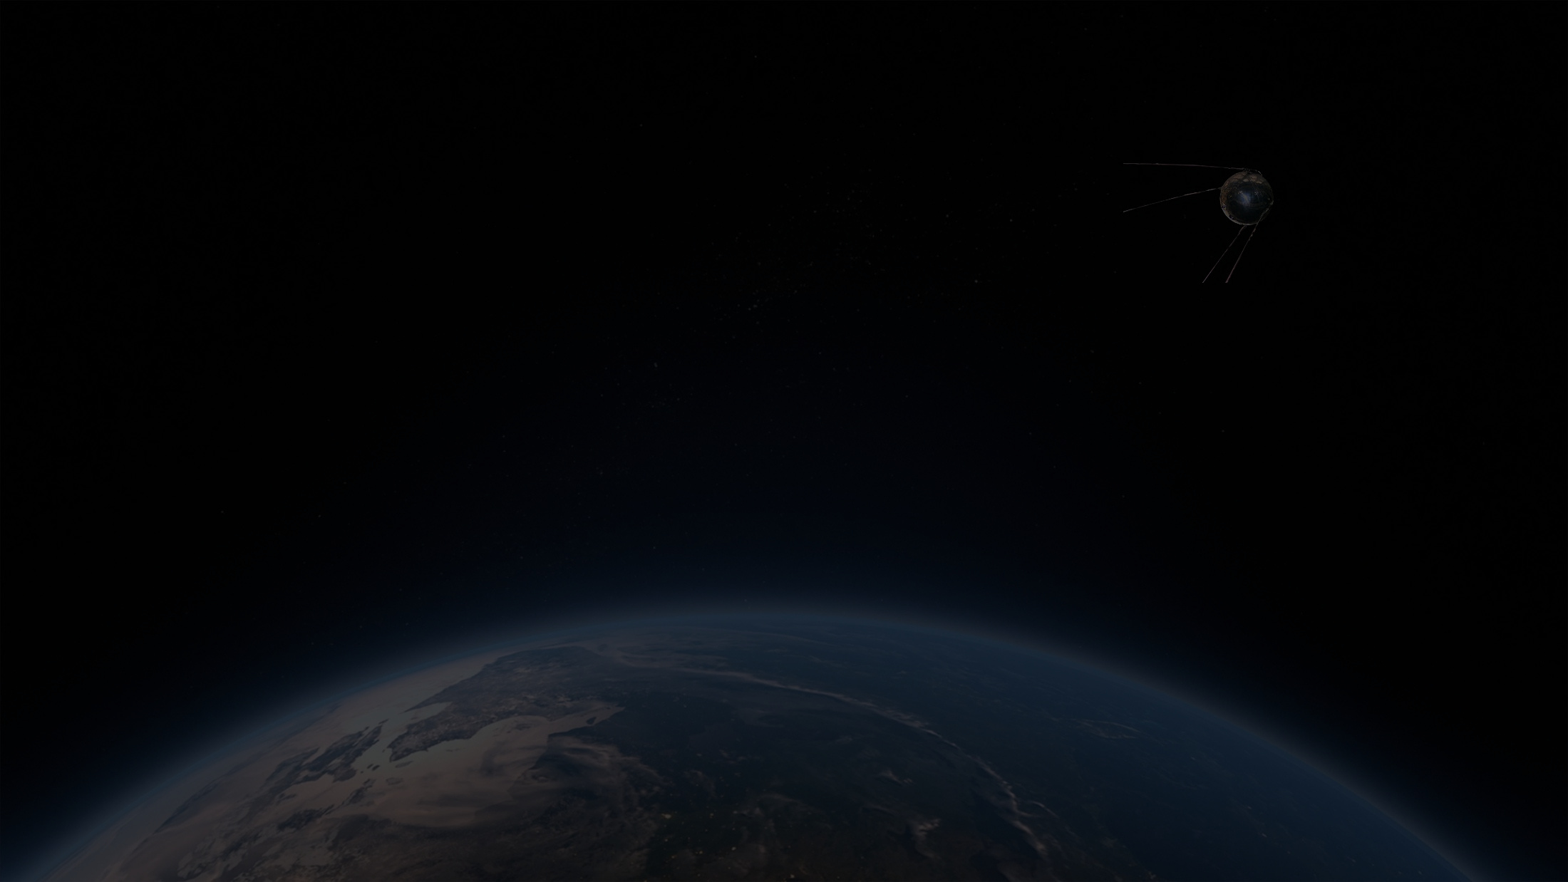
PROJECT OVERVIEW
Intelligent Prediction: A machine learning–based web application designed to analyze exoplanet and stellar parameters to predict habitability.
Scientific Analysis: Combines feature engineering, ML predictions, and interactive dashboards to identify planets that may support life.
Accessible Platform: An educational tool featuring famous exoplanets, discovery methods, and a 3D starfield experience.
Cloud Deployment: Built with a Flask backend and deployed for online access.

Slide 3

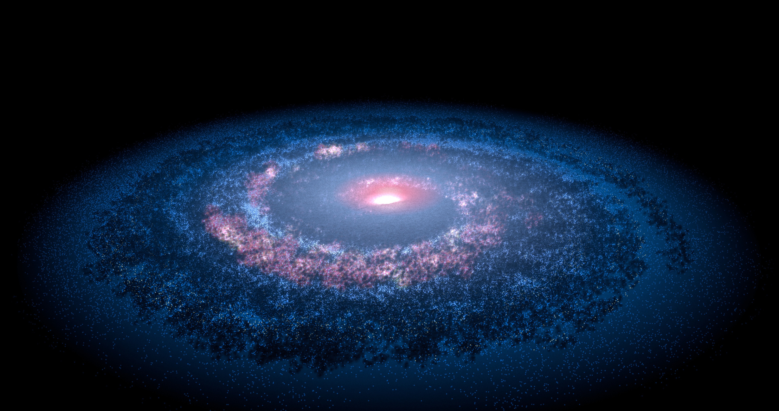

PROJECT OBJECTIVES
Classify Habitability: Determine if an exoplanet is Habitable or Not Habitable using binary classification.
Scoring System: Compute a Habitability Score and Percentage based on planetary suitability.
Data Ranking: Rank confirmed exoplanets based on their predicted habitability scores.
Visual Analytics: Provide insights through interactive dashboards and feature importance plots.
End-to-End Development: Demonstrate a full-stack ML lifecycle from data preprocessing to web deployment.

Slide 4
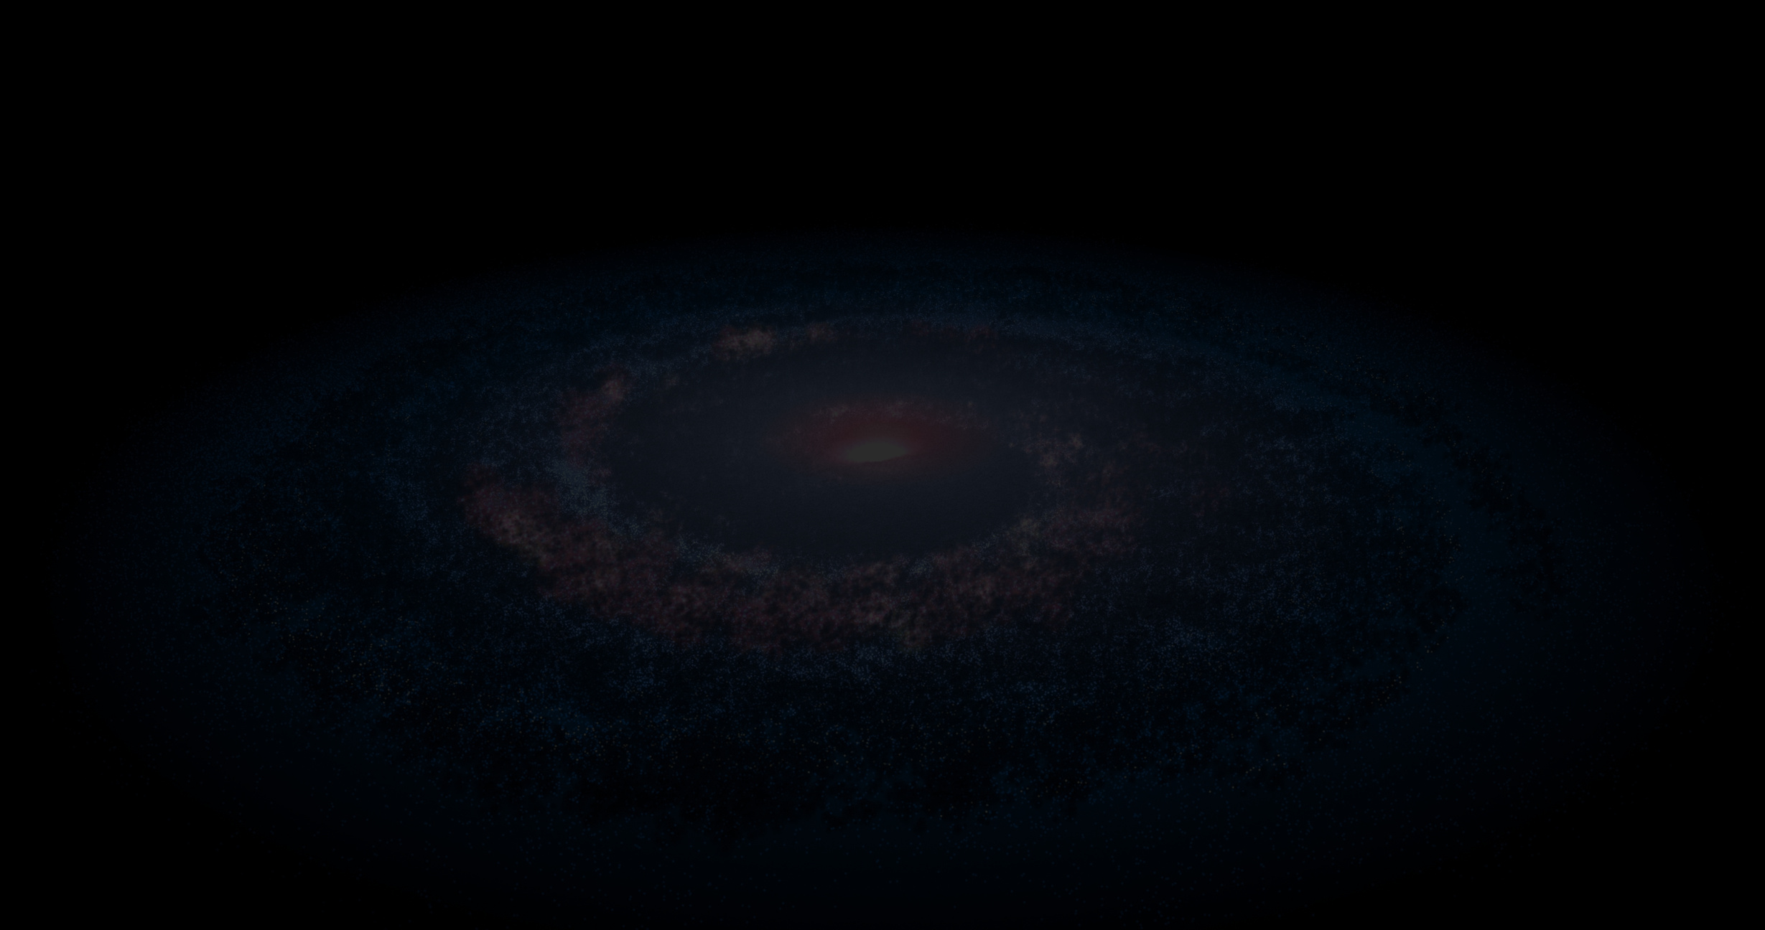

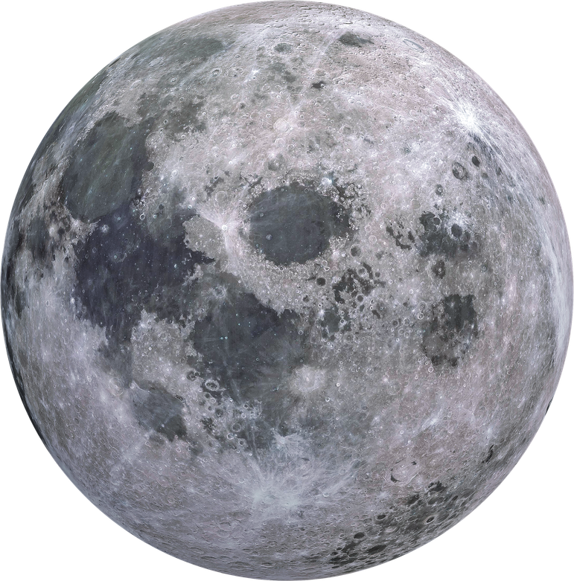
TECHNOLOGY STACK
Programming & Machine Learning
Language: Python 3.8+
Core Libraries: NumPy, Pandas, Scikit-learn
Algorithm: Random Forest Classifier
Serialization: Joblib / Pickle
Web & Frontend
Backend Framework: Flask (Python)
Frontend Core: HTML5, CSS3, JavaScript (ES6+), Bootstrap
Graphics: Three.js (3D Starfield), GSAP (Animations), Chart.js (Visualizations)

Slide 5


DATASET & PARAMETERS
The system analyzes real exoplanet data with 10 key input features:
Planetary Features: Radius (Earth radii), Mass (Earth masses), Equilibrium Temperature (K), and Orbital Period (days).
Stellar Features: Effective Temperature (K), Radius (Solar radii), and Mass (Solar masses).
System Features: Distance to the system (parsec), number of stars, and number of planets.

Slide 6

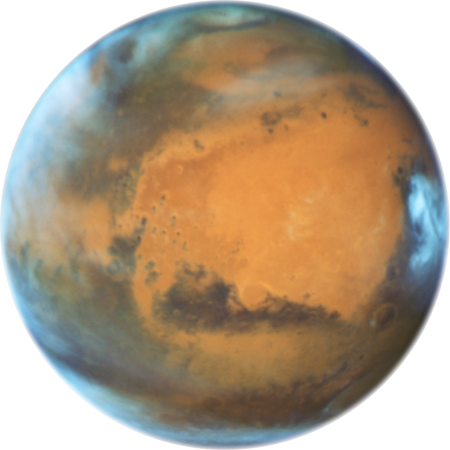
MACHINE LEARNING MODEL
1.
HABITABILITY SCORE LOGIC
2.
RANDOM FOREST CLASSIFIER
Algorithm: A robust ensemble learning method chosen for high accuracy and ability to handle non-linear data.
Training: Trained on NASA Exoplanet Archive data.
Output: Provides binary classification (Habitable/Not Habitable) along with probability scores for confidence levels.
Temperature Closeness: Evaluates how near the planet's temperature is to Earth's average (288K).
Physical Constraints: Assesses the suitability of the planet's radius and mass.
Normalization: The raw metrics are converted into a 0–100% habitability percentage.

Slide 7
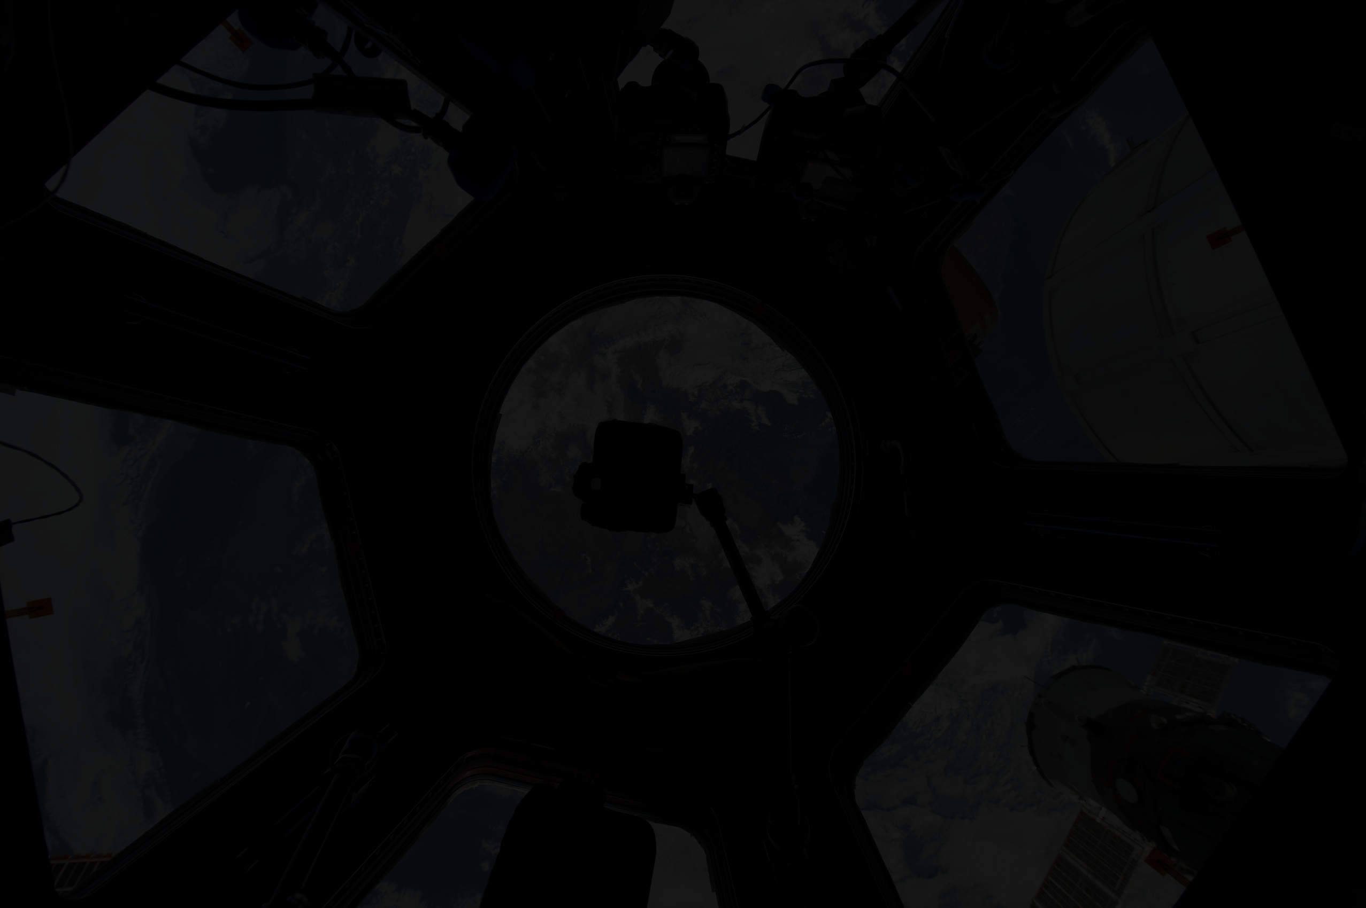

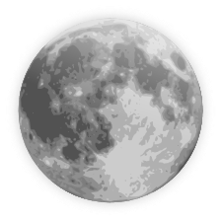
WEB APPLICATION FEATURES
🏠 Home Page: Project overview and navigation to key features.
🔮 Prediction Page: Interactive form for users to input planetary parameters and receive instant predictions.
🏆 Rankings Page: A searchable table showing confirmed exoplanets ranked by their habitability score.
📊 Dashboard: Dynamic charts showing:
Habitability Score Distribution
Feature Importance (which parameters matter most)
Star Temperature vs. Habitability Score
🚀 REST API: Endpoints for single and batch predictions (up to 100 planets).

Slide 8

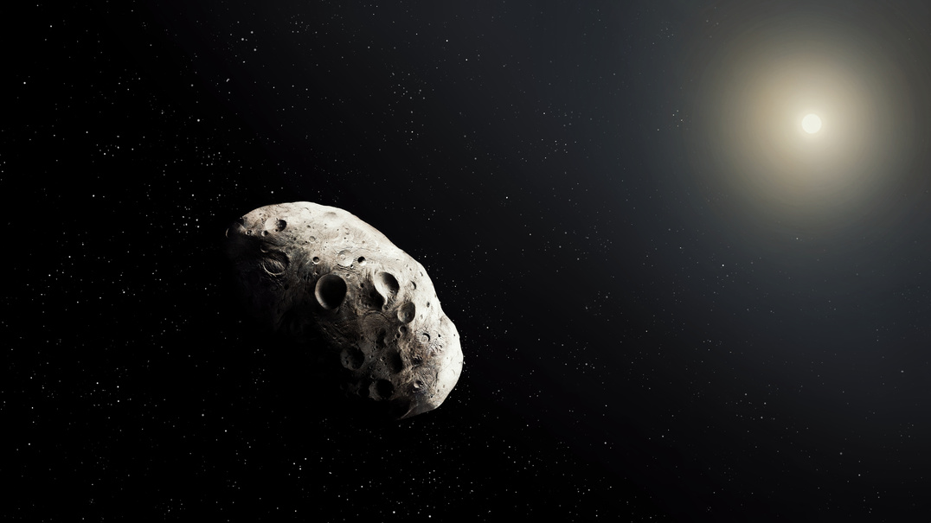



PROJECT MILESTONES
MILESTONE 1
MILESTONE 2
MILESTONE 3
MILESTONE 4
Data exploration and statistical analysis of planetary trends.
Preprocessing, handling missing values, and feature scaling.
Model building, training, and performance evaluation.
Interactive dashboard creation and Flask web ,Deployment to cloud platforms.

Slide 9



CONCLUSION
Scientific Insight: ExoHabit-AI bridges the gap between raw astronomical data and actionable insights by analyzing over 5,600 confirmed planets to identify those with the highest potential to support life.
Technical Excellence: The project demonstrates a robust end-to-end implementation of the Random Forest algorithm, achieving high-accuracy habitability predictions through advanced feature engineering and data processing.
Interactive Innovation: By integrating a Flask backend with a 3D Three.js frontend, the application provides an immersive and educational experience that makes complex planetary science accessible to everyone.
Future Readiness: With a roadmap focused on real-time data integration and advanced atmospheric analysis, ExoHabit-AI is positioned to grow alongside the next generation of space exploration missions.

Slide 10
THANK YOU!

