Slide 1
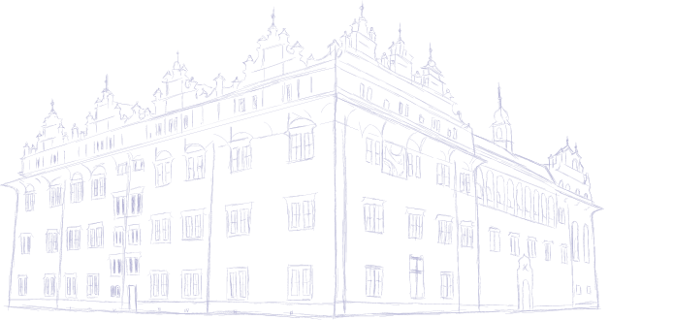


Exoplanet Habitability Prediction Using ML
Roshini s

Slide 2
INTRODUCTION
Thousands of exoplanets have been discovered outside our solar system. However, identifying which of them could support life is a major scientific challenge.
Habitability depends on important factors such as:
Planet radius and mass
Orbital period
Equilibrium temperature
Star properties (temperature, mass, metallicity)
Analyzing large exoplanet datasets manually is difficult. Therefore, in this project, we use Machine Learning to predict whether a planet is Habitable or Not Habitable.

Slide 3
PROBLEM STATEMENT
Although thousands of exoplanets have been discovered, determining which planets are potentially habitable remains a complex challenge. Habitability depends on multiple planetary and stellar parameters, and analyzing these features manually for large datasets is inefficient and time-consuming.
There is a need for:
A data-driven approach to analyze exoplanet features
An automated system to classify planets as Habitable or Not Habitable
An interactive platform to visualize planetary data and predictions
This project aims to solve this problem using Machine Learning and data visualization techniques.

Slide 4
OBJECTIVE
The main objectives of this project are:
To analyze exoplanet data obtained from NASA Exoplanet Archive
To select important planetary and stellar features affecting habitability
To build a Machine Learning model (Random Forest) for predicting habitability
To create a new “habitable” label based on scientific threshold conditions
To develop an interactive Streamlit web application
To provide real-time prediction and visualization of exoplanet data

Slide 5
DATASET DESCRIPTION
1
2
Planet features
Star Features
Radius
Mass
Orbital Period
Equilibrium Temperature
Insolation flux
Temperature
Mass
Radius
Metallicity
DATASET
Dataset Source: NASA Exoplanet Archive
Contains thousands of discovered exoplanets
Selected 10 important features for prediction
3
System Feature
Distance from earth

Slide 6
Methodology
Data cleaning & Preprocessing
Feature Engineering
Model Selection
Scaling
Training & Testing
Data Selecting columns, Filtering, Scaling features
Creating Habitable label based on radius & temperature
Random Forest Classifier
StandardScaler for consistent feature ranges
80-20 split or cross validation

Slide 7
Dashboard Design
Streamlit Interface
Navigation: Prediction page Vs Data Visualization page
Data preview: First 5 habitable planets.
Correlation Heatmap .
Scatter plots of features vs features planet radius .
Bar chart :Habitable vs non-Habitable count.
Prediction Workflow
User inputs planetary and Steller features
Model predicts Habitable / Not Habitable
Real-Time visualization and feedback

Slide 8
1
2
Imbalanced Dataset
Feature Mismatch
Random Forest handles class imbalance
Ensuring 10 features match scaler model
Challenges & Solutions
3
Real-time predictions
Streamlit provides instant feedback

Slide 9
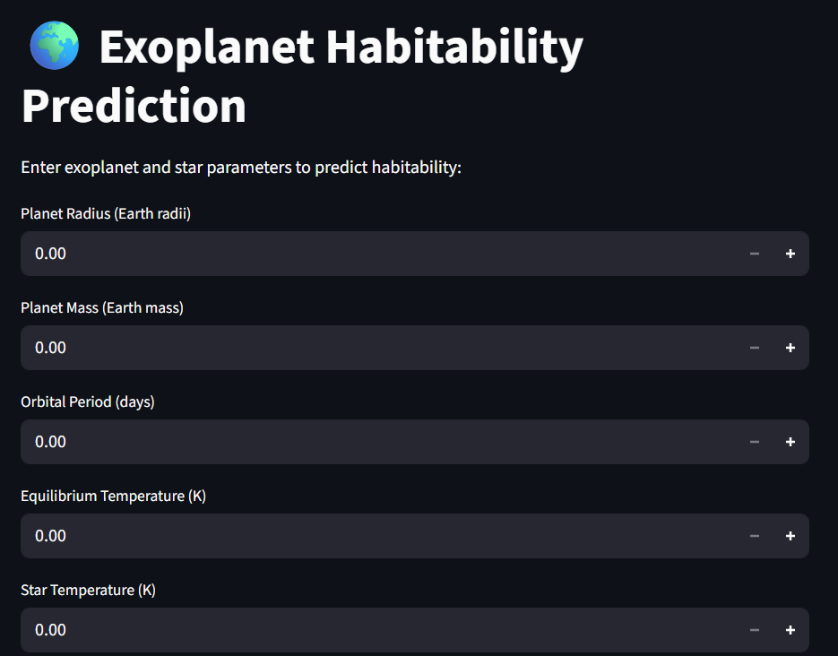
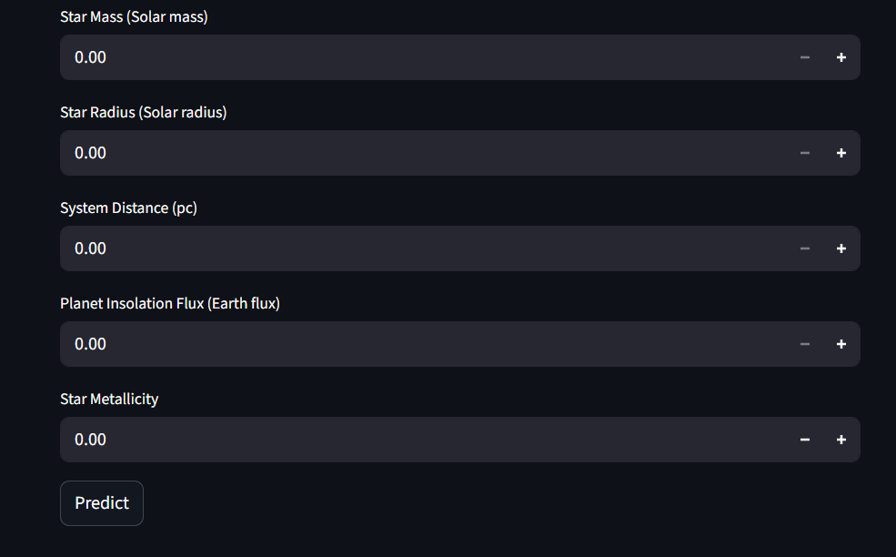
Prediction Page

Slide 10
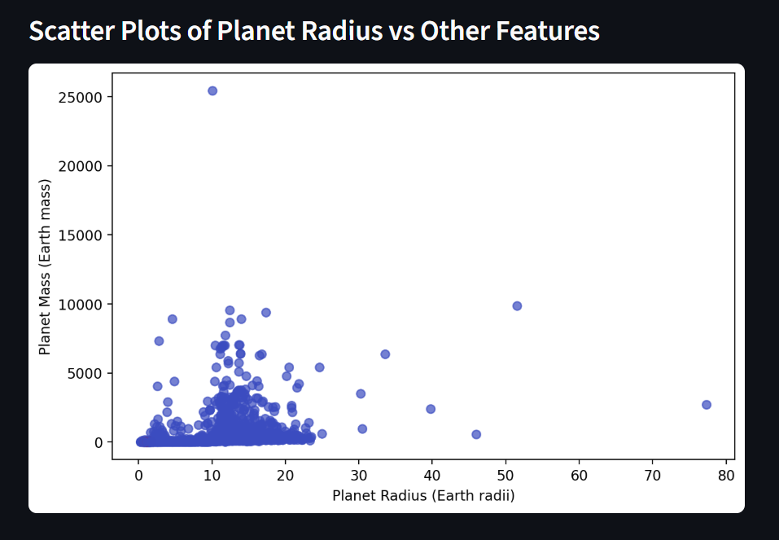
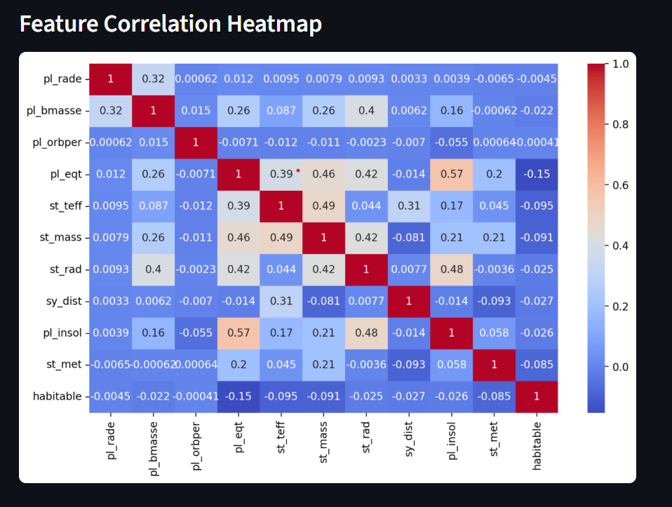
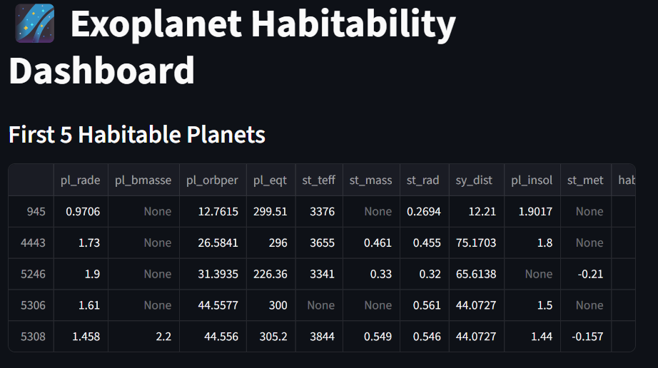
Dashboard

Slide 11
Conclusion
Successfully build an interactive dashboard for predicting exoplanet habitability
Model allows user to input planet / star data and get instant result
Data visualization helps explore the planetary system trends

Slide 12

Thank You

