Slide 1
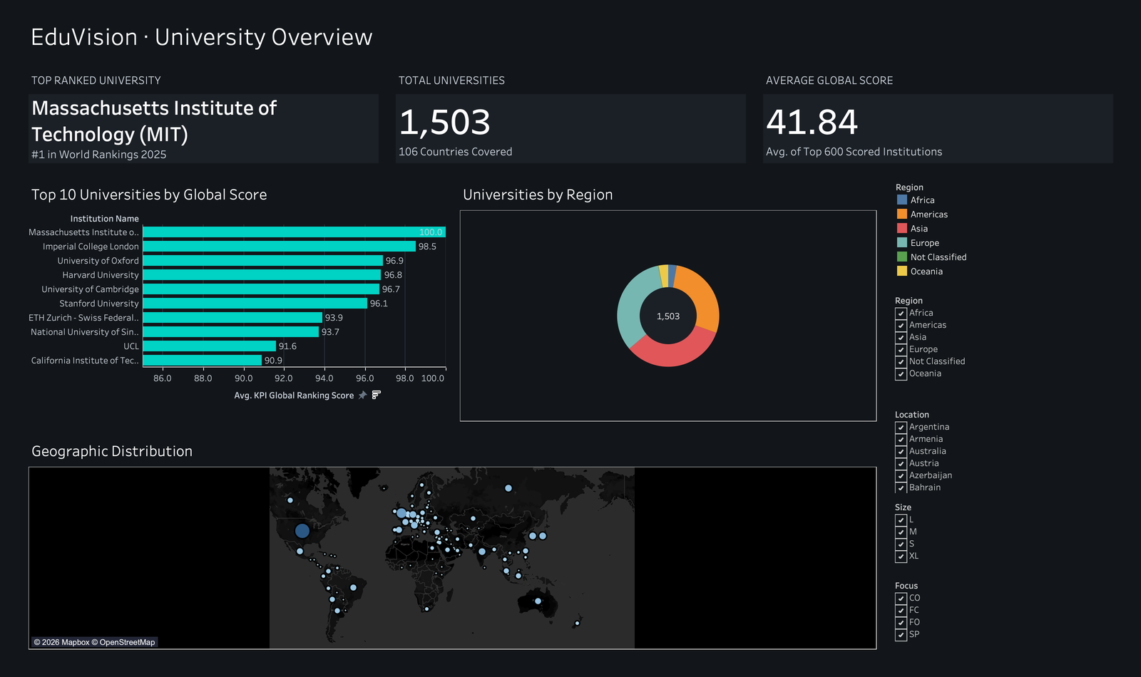
INFOSYS SPRINGBOARD VIRTUAL INTERNSHIP
EduVision_DV
Global Higher Education Performance Analytics
QS World University Rankings 2025 integrated with Times Higher Education, delivered as four interactive Tableau Desktop dashboards.
1,503
106
6
institutions
countries
KPIs
Sireesha Kurapalli
Tableau Desktop 2026.2 · September 2026
Notes:
Introduce the project: an end-to-end BI build for the Infosys Springboard internship. Two independent global ranking sources harmonised into one validated dataset, then four executive dashboards in Tableau Desktop. Everything you see is built from 1,503 real institutions.

Slide 2
OBJECTIVE
From two raw ranking files to four decision dashboards
01
02
03
04
Ingest
Clean
Integrate
Engineer & validate
QS 2025 (1,503 × 28) and THE (200 × 13) loaded from source files with encoding and type checks.
Rank strings parsed to numerics: '15=' → 15, '1201-1400' → 1300.5, '1401+' → 1401. Countries normalised.
QS held as the base table; THE joined on institution identity with 30 reviewed manual mappings.
Six KPIs plus three tooltip fields, then 28 automated assertions before anything reaches Tableau.
1,503
195
28 / 28
Institutions preserved
QS institutions matched to THE
Validation checks passed
No row dropped at any pipeline stage
1,308 remain deliberately null
Re-runs reproduce byte-identical output
Notes:
Four stages. The key discipline point: QS is the base table and every one of its 1,503 rows survives to the final dataset. The THE join enriches 195 of them; the other 1,308 keep null THE fields rather than being dropped or zero-filled.

Slide 3
THE DATASET
Two sources, one base table, honest gaps
BASE TABLE
ENRICHMENT
JOIN OUTCOME
QS World University Rankings 2025
Times Higher Education Rankings
195 matched
Five THE institutions were left unmatched on purpose — three are absent from QS (Karolinska, Charité, Scuola Normale Superiore di Pisa) and two are ambiguous multi-campus systems (Massachusetts, Indiana). Guessing a campus would have invented data.
1,503 institutions · 28 raw columns
200 institutions · 13 raw columns
Overall score published for the top 600 only
Academic reputation and citations for all 1,503
Region, Size, Focus and research-intensity class
Students-per-staff and international student %
FTE student headcount
Research environment score (productivity proxy)
Final dataset: 1,503 rows × 52 columns
Null policy
THE-derived fields stay null for the 1,308 unmatched institutions. They are never zero-filled, never imputed, and never averaged away. Tableau surfaces the gap in-view — the "1 null", "5 nulls" and ">1K nulls" indicators on the dashboards are the dataset telling the truth about its own coverage.
Notes:
Explain why QS is the base: it is the broader frame at 1,503 institutions against THE's 200. The five unmatched THE institutions are the interesting part — I could have forced them in, but two are multi-campus systems where picking Amherst over Boston would be fabricating a data point. The null policy is the single most important rule in this project.

Slide 4
KPI FRAMEWORK
Six measures — and what each one actually covers
KPI
Source measure
Coverage
Mean
Range
Global Ranking Score
QS Overall Score
600
41.84
20.8 – 100
Academic Reputation
QS Academic Reputation
1,503
20.29
1.3 – 100
Research Impact
QS Citations per Faculty
1,503
23.50
1.0 – 100
Students per Staff
THE Student–Staff Ratio
195
17.44
3.8 – 58.0
International Student %
THE International Students
195
25.48%
1% – 72%
Research Productivity (Proxy)
THE Research Environment
195
61.23
34.9 – 100
Research Productivity (Proxy)
This is a project proxy derived from the THE Research Environment score — not THE's official Research Productivity metric. It is labelled "(Proxy)" everywhere it appears, and the Research Analytics dashboard carries a permanent footnote saying so.
Notes:
Point at the Coverage column — that is the honesty column. Only two KPIs cover all 1,503 institutions; three cover the 195 THE-matched ones, and the QS overall score exists for the top 600 only. Every average on the dashboards is computed over its own valid population, never over a padded 1,503.

Slide 5
VALIDATION
Evidence the numbers are trustworthy
28 / 28
2
0
Assertions passed
Independent implementations
Bytes of drift
Structure, coverage, ranges and means
Script pipeline and Colab notebook agree
Re-runs reproduce the dataset exactly
What is checked
Why it is reproducible
Row count holds at 1,503 through every stage
106 countries; United States at 197 institutions
195 matched / 1,308 null — exact, not approximate
Research-intensity split: VH 1021, HI 362, MD 104, LO 16
Every KPI's non-null count, minimum, maximum and mean
The cleaning, integration and KPI scripts were re-run end to end and produced files byte-identical to the committed dataset. The Colab notebook — a separate implementation of the same logic — was executed across all 18 code cells and exported a dataset identical to the script output.
Two independent paths landing on the same bytes is the strongest evidence available that the numbers on the dashboards are not an accident of one particular run.
Notes:
This is the slide that answers 'how do I know this is right'. Not just 'the code ran' — the code ran twice, by two different routes, and produced the same bytes. If asked, the validation output is in docs/testing_report.md.

Slide 6
DASHBOARD 1 OF 4
University Overview
Three live KPI cards
Top institution, total count and average score — all computed, none hard-coded.
Top 10 by global score
Axis framed 85–100 so the gap from MIT's 100.0 to Caltech's 90.9 is readable.
Distribution and spread
A donut splits all 1,503 by region; the map plots their footprint.
Four linked filters
Region, Location, Size and Focus drive every view at once.
Notes:
Start here. The average global score of 41.84 is computed over the 600 institutions QS actually scored — the subtitle says so explicitly. Demonstrate a filter: pick one region and watch all four views respond.

Slide 7
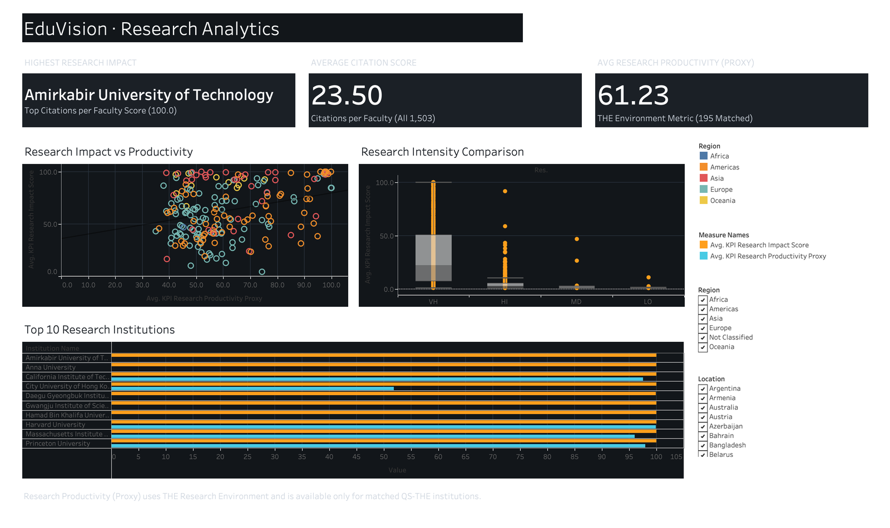
DASHBOARD 2 OF 4
Research Analytics
Impact against productivity
A scatter of the matched cohort shows only a weak relationship between the two.
Research intensity as a control
Box plots across VH / HI / MD / LO show most of the spread sits inside Very High.
Top 10 by research impact
Paired bars put citation impact beside the productivity proxy, institution by institution.
Mandatory proxy footnote
The caption naming the proxy's origin is pinned to the dashboard.
Notes:
The honest finding here is a negative one: the productivity proxy does not predict citation impact. Note the 5-nulls indicator on the Top 10 chart — five of those institutions have no proxy value at all, and the chart says so rather than drawing a zero.

Slide 8
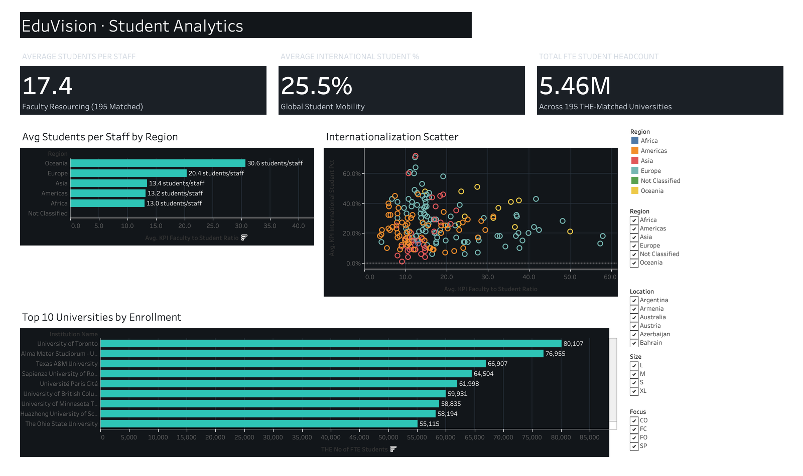
DASHBOARD 3 OF 4
Student Analytics
Teaching load by region
Oceania carries 30.6 students per staff against Africa's 13.0.
Internationalisation
International share against staffing ratio separates open systems from large domestic ones.
Enrolment scale
Toronto tops the cohort at 80,107 FTE students, ahead of Bologna's 76,955.
Coverage stated in view
Every card names its population, so no figure implies full coverage.
Notes:
Watch the coverage language on this tab: all three KPIs are THE-derived, so each card says '195 matched' rather than implying it speaks for all 1,503. The >1K nulls marker on the scatter is the same discipline.

Slide 9
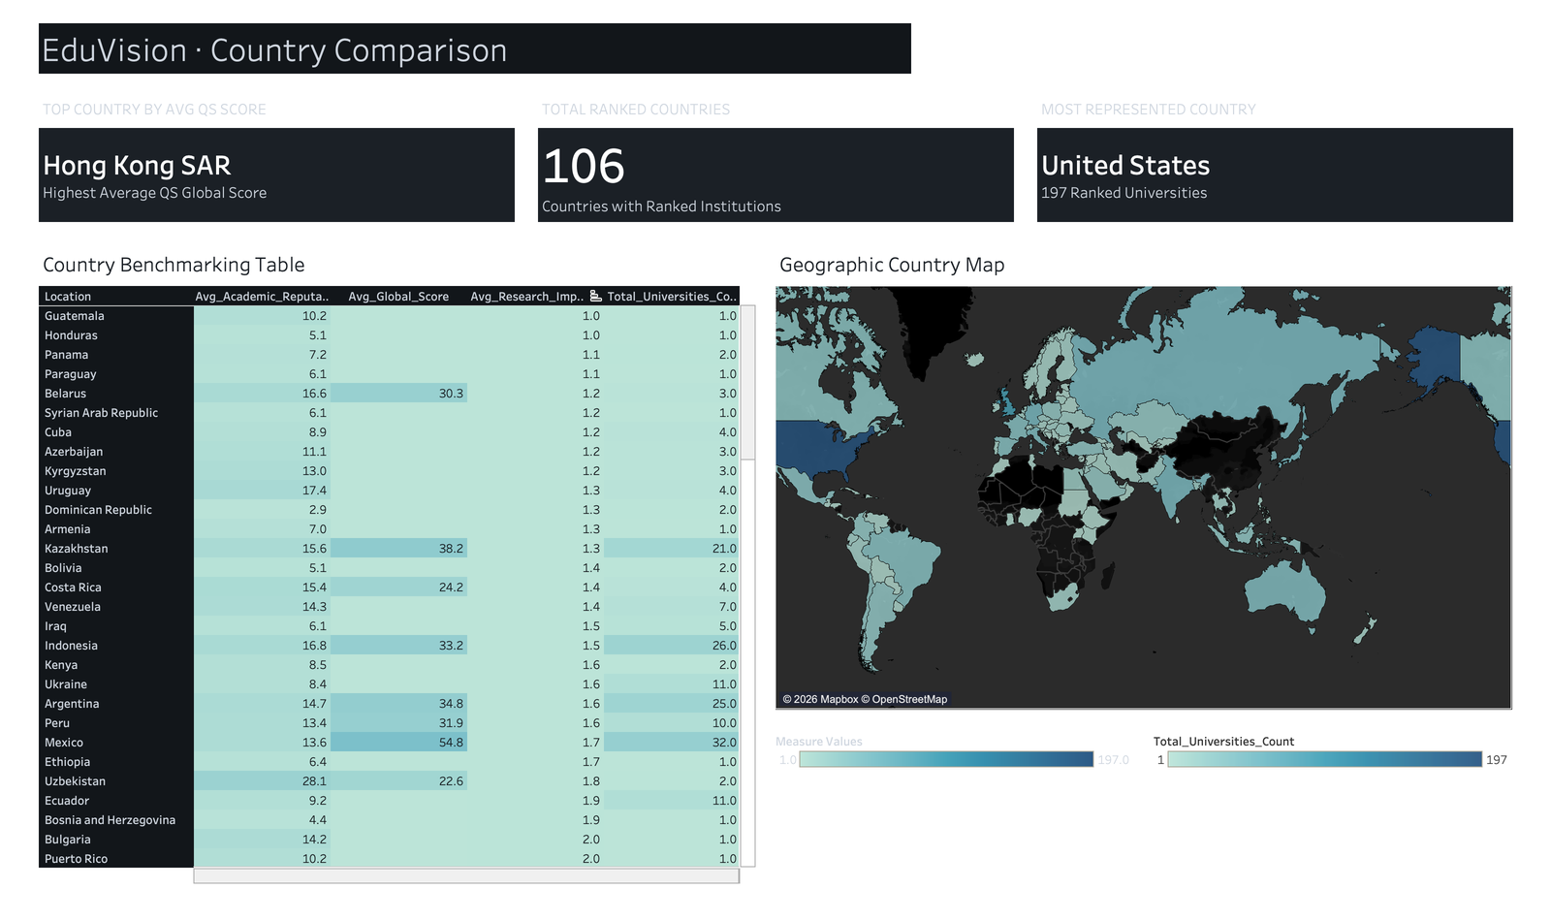
DASHBOARD 4 OF 4
Country Comparison & Benchmarking
Concentration beats volume
Hong Kong SAR leads on average score; the US leads on count at 197.
Benchmarking table
All 106 countries scored on four measures, colour-graded for outliers.
Interactive cross-filter
Selecting a country row zooms the choropleth and updates the country count.
Clearing restores everything
Deselecting restores all 106 countries on the map.
Notes:
Live demo moment: click a country row in the table and show the map responding, then clear it. If asked why the top-country cards don't change — they are deliberately global reference values, so they stay stable while the map and the country count respond.

Slide 10
WHAT THE DATA SHOWS
Four findings and where the project stands
Elite performance is concentrated, not national
Productivity does not buy citation impact
Hong Kong SAR posts the highest average QS score across just six institutions, while the United States fields 197 and sits lower on the mean. Depth of system and height of peak are different things.
The research proxy and citation impact scatter widely against each other. Institutions reach high impact from across the productivity range, so the two should be reported side by side, never substituted.
Teaching load splits sharply by region
Coverage is the finding nobody reports
Oceania runs 30.6 students per staff member against Africa's 13.0 — a structural difference in how systems are resourced, not a quality signal.
Only two of six KPIs describe all 1,503 institutions. Three describe 195. Treating those as interchangeable would have produced confident numbers about a population that was never measured.
Delivered
EduVision_DV.twbx — 4 dashboards, 21 worksheets, 10 calculated fields, 1 cross-filter action · reproducible Python pipeline and Colab notebook · methodology, testing and dashboard-build documentation.
Notes:
Close on the fourth finding — it is the one that shows judgement rather than output. Then offer the live workbook for questions: every figure on these slides can be traced back to a filter or a tooltip in Tableau.

