Slide 1
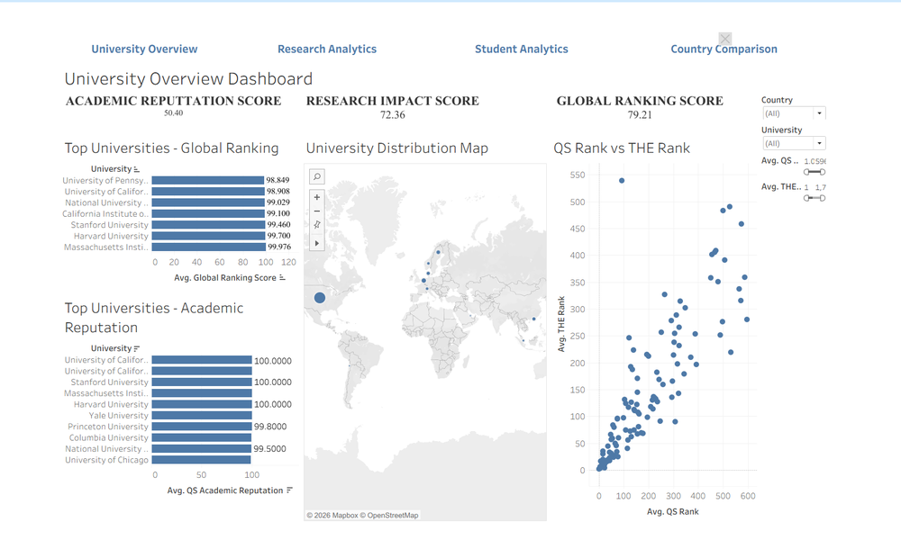
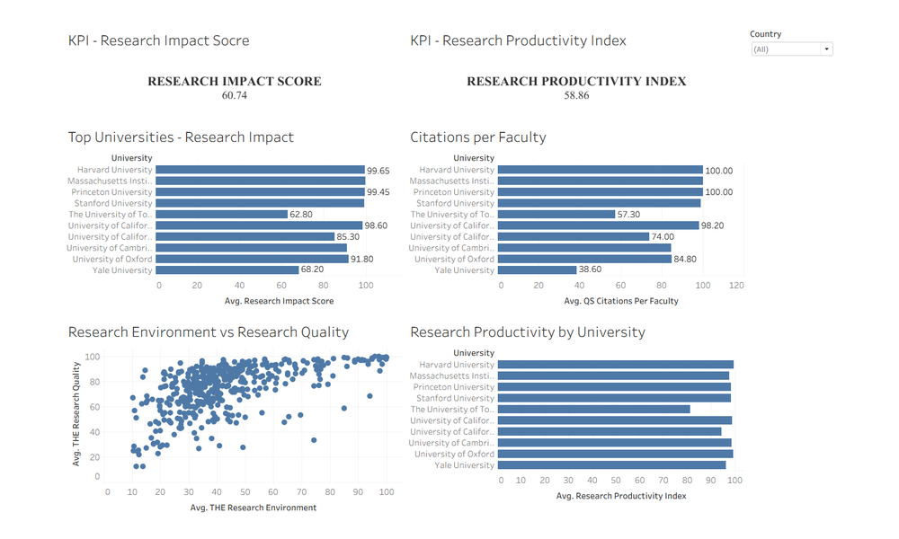
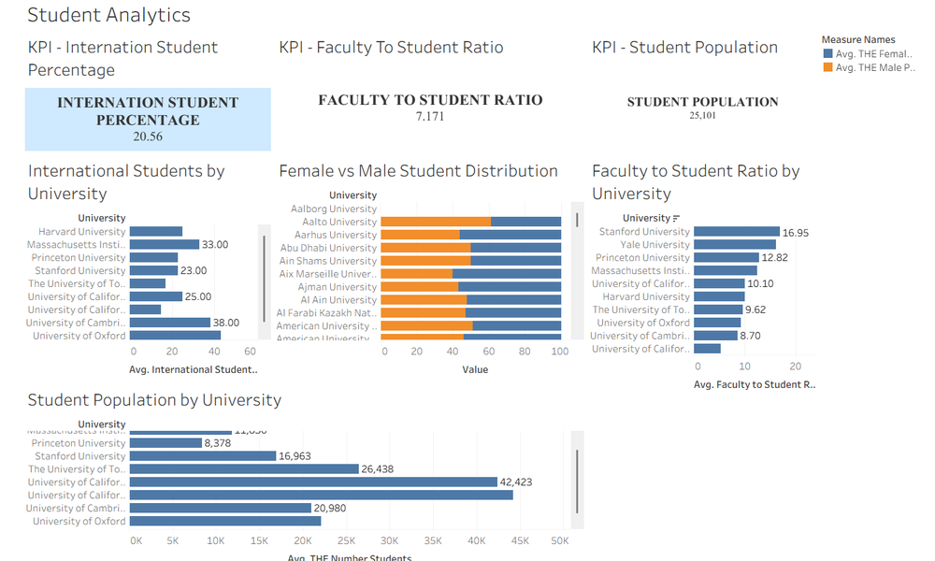
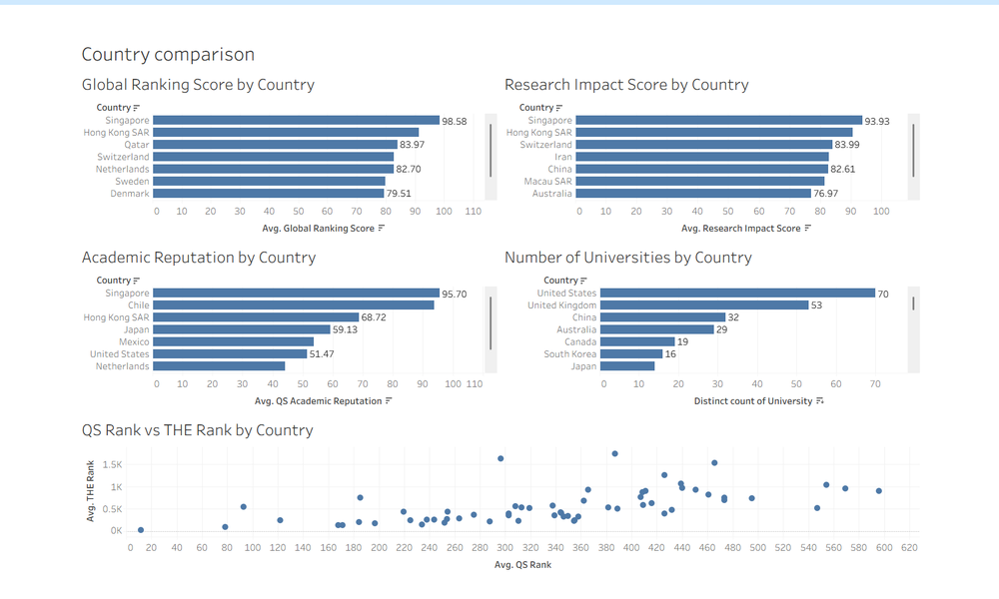
PROJECT PRESENTATION
EDUVISION DV
Higher Education
Performance Dashboard
University Overview
Research Analytics
A Tableau workbook for exploring university performance, research strength, student characteristics and country-level comparisons.
Student Analytics
Country Comparison
01

Slide 2
PROJECT AT A GLANCE
One workspace. Four perspectives.
EduVision DV organizes university-level indicators into a single workbook so a viewer can move from institution performance to research, student composition and country comparisons without switching between separate reports.
04
457
dashboards
university rows in the current workbook
06
01
core KPI measures
.twbx packaged workbook
THE FOUR DASHBOARDS
01
02
03
04
University Overview
Research Analytics
Student Analytics
Country Comparison
Ranking, academic reputation, geography and QS/THE comparison.
Impact, citations, research environment/quality and productivity.
International students, enrollment, staff ratio and gender mix.
Country-level scores, university counts and rank comparison.
02

Slide 3
PROBLEM & OBJECTIVE
Why this dashboard was built
THE CHALLENGE
THE OBJECTIVE
Useful indicators are spread across ranking and student measures.
Turn the indicators into an interactive, navigable analytical view.
• Rank, reputation, research and student indicators answer different questions.
• Reading separate tables makes institution and country comparisons slower.
• A viewer needs a consistent way to filter, inspect and compare records.
• Bring core university and country indicators into one Tableau workbook.
• Use KPI cards, ranking bars, a distribution map and scatter plots to guide exploration.
• Provide filters and navigation so users can focus on the level of detail they need.
03

Slide 4
DATA SOURCES & COVERAGE
A consolidated university-level data foundation
QS World University Rankings 2025
Times Higher Education indicators
QS
THE
Ranking position, academic reputation, citations per faculty, and other institutional indicators.
MERGE
THE rank/year, research environment and quality, student numbers, faculty ratio and gender indicators.
TABLEAU DATA SOURCE
University_Data • university_final_dataset
457 university rows represented in the current workbook
04

Slide 5
MEASURES USED ACROSS THE WORKBOOK
KPI framework
Global Ranking Score
Academic Reputation Score
Research Impact Score
High-level view of overall ranking performance.
Academic reputation signal from the QS measures.
Summary view of research performance.
Research Productivity Index
International Student %
Faculty-to-Student Ratio
Research productivity indicator used for comparison.
Share/percentage measure for student internationalisation.
Students per faculty/staff indicator used in comparisons.
05

Slide 6
DASHBOARD ARCHITECTURE
Four dashboard modules, one navigation experience
01
UNIVERSITY OVERVIEW
02
RESEARCH ANALYTICS
3 KPI cards + 4 views
2 KPI cards + 4 views
Global ranking • country map • QS vs THE • academic reputation
Impact • citations per faculty • environment vs quality • productivity
03
STUDENT ANALYTICS
04
COUNTRY COMPARISON
3 KPI cards + 4 views
5 views
International students • student population • ratio • gender distribution
Country scores • university counts • QS vs THE country comparison
SHARED NAVIGATION CONNECTS ALL FOUR DASHBOARDS
06

Slide 7
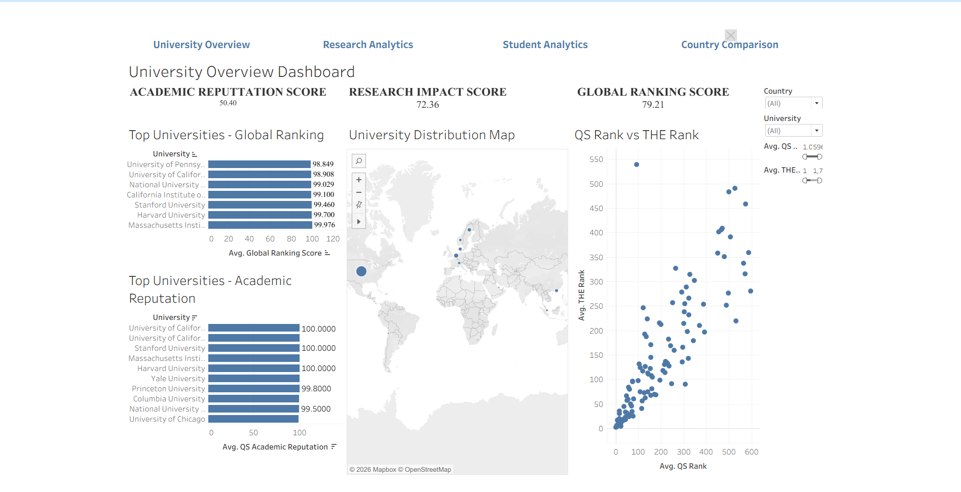
01 / DASHBOARD SHOWCASE
University Overview
Rankings, academic reputation, geography and QS/THE comparison, with filters and shared navigation.
07

Slide 8
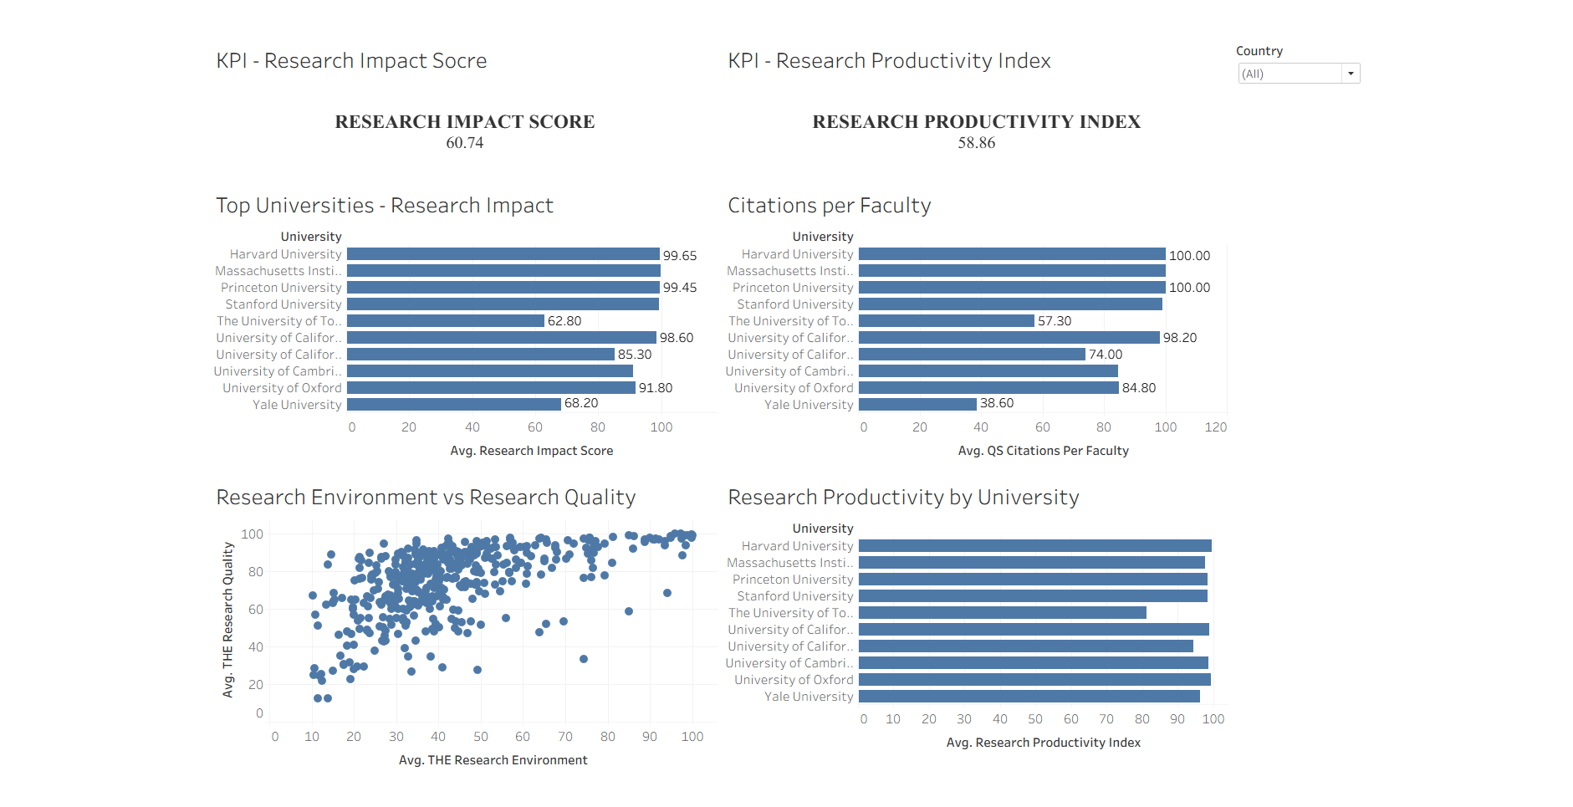
02 / DASHBOARD SHOWCASE
Research Analytics
Research impact and productivity KPIs with citation, research quality/environment and productivity views.
08

Slide 9
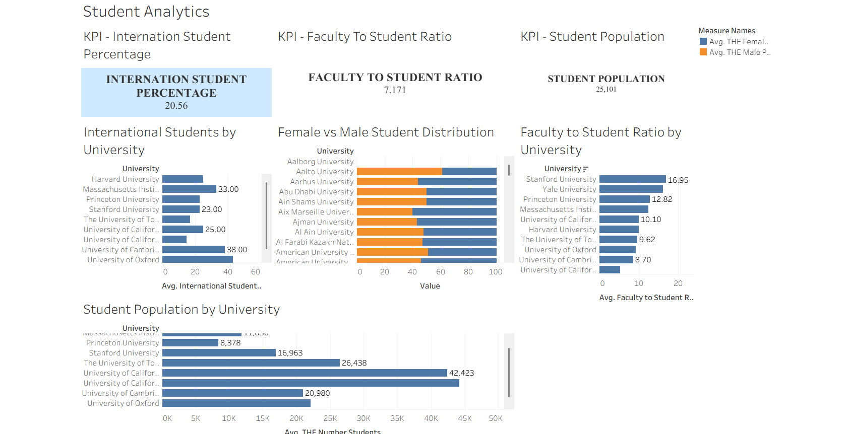
03 / DASHBOARD SHOWCASE
Student Analytics
Student diversity and institutional capacity: international percentage, student count, staff ratio and gender distribution.
09

Slide 10
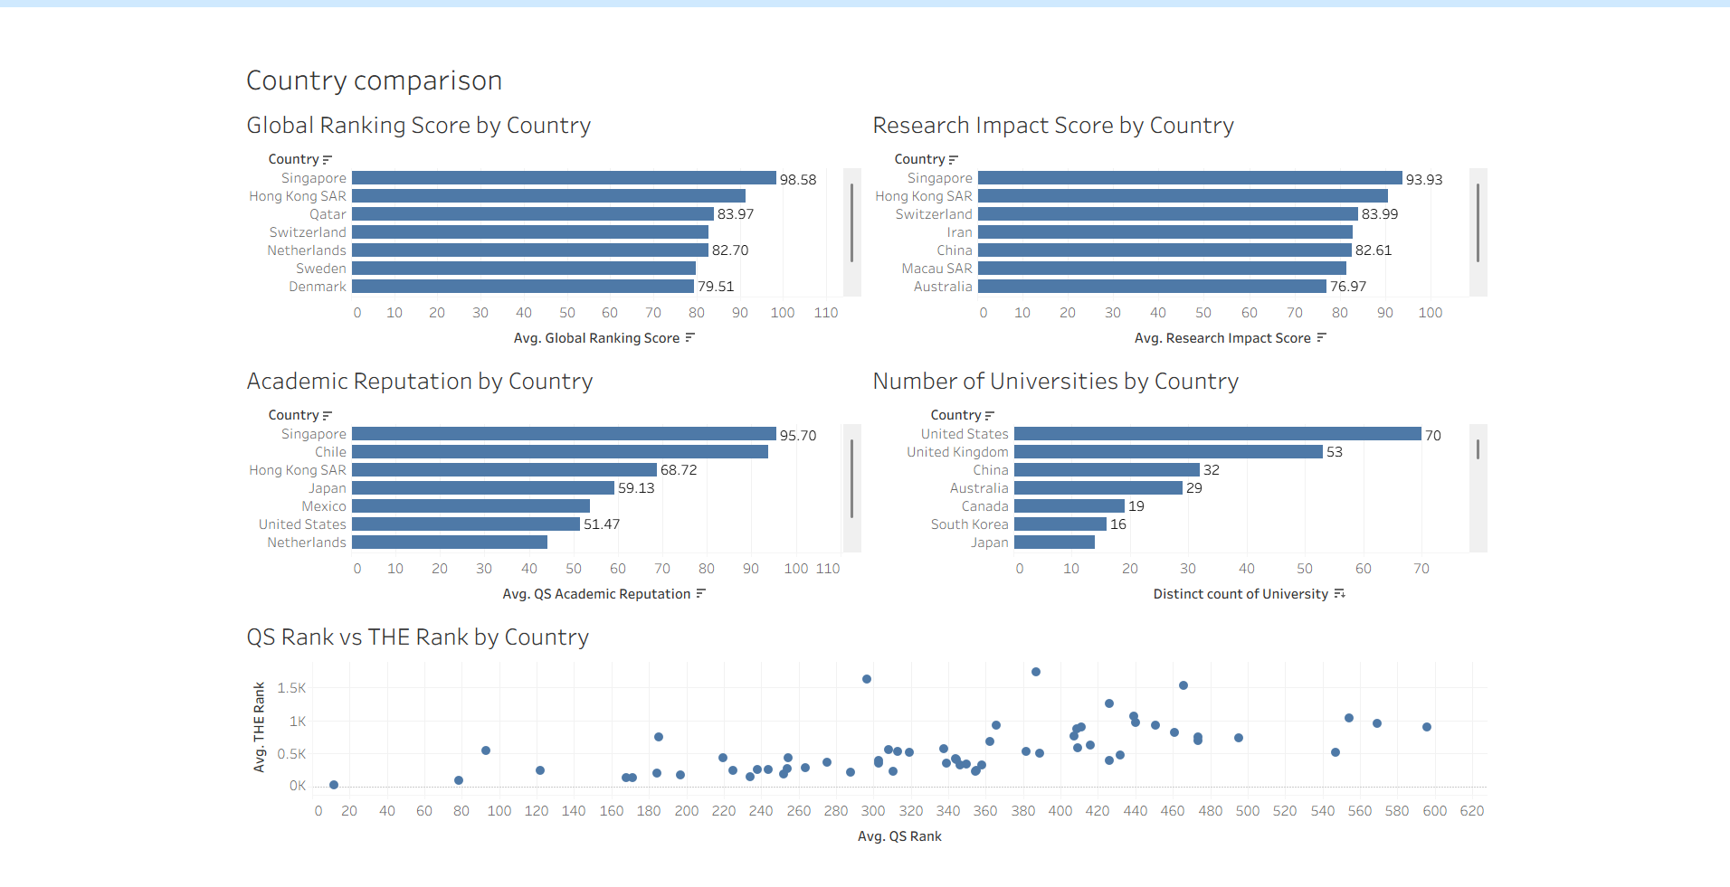
04 / DASHBOARD SHOWCASE
Country Comparison
Country-level benchmarking with average score bars, university counts and QS/THE rank comparison.
10

Slide 11
FILTERS & NAVIGATION
Designed for exploration, not just display
01
02
03
FILTER
EXPLORE
NAVIGATE
Narrow the view
Inspect values
Move by question
Country and University filters; QS Rank and THE Rank ranges on University Overview.
Hover over bars and points to inspect country, university and metric values in tooltips.
Use the shared navigation buttons to switch among University, Research, Student and Country views.
11

Slide 12
HOW TO READ THE VIEWS
Visual choices matched to analytical questions
01
BAR CHART
02
SCATTER PLOT
Rank and compare
Compare two ranking measures
Horizontal bars make top performers and country summaries easy to scan. Most ranking charts use Top 10 filters.
Each point represents a university or a country, depending on the view. Position helps reveal agreement and divergence.
03
MAP
04
STACKED BAR
See geographic distribution
Compare gender percentages
The map gives a spatial view of represented institutions; point size/position helps locate concentrations.
Female and male measures use two colors. Missing values should be interpreted as unavailable, not zero.
12

Slide 13
VALIDATION CHECKLIST
Build validation completed during dashboard development
✓
Workbook packaging
✓
Dashboard navigation
All four dashboards are stored in one Tableau packaged workbook (.twbx).
Navigation buttons were added to move across the four dashboards.
✓
Filter interactions
✓
Chart inspection
Country/University and ranking-range controls were exercised on University Overview; Country filters are included on the other analytical dashboards.
Bar labels, tooltips, Top 10 ranking views, map and scatter plots were reviewed.
✓
Gender data handling
✓
Delivery route
Female and male percentages are displayed as separate measures; missing records are not treated as zero.
Workbook was saved locally and the user reports that Tableau Public publishing is complete.
13

Slide 14
EDUVISION DV
From ranking data
to guided comparison.
The final workbook brings together four dashboard perspectives with KPI cards, analytical charts, interactive filters and shared navigation.
4
dashboards
17
visual views
6
core KPI measures
16

