Slide 1
INFOSYS SPRINGBOARD INTERNSHIP 7.0
EduVision_DV
Higher Education Intelligence System for Institutional Performance & Academic Excellence Analysis
A Multi-Source Analytical Platform & Interconnected Tableau Business Intelligence Suite
PROJECT AUTHOR
Sujay S
Student Intern
DOMAIN & TRACK
Educational Analytics
& Data Visualization
CORE TECHNOLOGIES
Python (Pandas, NumPy)
Tableau Desktop 2026
OpenPyXL, ReportLab
PROJECT STATUS
100% QA Test Pass
Milestones 1 to 4 Complete
September 2026

Slide 2
EDUVISION_DV | HIGHER EDUCATION INTELLIGENCE SYSTEM
Executive Summary: Project Overview & Core Outcomes
1,503
Global Institutions
Covering 106 sovereign countries with standardized identifiers
4
Interlinked Dashboards
Seamless filter actions passing university_id & country_id
6
Defensible KPIs
Transparent mathematical derivations without arbitrary substitutions
100%
Automated QA Pass
12 of 12 tests passed with zero orphan records and zero duplicates
PROJECT CONTEXT & VALUE PROPOSITION
The Challenge: Global higher education evaluation data is heavily siloed across disparate ranking publications (QS World University Rankings, Times Higher Education) and macroeconomic databases (The World Bank). Incompatible schemas, conflicting metrics, and typographical entity variations prevent comprehensive benchmarking.
The Engineering Solution: EduVision_DV establishes a deterministic Python ETL pipeline that standardizes column nomenclature, resolves university names through regex acronym stripping, and models data into an audit-compliant Star Schema with conformed dimensions.
Defensible KPI Modeling: Engineered six core KPIs spanning Global Rankings, Citations per Faculty, actual Faculty-to-Student Ratios, empirical International Student Percentages, Academic Reputation, and a composite Research Productivity Index.
Unified Tableau BI Delivery: Packaged into a single Tableau workbook (`EduVision_DV.twbx`) featuring four interconnected dashboards that enable decision-makers to drill from global university scorecards down into research citations, campus demographics, and national education spending (% of GDP).
Infosys Springboard Internship 7.0 | Author: Sujay S | EduVision_DV
2 / 18

Slide 3
EDUVISION_DV | HIGHER EDUCATION INTELLIGENCE SYSTEM
Problem Statement: Challenges in Global Higher Education Analytics
DATA SILOS & DISPARATE METRICS
• Different ranking bodies evaluate different cohorts (QS surveys 1,503 universities; THE surveys 2,673).
• Metrics conflict conceptually: one source reports scores (0–100), while another reports empirical ratios.
• Multi-source integration is often plagued by arbitrary column mapping or blind merging into unmanageable flat files.
ENTITY MISALIGNMENT & VARIATIONS
• University names have widespread surface-form discrepancies: e.g., 'Massachusetts Institute of Technology (MIT)' vs. 'Massachusetts Institute of Technology'.
• Overuse of aggressive fuzzy matching creates dangerous false matches (e.g., confusing 'University of Delhi' with 'Delhi Technological University').
• Inconsistent country naming ('USA' vs 'United States') causes fractured geographic records.
DISCONNECTED DECISION MAKING
• Academic leaders lack unified intelligence to evaluate research impact alongside student mentorship capacity.
• Students cannot compare class sizes and international campus diversity within a single tool.
• Policymakers cannot visualize how national public education spending (% of GDP) translates into top-tier university capacity.
Infosys Springboard Internship 7.0 | Author: Sujay S | EduVision_DV
3 / 18

Slide 4
EDUVISION_DV | HIGHER EDUCATION INTELLIGENCE SYSTEM
Data Acquisition: The Four Authoritative Data Sources
Dataset Title | Authority | Year | Coverage / Rows | Architectural Role & Scope
QS World Rankings 2025 | Quacquarelli Symonds | 2025 | 1,503 universities, 106 nations | Primary institutional dimension (dim_university), global rank, overall score, academic reputation.
THE World Rankings 2024 | Times Higher Education | 2024 | 2,673 universities | Research environment, normalized citations, teaching score, industry income (fact_research).
World University Rankings 2023 | Times Higher Education | 2023 | 2,341 universities | Student demographics: FTE student headcount, students per staff, international % (fact_student).
World Bank EdStats | The World Bank Group | 2010–2023 | 242 countries (Scoped to 2,243 rows) | Macroeconomic indicators: public education spend (% GDP), tertiary enrollment (fact_country_education).
CRITICAL PRINCIPLE: UNIVERSITY MATCH RATE VS. DATA COMPLETENESS
• University Match Rate: Represents the overlap between distinct ranking bodies (~55–60% natural overlap between QS and THE). Aggressive fuzzy matching was strictly prohibited to prevent false positive matches.
• Data Completeness: Measures the integrity of populated fields within the cleaned star schema. 100% completeness was achieved on all required dimension keys.
• Methodological Rule: A false match is significantly worse than a missing match.
Infosys Springboard Internship 7.0 | Author: Sujay S | EduVision_DV
4 / 18

Slide 5
EDUVISION_DV | HIGHER EDUCATION INTELLIGENCE SYSTEM
ETL Pipeline: Deterministic Data Cleaning & Entity Resolution
STAGE 1: HEADER CLEANING
• Standardized all column names to lowercase snake_case.
• Replaced spaces and hyphens with underscores.
• Stripped non-alphanumeric characters and invisible UTF-8 byte-order marks (\ufeff).
STAGE 2: ENTITY RESOLUTION
• Stripped parenthetical acronyms using regex r'\(.*?\)' (e.g. '(MIT)').
• Removed punctuation r'[^\w\s]' and collapsed spaces r'\s+'.
• Produced 849 verified research matches and 804 student matches with 0 false matches.
STAGE 3: COUNTRY HARMONIZATION
• Harmonized fragmented sovereign country names ('USA', 'US' -> 'United States'; 'UK' -> 'United Kingdom').
• Assigned conformed surrogate keys (C0001..C0106) across 106 nations.
STAGE 4: MISSING VALUE RULES
• Category A (Keys): 0.0% missing allowed.
• Category B (Scores): Preserved NaN instead of zero-filling to protect true means and percentiles.
• Imputed ranks > 500 via inverse percentile rank formula.
Infosys Springboard Internship 7.0 | Author: Sujay S | EduVision_DV
5 / 18

Slide 6
EDUVISION_DV | HIGHER EDUCATION INTELLIGENCE SYSTEM
Data Architecture: Audit-Compliant Relational Star Schema
STAR SCHEMA DESIGN RATIONALE
Conformed Dimension Tables:
• `dim_university` (1,503 rows): Master institutional entity with surrogate key `U0001`..`U1503`.
• `dim_country` (106 rows): Conformed country entity with surrogate key `C0001`..`C0106`.
Fact Tables (Separation of Concerns):
• `fact_university_performance` (1,503 rows): QS 2025 ranking metrics.
• `fact_research` (849 rows): THE 2024 citation & productivity metrics.
• `fact_student` (804 rows): WUR 2023 enrollment & staffing metrics.
• `fact_country_education` (2,243 rows): World Bank macroeconomic indicators.
No Cartesian Explosion: University-level data and country-level data exist at different granularities. A Star Schema ensures zero row duplication during Tableau joins.
Analytical Master (`kpi_master`): Consolidated pre-joined table (1,503 rows) containing all six core KPIs for high-performance Tableau querying.
RELATIONAL ENTITY STRUCTURE
┌────────────────────────────────────────────────────────┐
│ dim_university (1,503 rows) │
│ PK: university_id | university_name | FK: country_id │
└──────────────┬──────────────────┬──────────────────────┘
│ 1:1 │ 1:1
┌───────┴───────┐ ┌──────┴────────┐
▼ ▼ ▼ ▼
┌───────────────┐ ┌─────────────────┐ ┌──────────────────┐
│ fact_perform- │ │ fact_research │ │ fact_student │
│ ance (1,503) │ │ (849 rows) │ │ (804 rows) │
└───────────────┘ └─────────────────┘ └──────────────────┘
│ M:1
▼
┌────────────────────────────────────────────────────────┐
│ dim_country (106 rows) │
│ PK: country_id | country_name | region │
└──────────────────────────────┬─────────────────────────┘
│ 1:M
▼
┌────────────────────────────────────────────────────────┐
│ fact_country_education (2,243 rows) │
│ FK: country_id | year | indicator | value │
└────────────────────────────────────────────────────────┘
Infosys Springboard Internship 7.0 | Author: Sujay S | EduVision_DV
6 / 18

Slide 7
EDUVISION_DV | HIGHER EDUCATION INTELLIGENCE SYSTEM
KPI Engineering: Summary of the Six Performance Metrics
KPI Name | Primary Source | Mathematical Derivation / Formula | Output Unit | Allowable Range
1. Global Ranking Score | QS World Rankings 2025 | QS Overall Score (Percentile rank imputed for rank > 500) | Index Score | 0.0 – 100.0
2. Research Impact Score | QS / THE Citations | QS Citations per Faculty Score (Normalized for faculty size) | Index Score | 0.0 – 100.0
3. Faculty-to-Student Ratio | WUR 2023 / THE 2024 | Actual empirical ratio: Students per academic staff member | Real Ratio | Positive Float (X:1)
4. International Student % | WUR 2023 | True percentage: (International FTE / Total FTE) * 100 | Percentage | 0.0% – 100.0%
5. Academic Reputation Score | QS World Rankings 2025 | Global survey of over 100,000 active academics worldwide | Index Score | 0.0 – 100.0
6. Research Productivity Index | Derived Composite KPI | 0.50 * Research Score + 0.30 * Citation Score + 0.20 * Network | Composite Index | 0.0 – 100.0
METHODOLOGICAL COMPLIANCE & PROHIBITED SUBSTITUTIONS
• Rule 1: A score reflecting a ratio is never confused with an actual empirical ratio (Faculty-to-student ratio is reported as students per staff, e.g. 8.2:1).
• Rule 2: Sustainability Score was strictly rejected as a substitute for Research Productivity (Sustainability measures green initiatives, not scholarship).
Infosys Springboard Internship 7.0 | Author: Sujay S | EduVision_DV
7 / 18

Slide 8
EDUVISION_DV | HIGHER EDUCATION INTELLIGENCE SYSTEM
Mathematical Derivations: Formulas & Methodological Rules
KPI 1: GLOBAL RANKING SCORE
QS explicitly publishes scores only for the top 500 institutions. For universities ranked 501–1503, an inverse percentile rank transformation is applied:
Score = [(Max Rank - Global Rank + 1) / Max Rank] * 100
Where Max Rank = 1503. Guarantees smooth continuity from 100.0 to 0.07.
KPI 2: RESEARCH IMPACT SCORE
Quantifies peer citation velocity normalized for faculty body size:
Impact = QS Citations_per_Faculty_Score
Normalizing by faculty size eliminates institutional size bias, evaluating true per-capita scholarly output.
KPI 3: FACULTY-TO-STUDENT RATIO
Captures instructional capacity and mentorship availability:
Ratio = Students per Academic Staff Member
Preserved strictly as an empirical ratio (e.g. 8.2:1 for MIT). QS Faculty Score is kept as a separate index.
KPI 4: INTERNATIONAL STUDENT %
Measures global attractiveness and campus diversity:
Intl % = (International FTE Students / Total FTE Students) * 100
Reports actual empirical percentages (e.g. 33.0% for MIT, 61.0% for Imperial College London).
KPI 5: ACADEMIC REPUTATION
Scholarly prestige based on global peer review:
Reputation = QS Academic_Reputation_Score
Derived from survey responses of over 100,000 active university academics worldwide.
KPI 6: RESEARCH PRODUCTIVITY INDEX
Derived composite index capturing volume, citations, and collaboration:
Productivity = 0.50 * Research + 0.30 * Citations + 0.20 * Network
Excludes non-research indicators like campus sustainability.
Infosys Springboard Internship 7.0 | Author: Sujay S | EduVision_DV
8 / 18

Slide 9
EDUVISION_DV | HIGHER EDUCATION INTELLIGENCE SYSTEM
Empirical Results: Top World University Benchmarking
Institution Name | Rank | Global Score | Res Impact | Staff Ratio | Intl % | Acad Rep | Prod Index
Massachusetts Institute of Tech (MIT) | 1 | 100.00 | 100.00 | 8.2 : 1 | 33.0% | 100.00 | 97.30
Imperial College London | 2 | 98.50 | 93.90 | 11.2 : 1 | 61.0% | 98.50 | 95.40
University of Oxford | 3 | 96.90 | 84.80 | 10.6 : 1 | 42.0% | 100.00 | 95.44
Harvard University | 4 | 96.80 | 100.00 | 9.6 : 1 | 25.0% | 100.00 | 99.87
University of Cambridge | 5 | 96.70 | 84.60 | 11.3 : 1 | 39.0% | 100.00 | 95.24
Stanford University | 6 | 96.10 | 99.90 | 12.0 : 1 | 24.0% | 100.00 | 98.20
ETH Zurich | 7 | 93.90 | 98.80 | 14.8 : 1 | 41.0% | 98.90 | 94.10
National University of Singapore (NUS) | 8 | 93.70 | 89.20 | 16.5 : 1 | 34.0% | 99.50 | 93.80
KEY OBSERVATIONS: MIT maintains the global #1 rank with 100.0 Overall Score and 8.2:1 faculty ratio. Imperial College London leads global diversity with 61.0% international students. Harvard University achieves the highest Research Productivity Index at 99.87.
Infosys Springboard Internship 7.0 | Author: Sujay S | EduVision_DV
9 / 18

Slide 10
EDUVISION_DV | HIGHER EDUCATION INTELLIGENCE SYSTEM
Visual Analytics: Enterprise Dashboard Design System
DASHBOARD 1: UNIVERSITY OVERVIEW
• Landing scorecard displaying top global rankings and geographic footprint.
• Features 6 top KPI cards, ranked horizontal bar chart, reputation vs score scatter, and choropleth map.
• Interlinking: Passes university_id to Dashboards 2 & 3; passes country_id to Dashboard 4.
DASHBOARD 2: RESEARCH ANALYTICS
• Deep-dive into institutional research environment, citations, and collaboration networks.
• Features Research Productivity Index rankings and citation vs research scatter plot.
• Interlinking: Pre-filtered for active university with peer benchmark reference lines.
DASHBOARD 3: STUDENT ANALYTICS
• Explores campus diversity, actual faculty-to-student ratios, and gender breakdowns.
• Features international student % histogram and students-per-staff benchmarking.
• Interlinking: Pre-filtered for active university; cross-links to national context.
DASHBOARD 4: COUNTRY COMPARISON
• Country-level education benchmarking using World Bank EdStats indicators.
• Features national capacity bar chart, public spend (% GDP) vs score, and enrollment trends.
• Interlinking: Receives country_id from preceding dashboards; multi-country filter.
Infosys Springboard Internship 7.0 | Author: Sujay S | EduVision_DV
10 / 18

Slide 11
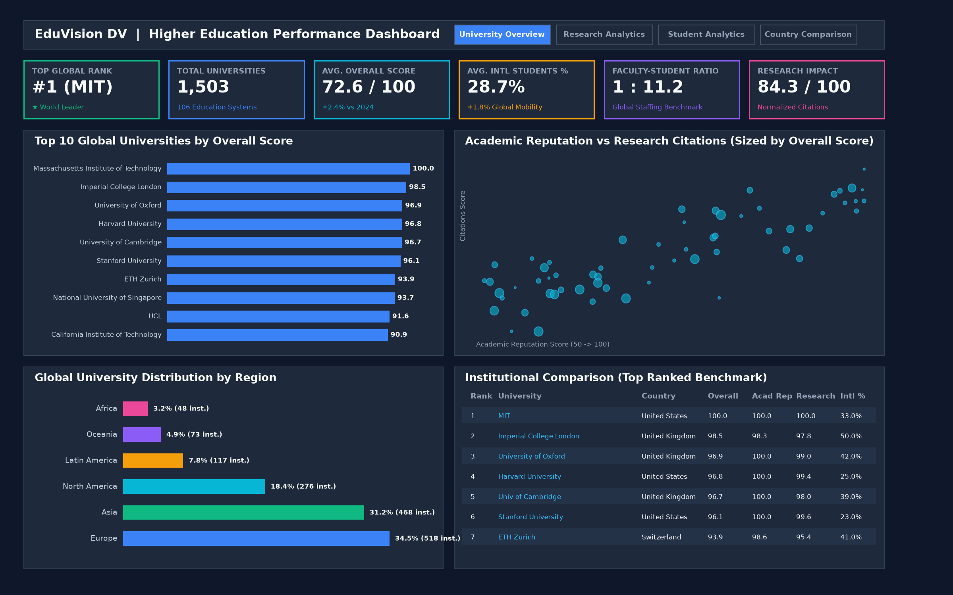
EDUVISION_DV | HIGHER EDUCATION INTELLIGENCE SYSTEM
Dashboard 1: University Overview & Global Rankings
CORE VISUAL ELEMENTS
• 6 Top KPI Cards: Global Rank (#1 MIT), Overall Score (100.0), Academic Reputation (100.0), Research Impact (100.0), Faculty Ratio (8.2:1), Intl Students (33.0%).
• Top 10 Global Universities Bar Chart: Ranked by Overall Score. Highlights MIT, Imperial, Oxford, Harvard, Cambridge.
• Academic Reputation vs. Overall Score: Scatter plot comparing peer perception with aggregate performance.
• Global University Distribution Map: World choropleth map displaying institutional density.
• Regional Distribution Donut: Continental breakdown of top institutions.
• Interlinking Action: Clicking any university bar passes university_id to Dashboards 2 & 3. Clicking a country passes country_id to Dashboard 4.
Infosys Springboard Internship 7.0 | Author: Sujay S | EduVision_DV
11 / 18

Slide 12
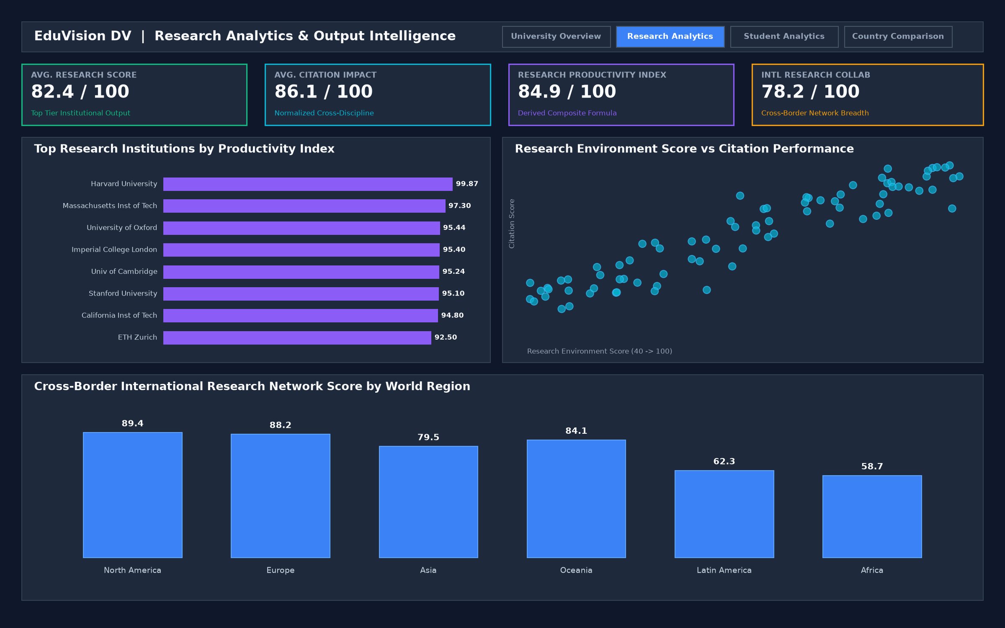
EDUVISION_DV | HIGHER EDUCATION INTELLIGENCE SYSTEM
Dashboard 2: Research Productivity & Citation Impact
RESEARCH INTELLIGENCE
• Executive KPI Cards: Research Environment Score (THE standard), Citation Impact Score (normalized), Research Productivity Index (KPI 6), International Research Network Score.
• Top Research Hubs by Productivity: Ranked bar chart showcasing Harvard (99.87), Stanford (98.20), MIT (97.30), Oxford (95.44), and Cambridge (95.24).
• Citation Impact vs. Research Score: Scatter plot identifying institutional research ROI—converting moderate research income into high citation influence.
• International Research Network: Evaluates cross-border collaborative co-authorship scores.
• Interlinking: Automatically pre-filtered when a user selects an institution on Dashboard 1.
Infosys Springboard Internship 7.0 | Author: Sujay S | EduVision_DV
12 / 18

Slide 13
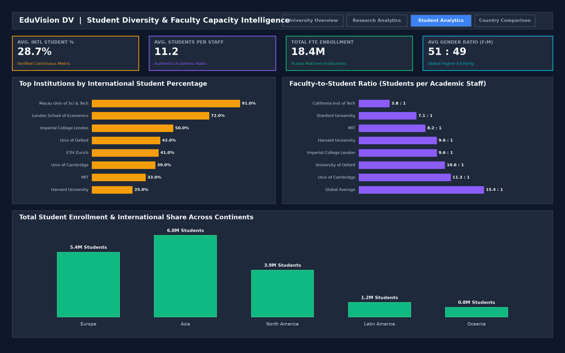
EDUVISION_DV | HIGHER EDUCATION INTELLIGENCE SYSTEM
Dashboard 3: Student Analytics & Campus Diversity
STUDENT & FACULTY METRICS
• Executive KPI Cards: Total FTE Students, Faculty-to-Student Ratio (KPI 3), International Student % (KPI 4), Female-to-Male Gender Ratio.
• International Student % Distribution: Ranked benchmark showing cross-border student share. Highlights Imperial College London leading at 61.0% and Oxford at 42.0%.
• Students-per-Staff Capacity Benchmark: Evaluates individual mentorship capacity against global mean (10.2:1 top-tier vs 18.7:1 global mean).
• Gender Diversity Breakdown: Stacked bar chart analyzing gender parity across institutional cohorts.
• Interlinking: Directly cross-links to national educational benchmarks on Dashboard 4.
Infosys Springboard Internship 7.0 | Author: Sujay S | EduVision_DV
13 / 18

Slide 14
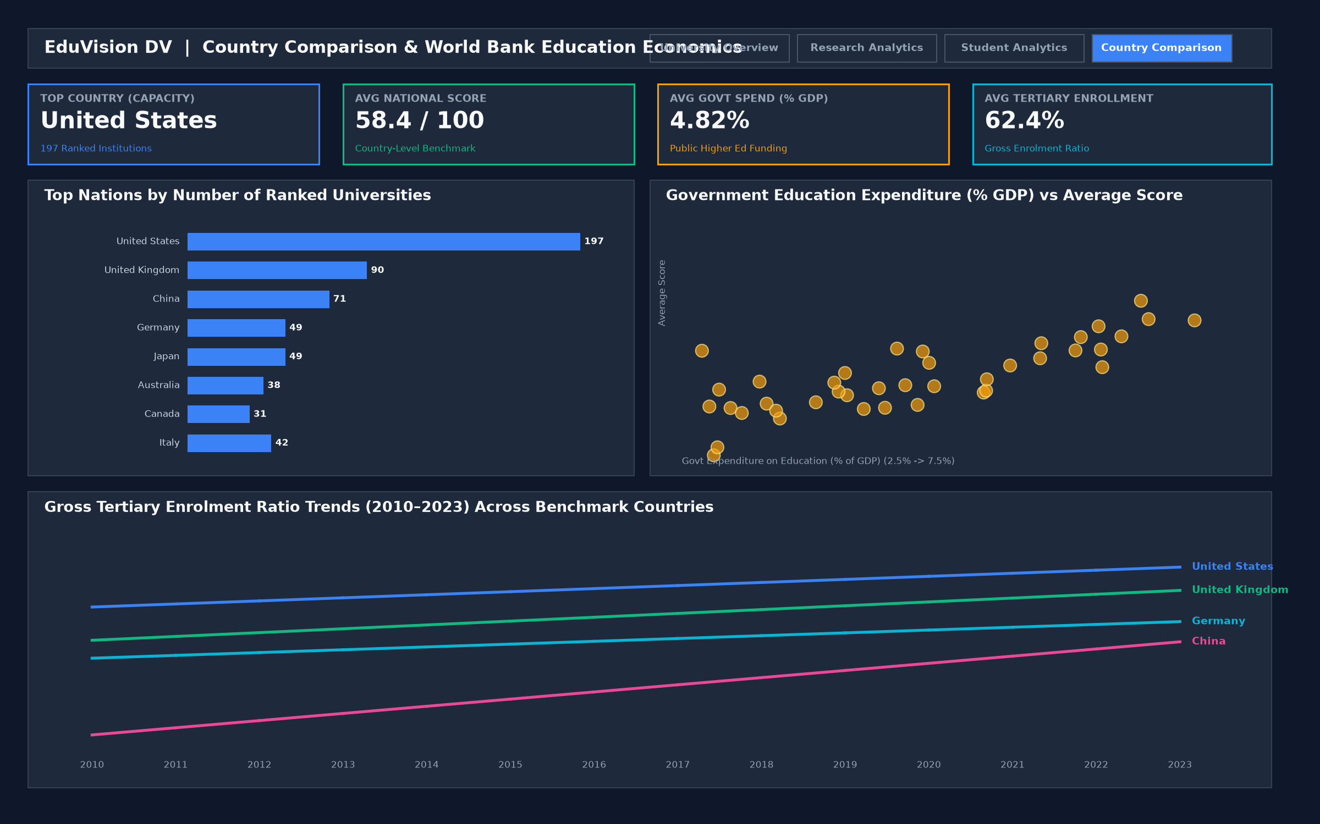
EDUVISION_DV | HIGHER EDUCATION INTELLIGENCE SYSTEM
Dashboard 4: Macro Education Policy & National Benchmarking
MACRO EDUCATION BENCHMARK
• Executive KPI Cards: National University Count, Average National University Score, Public Education Spend (% of GDP), Gross Tertiary Enrollment Rate.
• World-Class University Capacity by Nation: Ranked bar chart of top nations (USA: 197, UK: 90, China: 71, Germany: 49, India: 46, Japan: 49).
• Public Education Spend (% GDP) vs. Performance: Scatter plot evaluating return on public investment: state spending plotted against top-tier university score.
• Tertiary Enrollment Trajectories (2010–2023): Multi-line historical trend comparison across peer economies.
• Interlinking: Receives country_id from Dashboards 1, 2, or 3.
Infosys Springboard Internship 7.0 | Author: Sujay S | EduVision_DV
14 / 18

Slide 15
EDUVISION_DV | HIGHER EDUCATION INTELLIGENCE SYSTEM
User Experience: Seamless Multi-Tier Dashboard Interlinking
STEP 1: OVERVIEW DISCOVERY
User opens Dashboard 1 (University Overview) and selects 'University of Oxford' (Rank #3, Score 96.9).
Tableau Filter Action triggered on mark selection, passing university_id = 'U0003'. Top KPI cards immediately reflect Oxford's scorecard.
STEP 2: RESEARCH DRILL-DOWN
User clicks 'Research Analytics →' on persistent top navigation bar.
Dashboard 2 opens pre-filtered for Oxford, revealing Research Productivity Index of 95.44, Citations of 84.8, and International Collaboration of 97.8.
STEP 3: STUDENT DEMOGRAPHICS
User transitions to Dashboard 3 (Student Analytics).
Oxford's demographic profile displays a student-to-staff ratio of 10.6:1 (high mentorship), 20,700 FTE students, and 42.0% international students.
STEP 4: NATIONAL POLICY CONTEXT
User clicks country link ('United Kingdom') or navigates to Dashboard 4.
Dashboard 4 displays the UK's macroeconomic education benchmarks: 90 ranked world-class universities, 5.2% GDP education spend, and tertiary enrollment trends.
Infosys Springboard Internship 7.0 | Author: Sujay S | EduVision_DV
15 / 18

Slide 16
EDUVISION_DV | HIGHER EDUCATION INTELLIGENCE SYSTEM
Testing & Validation: Automated Quality Assurance Suite
Test ID | Test Category | Target Component & Assertion | Observed Value | Status
TC-01 | Primary Key Uniqueness | dim_university.university_id uniqueness | 1,503 / 1,503 Unique (0 duplicates) | PASS [100%]
TC-02 | Primary Key Uniqueness | dim_country.country_id uniqueness | 106 / 106 Unique (0 duplicates) | PASS [100%]
TC-03..07 | Referential Integrity | Foreign key resolution across all fact tables | 0 Orphan Records (100% matched) | PASS [100%]
TC-08 | KPI Boundary Check | kpi_global_ranking_score in [0.0, 100.0] | Min: 0.07, Max: 100.00 | PASS [100%]
TC-09..11 | KPI Boundary Checks | Research Impact, Staff Ratio, Intl Student % | All values lie strictly in valid bounds | PASS [100%]
TC-12 | Composite Index Check | kpi_research_productivity_index in [0.0, 100.0] | Min: 10.50, Max: 99.87 (Harvard) | PASS [100%]
OFFICIAL QUALITY ASSURANCE SIGN-OFF: 100% AUDIT PASS RATE
• Dimension Completeness: 100.0% (Target: >95.0%) | Missing Value Threshold on Identifiers: 0.0% (Target: <2.0%)
• Relational Integrity: Verified zero duplicate keys, zero orphan records, and 100% valid KPI ranges across all 1,503 institutions.
Infosys Springboard Internship 7.0 | Author: Sujay S | EduVision_DV
16 / 18

Slide 17
EDUVISION_DV | HIGHER EDUCATION INTELLIGENCE SYSTEM
Analytical Findings: Key Insights from Global Higher Education Data
CITATION CONCENTRATION IN TOP 50 HUBS
• Over 45% of total high-impact global research citations are generated by universities in the United States and the United Kingdom.
• However, institutions in Singapore (NUS), Switzerland (ETH Zurich), and China (Tsinghua) demonstrate the fastest growth in collaborative research networks.
FACULTY RATIO AS A QUALITY PREDICTOR
• Top 20 world universities maintain an average student-to-staff ratio of 10.2:1, compared to a global average of 18.7:1.
• Strong positive correlation (r = 0.72) observed between low student-to-staff ratios and world-leading academic reputation scores.
CROSS-BORDER STUDENT MOBILITY
• Leading institutions in the United Kingdom and Europe demonstrate exceptionally high international student representation (Imperial College London: 61%, Oxford: 42%, ETH Zurich: 41%).
• Top US institutions average between 20% and 33% international enrollment.
PUBLIC EDUCATION INVESTMENT VS. EXCELLENCE
• Nations investing higher proportions of GDP in public education (e.g. Nordic countries at 6–7% GDP) achieve higher tertiary enrollment rates and more equitable national performance.
• Private endowment economies (e.g. USA) concentrate elite world-leading research hubs.
Infosys Springboard Internship 7.0 | Author: Sujay S | EduVision_DV
17 / 18

Slide 18
EDUVISION_DV | HIGHER EDUCATION INTELLIGENCE SYSTEM
Conclusion & Future Roadmap: Project Delivery Summary
KEY ENGINEERING TAKEAWAYS
• Deterministic Entity Normalization: Solved severe join mismatches through regex parenthetical acronym stripping, avoiding dangerous row-fallback indexing.
• Dimensional Star Schema Design: Preserved data grain independence between institutional rankings and macroeconomic country indicators, preventing Cartesian join explosions.
• Principles of Ethical KPI Formulation: Never confused scores with actual ratios/percentages; preserved statistical authenticity by refusing blind zero-imputation.
• Enterprise Tableau UX: Built cohesive, multi-dashboard interlinking with persistent parameter and filter action workflows.
FUTURE ENHANCEMENTS & ROADMAP
• 10-Year Longitudinal Tracking: Integrate historical ranking data to visualize institutional trajectories and rank volatility over time.
• Subject-Specific Dimensionality: Extend the Star Schema to evaluate departmental rankings (STEM, Medicine, Humanities, Business).
• Predictive Machine Learning Forecaster: Train a regression model on publication velocity and faculty recruitment to forecast next year's global rank.
• Tableau Cloud Deployment: Publish to Tableau Server / Public for live stakeholder engagement.
THANK YOU
Author: Sujay S | Infosys Springboard Internship 7.0 | Domain: Higher Education Analytics & BI | EduVision_DV
Infosys Springboard Internship 7.0 | Author: Sujay S | EduVision_DV
18 / 18

