Slide 1
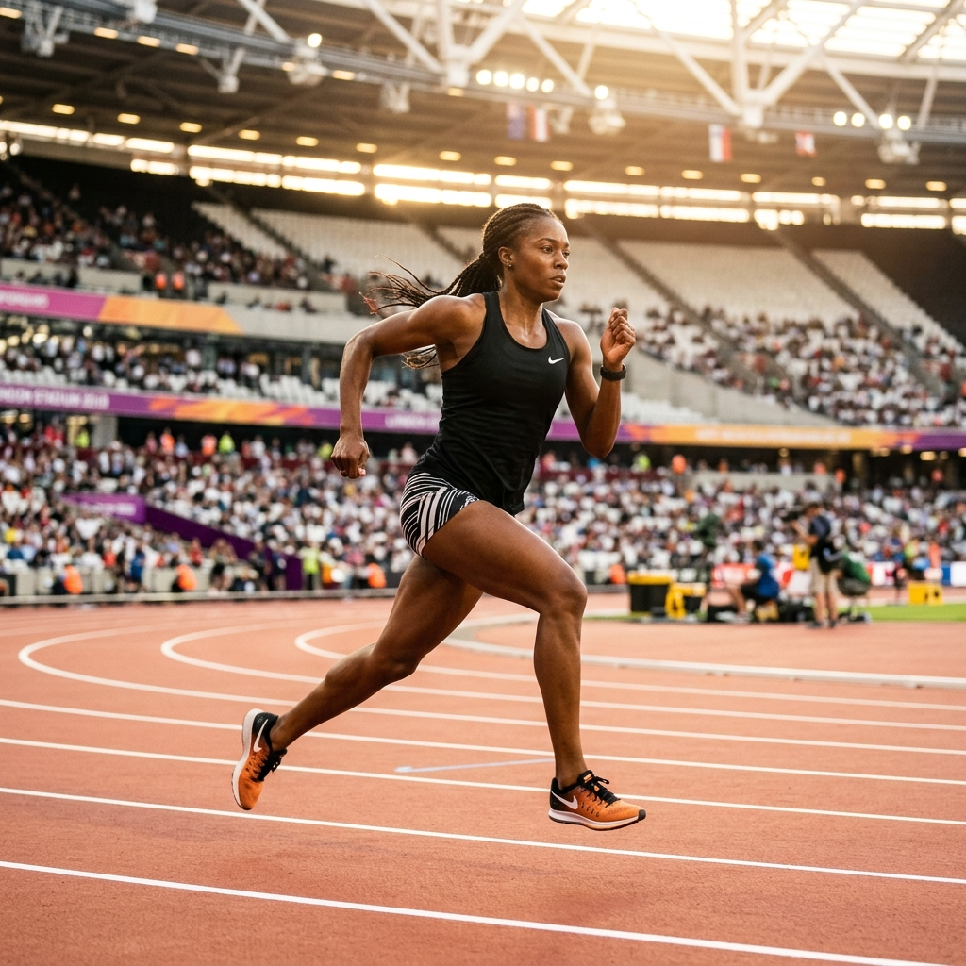
PROJECT PRESENTATION
KINETICGUARD
Sports Injury Risk Detection from Video
An End-to-End Real-Time Computer Vision & Biomechanical Telemetry Pipeline for Non-Contact
Injury Prevention
Presented by:
Nagaveni Shivanand Harakuni

Slide 2
PROBLEM STATEMENT
The Challenge of Non-Contact Athletic Injuries
Injury Causation & Mechanics
• Sports injuries frequently occur due to improper movement mechanics, cumulative fatigue, bilateral limb asymmetry, and excessive physical load.
• Over 70% of ACL tears and hamstring strains occur during non-contact deceleration, rapid direction cuts, and landing.
• Subtle joint deviations (e.g. knee valgus inward collapse) happen in under 50ms, evading human visual perception.
Coaching & Athlete Pain Points
• Manual visual movement analysis is highly subjective, qualitative, time-consuming, and difficult to perform consistently.
• Laboratory motion-capture systems cost $50,000+, require invasive body markers, and are restricted to lab rooms.
• Coaches need objective, quantitative movement telemetry to identify potential injury risks before tears occur.
• Athletes need clear, actionable feedback to improve movement quality and reduce injury vulnerability.
CORE PROBLEM: Traditional coaching lacks accessible, non-invasive, objective tools to detect high-risk movement flaws in real time before severe musculoskeletal injuries happen.

Slide 3
OBJECTIVE & PROPOSED SOLUTION
What KineticGuard is Designed to Achieve
Slide 3 of 11
1. Video Movement Analysis
• Ingest standard 2D smartphone/broadcast athletic video.
• Extract 33 3D anatomical body landmarks frame-by-frame.
• Track skeleton joint trajectories, velocities, and motion trails.
2. Biomechanical Risk Engine
• Calculate dynamic 3D joint angles (Knee Valgus, Hip, Spine).
• Identify kinematic movement abnormalities and limb asymmetry.
• Model fatigue via Acute-to-Chronic Workload Ratio (ACWR).
• Compute composite 0–100% Injury Risk Index.
3. Actionable Insights
• Generate automated clinical Evaluation Reports.
• Provide personalized corrective rehabilitation drills.
• Maintain longitudinal historical session directories.
• Broadcast proactive high-risk anomaly notifications.
SOLUTION TRANSFORMATION FLOW:
[ Subjective / Inconsistent Analysis ] ───▶ [ KineticGuard AI Vision Platform ] ───▶ [ Objective, Actionable Clinical Insights ]

Slide 4
METHODOLOGY & WORKFLOW
Step-by-Step Computational Pipeline Flowchart
STEP 01
1. Athlete Profile
Biometrics, medical history & coach assignment
STEP 02
2. Video Upload
MP4/MOV validation & OpenCV frame decoding
STEP 03
3. Pose Estimation
MediaPipe 33-landmark coordinate detection
STEP 04
4. Skeleton Tracking
2D/3D wireframe & joint velocity telemetry
STEP 05
5. Joint Biomechanics
3D vector angles (Valgus, Flexion, Spine)
STEP 06
6. Risk Analysis
ACWR workload, asymmetry & 0-100% risk index
STEP 07
7. Evaluation Report
Clinical summary & corrective exercise drills
STEP 08
8. History & Alerts
Date-range filtered logs & threshold alerts

Slide 5
TECHNOLOGIES USED
Production Technology Stack & Tools
Frontend
• React.js 18 (Component Architecture)
• Vite (Build & Hot Module Reload)
• Tailwind CSS (Theme Tokens)
• React Router DOM (Navigation)
• Axios (API Communication)
• Lucide React (Vector Icons)
• Framer Motion (Animations)
Backend
• Python 3.10 (Core Logic)
• FastAPI (High-Speed Async REST)
• JWT Authentication (Security)
• Pydantic (Schema Validation)
• Uvicorn (ASGI Web Server)
• Bcrypt (Password Hashing)
• Python Multipart (File Uploads)
Computer Vision
• OpenCV (Video Decoding & FPS)
• MediaPipe Pose (33 Landmarks)
• Skeleton & Landmark Tracking
• Biomechanical Angle Engine
• NumPy & SciPy (3D Vectors)
• ACWR Workload Algorithm
• HTML5 Canvas Overlay
Database & Security
• MongoDB (NoSQL Document Store)
• Motor (Async MongoDB Driver)
• PyMongo (Database Client)
• Role-Based Access Control (RBAC)
• Coach-Athlete Data Isolation
• UUID File Naming System
• Local Secure Storage

Slide 6
SYSTEM ARCHITECTURE
Multi-Tier System Architecture & Data Flow
1. Users Layer
Athlete / Coach / Admin / Physio Clients
2. Frontend Layer
React 18 SPA + Tailwind CSS Dashboard (Port 5173)
3. Backend Gateway
FastAPI REST Server + JWT Authentication & RBAC (Port 8000)
4. Video Processing
OpenCV Video Validator + Multi-Format Streaming Ingestion
5. Pose & Skeleton Analysis
MediaPipe 33-Keypoint Extraction + 2D/3D Wireframe Tracking
6. Biomechanical / Risk Engine
3D Joint Angle Vectors + ACWR Fatigue + Anomaly Scoring
7. MongoDB Persistence
Collections: Users, Athletes, Videos, AnalysisSessions, Biomechanics
8. Outputs & Delivery
Clinical Evaluation Reports + Date-Filtered History + Proactive Alerts

Slide 7
IMPLEMENTATION BY MILESTONES
Four Unified Engineering Milestone Stages
Milestone 1
• Authentication & Security
• Role-Based Access Control (RBAC)
• Athlete Biometric Registry
• Coach-Athlete Assignment
• User Profile Self-Service (`PUT /me`)
• Dark / Light Theme System
Milestone 2
• Video Upload & File Management
• MediaPipe 33-Keypoint Extraction
• Real-Time Skeleton Tracking
• 2D/3D Wireframe Canvas
• Joint Biomechanics Engine
• Interactive Telemetry Player
Milestone 3
• Athlete Intelligence Dashboard
• Kinematic Joint Anomaly Analysis
• Bilateral Asymmetry Detection
• Fatigue / ACWR Workload Ratio
• Composite Injury Risk Scoring
• Dynamic Vulnerability Badging
Milestone 4
• Clinical Evaluation Reports
• Personalized Corrective Drills
• Historical Session Logs
• Date-Range Query Filter
• Proactive Anomaly Alerts
• Printable Report Export

Slide 8
KEY FEATURES
Core Implemented Capabilities of KineticGuard
Role-Based User Access
Separate tailored workflows for Athletes, Coaches, Physios, and Admins with strict data isolation.
Athlete Profile Hub
Captures physical indicators, sports, playing positions, injury history, and disability status.
Video Processing & Storage
Multi-format validation, chunked upload, thumbnail preview, and permanent disk deletion.
Pose & Skeleton Tracking
MediaPipe 33-landmark detection with real-time motion trails and velocity calculations.
Biomechanical Telemetry
Frame-by-frame 3D angles: Knee Valgus/Varus, Hip Flexion, Ankle, and Spine Lateral Sway.
Injury Risk & Intelligence
Composite 0-100% risk index, bilateral asymmetry percentage, and ACWR fatigue tracking.
Clinical Evaluation Reports
Diagnostic observations, risk badges, and algorithmically generated rehabilitation drills.
Historical Logs & Alerts
Date-range filtered session directory with one-click report review and real-time alerts.

Slide 9
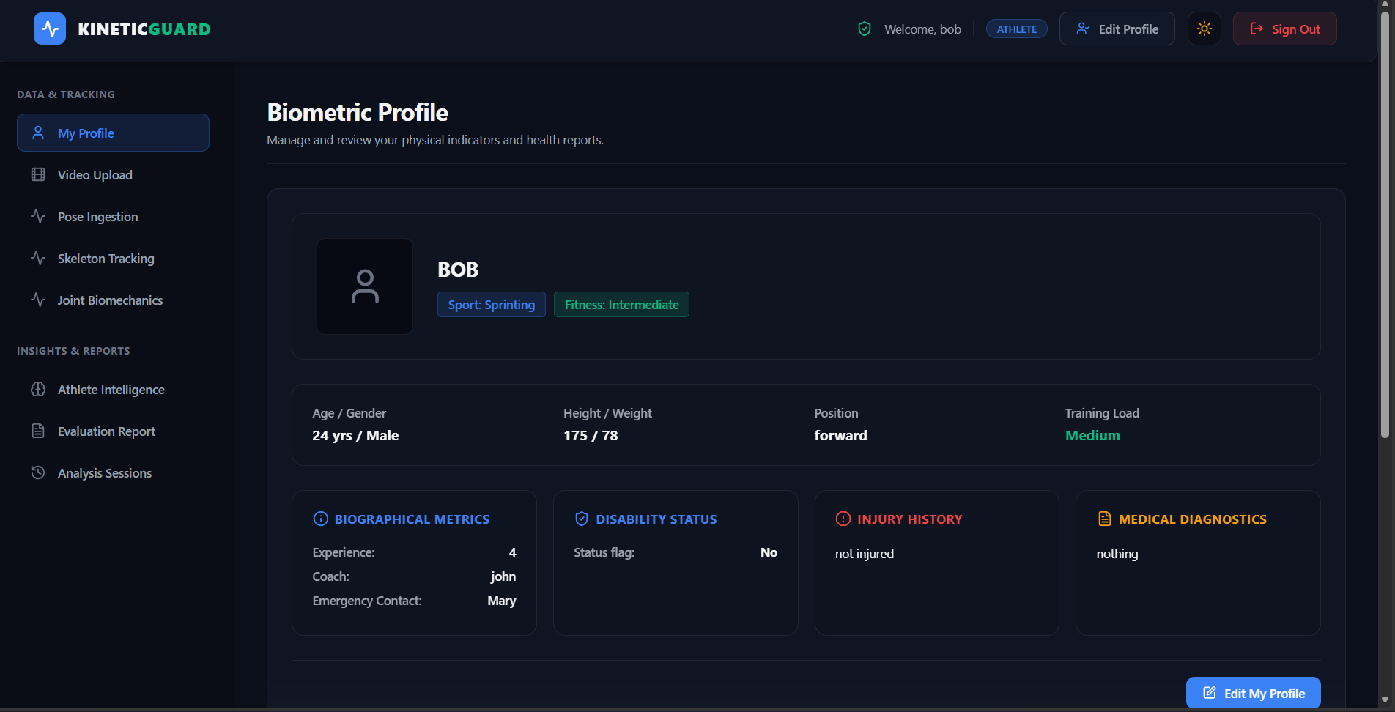
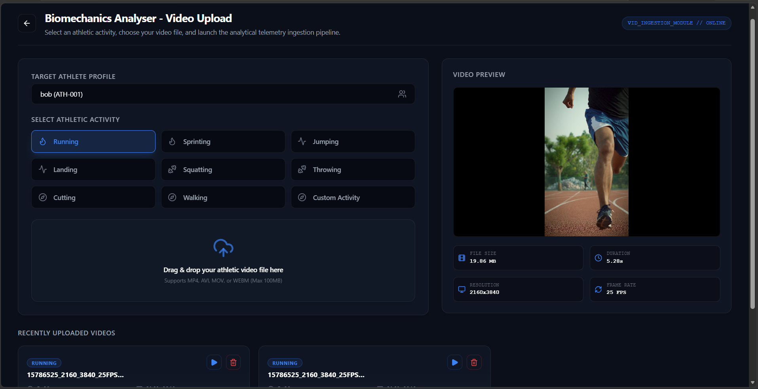
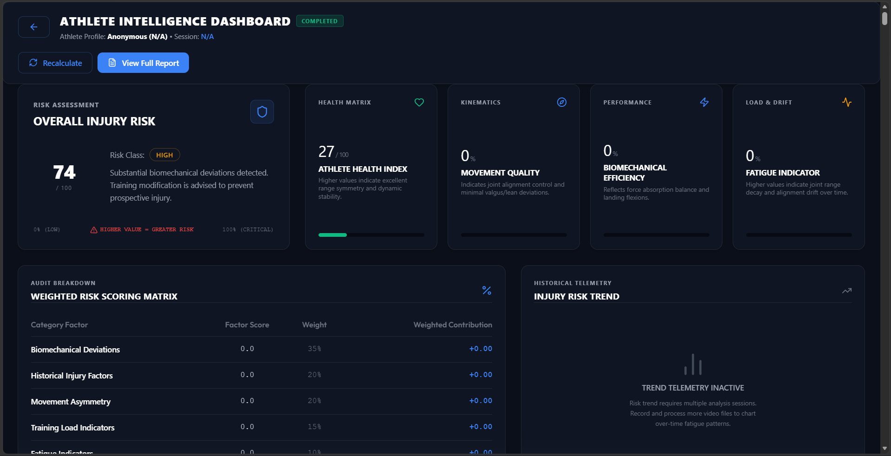
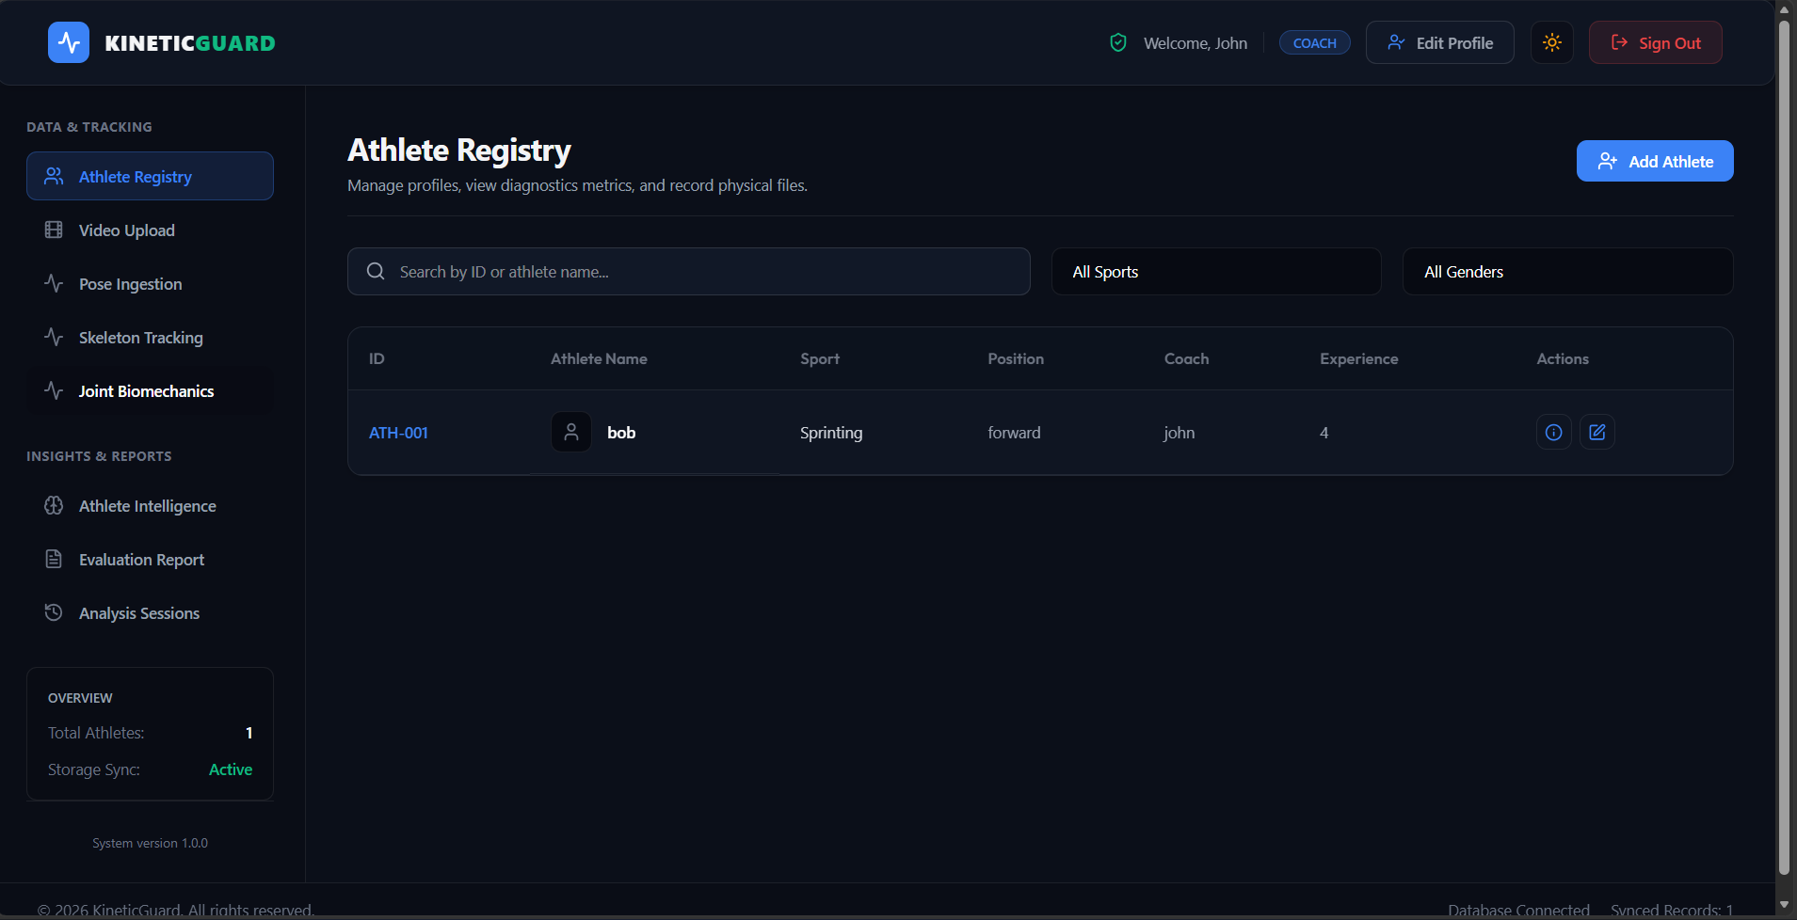
APPLICATION INTERFACES

Slide 10
LIVE DEMONSTRATION
End-to-End Live Demonstration Workflow
PHASE 1
Step 1: Authenticate
Log in as Coach or Athlete with JWT security credentials.
PHASE 2
Step 2: Select Athlete
Choose athlete from the Biometric Registry or view profile.
PHASE 3
Step 3: Upload Video
Upload athletic movement video (MP4/MOV) with validation.
PHASE 4
Step 4: Process Movement
Automated background pose estimation and skeleton tracking.
PHASE 5
Step 5: View Biomechanics
Inspect joint angle heatmaps, velocities, and 3D wireframes.
PHASE 6
Step 6: View Risk Results
Review composite risk score, radar charts, and ACWR fatigue.
PHASE 7
Step 7: Generate Report
Review clinical observations and personalized corrective drills.
PHASE 8
Step 8: Review History
Query longitudinal sessions by date range and view alerts.

Slide 11
CONCLUSION & FUTURE SCOPE
Project Summary & Future Technical Roadmap
Conclusion
• KineticGuard delivers an end-to-end platform for automated, video-based athletic movement analysis.
• Combines markerless computer vision, 3D joint kinematics, and machine learning risk assessment.
• Eliminates reliance on costly $50,000+ motion capture laboratories by using standard camera video.
• Provides structured clinical insights that empower coaches and athletes in proactive injury prevention.
• Successfully implements and integrates all 4 engineering milestones into a production-ready application.
Future Scope
• Real-Time Camera Analysis: Live on-pitch sideline video stream processing via WebRTC.
• Advanced AI Prediction: Transformer-based temporal models for multi-week injury forecasting.
• Wearable Sensor Fusion: Integrate IMU sensors (accelerometers & gyroscopes) with vision data.
• Team Multi-Athlete Tracking: Simultaneous multi-player tracking during active team matches.
• Cloud & Mobile Deployment: Native iOS/Android app with cloud GPU acceleration.
• Personalized Rehabilitation: Adaptive AI exercise prescriptions based on recovery progression.

Slide 12
THANK YOU

