Slide 1
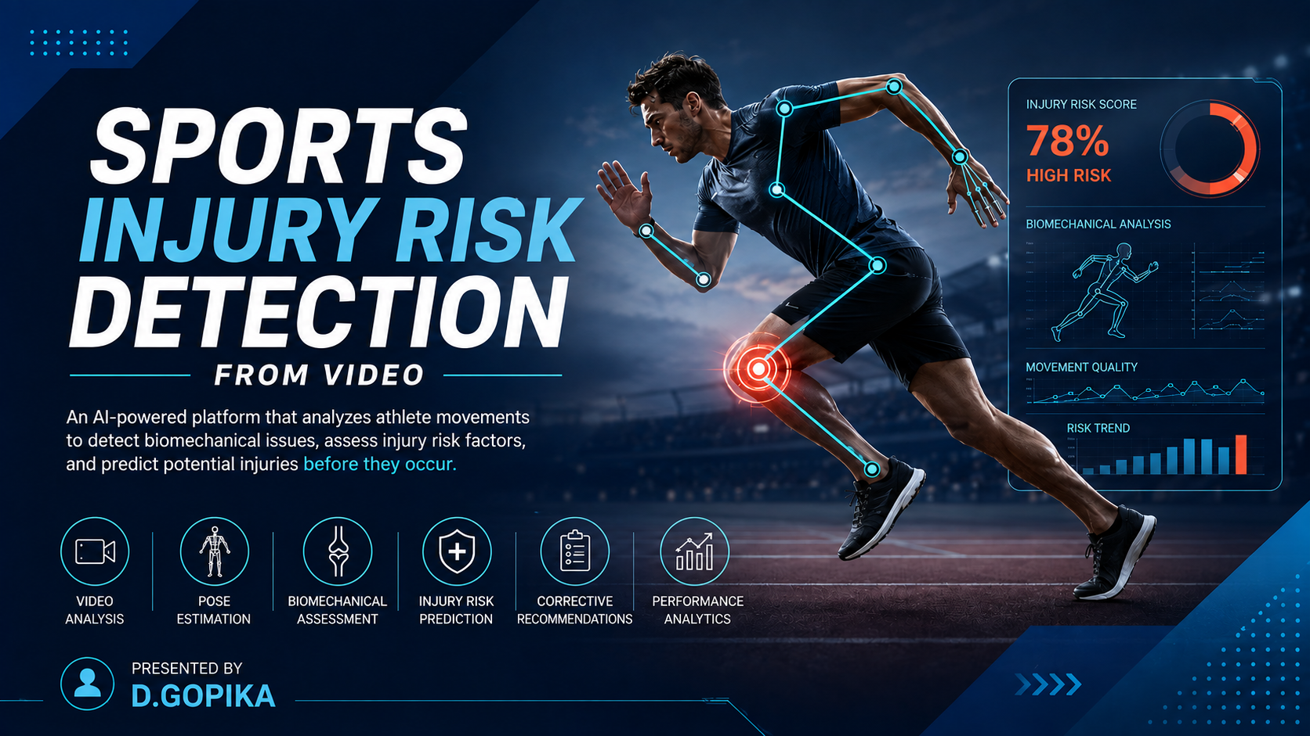

Slide 2
Problem Statement:
→ Sports injuries can happen because of improper posture and movement.
→ Identifying risky movements manually can be difficult and time-consuming.
→ Athletes need a simple way to analyze their movements using video.
→ Our project uses computer vision and AI techniques to analyze sports movements.
→ The system helps identify potential injury-risk factors and provides useful feedback.

Slide 3
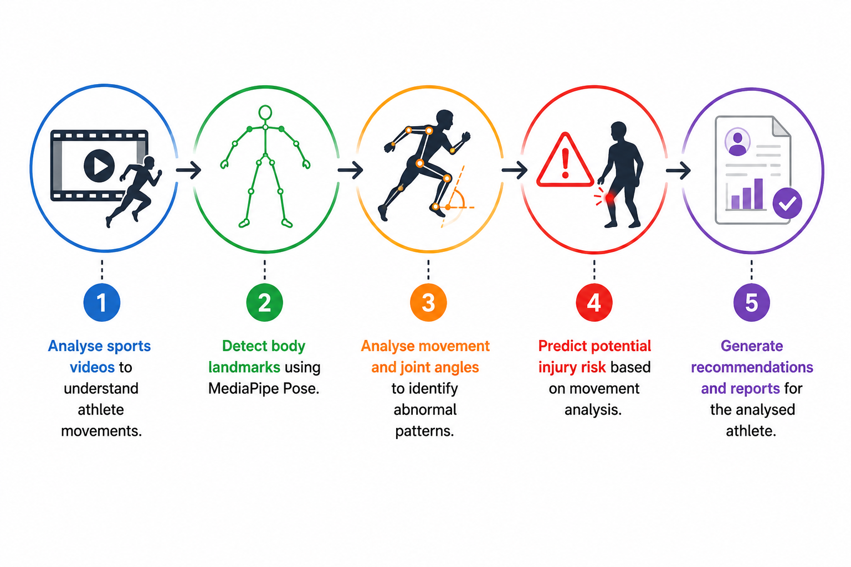
Project Objectives:
1. 🎥 Analyse sports videos to understand athlete movements.
2. 🧍 Detect body landmarks using MediaPipe Pose.
3. 📐 Analyse movement and joint angles to identify abnormal patterns.
4. ⚠️ Predict potential injury risk based on movement analysis.
5. 📄 Generate recommendations and reports for the analysed athlete.

Slide 4
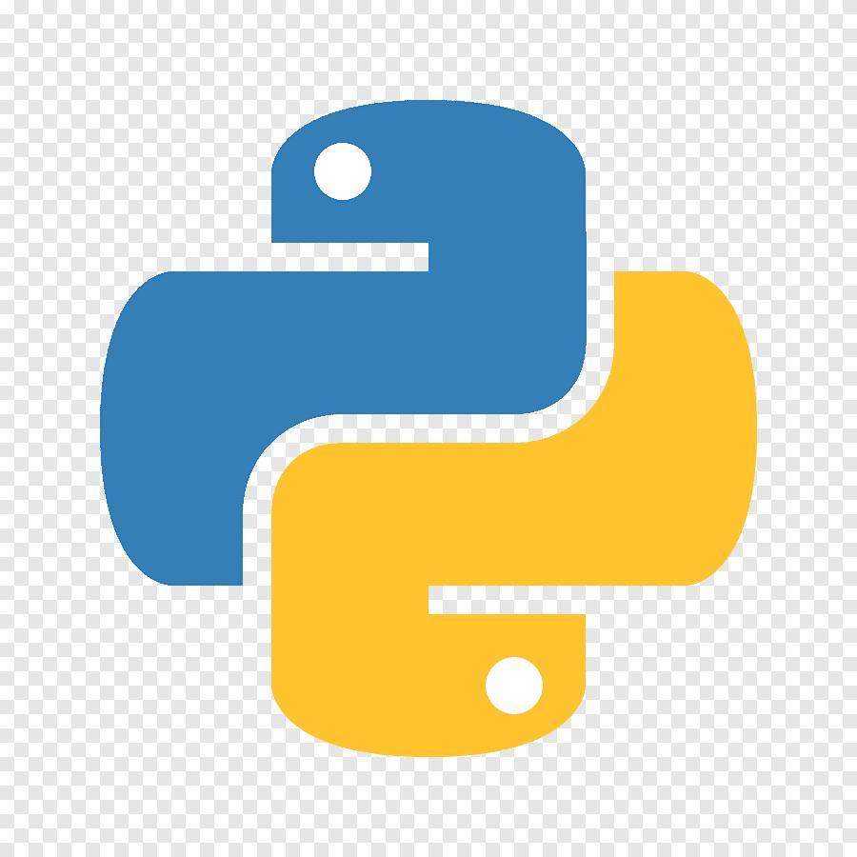



Technology Stack:
Used for Programming
Used for Backend
Used for Pose Estimation
Used for Computer Vision

Slide 5
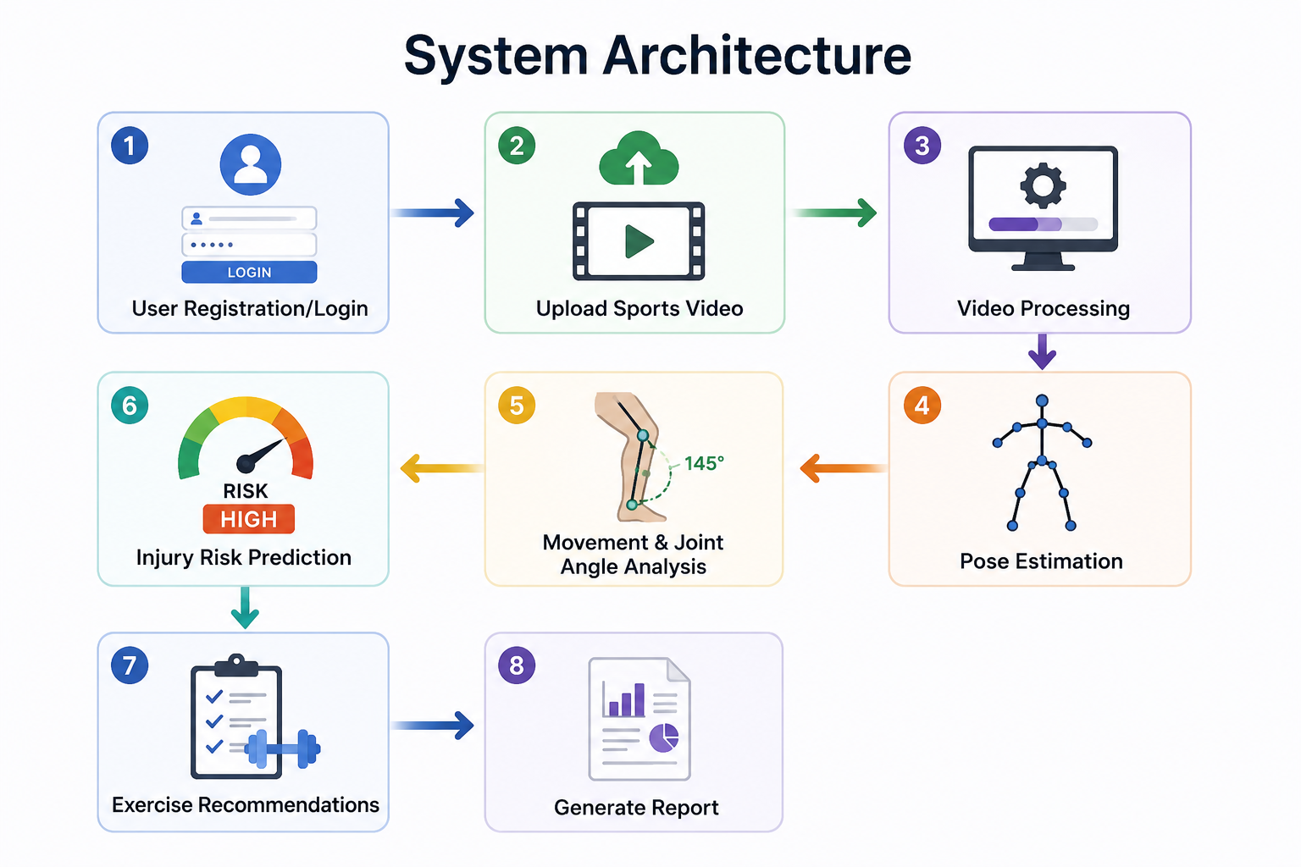
System Workflow:

Slide 6
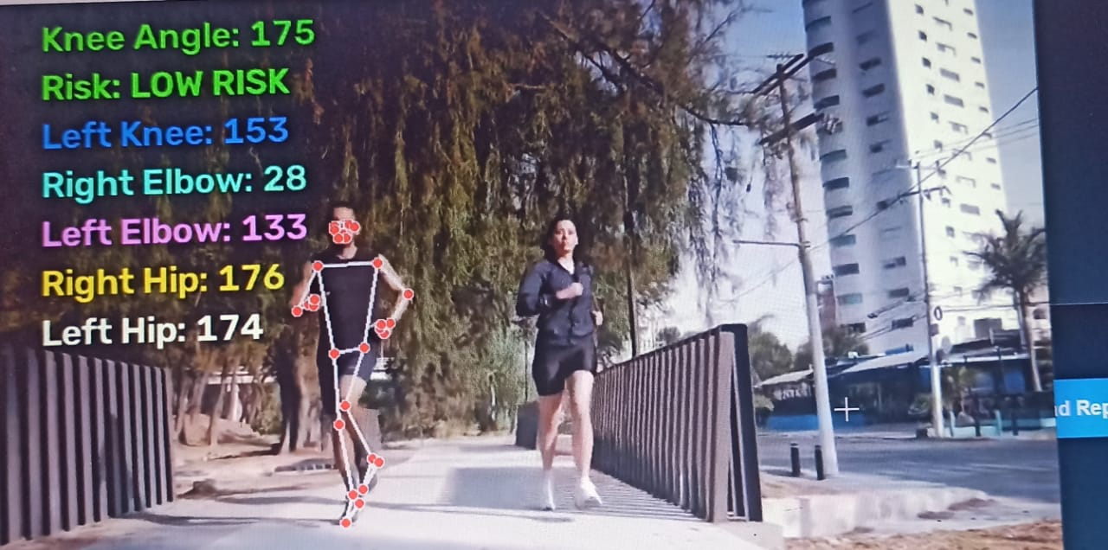
Dataset & Pose Estimation:
Dataset:
-> Sports movement videos are used as input for analysis.
-> The videos contain different body movements relevant to sports activity.
-> The processed data is used for movement and risk analysis.
Pose Estimation:
-> MediaPipe Pose is used to detect human body landmarks.
-> Body landmarks provide the position of important body parts.
-> These landmarks are used to calculate movement-related measurements.
-> OpenCV is used for video processing

Slide 7
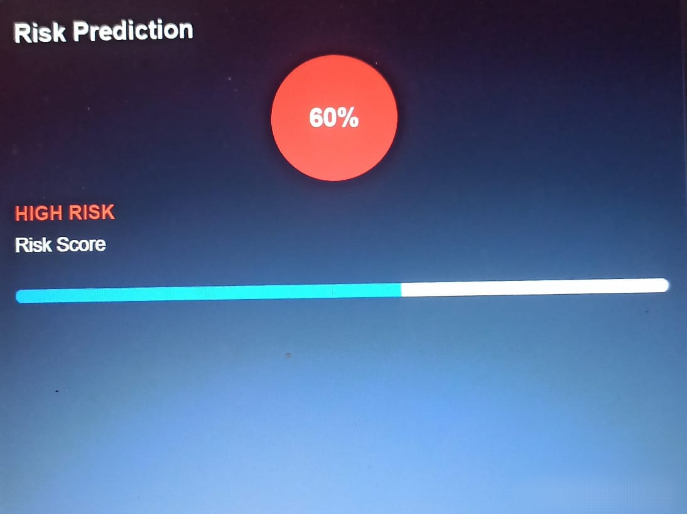
Movement Analysis & Risk prediction:
Movement Analysis:
->Extract body landmarks from each video frame.
->Calculate important joint angles.
->Analyze movement patterns and posture.
->Identify abnormal or risky movement patterns.
Risk Prediction:
->The analyzed movement data is passed to the risk module.
->The system identifies potential injury-risk factors.
->Results are presented in an easy-to-understand format.

Slide 8
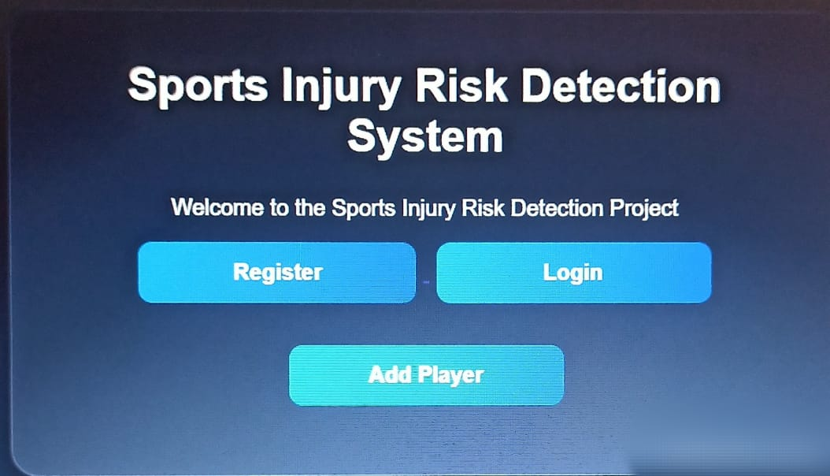
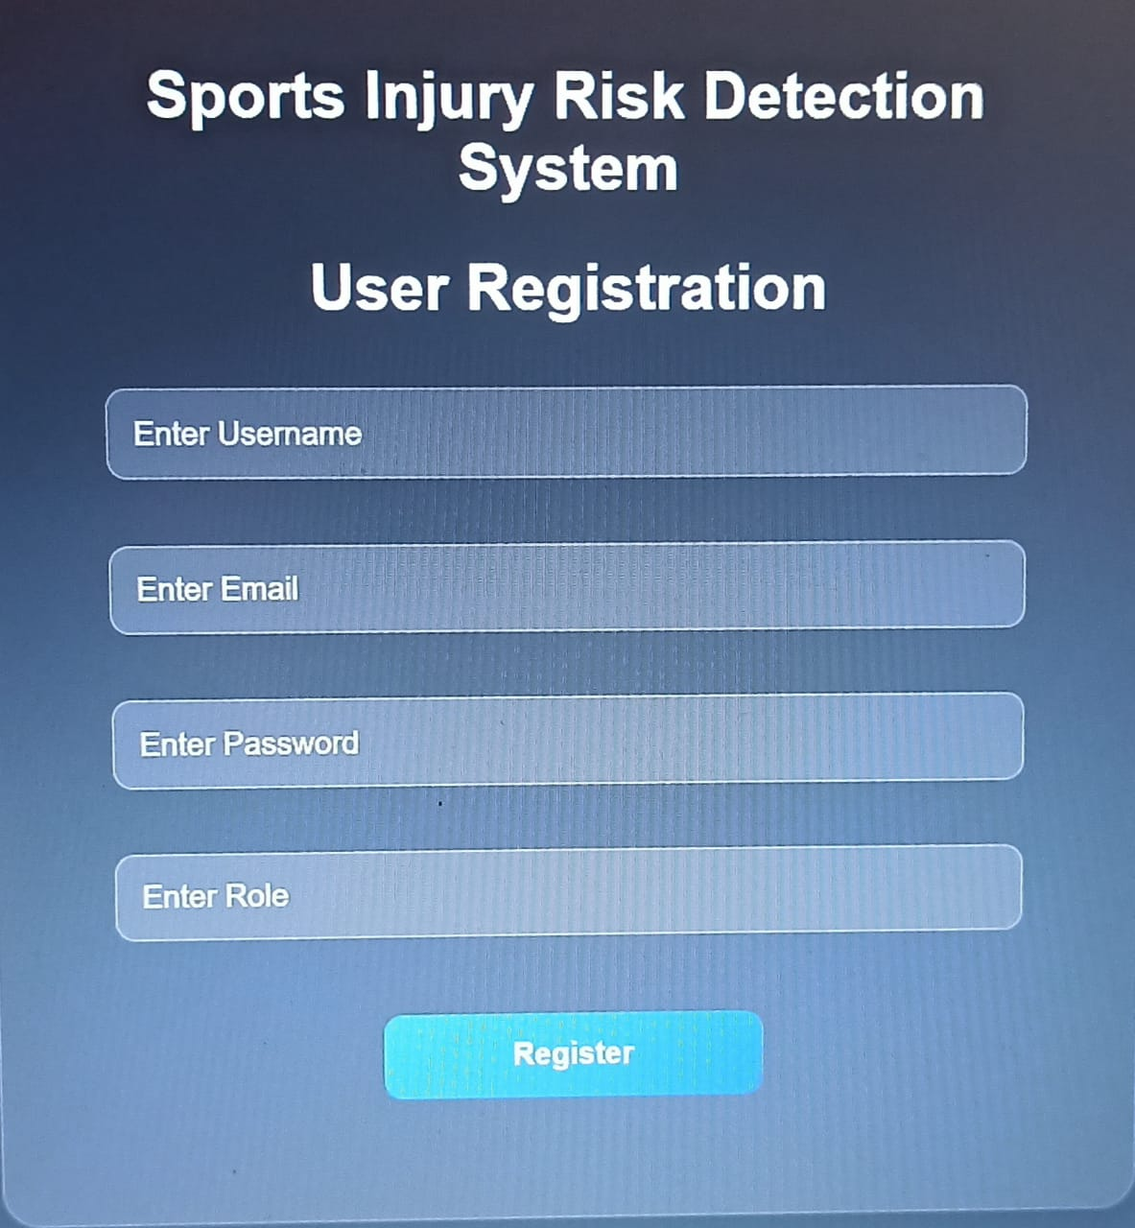
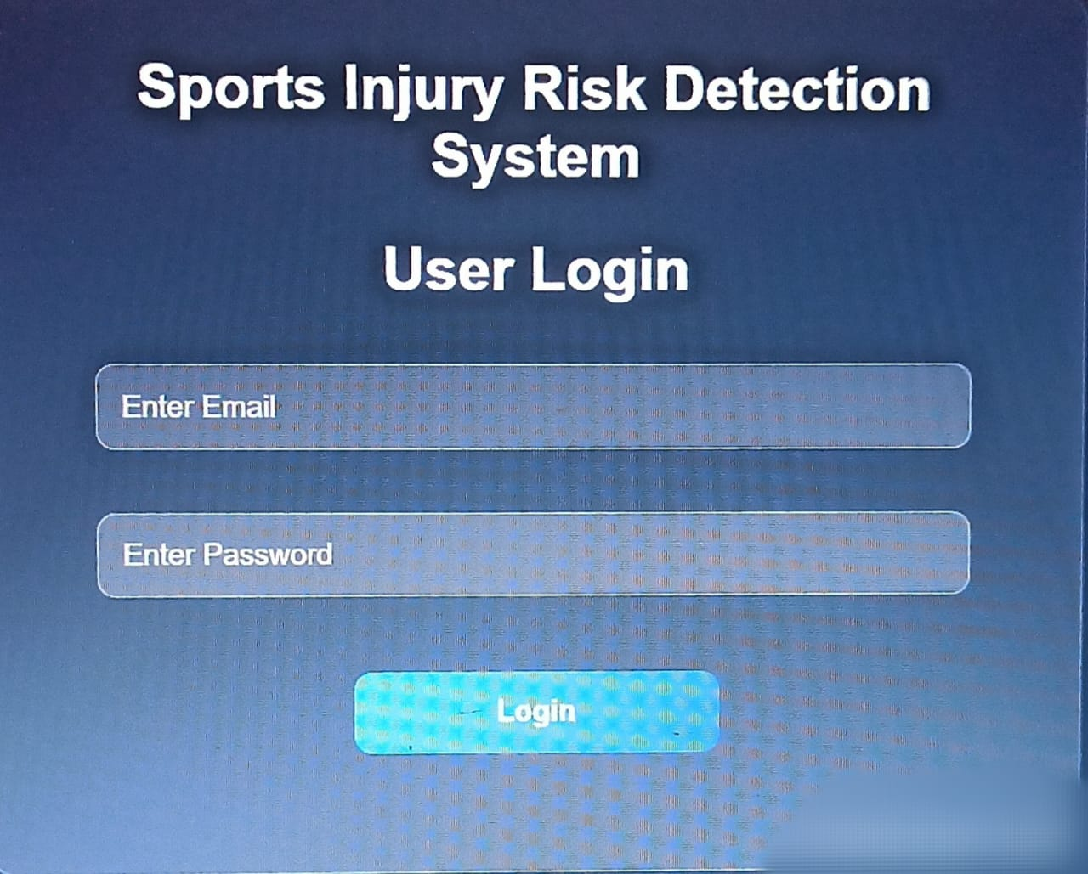
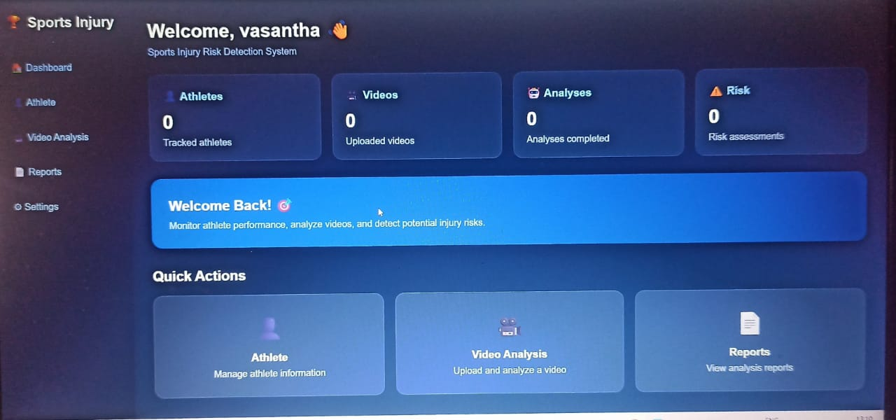
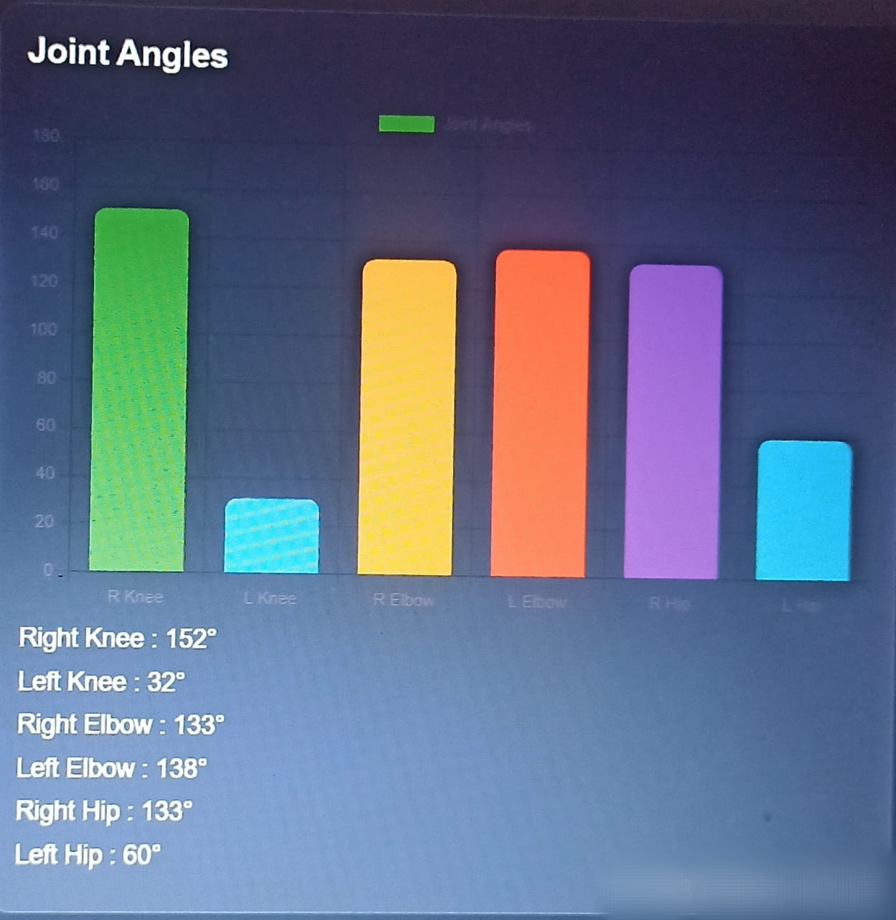
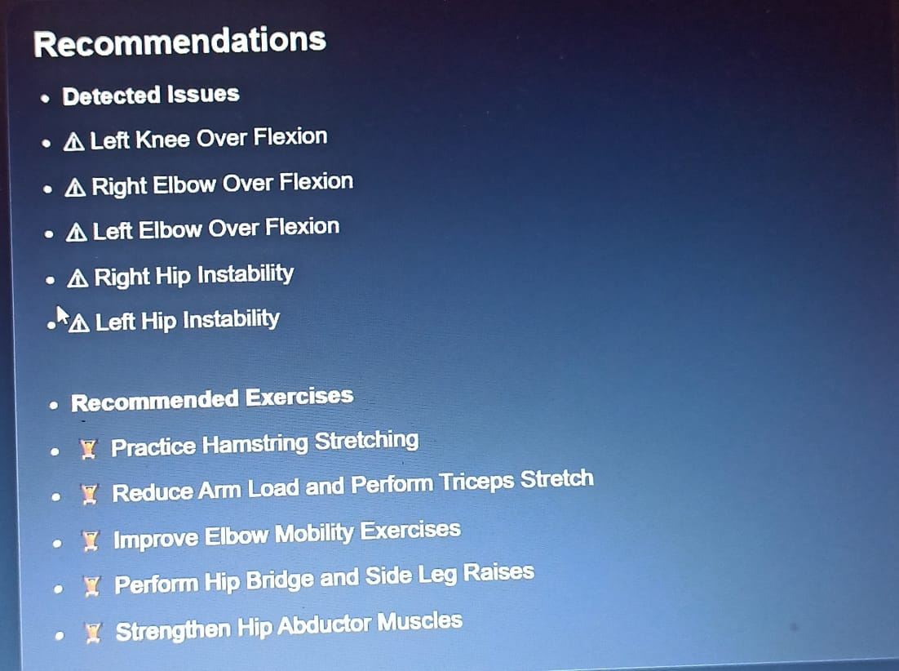
Project Screens/Working Demo:
=>
=>
=>
=>
=>
=>

Slide 9
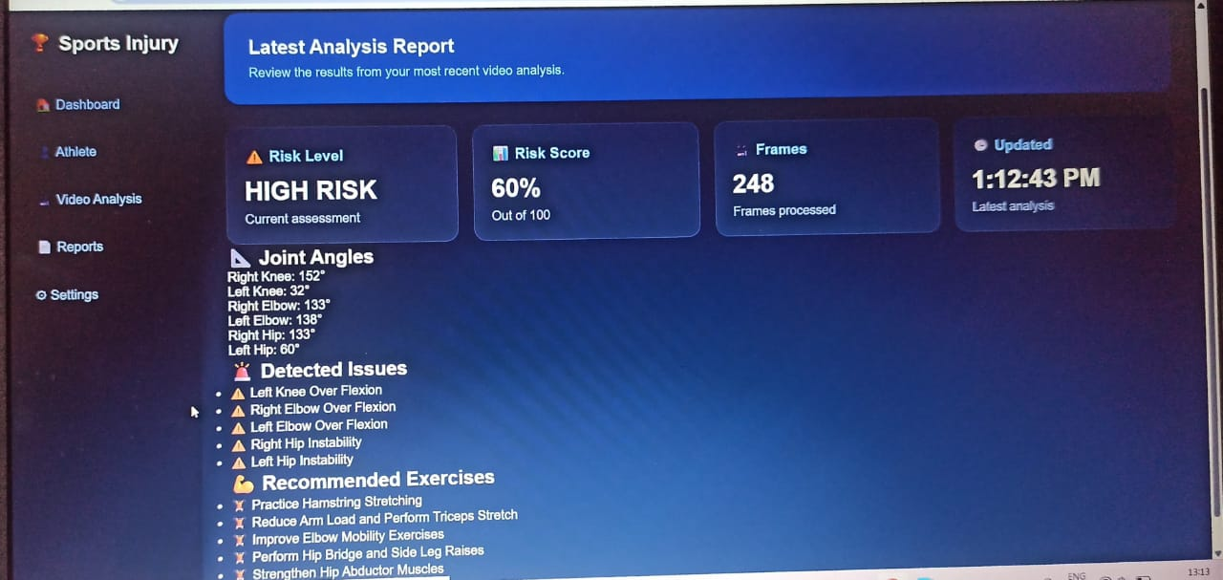
Results & Generated Reports:
→Successfully implemented the user registration and login system.
→Video upload and processing workflow is working.
→Pose landmarks are generated using MediaPipe.
→Movement analysis results are generated from the detected landmarks.
→Risk prediction results are displayed to the user.
→Reports are generated based on the analysis results.

Slide 10
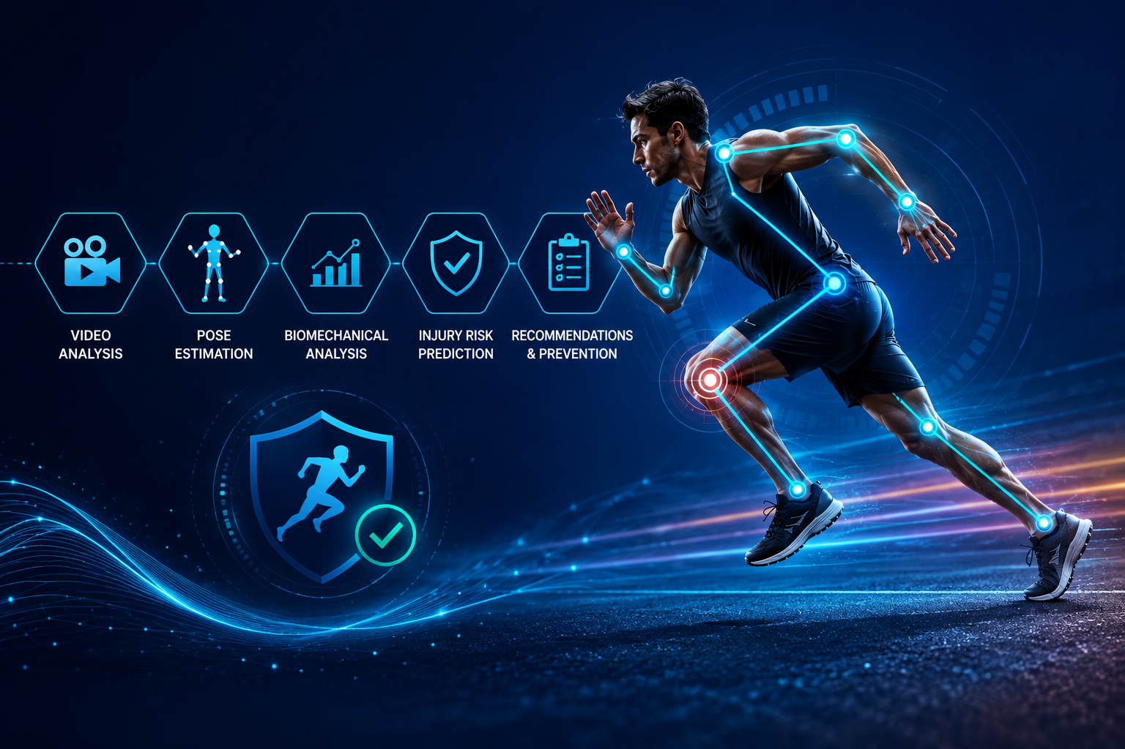
Conclusion:
→The project demonstrates how AI and computer vision can be used for sports movement analysis.
→MediaPipe helps detect body landmarks from sports videos.
→The detected movements can be analyzed to identify potential injury-risk factors.
→The system combines video processing, pose estimation, movement analysis and risk prediction.
→The project provides a foundation for intelligent sports injury prevention.

Slide 11
Future Scope:
→Improve prediction accuracy using larger and more diverse datasets.
→Support more sports and different types of movements.
→Improve the risk-prediction model using machine learning.
→Add real-time camera-based movement analysis.
→Provide more detailed athlete performance analytics.
→Develop a mobile or cloud-based version in the future.

Slide 12
Thank you

