Slide 1
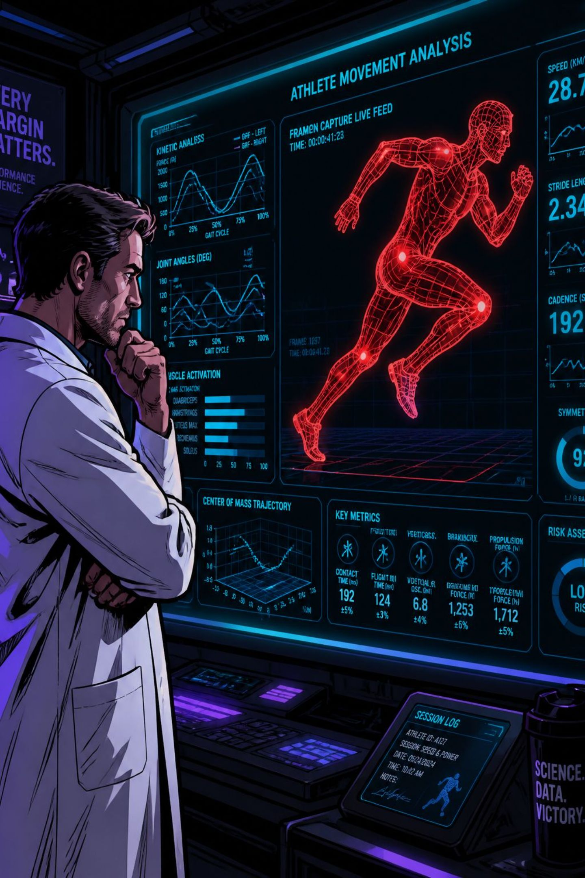
Sports Injury Risk Detection Platform
AI-Powered Athlete Movement Analysis & Injury Prevention
Monitor. Analyse. Prevent injuries.
A smart platform designed to analyse athlete movement, identify biomechanical issues, and support early injury‑risk detection.

Slide 2




Technology Stack — Modern Full‑Stack Architecture
Python + FastAPI
React + Vite
SQLite + SQLAlchemy
JWT + bcrypt
Fast, component‑based UI for login, registration, dashboard and athlete profile workflows.
Secure session tokens and strong password hashing to protect user credentials and API access.
High‑performance backend REST API handling authentication, athlete management and frontend communication.
Lightweight local data store for development with ORM for structured data access and migrations.
Labels: Python | FastAPI | React | Vite | SQLite | SQLAlchemy | Axios | JWT | bcrypt

Slide 3

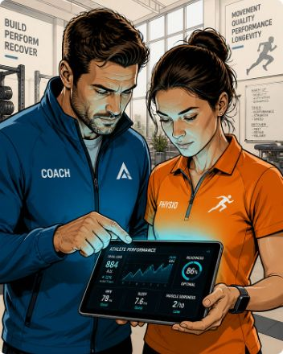
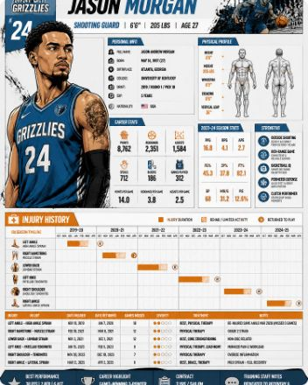
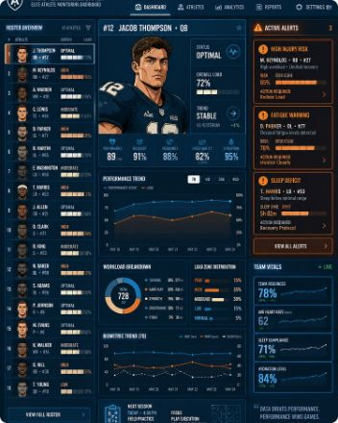
Core Features
Secure User Authentication
Role‑Based Access Control
Athlete Profile Management
Athlete Monitoring Dashboard
Registration and login with JWT sessions and bcrypt password hashing to ensure protected access.
Support for Athlete, Coach, Physiotherapist, Sports Scientist and Administrator roles with tailored interfaces.
Structured athlete records: demographics, position, injury history and training load for longitudinal tracking.
Centralised view of athlete roster, analysis previews and system health to support clinical and coaching decisions.

Slide 4
Problem Statement — Challenges in Injury Prevention
1
2
3
4
Delayed Injury Detection
Manual Assessment
Fragmented Athlete Data
Need for Preventive Analysis
Movement abnormalities often go unnoticed until pain or injury occurs, reducing preventive opportunities.
Traditional observation is time‑consuming and limited by subjective interpretation and clinician availability.
Training load, medical notes and performance metrics are frequently siloed across systems and spreadsheets.
There is a clear requirement for automated analysis to surface early risk indicators before injuries progress.

Slide 5

System Architecture Overview
Users
React + Vite
HTTP / JWT
FastAPI → DB
Architecture highlights: modular design (frontend, backend, database), REST API communication, JWT‑protected resources and an AI‑ready structure for future video processing and pose‑based analysis.

Slide 6
Challenges & Solutions
Secure Access
Role Management
Athlete Data Management
Future AI Integration
Challenge: Protect sensitive athlete data.
Solution: JWT auth, bcrypt hashing and protected API routes.
Challenge: Mixed user responsibilities.
Solution: Granular RBAC for five user roles to constrain actions and UI access.
Challenge: Disorganised records and scattered metrics.
Solution: Structured database models via SQLAlchemy and consistent profile schemas.
Challenge: Complex video processing and ML requirements.
Solution: Architecture designed to add video ingestion, pose estimation and risk models in future milestones.

Slide 7

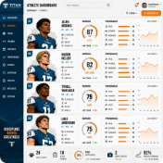

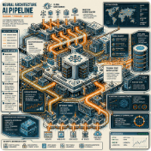
Measured Outcomes — Milestone 1 Deliverables
Secure Authentication
Centralised Athlete Information
Controlled Data Access
AI‑Ready Foundation
Complete registration and login workflow with hashed passwords and JWT session tokens.
Role‑based permissions ensure sensitive data is only visible to authorised roles.
Implemented structure enables future addition of video processing, pose estimation and prediction modules.
Profiles centralise demographics, injury history and training load for consistent record‑keeping.

Slide 8
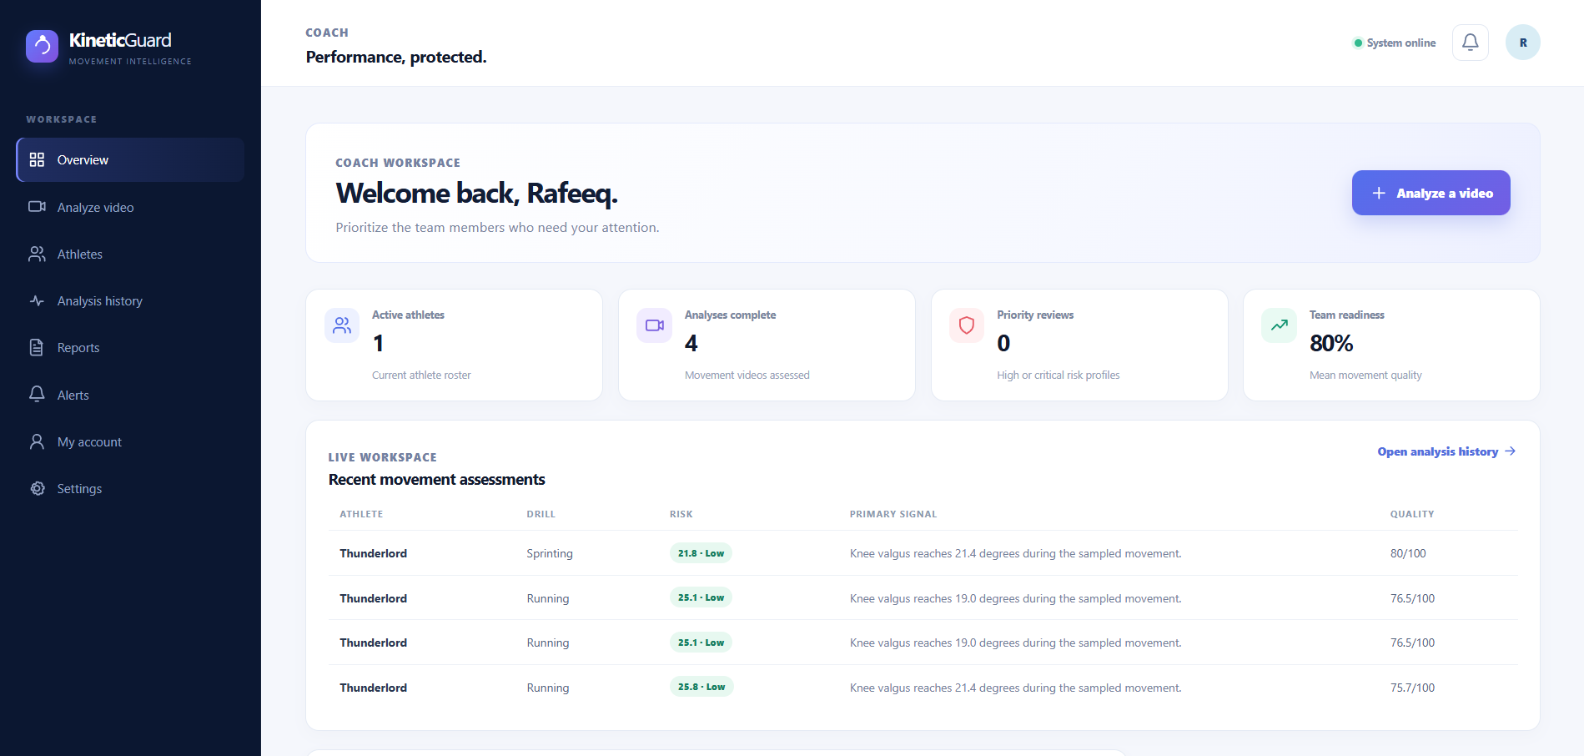
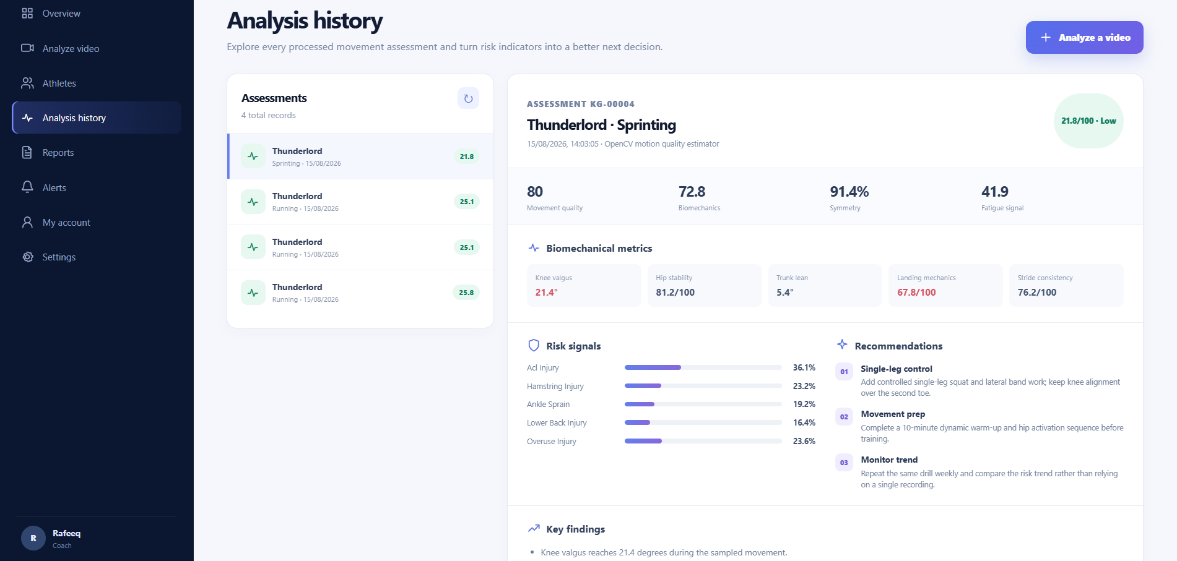
UI — Application Screens
The platform provides an intuitive interface for athletes and sports professionals to securely access athlete information, manage profiles and monitor the injury‑analysis workflow.

Slide 9
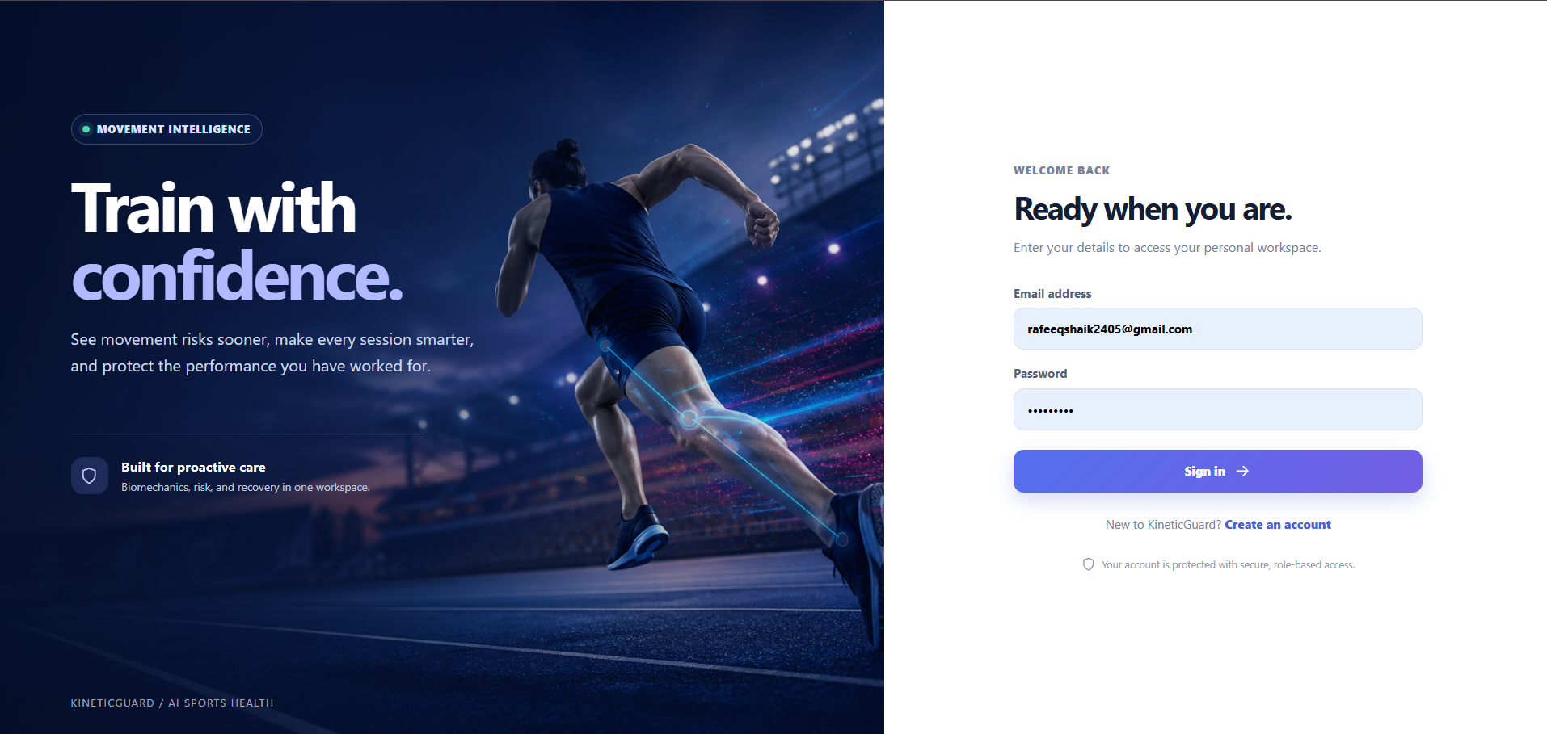
Athlete Registration & Authentication
01
Simple User Registration
Users create an account with name, email, password and role selection.
02
Secure Authentication
Passwords hashed with bcrypt; login issues JWT access tokens for API calls.
03
Role Selection
Five supported roles: Athlete, Coach, Physiotherapist, Sports Scientist, Administrator.
04
Personalised Access
Post‑login routing directs users to role‑appropriate dashboards and tools.

Slide 10
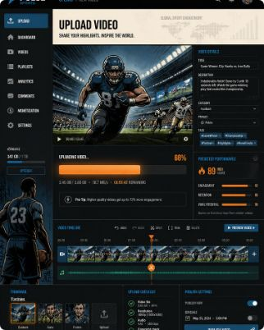
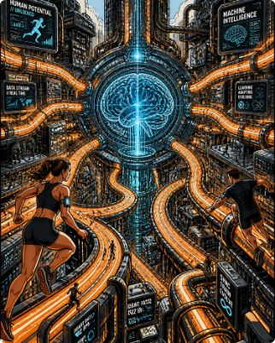
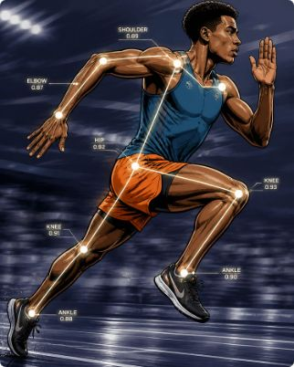
Future Enhancements & Roadmap
Video Processing
Pose & Biomechanical Analysis
AI Injury Risk Prediction
Enable upload and processing of training videos. Technologies to explore: OpenCV, FFmpeg.
Extract keypoints and evaluate joint angles, symmetry and abnormal movement patterns. Potential tools: MediaPipe, OpenPose, MoveNet.
Develop models to produce risk classifications, alerts and preventive recommendations from movement and athlete data.

