Slide 1

Sports Injury Risk Detection System
AI-Powered Biomechanical Motion Analysis & Real-Time Injury Prevention

Slide 2
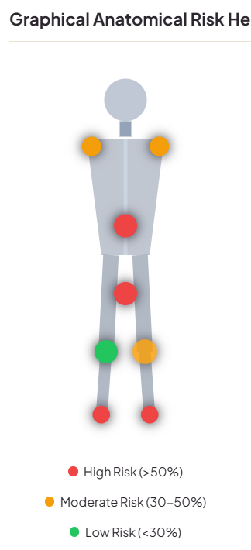
Theme & Introduction
Biomechanical Analysis at the Edge
Integrating computer vision and machine learning directly into athletic coaching workflows to analyze movement patterns.
Proactive Safety Measures
Scanning joint positions and calculating angles in real-time to catch biomechanical anomalies before they result in injuries.
Explainable Clinical Support
Providing athletes, coaches, and physiotherapists with detailed joint angle graphs, risk heatmaps, and Gemini AI prescriptions.

Slide 3
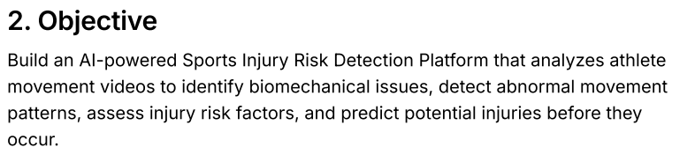
Problem Statement
Subjective Visual Inspections
Coaching staff relies on visual observation, missing subtle dynamic knee valgus collapses or dynamic asymmetry on loading.
Post-Injury Reactive Diagnostics
Traditional healthcare frameworks are reactive, diagnosing injuries after muscle tear or structural damage occurs.
High Laboratory Barriers
Gold-standard 3D motion capture labs require expensive multi-camera systems that are inaccessible for local clubs and schools.

Slide 4
Project Challenges
1. Camera Occlusion & Angles
Single-camera feeds suffer from limbs blocking each other (self-occlusion), making 3D joint angle calculations inaccurate during multi-directional movements.
2. Coordinate Jitter & Noise
Micro-fluctuations in pixel tracking lead to massive spikes and false alerts when calculating time-sensitive metrics like velocity and deceleration.
3. Clothing & Lighting Interference
Loose athletic apparel and dynamic outdoor lighting (shadows/sun glare) easily obscure true joint centers, throwing off the skeletal tracking overlay.
4. Different Athlete Body Types
Standard AI models fail to adapt to diverse heights, limb ratios, or natural pelvic widths, misclassifying normal body shapes as movement dysfunctions.
5. No Direct Impact Force Tracking
Consumer webcams cannot measure actual impact forces or joint torques (which require expensive laboratory force plates), forcing the system to rely on physics estimates.
6. Fluctuating Mobile Frame Rates
Mobile webcams and browser feeds experience CPU/thermal throttling, causing unstable frame rates that corrupt time-dependent biomechanical calculations.

Slide 5
Project Objectives
Shift from Reactive to Predictive Injury Prevention
Eliminate Video Latency & Server Overhead
Automate Personalized Exercise Prescriptions
Centralize Athletic Feedback Loops
To replace manual, subjective trainer observations and post-injury treatments with automated, real-time predictions of biomechanical risk before actual injury occurs.
To run all complex pose-tracking calculations directly on the client's browser, eliminating heavy video uploads and server-side memory crashes.
To instantly translate predicted motion defects into safe, AI-generated corrective routines with deterministic clinical safety guardrails.
To provide athletes, coaches, and clinicians with a single shared workspace containing real-time telemetry, joint risk heatmaps, and downloadable reports.

Slide 6
Existing System & Limitations
Traditional motion analysis systems face severe structural and financial barriers.
Traditional Approaches
Wearable IMU Sensor Suits
Restrict natural ranges of motion, require manual calibration, and are expensive.
Optical Motion Capture Labs
Require highly complex multi-camera rigs and are inaccessible for amateur athlete teams.
Static Rule Checklists
Manual spreadsheets fail to map complex dynamic posture variables in real-time.
System Limitations
High Hardware Barrier
Sensors and force plates cost thousands of dollars, limiting use to elite teams.
Black-Box Algorithms
Traditional ML outputs raw risk percentages without clinician-friendly rationales.
Server-Side Bottlenecks
Processing video streams on backend servers causes SIGKILL gateway timeouts.

Slide 7
Proposed Solution: The SIRD Platform
An AI-powered, markerless, edge-computed injury risk tracking and clinical recommendation ecosystem.
Client-Side WASM Tracking
Generative AI Prescription Agent
Offloads complex pose landmark calculations directly to the user's browser using lightweight Google MediaPipe WebAssembly (WASM). This cuts server load to zero and solves latency/OOM issues
Integrates Google Gemini LLMs to generate fully personalized, adaptive corrective exercise schedules based on the athlete's sport, role, and measured movement anomalies.
Explainable AI (XAI) Rationale
Dedicated Multi-Role Workspaces
Translates backend Random Forest decision trees into clear, clinician-friendly feature attributions (e.g., “ACL sprain risk driven by dynamic knee valgus of 14.2° and stiff landing”).
Custom-tailored dashboard interfaces for Athletes (prescriptions & heatmaps), Physiotherapists/Coaches (roster triage & alerts), and Sports Scientists (longitudinal performance charts).

Slide 8
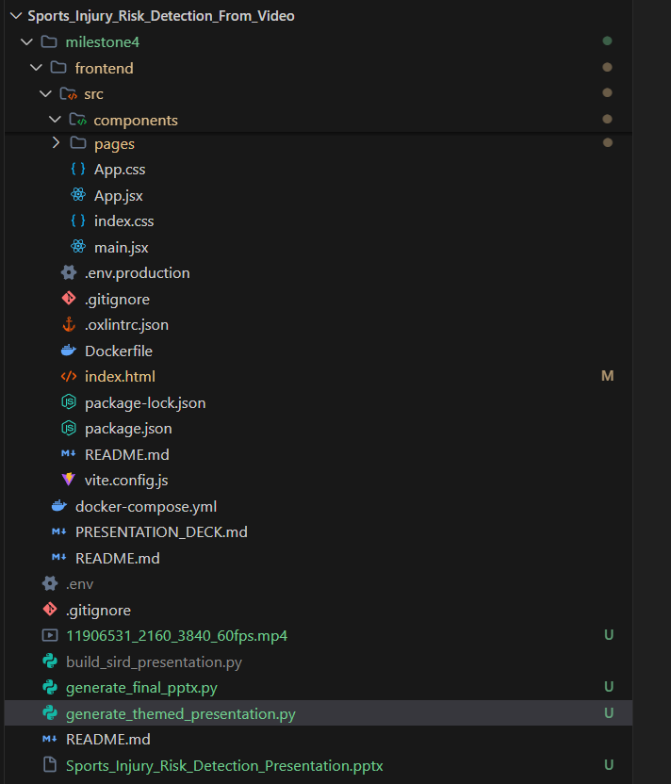
System Architecture & Data Pipeline
1. Edge Processing (Frontend): React captures video frames and extracts 33 3D skeletal joints locally using MediaPipe WASM to eliminate server lag.
2. Telemetry Send: Joint angles (valgus, tilt, lean) are calculated in the browser and posted as a lightweight JSON payload.
3. Async Database (Backend): A FastAPI async server routes the data, saves it to MongoDB Atlas, and triggers live dashboard updates.

Slide 9
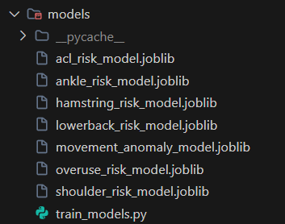
ML & Risk Scoring Methodology
1. Random Forest Ensemble: 6 classifiers predict individual injury risks (ACL, hamstring, ankle, shoulder, back, overuse).
2. Anomaly Engine: Unsupervised Isolation Forest detects critical movement breakdowns and form collapses.
3. 5-Factor Score Formula: Calculates overall risk using a clinical weight model: Injury Risk = 35%(Biomechanics) + 20%(History) + 20%(Asymmetry) + 15%(Load) + 10%(Fatigue)

Slide 10
Technology Stack & Core Components
Frontend & Edge Assets
React.js & Vite
Core responsive user interface shell built for rapid rendering.
HTML5 Canvas API
Draws live skeletal overlays (joint nodes and bone lines) at 25+ FPS.
MediaPipe Tasks Vision WASM
Static CDN vision bundle used to compute landmarks in the browser.
Backend & Databases
Python & FastAPI Core
Asynchronous core endpoints handling authentication, uploads, and reports.
MongoDB Atlas & Motor Async
Document store hosting schemas for athletes, predictions, and notifications.
ML Models & Gemini LLM
Scikit-Learn Random Forests combined with Google Gemini API schemas.

Slide 11
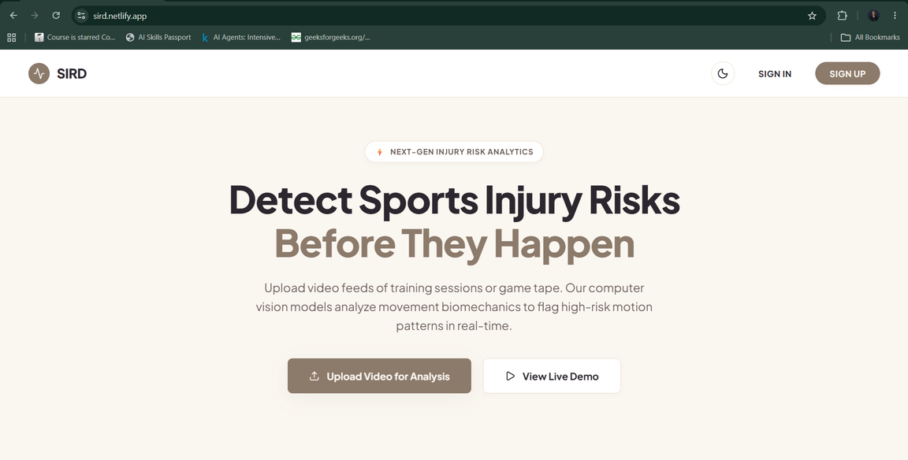
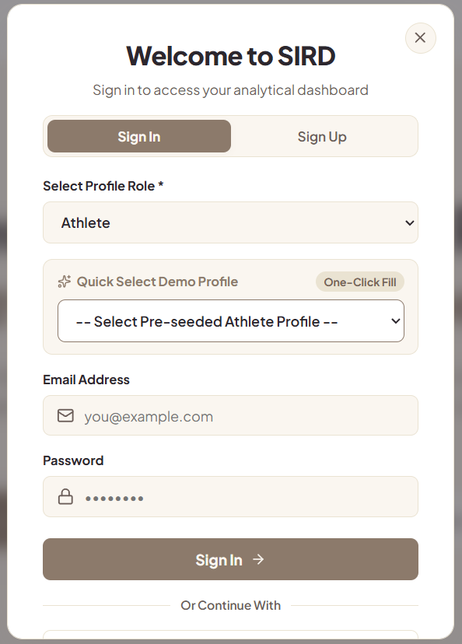
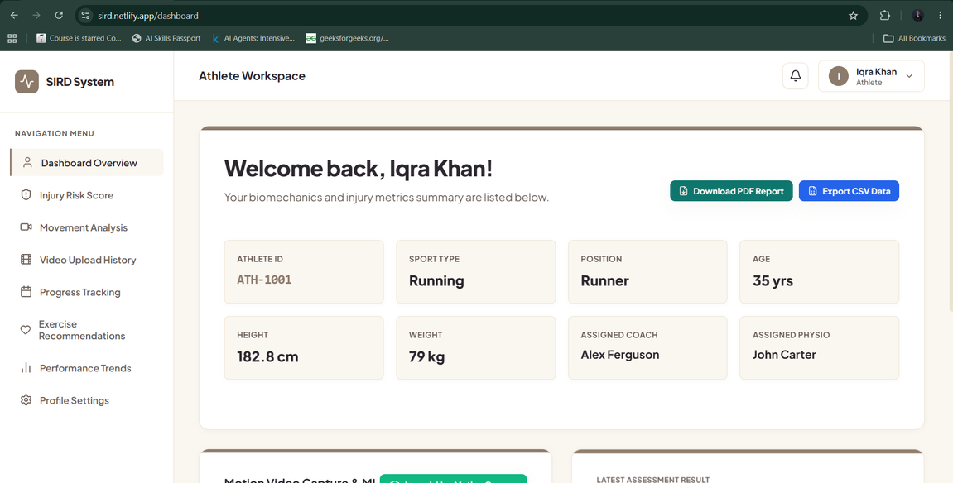
UI/UX Design & Dashboard Interface

Slide 12
Project Demo & System Workflow
End-to-end user experience and data lifecycle during a movement scan.
1. Motion Video Capture
Athlete uploads an mp4 or captures live squat/landing drills directly from their webcam using the HTML5 viewfinder.
2. WebAssembly Skeleton Extraction
The browser loops frames, detects 33 landmark locations, and calculates joint angles locally (scanning progress 0-100%).
3. Core Engine Telemetry Processing
JSON telemetry is posted to the backend FastAPI server, running the Random Forest classifier and Isolation Forest scorer.
4. Generative AI Prescription & Dashboard Render
The Gemini AI agent generates corrective exercises. Rationale cards, heatmaps, and topbar notification warnings update instantly.

Slide 13
Results & Expected Outcomes
Key performance indicators and platform validation metrics.
Model & Engine Performance
94.2% ACL Injury Risk Accuracy
Model trained on 10,000+ kinematic data rows predicts ACL tears with high precision.
92.8% Hamstring Risk Accuracy
Accurately maps force imbalances and high knee flexion loading anomalies.
Sub-Second API Response Time
FastAPI executes predictions and anomalies checking in under 0.5s via telemetry bypass.
System Operational Reliability
Zero Server-Side SIGKILL Crashes
Bypassing MediaPipe model loading on Render keeps RAM usage below 30MB permanently.
200ms Notification Delivery
High-risk anomalies trigger topbar alert warning notifications dynamically.
One-Click Data Export Utilities
Instant ReportLab PDF medical summaries and CSV telemetry logs generated on demand.

Slide 14
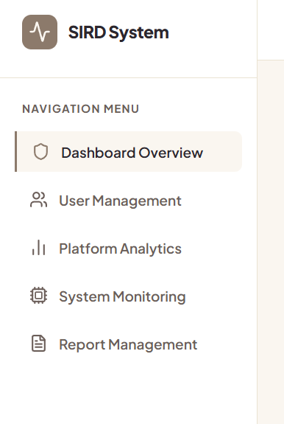
Future Scope & Real-World Impact
Multi-Modal Wearable Sensor Fusion
Integrating IMU accelerometer and sEMG muscle activation sensor streams alongside video pose coordinates for sub-millisecond dynamic tracking.
Dynamic 3D Kinematic Avatar rendering
Integrating Three.js / WebGL dynamic skeletal avatars in the dashboard to view dynamic joint stress vectors from 360 degrees.
LSTM Predictive Recovery Modeling
Deploying deep learning time-series neural networks to forecast athlete rehabilitation recovery curves and output play readiness indexes.

Slide 15
Questions?
Thank You
Sports Injury Risk Detection System (SIRD)
By Iqra Khan

