Slide 1
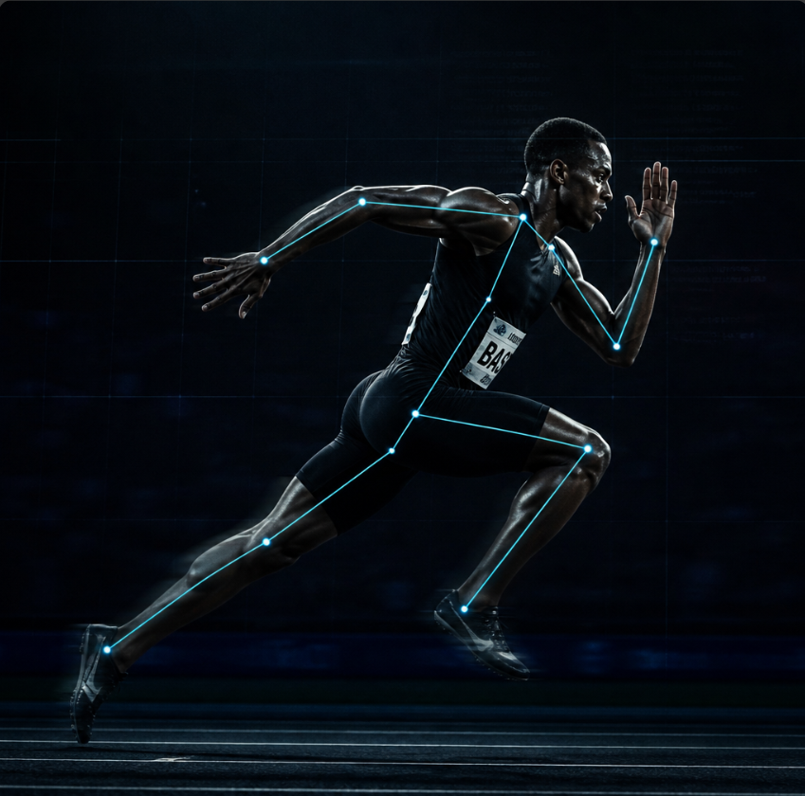
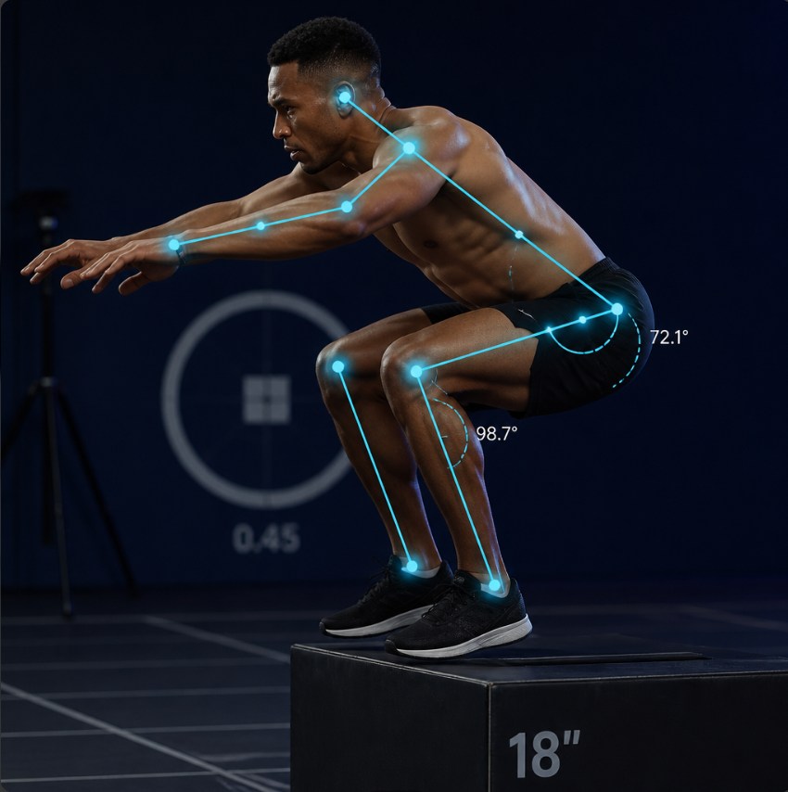
VANTAGE
Sports Injury Risk Detection
from Video
An AI-assisted platform for proactive athlete injury prevention — pose estimation, biomechanics, and an explainable injury risk score.
Milestones 1–4 — Full-stack build, tested end to end

Slide 2
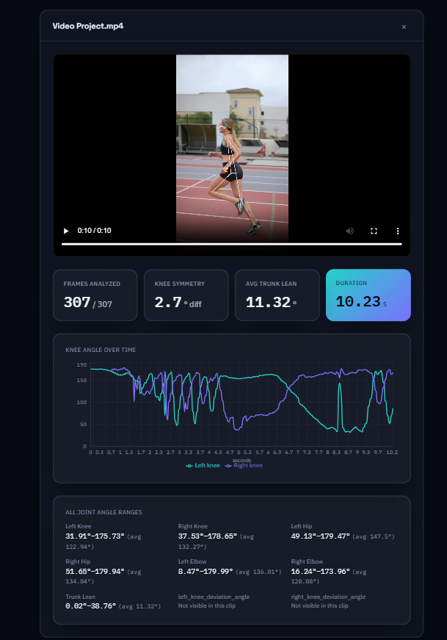
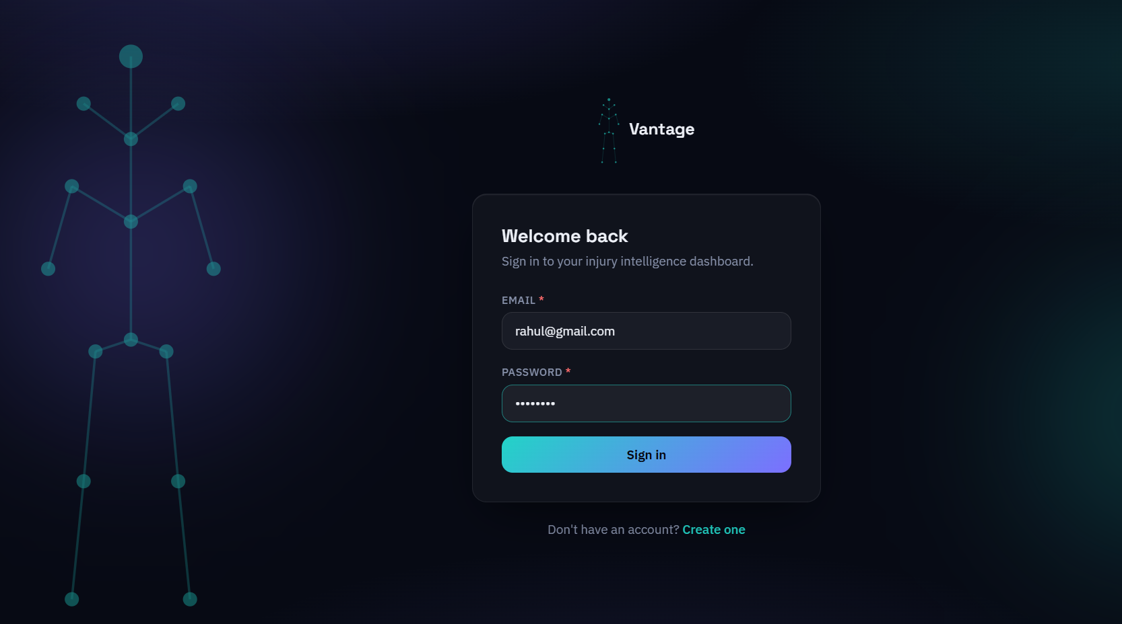
Vantage - Overview
Screenshots of the live Application

Slide 3



The Problem
Why proactive, video-based screening matters
Reactive
Subjective
Unscalable
Most injury prevention happens after the injury — once it's too late to change the outcome.
Manual movement screening depends heavily on who's watching and how experienced they are.
One physiotherapist can't personally screen every athlete on a roster, every week.

Slide 4




How It Works
One pipeline, from raw footage to an explainable risk score
→
→
→
Upload Video
Detect Pose
Compute Biomechanics
Injury Risk Score
A training or match clip
33 body keypoints per frame
Joint angles, symmetry
Explainable, 0–100

Slide 5


Tech Stack & Architecture
Backend
Frontend
Python + FastAPI
React + Vite
PostgreSQL + Alembic migrations
Tailwind CSS
MediaPipe + OpenCV
Recharts
JWT authentication
Vitest + Testing Library

Slide 6



MILESTONE 1
Accounts, Roles & Athlete Records
JWT Authentication
5 Roles
Email + password login; every permission enforced server-side, not just hidden in the UI.
Athlete, Coach, Physiotherapist, Sports Scientist, Admin — each with distinct read/write rules.
Structured Records
Migration-Managed Schema
Injuries, performance, assessments, training load — one table each, not free-text fields.
Every database change is a reviewable, reversible Alembic migration.

Slide 7
MILESTONE 2
Pose Estimation & Biomechanics
Skeleton Overlay
MediaPipe Pose draws a live skeleton over the uploaded video, frame by frame.
33
Joint Angle Calculation
Knee, hip, and elbow flexion angles — plus a frontal-plane knee valgus proxy.
body keypoints tracked
per video frame
Left/Right Symmetry
Range of motion compared as a clinical Limb Symmetry Index (LSI %).

Slide 8
MILESTONE 3
Injury Risk Scoring Engine
A weighted, explainable 0–100 score — not a black box
Biomechanical Deviations
35%
Movement Asymmetry
20%
Historical Injury Factors
20%
Training Load
15%
Fatigue
10%
Built on published sports-science thresholds — Acute:Chronic Workload Ratio, Limb Symmetry Index, Frontal Plane Projection Angle — with every score fully traceable to its contributing factors.

Slide 9


MILESTONE 4
Analytics, Reports & Deployment
Team Overview Dashboard
PDF & Excel Reports
Roster-wide risk view for coaches — highest risk athletes surfaced first.
Exportable risk assessment reports and training-load spreadsheets.

Slide 10

Built and Verified, Not Just Written
Real bugs, actually caught:
86
Video codec mismatch
OpenCV wrote MPEG-4 video, but browsers only play H.264 — caught before it shipped, fixed with an ffmpeg transcode step.
automated tests
(backend + frontend)
Migration cleanup bug
Postgres ENUM types weren't dropped on downgrade — caught by actually round-tripping every migration, twice.
Real Postgres in every
integration test — not mocked
Silent click-handler bug
A shared UI component silently dropped an onClick prop — caught by a test proven to fail on the broken version first.

Slide 11

Limitations & What's Next
Stated plainly — an honest self-assessment matters more than a polished pitch
Known Limitations
What's Next
No clinical validation against real injury outcomes yet
Collect real outcome data to validate the risk formula
No Team/Organization model — staff see every athlete
Add a Team/Organization model to scope staff access
Local disk storage & in-process jobs, not multi-server scale
Move to managed cloud storage and a real task queue

Slide 12
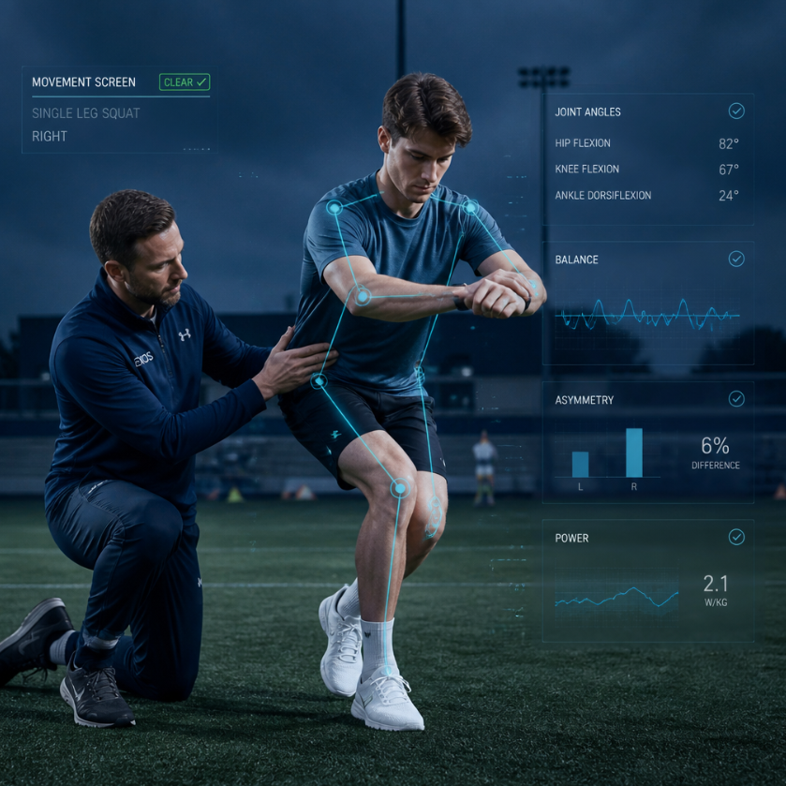
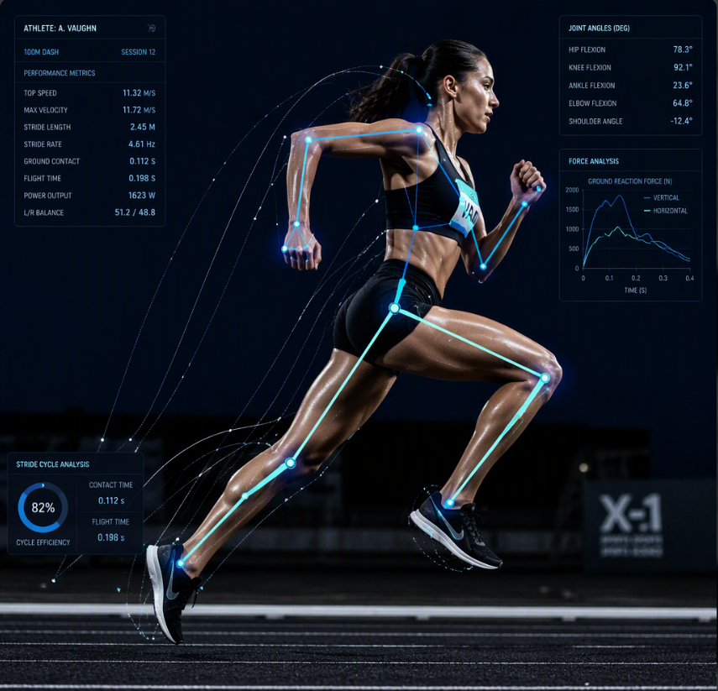
Thank You

