Slide 1

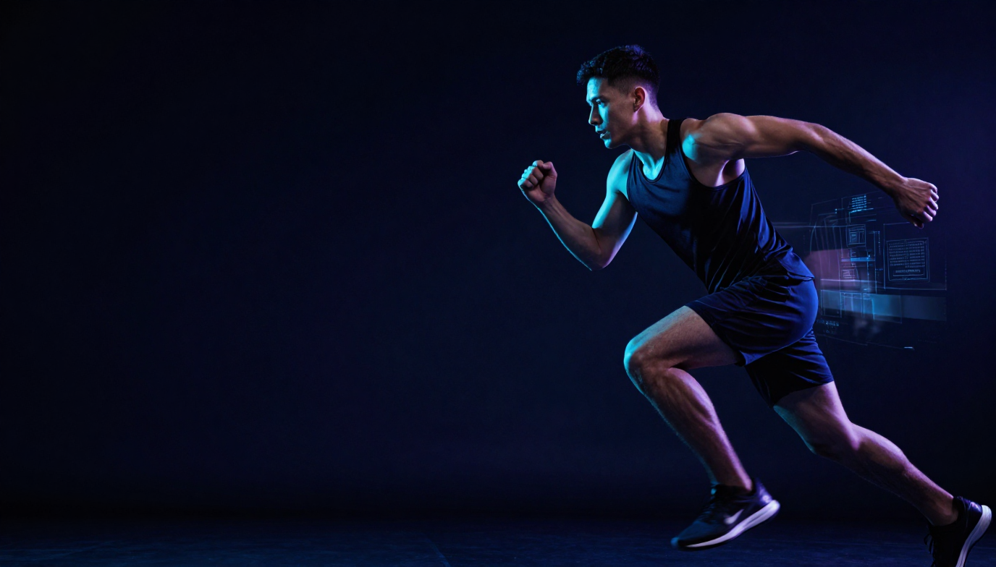
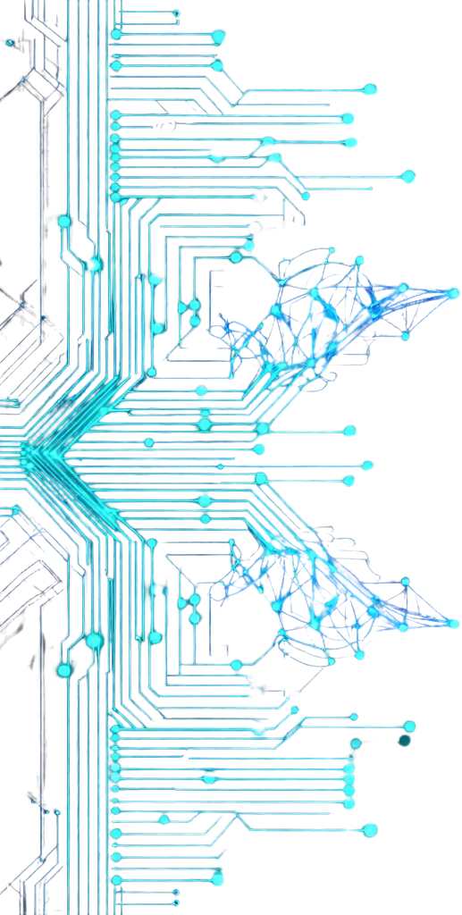
SPORTS INJ URY
RISK DETECTION FROM VIDEO
AI-powered movement intelligence for proactive injury prevention
Computer Vision
Pose Estimation
Biomechanics
Predictive Analytics
By:
Devarakonda Venkateshwarlu
01

Slide 2

Objective & Expected Outcomes
What the platform does
AI-powered injury intelligence
Analyzes athlete movement videos to identify biomechanical issues, abnormal patterns and injury risk factors before an injury occurs.
Computer vision → biomechanics → prediction → recommendations
Monitor movement continuously from uploaded video.
Estimate body pose, joint motion and movement trajectories.
Quantify biomechanical deviations and asymmetry.
Predict risk and classify it from Low to Critical.
Recommend corrective exercises, recovery and training changes.
Give coaches and medical teams actionable analytics.
Athletes
Safer training & movement feedback
Coaches
Team risk visibility & training decisions
Physiotherapists
Rehabilitation & correction analytics
Sports Scientists
Research-grade movement intelligence
02

Slide 3
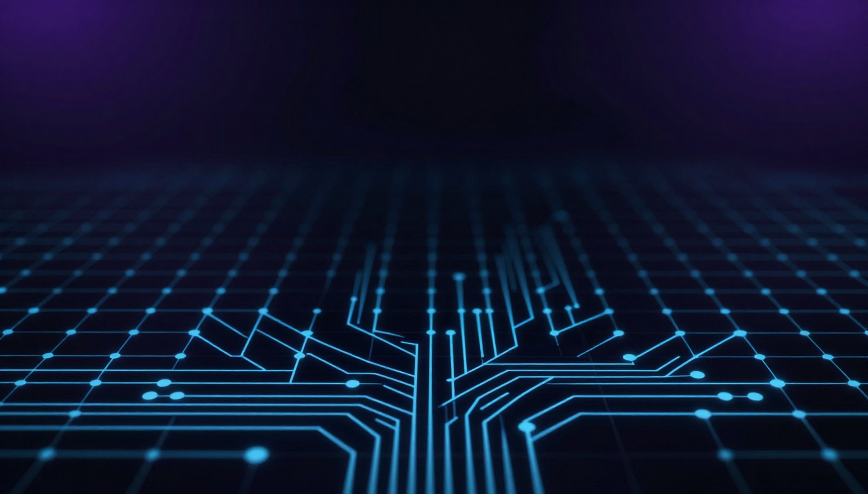
System Architecture
End-to-end pipeline from video capture to actionable injury prevention
Users & Roles
Athlete • Coach • Physiotherapist • Sports Scientist • Admin
Web Platform
React.js / Next.js • Dashboards • Reports • Alerts
API & Processing
FastAPI • JWT/OAuth2 • Video Processing • FFmpeg/OpenCV
AI Intelligence
Pose Estimation • Biomechanics • Anomaly Detection • Risk Prediction
Data Layer
PostgreSQL • MongoDB • Athlete History • Movement Features
Deployment
Docker • AWS / Azure • Monitoring & Logging
03

Slide 4
Core AI & Analysis Modules
01 Video Processing
02 Pose Estimation
Upload, validate, preprocess, frame extraction
Skeleton tracking, keypoints, motion trajectories
03 Biomechanics
04 Risk Prediction
Angles, ROM, symmetry, posture, alignment
Risk factors, injury probability, trend monitoring
05 Anomaly Detection
06 Risk Scoring
Technique deviation, fatigue, performance decline
Weighted risk score and Low → Critical categories
07 Recommendations
08 Analytics
Mobility, strength, recovery and training changes
Athlete, coach, physio and scientist dashboards
Frame Extraction → Pose Detection → Joint Angle Analysis → Movement Pattern Recognition → Risk Scoring
Each stage processes video input through specialized ML models to produce real-time injury risk scores.
04

Slide 5
Movement & Biomechanical Intelligence
Pose estimation
Biomechanical metrics
Supported activities
Key body points tracked across frames
Quantifies movement quality and alignment
Designed for common athletic movement patterns
Head
Shoulder
Knee valgus
Hip stability
Trunk lean
Landing mechanics
Stride length
Joint alignment
Balance
Running
Sprinting
Jumping
Squatting
Landing
Throwing
Cutting
Sport-specific drills
Elbow
Wrist
Hip
Knee
Ankle
Foot
Real-time movement analytics with joint-stress overlays, velocity tracking, and automated alert thresholds — flagging high-risk athletes instantly.
05

Slide 6
Injury Risk Prediction & Scoring
A transparent weighted model converts movement evidence into an interpretable risk score
Biomechanical deviations
Risk categories
35% contribution
Use risk level to trigger the right action.
LOW RISK
Historical injury factors
20% contribution
MODERATE RISK
Movement asymmetry
20% contribution
HIGH RISK
Training load indicators
15% contribution
CRITICAL RISK
Fatigue indicators
10% contribution
Risk score = weighted evidence
Risk heatmaps overlay joints in real-time. Stress indicators flag high-load zones. Movement deviation scores quantify biomechanical anomalies. Injury probability metrics ranked per athlete per session.
06

Slide 7
Dashboards, Alerts & Recommendations
Athlete Dashboard
Coach Dashboard
Risk score • movement reports • progress • exercises • performance trends
Team risk overview • athlete analytics • movement quality • training recommendations
Physiotherapist Dashboard
Sports Scientist Dashboard
Rehabilitation tracking • risk monitoring • correction analytics • recovery reports
Biomechanics • team trends • prediction insights • research reports
Admin Dashboard
Alert system
User management • platform analytics • monitoring • report management
High-risk movement • injury warning • training load • recovery reminder
07

Slide 8
Datasets & Technology Stack
Recommended datasets
Application stack
Human3.6M • MPII Human Pose • COCO Keypoints • SportsPose • FIFA Injury Dataset (reference)
Python • FastAPI • React.js / Next.js • Tailwind CSS • JWT / OAuth2 • PostgreSQL • MongoDB
AI / ML stack
Video, cloud & DevOps
OpenCV • YOLOv8 • MediaPipe • TensorFlow • PyTorch • Scikit-learn • XGBoost • NumPy • Pandas
FFmpeg • DeepSORT • Plotly • Matplotlib • Chart.js • Docker • AWS / Azure • GitHub Actions • Postman
09

Slide 9
Evaluation & Performance Metrics Results
Pose Estimation
Biomechanics
Keypoint detection • pose tracking • joint localization
Joint-angle accuracy • symmetry • movement quality
Injury Prediction
Recommendations
Prediction accuracy • precision • false positives • early warning effectiveness
Relevance • corrective exercise effectiveness • recovery improvement
System Performance
Video latency • API response • dashboard speed • concurrent processing
Goal: detect meaningful movement risk early enough to support proactive intervention.
10

Slide 10
Security, Integration & Deployment
Secure access
Data protection
Integration
JWT authentication • OAuth2 • role-based permissions
Athlete profiles, injury history and reports stored with controlled access
Frontend + backend APIs • validation • end-to-end workflows
Testing
Deployment
Deliverables
Functional • security • performance • API • end-to-end validation
Docker containers • AWS/Azure • monitoring • logging
Production build • documentation • user guides • final demonstration
11

Slide 11

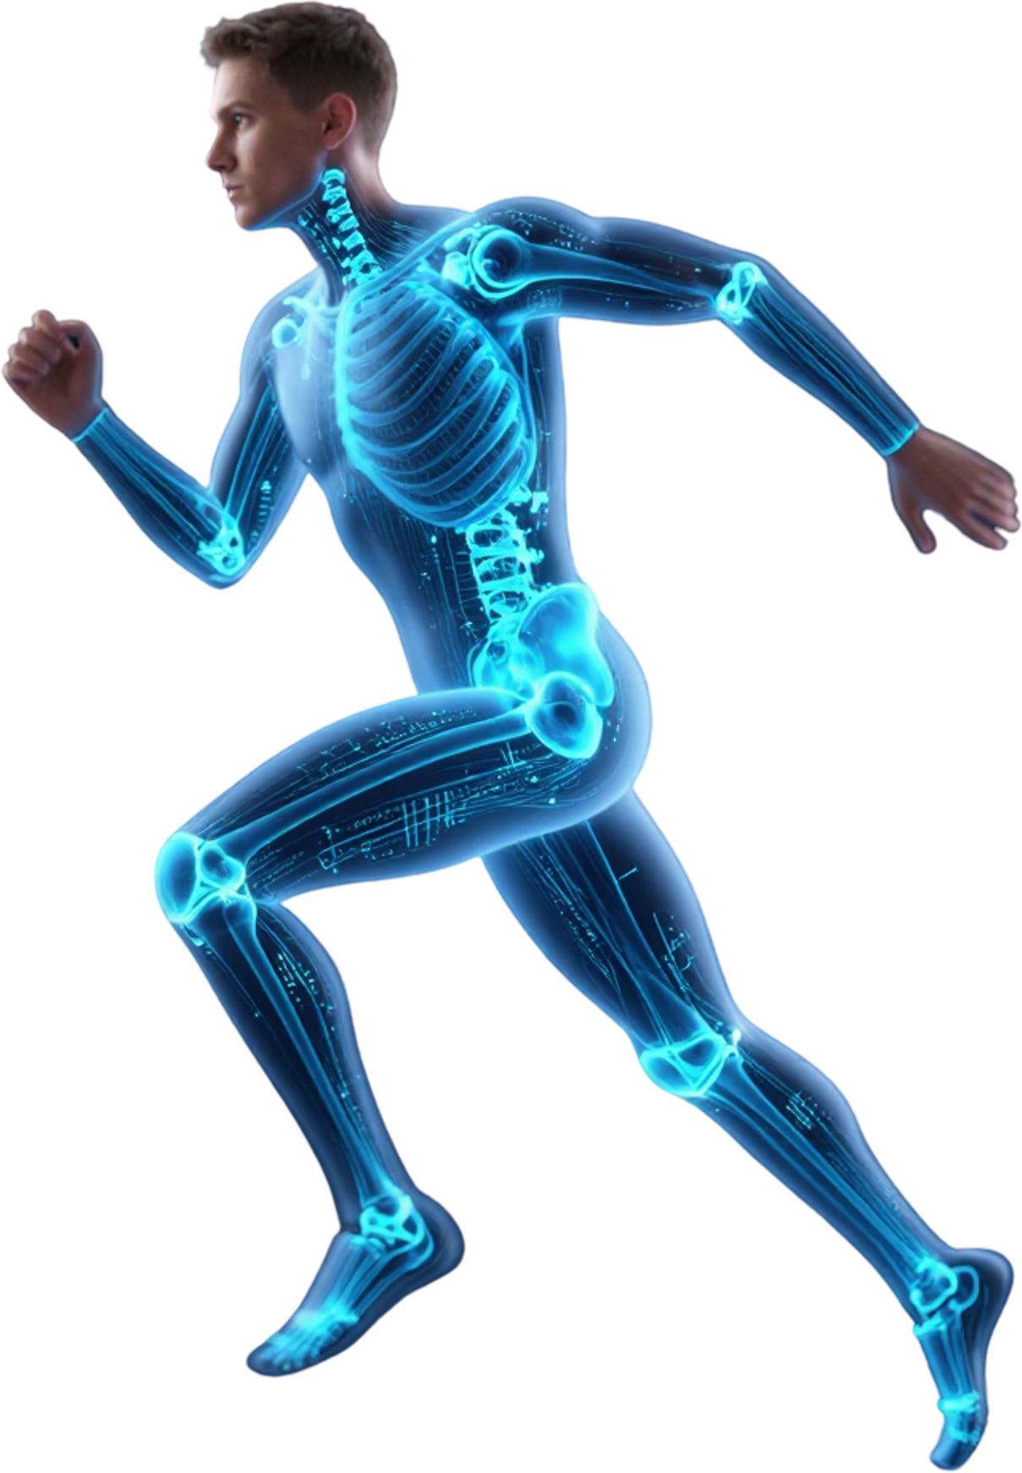
Future Scope
• Multi-Camera 3D Pose Analysis
— Full volumetric biomechanical reconstruction
• Sport-Specific AI Models
— Tailored risk profiles for football, basketball, athletics
• Wearable Sensor Fusion
— IMU + EMG data integrated with video inference
• Real-Time Coaching Feedback
— Live audio-visual alerts during training sessions
12

Slide 12




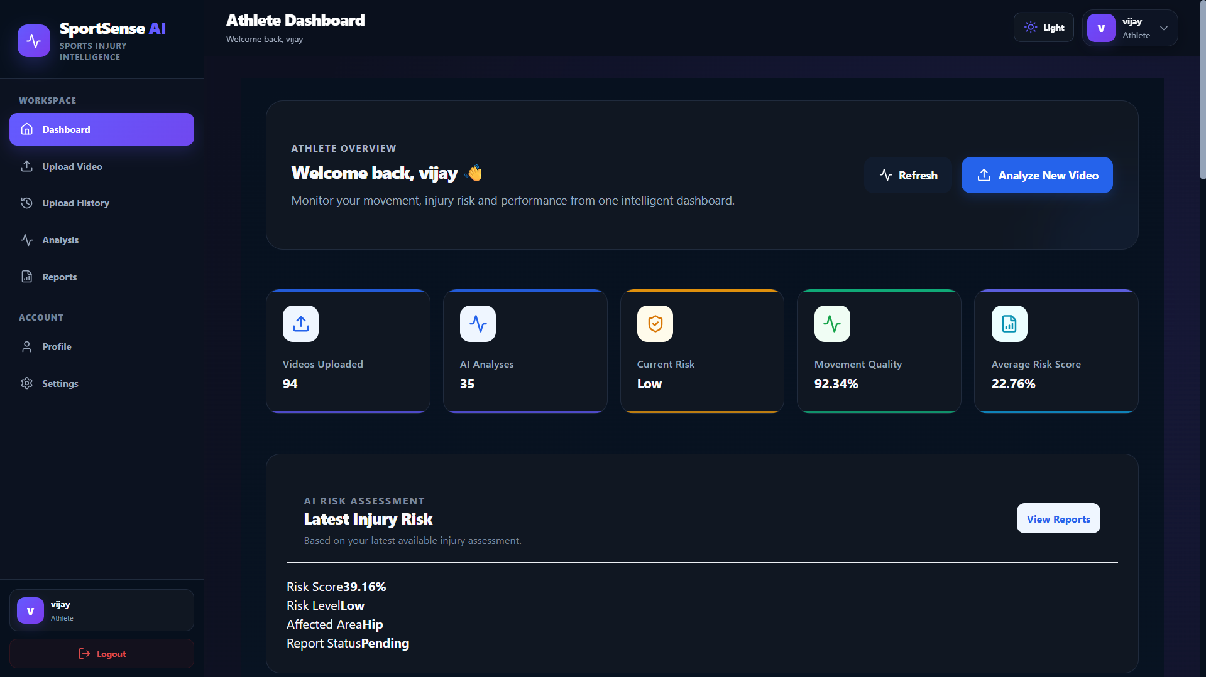
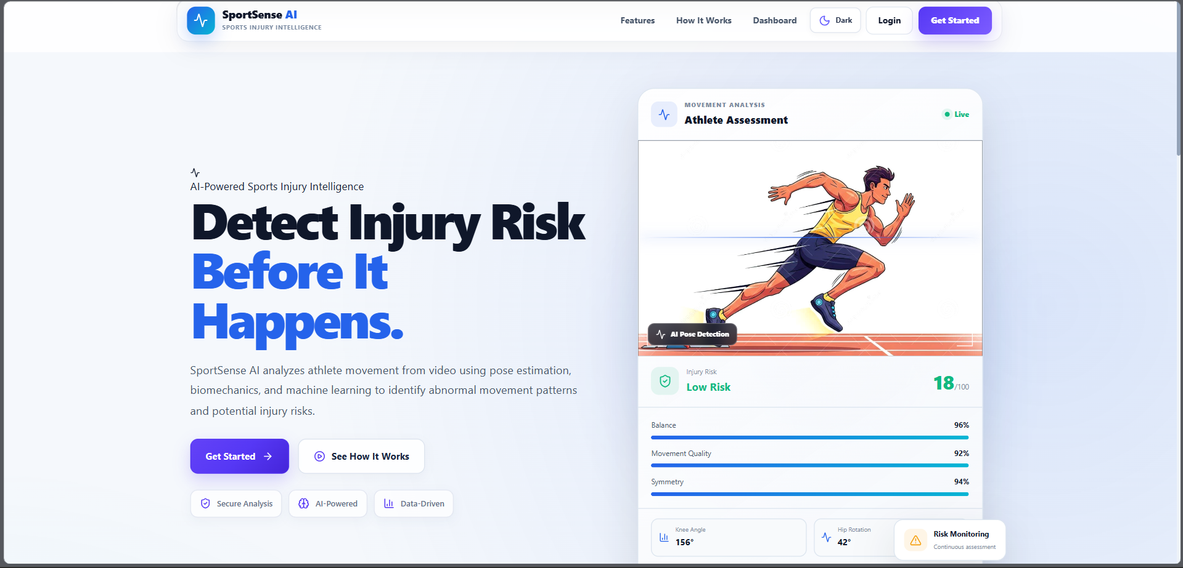
Results

Slide 13
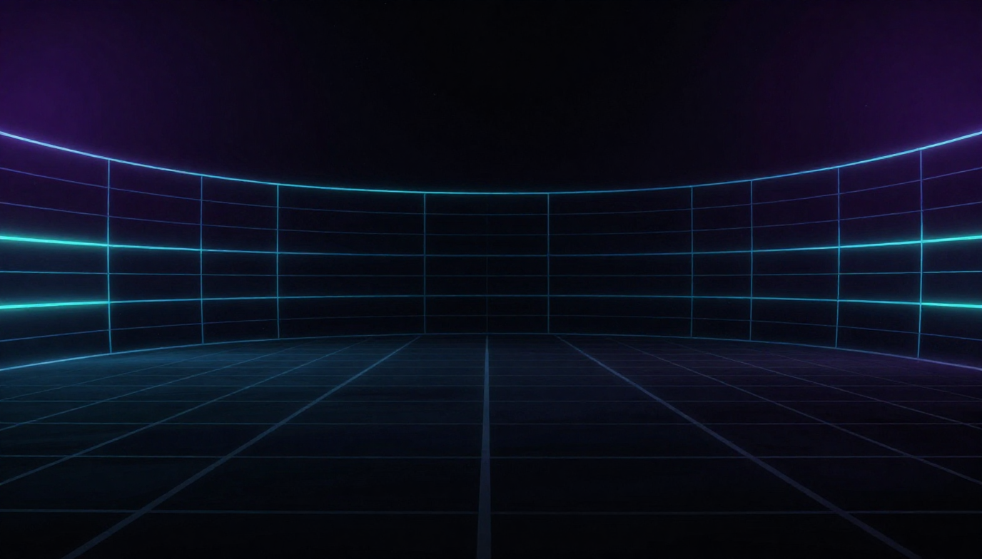
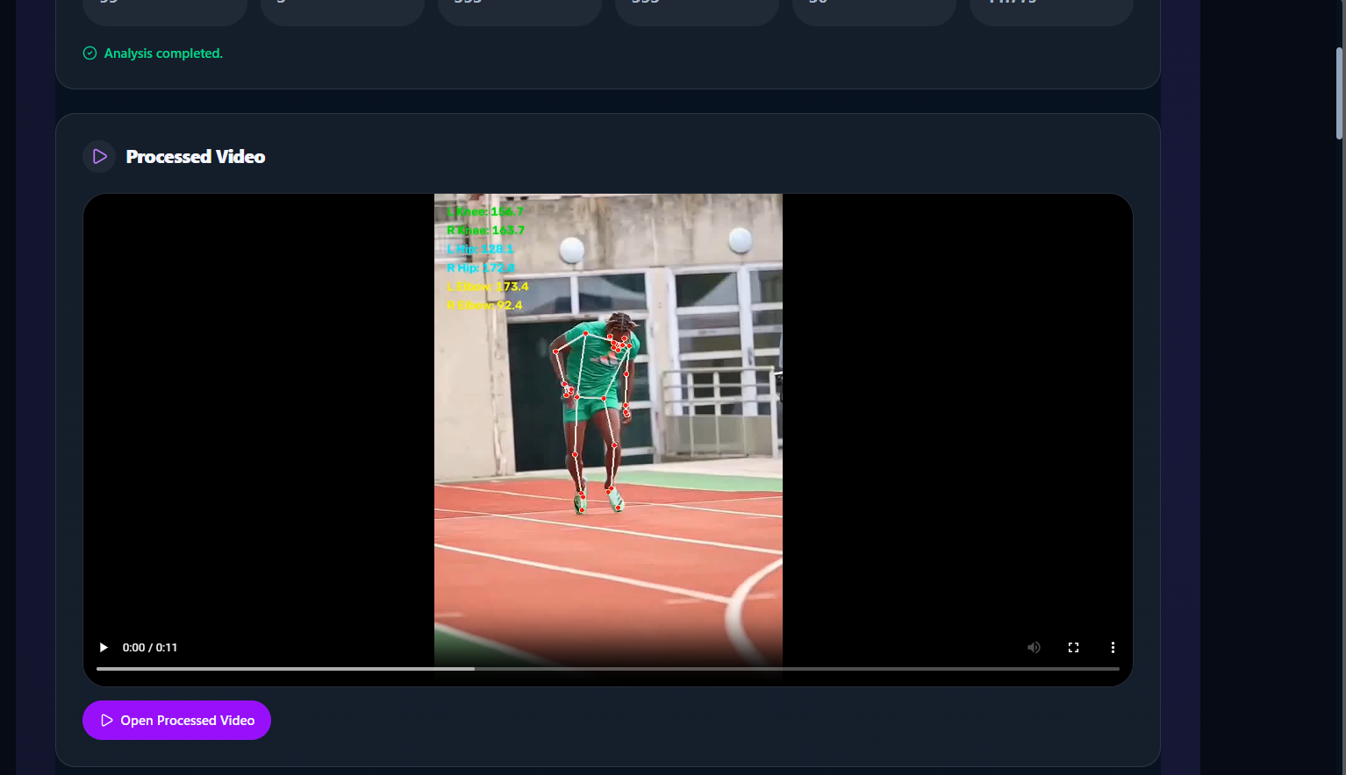
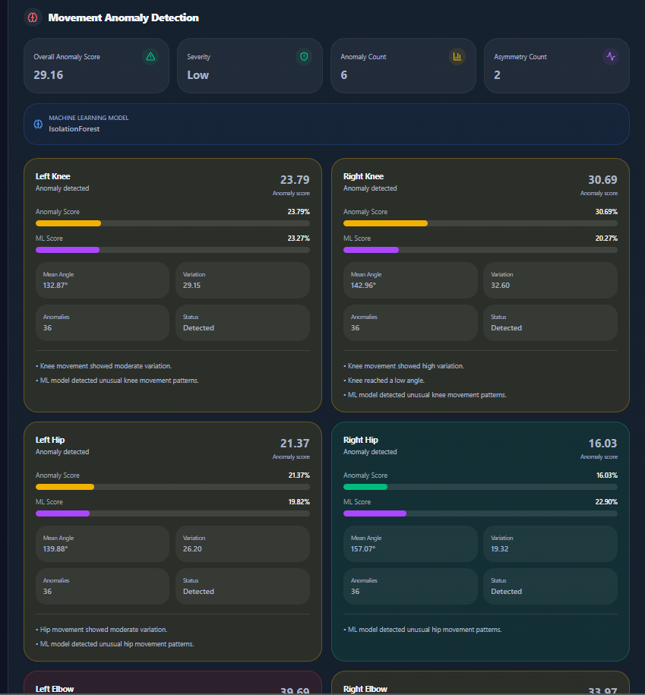
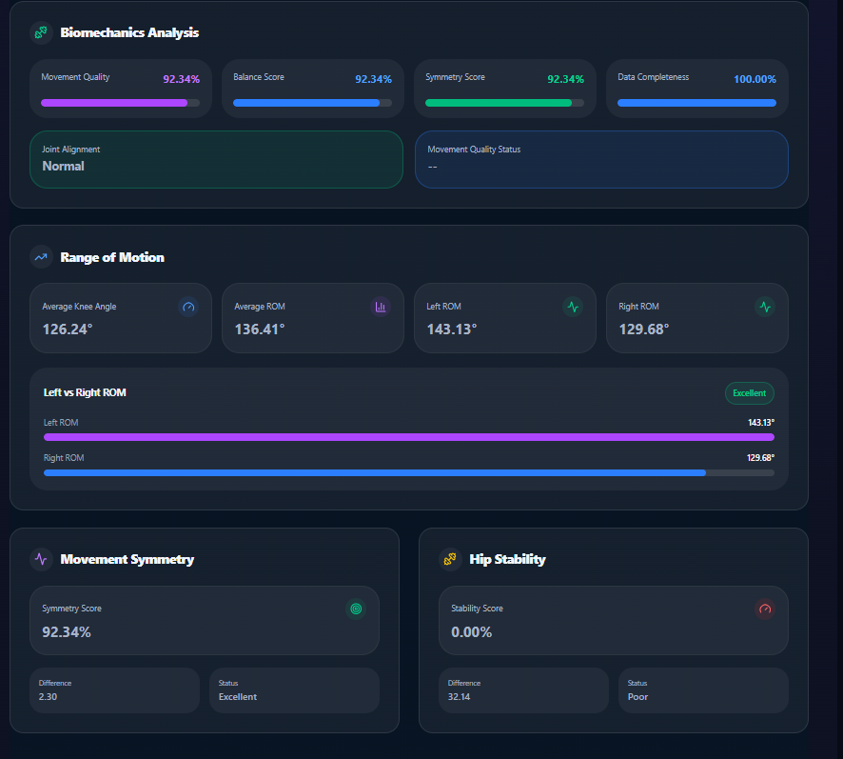

Slide 14

Thank You

