Slide 1
KINETIQ
TEAM PROJECT • INFOSYS SPRINGBOARD VIRTUAL INTERNSHIP 7.0
AI Sports Injury Risk Detection from Video
PRESENTED BY
Jayita Pal
Team Project
A video-based biomechanics, risk scoring and reporting platform for sports teams.
Infosys Springboard
Team Presentation
KinetIQ • AI Sports Injury Risk Detection
01

Slide 2
02 — PROBLEM
Problem Statement
Why a digital injury-risk screening workflow is needed
01
02
Manual assessment
Late red flags
Movement quality is often judged visually and can vary between reviewers.
Knee valgus, trunk lean and movement asymmetry may be missed during routine review.
03
04
Fragmented data
Need for explainability
Training load, injury history and movement metrics are difficult to combine consistently.
Teams need a transparent triage signal rather than an unexplained black-box score.
KinetIQ • AI Sports Injury Risk Detection
02

Slide 3
03 — SOLUTION
Proposed Solution
KinetIQ turns movement video into actionable, role-specific risk insights
Movement video submitted for analysis
VIDEO
GOAL
Surface risk factors before they become injury events.
Browser-based pose estimation extracts landmarks
POSE
Joint angles, ROM, trunk lean and symmetry
METRICS
The platform is designed as a screening and triage aid — not a medical diagnosis.
Weighted 0–100 injury-risk screening score
RISK
Dashboards, alerts and reports for the right role
ACTION
KinetIQ • AI Sports Injury Risk Detection
03

Slide 4
04 — FEATURES
Core Features
What the platform delivers end-to-end
01
02
03
Role-based access
Athlete registry
Video analysis
Athlete, coach, physiotherapist, sports scientist and administrator views.
Profiles, sport, training load and injury history.
Movement-video review with pose and biomechanical metrics.
04
05
06
Risk scoring
Analytics
Reports & alerts
Transparent composite score with risk flags and recommendations.
Movement-quality trends, risk distribution and factor contributions.
Team/athlete reports with PDF, Excel or CSV export and threshold alerts.
KinetIQ • AI Sports Injury Risk Detection
04

Slide 5
05 — STACK
Technology Stack
Modern web, database, computer-vision and reporting components
Frontend
TanStack Start • React 19 • Vite 7
UI
Tailwind CSS v4 • shadcn/ui
Data & Auth
Supabase • PostgreSQL • RLS • Auth
Computer Vision
MediaPipe Tasks Vision / Pose estimation
Analytics
Recharts
Exports & Testing
jsPDF • SheetJS • Vitest
ARCHITECTURE PRINCIPLE
Keep inference in the browser where practical; enforce data access at the database layer.
KinetIQ • AI Sports Injury Risk Detection
05

Slide 6
06 — WORKFLOW
System Workflow
From submitted video to a structured risk report
1
→
2
→
3
→
4
→
5
Submit Video
Pose Estimation
Biomechanics
Risk Score
Action
MP4 / WEBM / MOV or direct video link
Body landmarks extracted in-browser
ROM, knee alignment, trunk lean, symmetry
Weighted composite produces 0–100 score
Dashboards, alerts, recommendations, reports
Result: a consistent and explainable screening workflow that connects movement evidence to follow-up action.
KinetIQ • AI Sports Injury Risk Detection
06

Slide 7
07 — ACCESS
Roles, Security & Data Access
Different users see the information needed for their responsibilities
Athlete
Coach
Physiotherapist
Sports Scientist
Administrator
ACCESS CONTROL
DATA MODEL
Supabase Auth handles sign-in and account identity.
PostgreSQL Row-Level Security scopes data access.
Role helpers support controlled staff access.
UI restrictions are backed by database policies.
profiles / user_roles
athlete_profiles / injury history
video_submissions / pose_analyses
alerts and reporting data
KinetIQ • AI Sports Injury Risk Detection
07

Slide 8
08 — SCORING
Risk Scoring & Explainability
A transparent composite combines movement and athlete context
Biomechanical deviation
35%
WHY IT MATTERS
Injury history
20%
Shows which factors contributed to the score.
Supports review by coaches and clinical staff.
Keeps the scoring logic auditable.
Frames the result as a triage signal — not a diagnosis.
Movement asymmetry
20%
Training load
15%
Fatigue trend
10%
EXAMPLE LIVE SCORE
56 • High risk
KinetIQ • AI Sports Injury Risk Detection
08

Slide 9
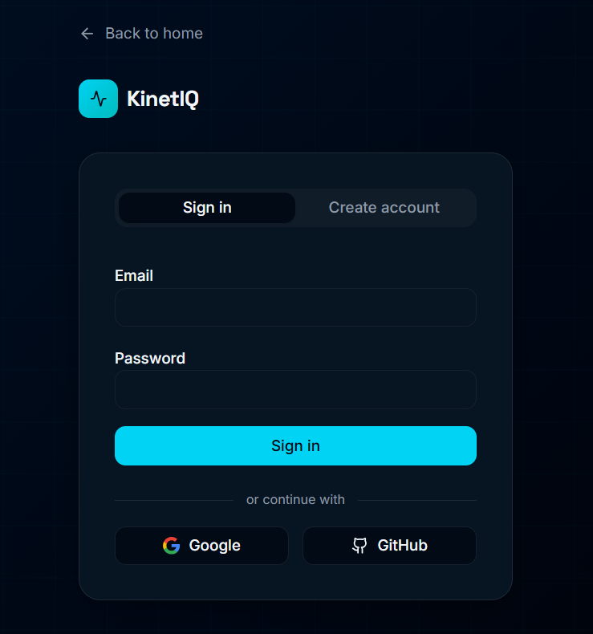
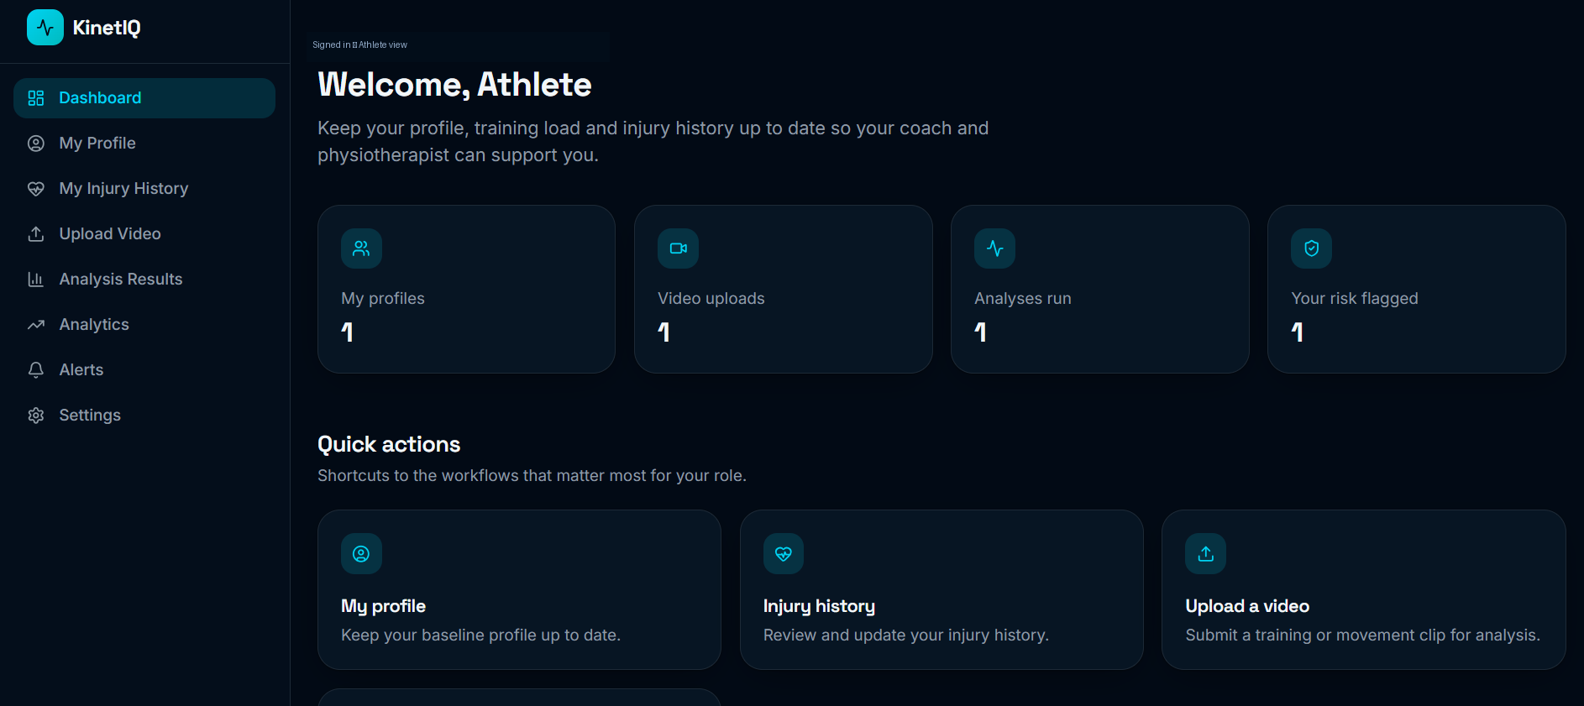
09 — LIVE PROJECT
Authentication & Dashboard
Selected screenshots from the running application
AUTHENTICATION
ATHLETE DASHBOARD
KinetIQ • AI Sports Injury Risk Detection
09

Slide 10
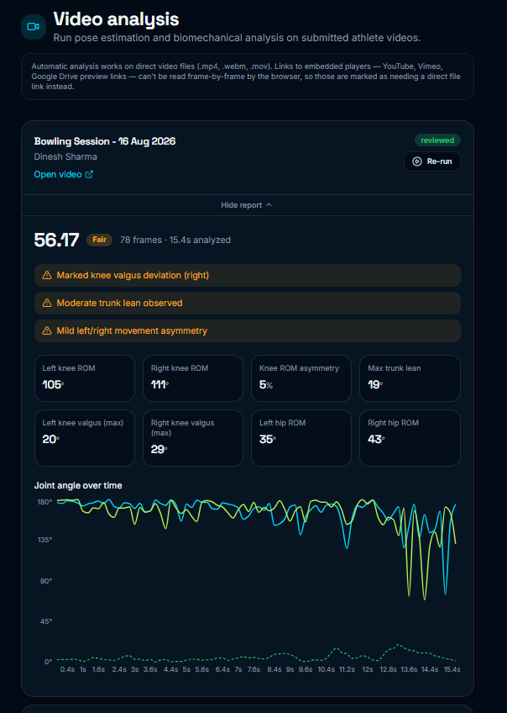
10 — LIVE PROJECT
Video Analysis
The core workflow converts movement video into measurable risk signals
OBSERVED OUTPUTS
Movement quality score
Knee ROM and valgus
Hip ROM and symmetry
Maximum trunk lean
Risk flags and recommendations
Joint-angle trend over time
EXAMPLE
56.47 • Fair
KinetIQ • AI Sports Injury Risk Detection
10

Slide 11
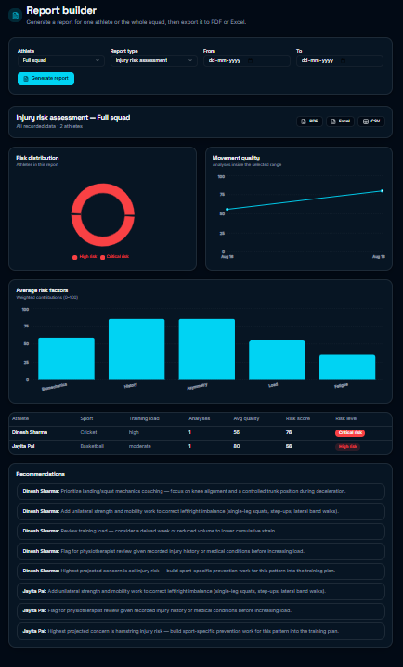
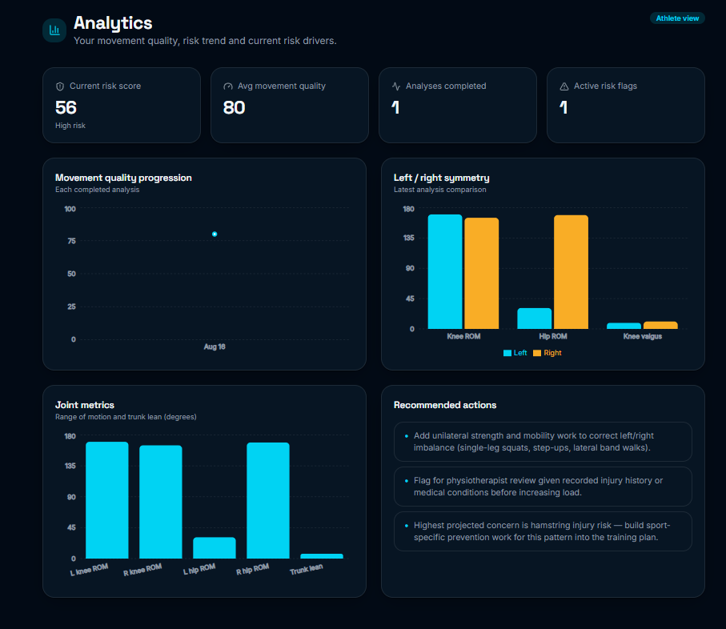
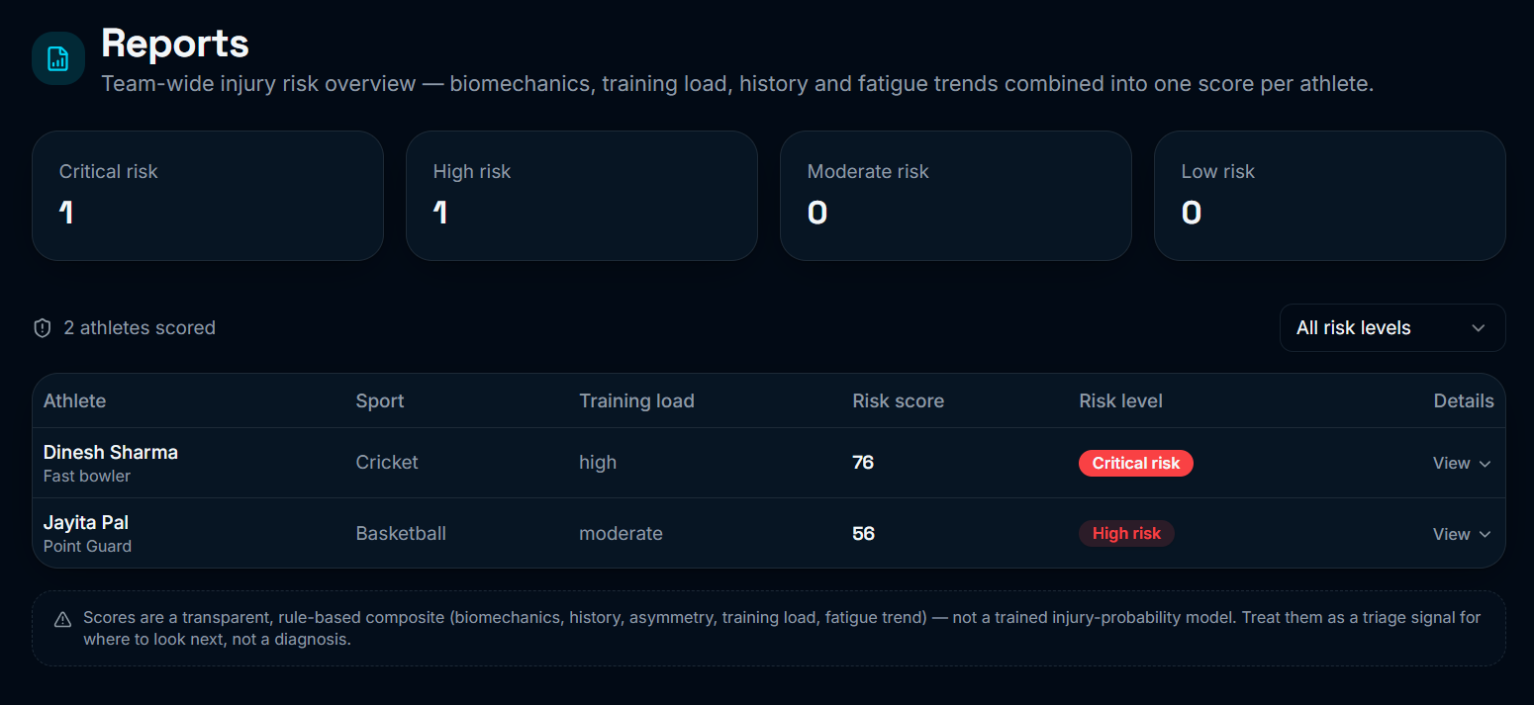
11 — LIVE PROJECT
Analytics, Reports & Export
Selected views demonstrate the reporting layer of the platform
ANALYTICS
TEAM REPORTS
REPORT BUILDER
KinetIQ • AI Sports Injury Risk Detection
11

Slide 12
12 — CONCLUSION
Outcome, Future Scope & Conclusion
What the team has delivered and where KinetIQ can go next
DELIVERED
FUTURE SCOPE
End-to-end video → pose → biomechanics → risk workflow
Role-based dashboards and database-backed access control
Analytics, alerts and team/athlete reporting
PDF / Excel / CSV export workflow
Unit-tested scoring logic and a working live demo
Train and validate a model using real injury outcomes
Multi-camera / 3D pose estimation
Wearable and automated training-load integration
Broader sports and movement coverage
Longitudinal athlete monitoring
KinetIQ is a transparent screening and decision-support platform — designed to help teams decide where to look next.
KinetIQ • AI Sports Injury Risk Detection
12

