Slide 1



CampusEventHub
INTER COLLEGE EVENT MANAGEMENT PLATFORM

Slide 2



Technology Stack: System Architecture & Framework
Python & ML
MongoDB: The NoSQL Database
Express.js: The Fast Framework
React: The User Interface Library
Node.js: The JavaScript Runtime environment
MongoDB provides a flexible document structure, ideal for handling various data types efficiently.
Express.js simplifies server-side development, enabling quick API creation with minimal overhead for applications.
React enhances user experiences through component-based architecture, allowing for dynamic, interactive web applications.
Node.js lets developers use JavaScript to write command line tools and server-side scripting

Slide 3

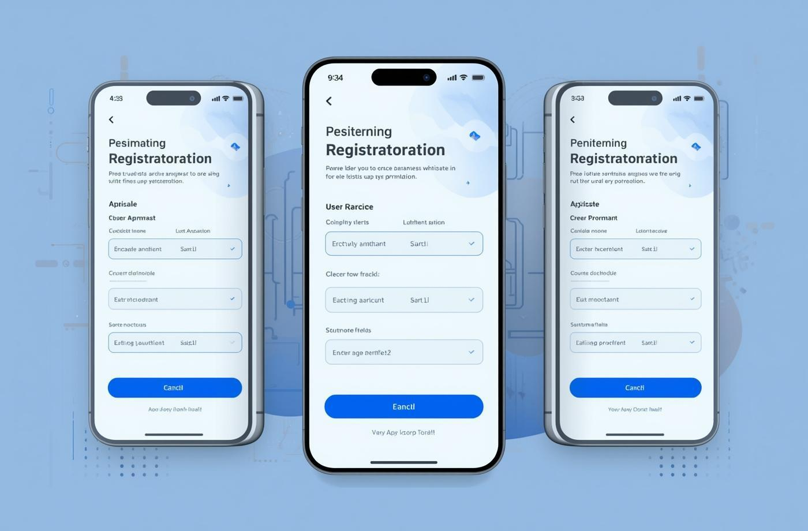

Core Capabilities of SIRD Platform
Event Creation Made Easy
Seamless Registration Process
Interactive Feedback System
Users can effortlessly set up events with clear, guided steps and customizable options.
Participants can register in just a few clicks, ensuring a smooth user experience.
Attendees provide valuable insights, enhancing future events and user satisfaction.

Slide 4
Challenges in Sports Injury Management
1
2
Manual Processes
Poor Engagement
Current event management relies heavily on manual processes, leading to time-consuming tasks and increased chances of human error, making it difficult for organizers to efficiently coordinate activities across different colleges.
Students often face difficulties in discovering relevant events, resulting in low participation rates and engagement levels. This disconnect between event creators and students diminishes the overall campus experience for everyone involved.
3
4
Inefficiencies
Streamlined Event Management
The existing system suffers from inefficient communication channels that hinder timely updates and feedback collection, which can lead to missed opportunities for improvement and a lack of real-time information for participants.
Implementing a centralized platform will facilitate streamlined event management, allowing for better communication, enhanced collaboration, and a more user-friendly experience that ultimately drives higher engagement and participation rates.

Slide 5
System Architecture Overview
The system architecture of CampusEventHub is designed to ensure robust performance and scalability. Key components include:
Modular Design: Each feature operates independently, allowing for easy updates and enhancements.
APIs for Integration: RESTful APIs facilitate seamless communication between different services and components.
Data Security: Implementation of JWT for secure user sessions and data encryption safeguards user information.
Scalability: The architecture supports horizontal scaling to accommodate growing user demands without compromising performance.

Slide 6
Challenges & Engineering Solutions in SIRD System
1
2
Security Enhancements
Scalability Solutions
Implementing JWT authentication and robust encryption protocols ensures that user data is protected, minimizing the risks associated with unauthorized access and maintaining confidentiality.
Utilizing a modular design allows the platform to adapt and grow seamlessly, accommodating increasing user numbers and event complexity without compromising performance.
3
4
User Engagement Strategies
Modular Design Advantages
Enhancing the user interface with intuitive design and real-time updates fosters greater user involvement, making it easier for students and colleges to engage with events and each other.
A modular architecture not only simplifies updates but also facilitates integration with third-party services, ensuring flexibility and future-proofing the platform as new technologies emerge.

Slide 7
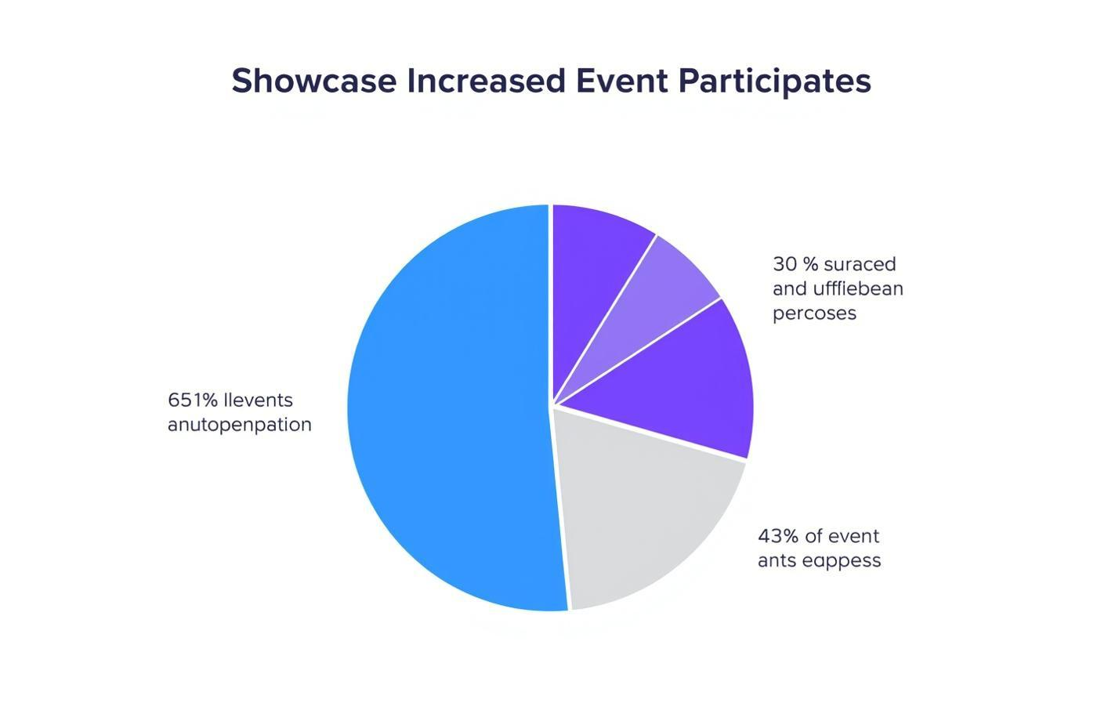
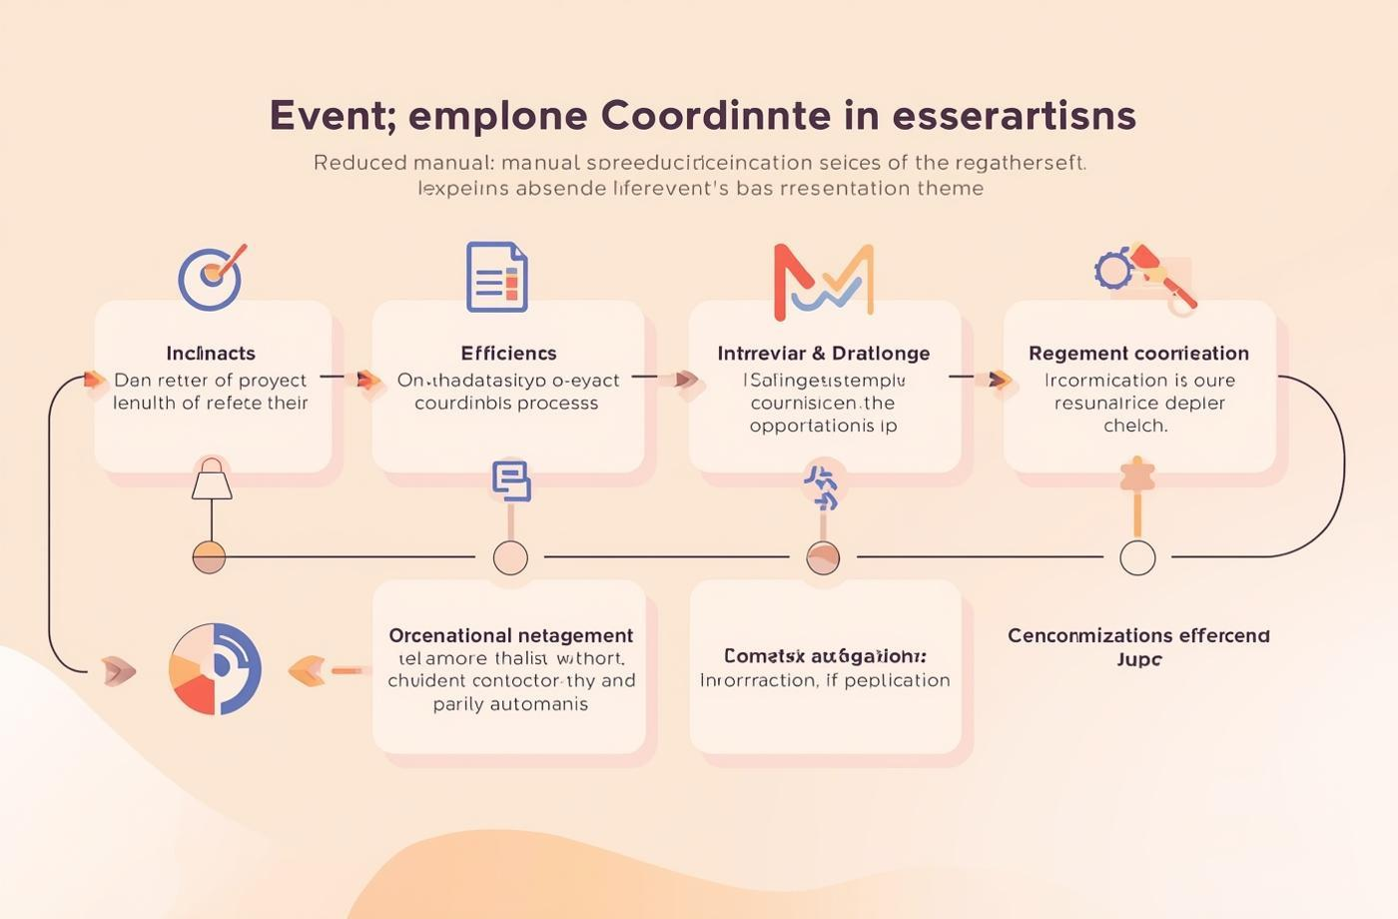

Measurable Impact & Clinical Validation
Increased Event Participation
Reduced Manual Coordination
Enhanced User Satisfaction
Our platform has led to a notable rise in student engagement, resulting in more events attended.
Automation features have effectively minimized the time spent on organizing events, making processes smoother and faster.
Users report a significant improvement in their experience, with streamlined navigation and intuitive design elements.

Slide 8

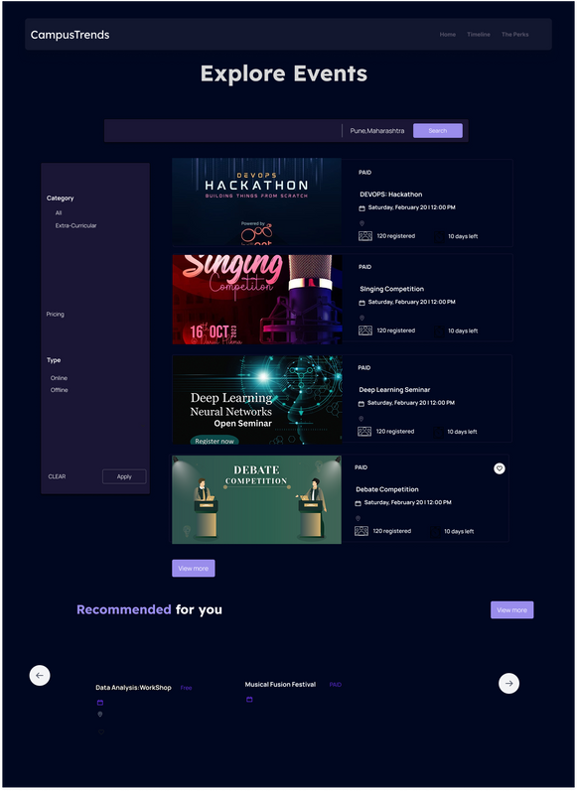
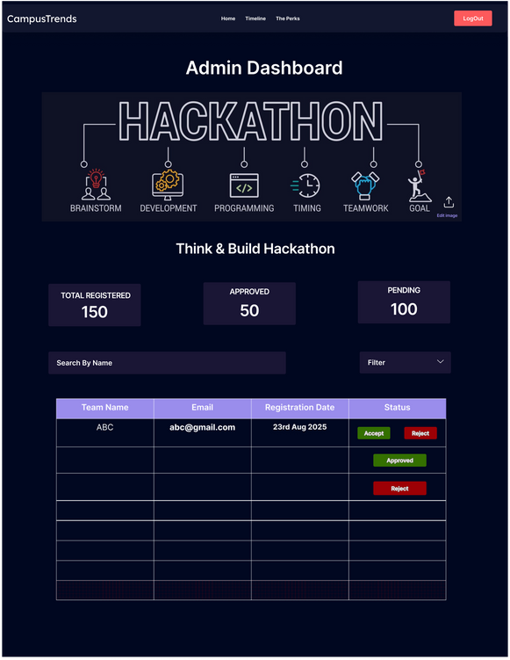
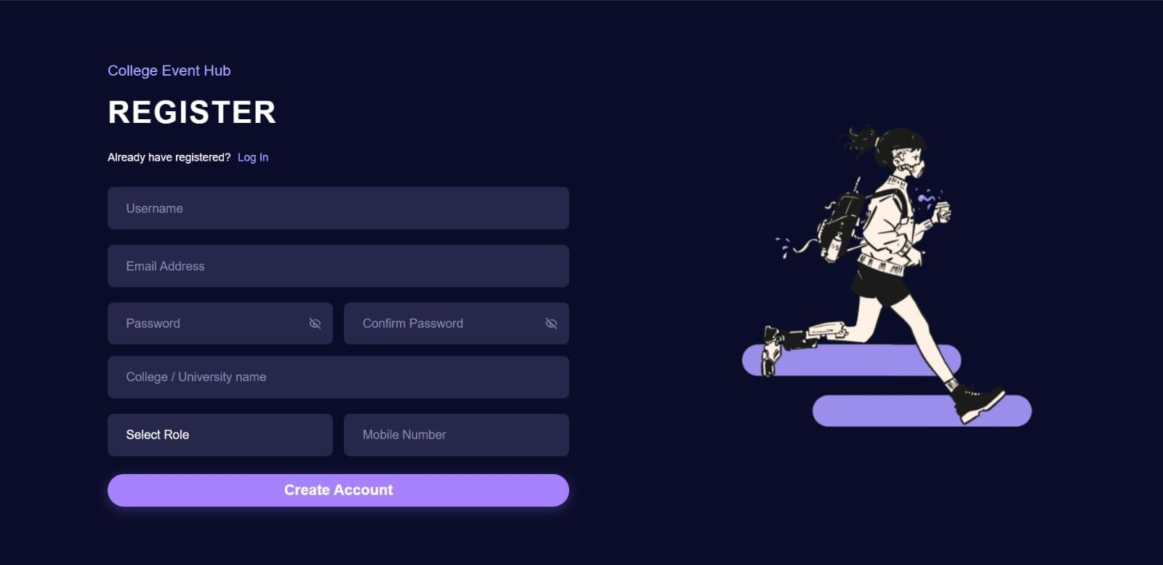
SIRD Multi-Role Dashboard Interface: Interactive 3D Radar Chart, Body Heatmap, Live Camera Viewfinder, and Exercise Prescriptions.

Slide 9

Athlete Motion Assessment Workflow
Simple User Onboarding Steps
The registration process for college admins is designed to be straightforward and efficient.
Secure Authentication Features
Admins undergo a secure authentication process to ensure data protection and privacy.
Comprehensive Dashboard Access
Once registered, admins gain access to a comprehensive dashboard for event management.

Slide 10



Future Enhancements for SIRD Platform
AI Recommendations for Enhanced User Experience
Advanced Analytics Dashboard for Insights
Secure and Efficient Payment Integration
Utilize AI to provide personalized event suggestions based on user interests and past attendance.
Smart reminders for upcoming events the user might be interested in.
Continuous learning from feedback to refine future suggestions.
Provide real-time analytics to help colleges track event success and user engagement metrics efficiently.
Predictive analytics to forecast turnout for future events.
Comparative analysis of multiple events to identify trends and improvement areas.
Streamline payment processes for event registrations, ensuring secure and user-friendly transactions.
Multiple payment options (UPI, cards, net banking, wallets) for convenience.
Fraud detection mechanisms and encrypted transactions for safety.

Slide 11
SIRD PROJECT TEAM MEMBERS
Lead Developer & AI Architect
Biomechanics Research Lead
Frontend UI/UX Specialist
Machine Learning Engineer
Backend & Cloud Engineer
Quality Assurance & Testing

Slide 12
Presentation Video...
https://drive.google.com/file/d/1GAGHVWyuiXgearCHCusDrzPZBf9mK978/view?usp=sharing

Slide 13
Q n A

Slide 14

Thank You

