Slide 1
Automated Legal Arguements Transcription And Translation
Presented By : Ankush Majalikar

Slide 2
Introduction
Legal proceedings generate large volumes of spoken arguments, judgments, and discussions, which are traditionally documented manually. This process is time-consuming, error-prone, and inefficient, especially in multilingual legal environments.
Legal Arguments Transcription and Translation aims to automatically convert courtroom audio and legal discussions into accurate written text and further translate it into required languages while preserving legal meaning and context.
With the advancement of Automatic Speech Recognition (ASR) and Natural Language Processing (NLP), it has become possible to digitize legal audio data, making it searchable, analyzable, and easily accessible.
This system helps lawyers, judges, legal researchers, and students by providing quick access to transcribed and translated legal content, reducing dependency on manual transcription.
The project focuses on handling domain-specific legal terminology, speaker variations, and language diversity to ensure high accuracy and reliability.
Overall, the proposed solution enhances efficiency, transparency, and accessibility in the legal system by automating transcription and translation of legal arguments.

Slide 3
Problem Statement
Legal proceedings involve extensive spoken arguments, hearings, and discussions that must be accurately recorded for future reference. Currently, transcription of legal audio is largely manual, making it time-consuming, costly, and prone to human errors. Additionally, variations in speaker accents, overlapping speech, background noise, and the use of complex legal terminology further reduce transcription accuracy.
Moreover, legal content is often required in multiple languages to support lawyers, clients, and judicial authorities across diverse linguistic regions. The absence of an automated and reliable system for both transcription and translation creates delays, limits accessibility, and hinders efficient legal analysis. Hence, there is a need for a robust solution that can accurately transcribe and translate legal arguments while preserving their original meaning and legal context.

Slide 4
Objective of the Project
To convert legal audio recordings into written text automatically.
To translate the transcribed legal content into required languages accurately.
To reduce manual effort and time involved in legal transcription work.
To maintain the accuracy of legal terms and meanings during transcription and translation.
To improve accessibility of legal information for lawyers, judges, and students.
To store and organize transcribed data for easy searching and future reference.

Slide 5
Scope of the Project
The project focuses on automatic transcription of legal audio recordings such as court arguments, hearings, and discussions.
It includes translation of transcribed legal text into one or more required languages.
The system supports handling of legal terminology and formal language used in judicial proceedings.
It can be used by lawyers, judges, legal researchers, and students for reference and analysis.
The project can be extended to support multiple languages, real-time transcription, and improved accuracy in the future.

Slide 6
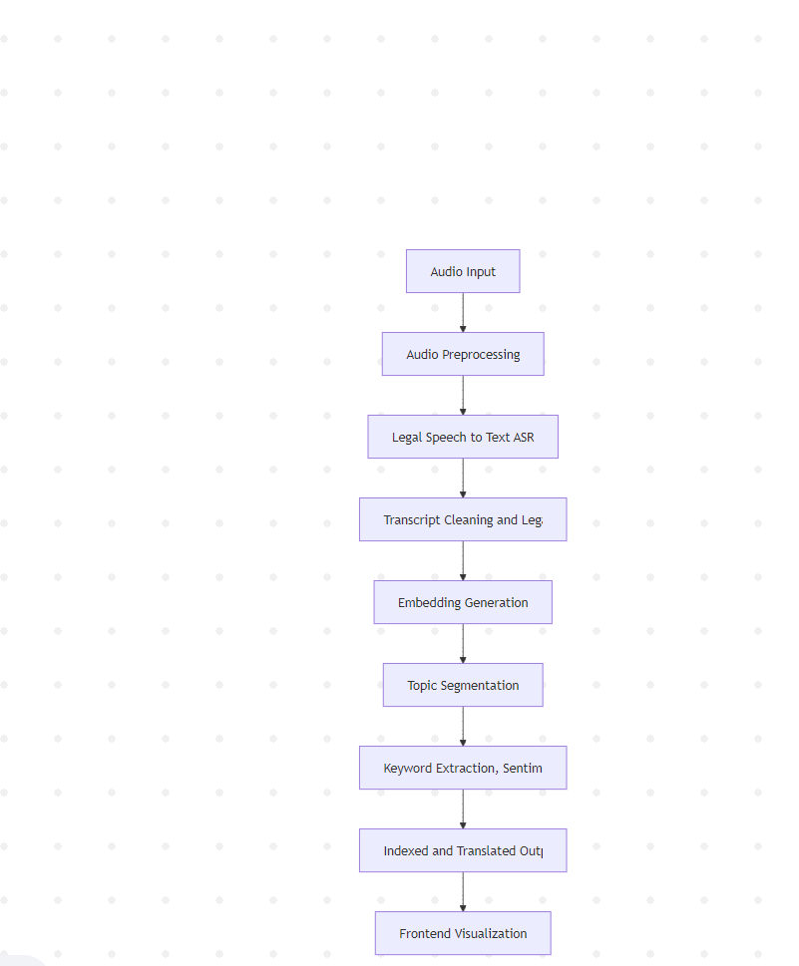
System Architecture

Slide 7
Core Application Modules
1. Audio Preprocessing
Converts raw legal audio into a standard format
Removes background noise and silent parts
Improves clarity of courtroom and legal discussions
2. Speech-to-Text Transcription
Converts legal arguments and hearings into text
Handles legal terms and formal language accurately
Generates clear and readable transcripts
3. Legal Text Processing
Cleans and structures transcribed legal text
Identifies important legal phrases and sections
Improves readability and consistency

Slide 8
4. Translation Module
Translates legal text into required languages
Preserves original legal meaning and context
Supports multilingual legal accessibility
5. Accuracy & Quality Analysis
Evaluates transcription accuracy
Checks translation consistency
Ensures reliability of generated content
6. Frontend Visualization
Displays transcribed and translated legal text
Enables easy viewing and navigation
Provides user-friendly interaction

Slide 9
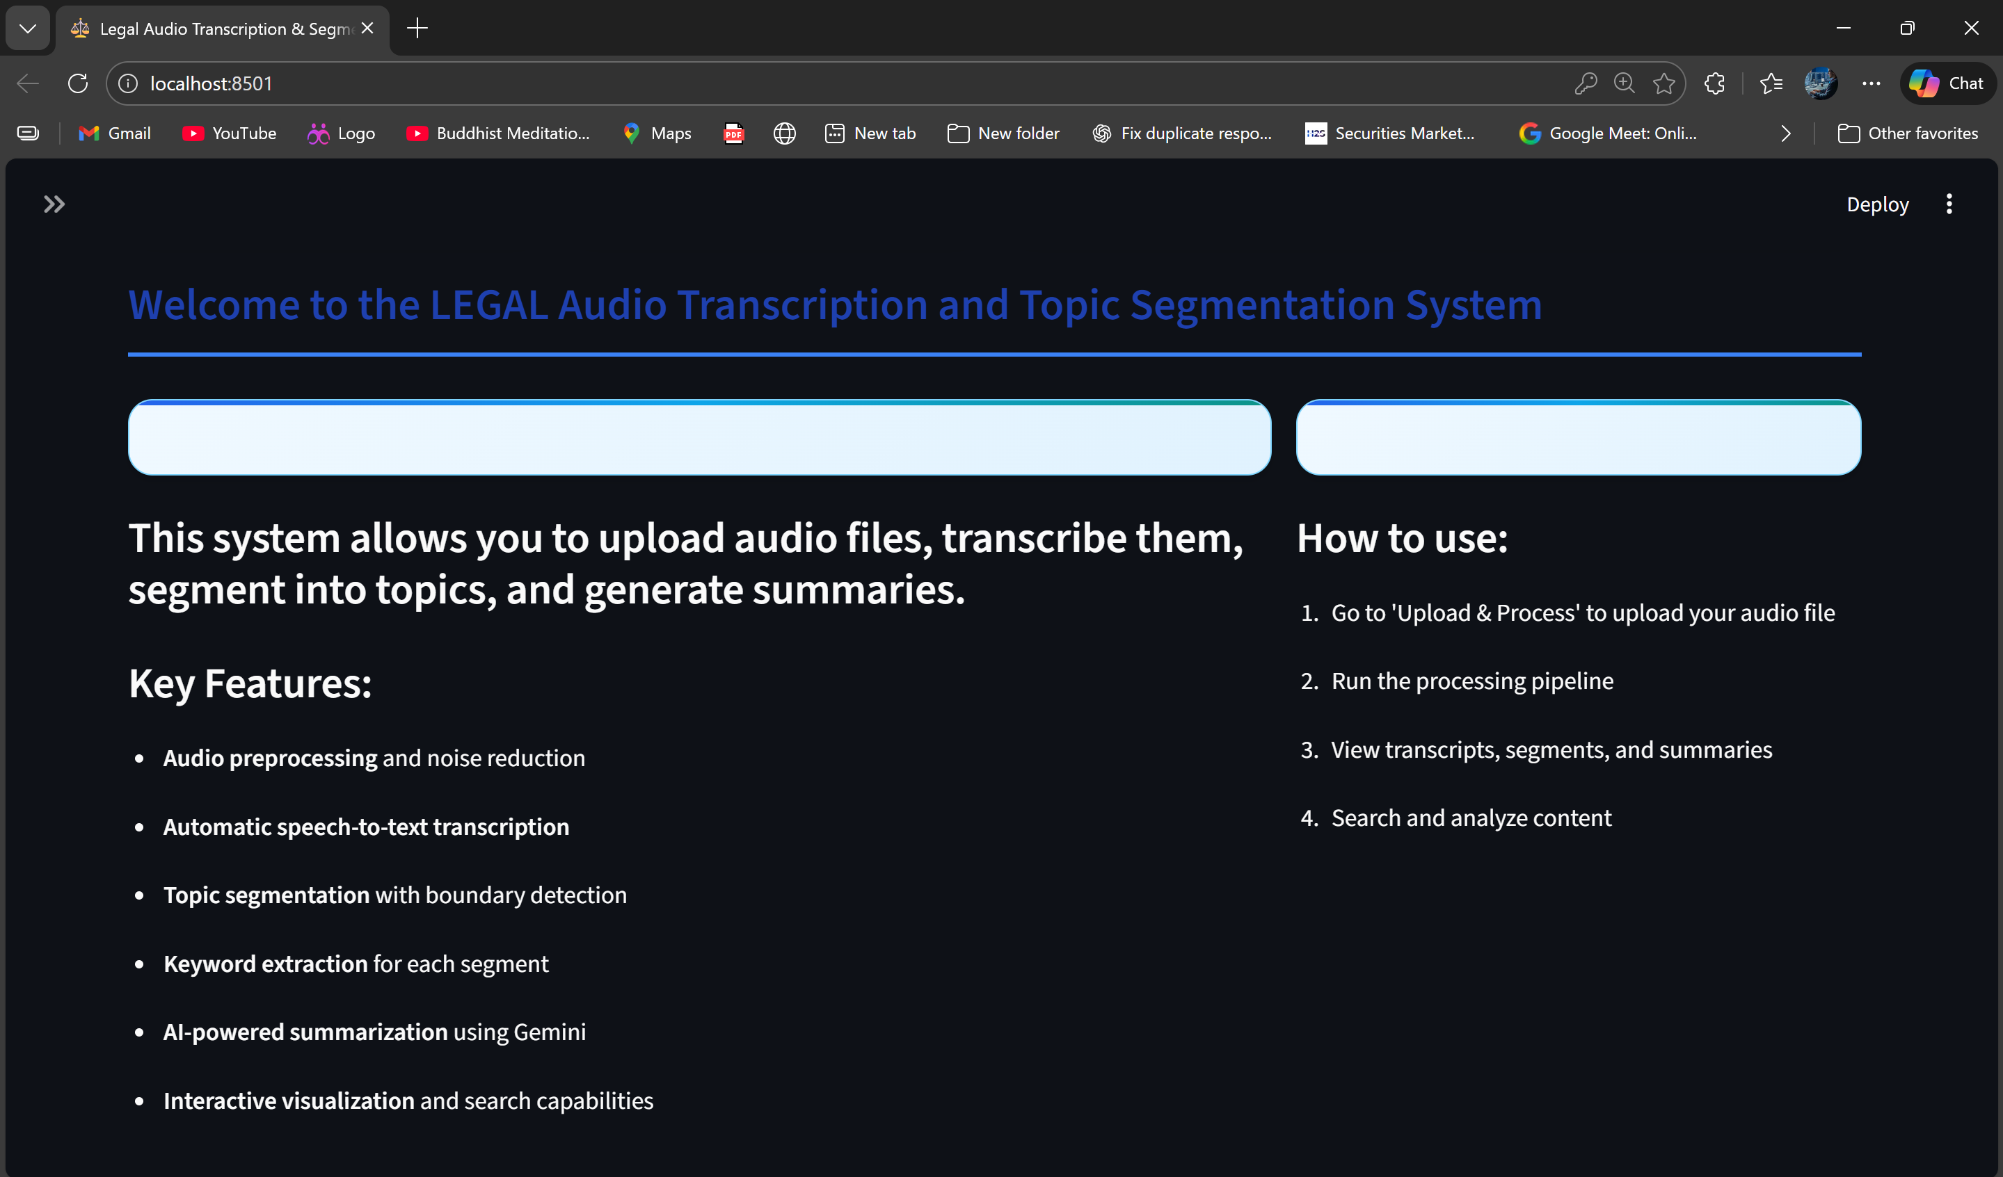
Frontend Interface

Slide 10
Technology Stack
1. Audio Processing
Librosa – Audio loading, normalization, and feature handling
PyDub – Audio format conversion and silence removal
FFmpeg – Audio decoding and preprocessing support
2. Speech-to-Text (ASR)
Whisper / Faster-Whisper – Accurate transcription of legal audio
Vosk (optional) – Offline speech recognition support
3. Natural Language Processing (NLP)
NLTK – Text cleaning and tokenization
SpaCy – Linguistic processing and legal text structuring
Hugging Face Transformers – Language models for text understanding

Slide 11
4. Translation
Transformer-based Translation Models – Multilingual legal text translation
Hugging Face Translation Pipelines – Preserving semantic and legal meaning
5. Backend
Python 3.9+ – Core processing and pipeline implementation
Flask – API handling and backend communication
6. Frontend / Visualization
React.js / HTML / CSS – User interface development
JavaScript – Interactive visualization and navigation
7. Data Storage
JSON / CSV – Structured storage of transcripts and translations
SQLite (optional) – Persistent storage support
8. Development Tools
Git & GitHub – Version control
VS Code – Development environment

Slide 12
Challenges Faced
Handling background noise and low-quality legal audio
Accurately transcribing complex legal terminology and accents
Maintaining legal meaning during translation
Variations in speaker clarity and speaking speed
Ensuring high transcription accuracy across long recordings

Slide 13
Future Scope
Support for real-time legal audio transcription
Speaker diarization to identify multiple speakers
Enhanced legal terminology recognition using domain-specific models
Automatic summarization of legal arguments and judgments
Integration with court management and legal document systems

Slide 14
Conclusion
The Automated Legal Arguments Transcription & Translation system provides an efficient solution for converting legal audio into accurate and structured text. By leveraging AI-based speech recognition and NLP techniques, the project reduces manual effort, improves accessibility, and supports multilingual legal documentation. The system enhances transparency and usability of legal records, making it a valuable tool for lawyers, judges, and legal researchers.

Slide 15
Thank You Q&A

