Slide 1




Automated Medical Podcast Transcription and
Topic Segmentation

Slide 2

Problem Statement AnD SOLUTION
PROBLEM
Medical podcasts are a rich source of clinical knowledge, expert opinions, and discussions on healthcare topics. However, these podcasts are often long and unstructured, making it difficult for medical students, researchers, and healthcare professionals to extract the most relevant information efficiently. Manually reviewing hours of audio is time-consuming, labor-intensive, and prone to missing critical insights, limiting the practical use of these resources in real-world medical learning, research, and clinical decision-making.
SOLUTION
Medical podcasts provide valuable clinical insights, but their length and unstructured format make manual review inefficient. Automated transcription, topic segmentation, keyword extraction, and summarization can streamline information retrieval. A searchable platform allows quick access, with future enhancements like multilingual support and medical entity recognition further improving usability.

Slide 3

Objectives
To automate transcription of medical podcast audio files
To segment long audio into meaningful sections
To extract important medical keywords
To generate concise and readable summaries
To visualize keyword frequency using word clouds
To provide a simple and interactive user interface

Slide 4

System Approach
The project follows a modular pipeline-based approach:
1. Audio uploaded by the user
2. Audio preprocessing such as noise reduction and normalization
3. Speech-to-text transcription using the Whisper model
4. Segmentation of transcripts into logical parts
5. Keyword extraction using TF-IDF techniques
6. Summarization of each segment
7. Keyword frequency visualization
8. User interaction through a Streamlit-based interface

Slide 5





Technology Stack
Category | Technologies Used
Programming Language | Python 3.x
Speech-to-Text | OpenAI Whisper
Audio Processing | Pydub, FFmpeg
Natural Language Processing | NLTK, Scikit-learn
Visualization | Matplotlib, WordCloud
Frontend | Streamlit
Testing | Pytest
Version Control | Git

Slide 6
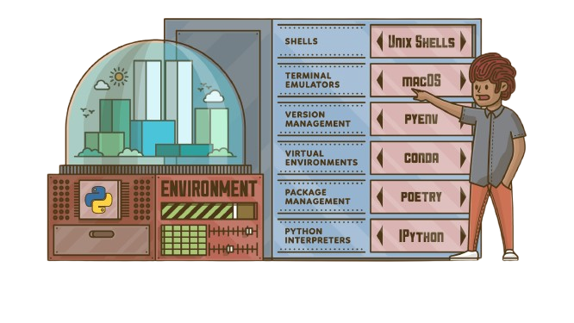
Setup & Installation
Requirements
Python 3.9 or higher
FFmpeg installed
Virtual environment
Installation Steps
Clone the project repository
Create and activate a virtual environment
Install dependencies using requirements.txt
Configure NLTK for offline usage
Verify the project directory structure

Slide 7
Project Workflow
Upload Audio
Preprocess
Transcribe
Segment
Streamlit UI
Visualize
Analyze
Keywords & Summary

Slide 8

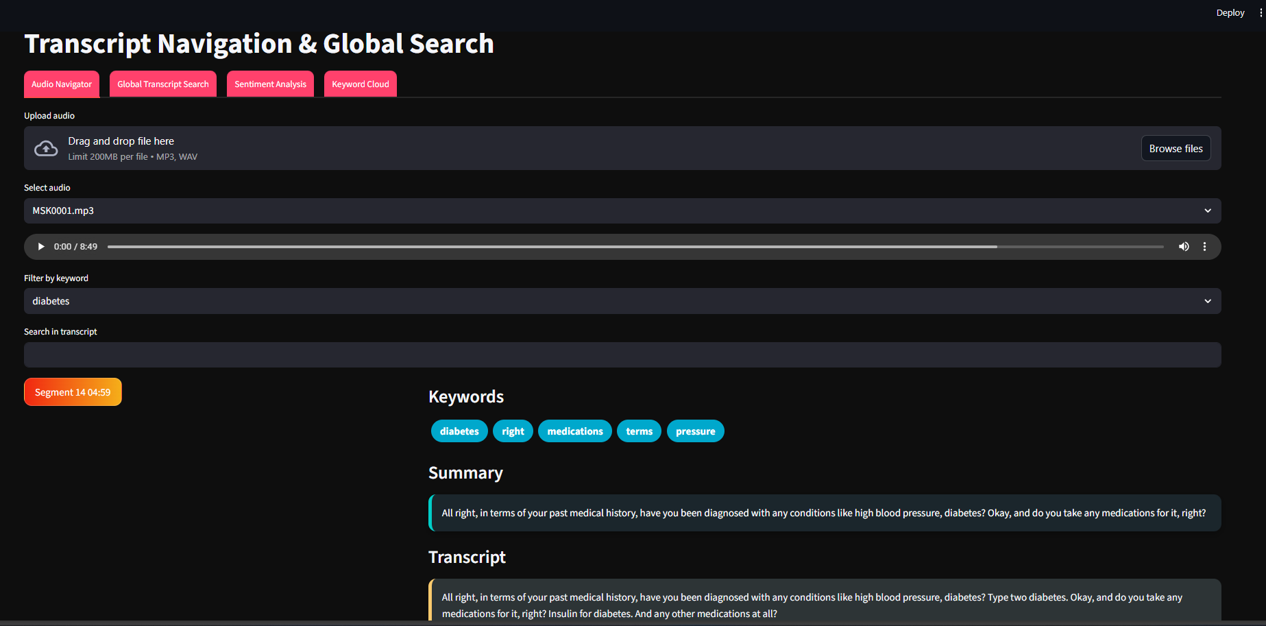
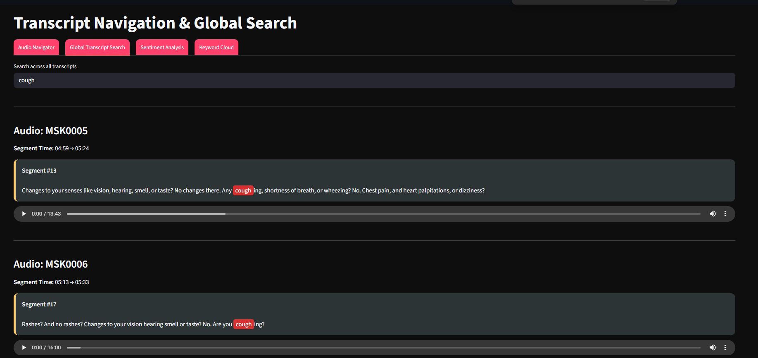
User Interface (UI) Preview

Slide 9
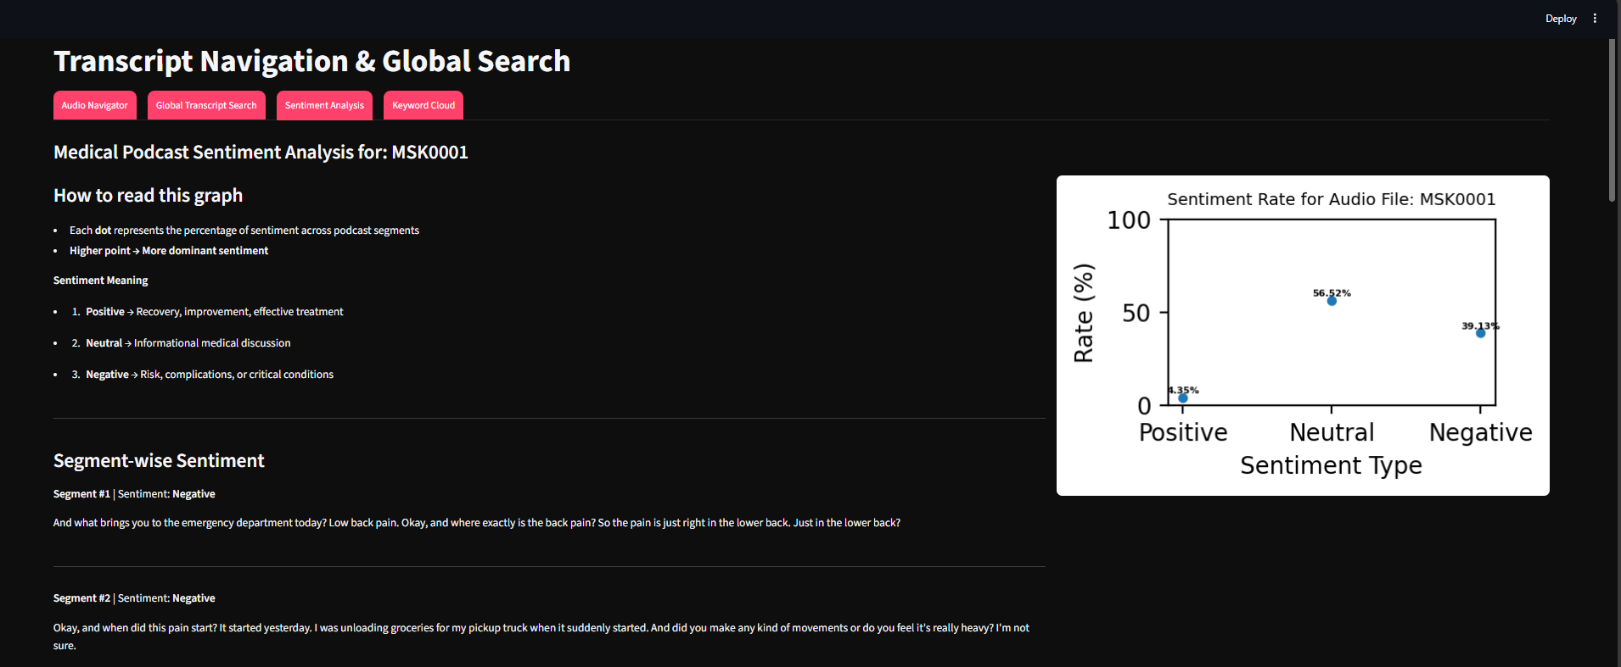

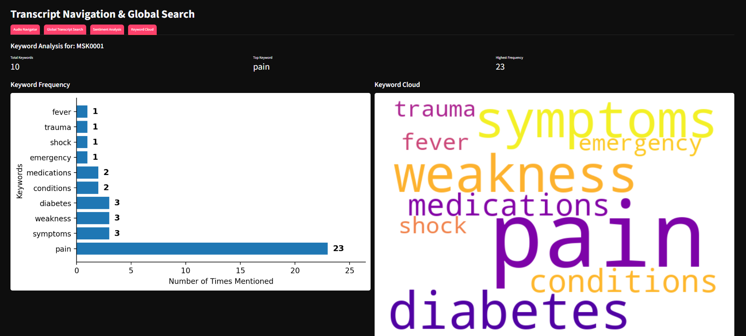

Slide 10

Troubleshooting
🔊 Audio Issue
✔ Check FFmpeg & format
📚 NLTK Error
✔ Verify NLTK configuration
✂Segmentation Issue
✔ Review logic
⏱Performance Issue
✔ Use smaller model or GPU

Slide 11

Use Cases
Medical students: Review podcast lectures
Researchers: Analyze expert opinions & clinical talks
Healthcare professionals: Summarize long medical discussions
Academic projects: NLP & Speech Processing
Analyze sentiment trends in medical conversations

Slide 12
Limitations & Challenges
⚡Speed: Depends on system & hardware
🔍 Context: Topic segmentation may miss nuances
💬 Sentiment: Subtle medical cues can be missed
⏱Processing: Long audios take more time
🌐 Language: Only English supported

Slide 13


Testing & Validation (Unit Testing)
Audio Preprocessing: Check format, duration, and quality
Transcription: Ensure text output is generated
Segmentation: Verify segments are non-empty
Keyword Extraction: Top keywords extracted correctly
Summarization: Summaries are concise & meaningful
Sentiment Analysis: Sentiment labels are accurate
End-to-End: Full pipeline runs without errors

Slide 14

Future Enhancements
🔹 Transformer-based topic modeling (BERTopic)
🔹 Speaker diarization
🔹 Multilingual podcast support
🔹 Medical Named Entity Recognition (NER)
🔹 Advanced sentiment analysis (context-aware)

Slide 15

References
• OpenAI Whisper Documentation
• NLTK Official Documentation
• Scikit-learn Documentation
• Streamlit Documentation
• Research papers on NLP applications in healthcare

Slide 16
Conclusion
Automated processing of medical podcasts reduces manual effort and time.
The system converts long audio into structured text with segments, keywords, and summaries.
Interactive search and visualizations improve accessibility of medical insights.
This project enhances learning, research efficiency, and knowledge extraction in healthcare.

Slide 17
THANK YOU……!

