Slide 1
CampusEventHub
INTER COLLEGE EVENT MANAGEMENT PLATFORM

Slide 2
Technology Stack MongoDB:- MongoDB provides a flexible document structure, ideal for handling various data types efficiently. Express.js:-Express.js simplifies server-side development, enabling quick API creation with minimal overhead for applications. Angular:- Angular is a TypeScript-based framework by Google for building dynamic web applications. Node.js:-Node.js lets developers use JavaScript to write command line tools and server-side scripting.

Slide 3

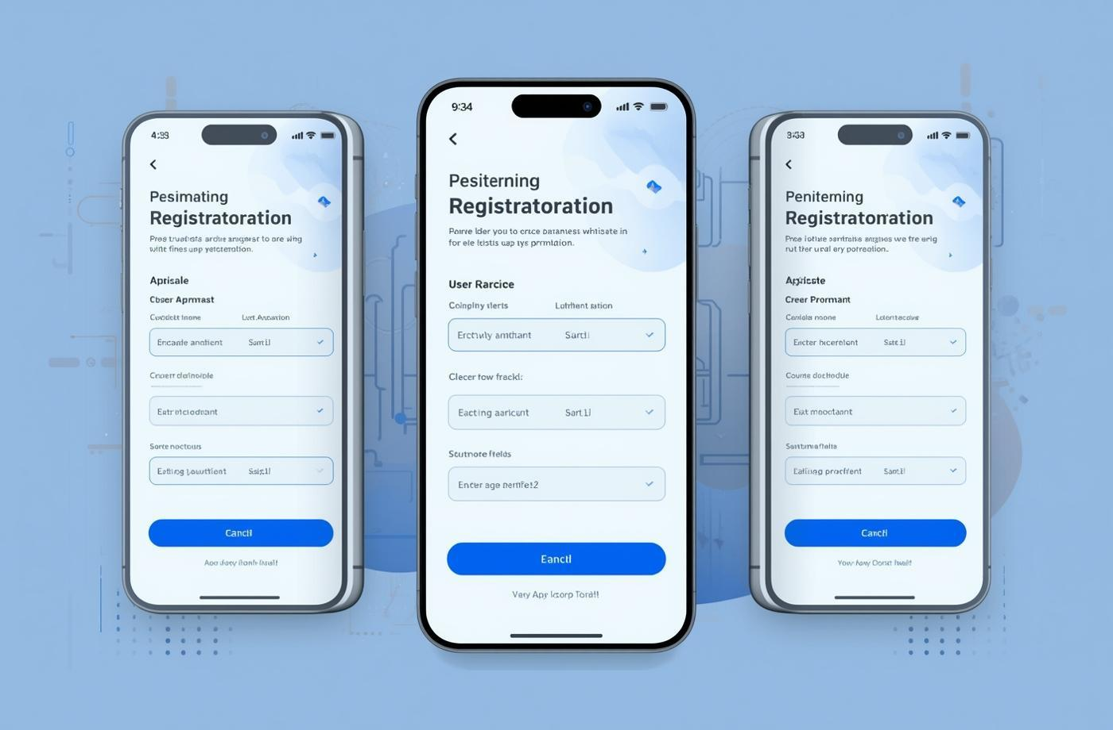

Core Features of CampusEventHub Platform
Event Creation Made Easy
Users can effortlessly set up events with clear, guided steps and customizable options.
Seamless Registration Process
Participants can register in just a few clicks, ensuring a smooth user experience.
Interactive Feedback System
Attendees provide valuable insights, enhancing future events and user satisfaction.

Slide 4
Challenges in College Event Management
Manual Processes Event management often relies on manual workflows, resulting in time-consuming coordination, higher chances of errors, and difficulty managing events efficiently across multiple colleges.
Low Student Engagement Students frequently struggle to discover events that match their interests, leading to low participation rates and reduced overall engagement within the campus community.
Communication Inefficiencies Poor communication channels delay important updates and limit effective feedback collection, causing missed opportunities and a lack of real-time information for both organizers and participants.
Need for Centralized Solutions Adopting a centralized platform can streamline event management, improve communication, enhance collaboration, and create a more engaging and user-friendly experience for everyone involved.

Slide 5
System Architecture Overview
The architecture of CampusEventHub is built using the MEAN stack, ensuring performance, scalability, and efficient data handling across the application.
Client-Side (Angular) The frontend is developed using Angular, providing a dynamic and responsive single-page application. It handles user interactions, event browsing, registrations, and communicates with backend services through HTTP requests.
Server-Side (Node.js & Express.js) The backend is powered by Node.js with Express.js, responsible for handling business logic, routing, and API development. RESTful APIs enable smooth communication between the frontend and database while maintaining a clean and modular structure.
Database Layer (MongoDB) MongoDB is used as the database, storing data in a flexible, document-based format. It efficiently manages user data, event details, registrations, and feedback, allowing easy scalability and fast data retrieval.

Slide 6
API Communication RESTful APIs connect Angular with the backend, ensuring secure and structured data exchange. This separation improves maintainability and allows independent development of frontend and backend components.
Authentication & Security JWT (JSON Web Tokens) is implemented for secure authentication and session management. Sensitive data is protected through encryption and validation mechanisms.
Scalability & Performance The system supports horizontal scaling, allowing it to handle increasing users and event data without performance degradation. The modular MEAN architecture ensures easy updates and future enhancements.

Slide 7
Challenges and Solutions in CampusEventHub
Security Enhancements User data security is addressed using JWT-based authentication and backend validation in Node.js. Sensitive data is protected through encryption and controlled access, reducing risks of unauthorized usage.
Scalability Solutions The system uses a modular backend with Express.js and a flexible MongoDB database, allowing it to scale efficiently as user traffic and event data increase without slowing down performance.
Improving User Engagement Angular provides a responsive and interactive interface with real-time updates, making it easier for students to discover events, register quickly, and stay informed.
Modular Architecture Benefits The separation of frontend (Angular), backend (Node.js/Express), and database (MongoDB) ensures easy maintenance, faster development, and the ability to integrate new features without breaking existing functionality.

Slide 8
Measurable Outcomes and Impact
Increased Event Participation The platform improves event visibility and accessibility, leading to higher student participation and better turnout across various college events.
Reduced Manual Coordination Automation through the system reduces dependency on manual processes, saving time for organizers and minimizing errors in event planning and management.
Improved User Experience A structured Angular-based interface ensures smooth navigation, faster interactions, and an overall better experience for both students and event organizers.

Slide 9
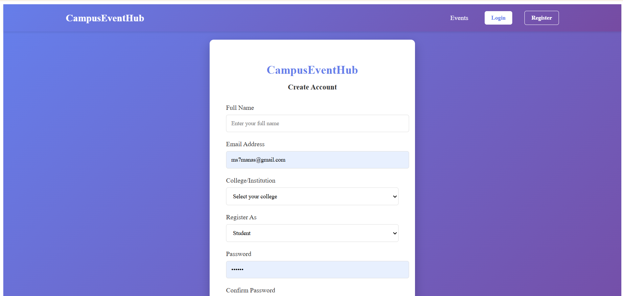
These mock-ups showcase a seamless experience for users, enhancing engagement through intuitive design and functionality.
Student And College Admin Registration Page

Slide 10
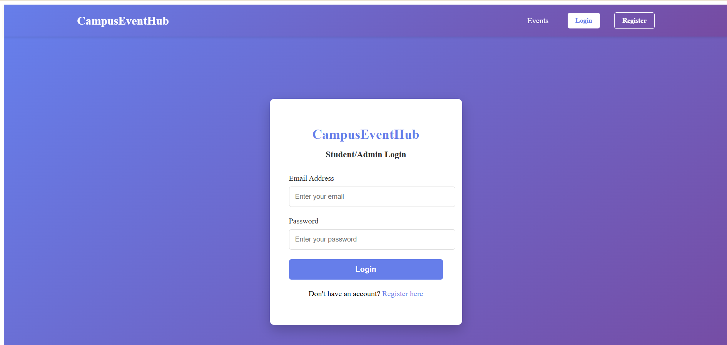
Student And College Admin Login Page

Slide 11
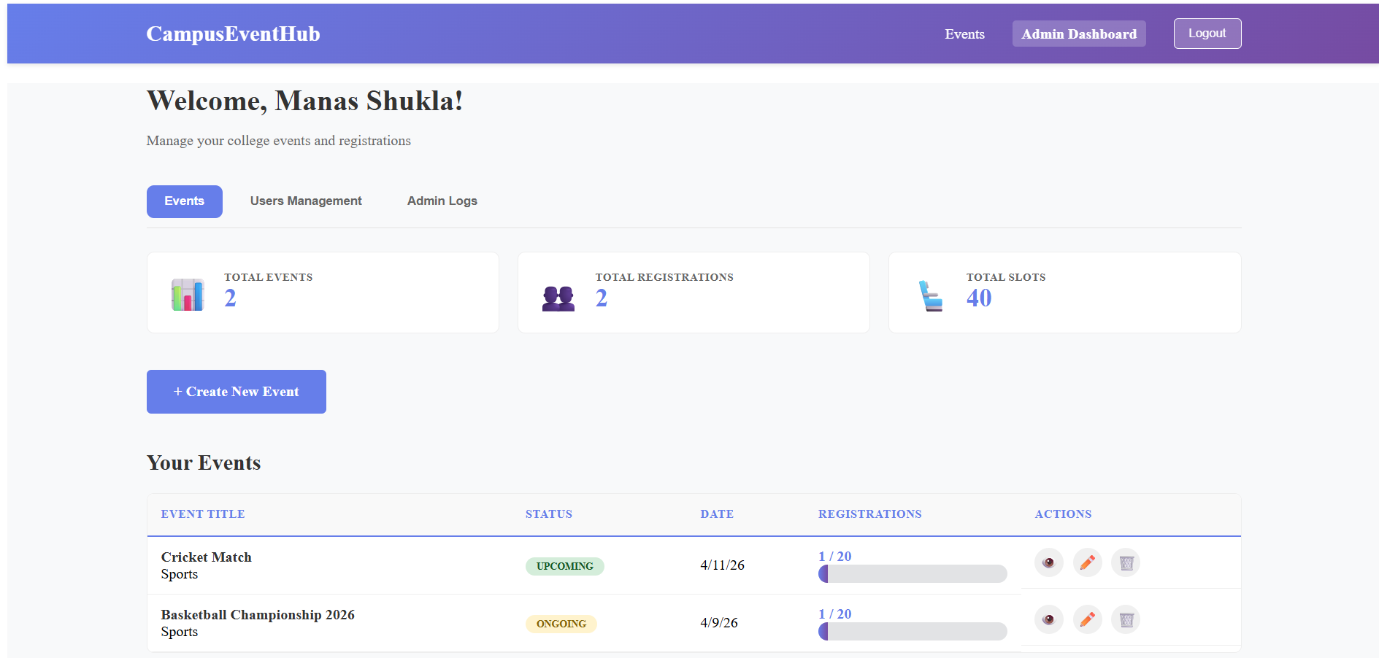
Admin Dashboard

Slide 12
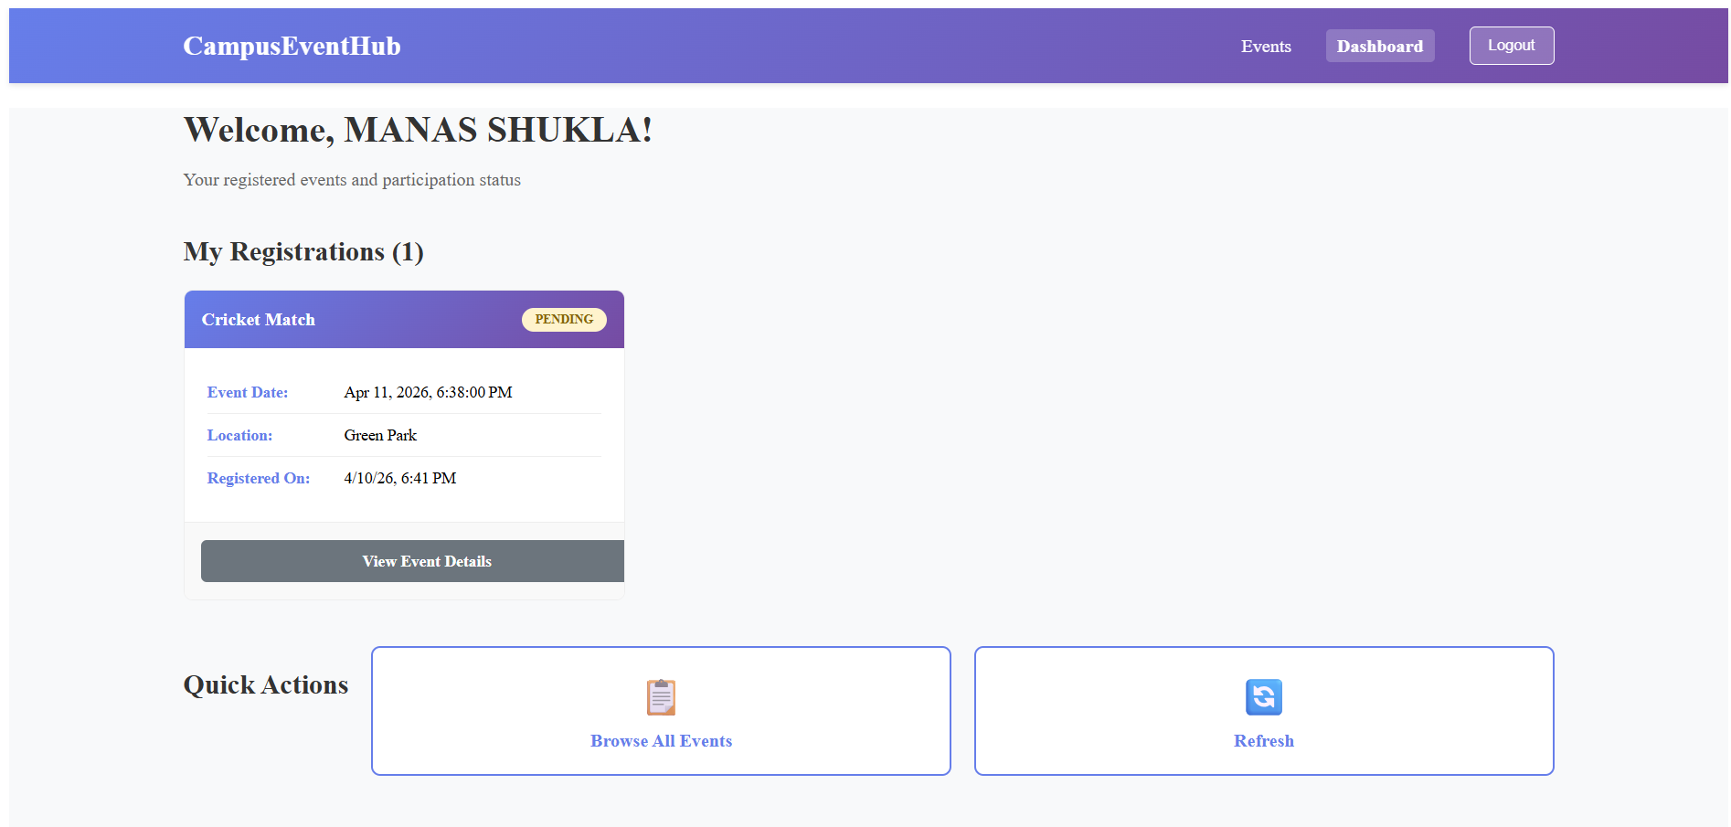
Student Dashboard

Slide 13

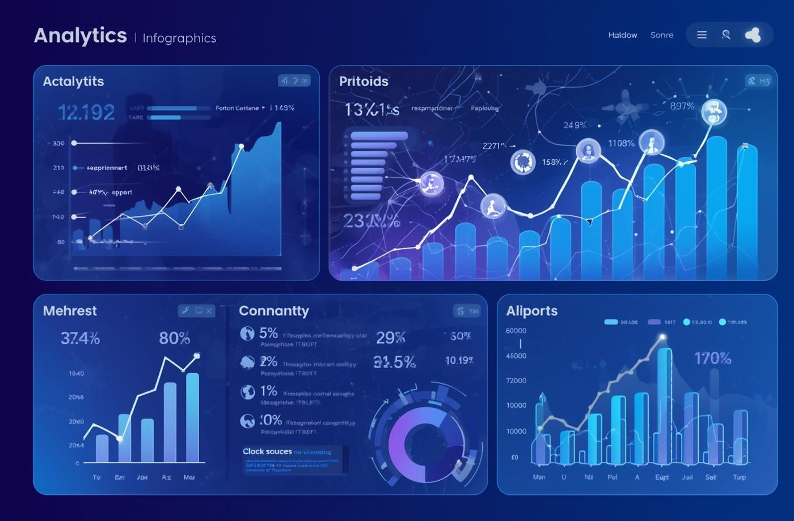

Future Enhancements for CampusEventHub
AI-Based Event Recommendations
Advanced Analytics Dashboard
Payment Integration
Provide admins with real-time insights such as participation rates, event performance, and user engagement to help make better decisions and improve future events.
Introduce secure online payment options for paid events, supporting methods like UPI, cards, and wallets, with proper validation and transaction tracking.
Implement basic recommendation logic using user activity and preferences to suggest relevant events. Over time, this can evolve into smarter, data-driven personalization.

Slide 14
TEAM MEMBERS
Manas Shukla Akash Pandey
Sumit Kumar Sahoo Shoeb Raza
Navyasree Ulava Nidhi Kumari

Slide 15
Q n A

Slide 16
Thank You

