Slide 1

INFOSYS SPRINGBOARD INTERNSHIP PROJECT
Hospital Performance
Intelligence System
for Operational and Patient Care Analytics
Nandini K M

Slide 2
Project Overview:
OBJECTIVE
HOSPITAL
DATA
Support data-driven hospital management decisions through interactive dashboards.
PURPOSE
Analyze admissions, patient stays, revenue and payer categories in one coherent analytical view.

Slide 3
Core Features:
01
02
03
04
Admission
analysis
Length-of-stay
analysis
Revenue
analysis
Payer mix
analysis
05
06
Specialty-wise
performance
Interactive
filters

Slide 4
Technology Stack:
Python
Pandas
Excel
Data processing and analysis — usage subject to confirmation
Python data manipulation library — confirm in project files
Initial exploration and cleaning
Tableau
Git / GitHub
Dashboard development and visualization
Version control and collaboration — confirm repository usage

Slide 5
Analytics Workflow
Hospital
Datasets
Cleaning &
Preparation
Data
Analysis
Tableau
Visualization
Interactive
Dashboards
Performance
Insights

Slide 6
Project Process:
1
Understand the dataset
5
Develop Tableau worksheets and dashboards
2
Inspect quality and missing values
6
Add interactive filters and KPI cards
3
Clean and prepare for analysis
7
Review dashboards and prepare presentation
4
Analyze relevant hospital metrics

Slide 7
Challenges & Considerations :
CHALLENGE
APPROACH / CONSIDERATION
Missing values
Inspection and imputation considerations
Inconsistent fields
Data standardization efforts
Selecting useful KPIs
Alignment with project objectives
Choosing chart types
Visual clarity and dashboard usability
Layout & interactivity
User-friendly filter design considerations

Slide 8
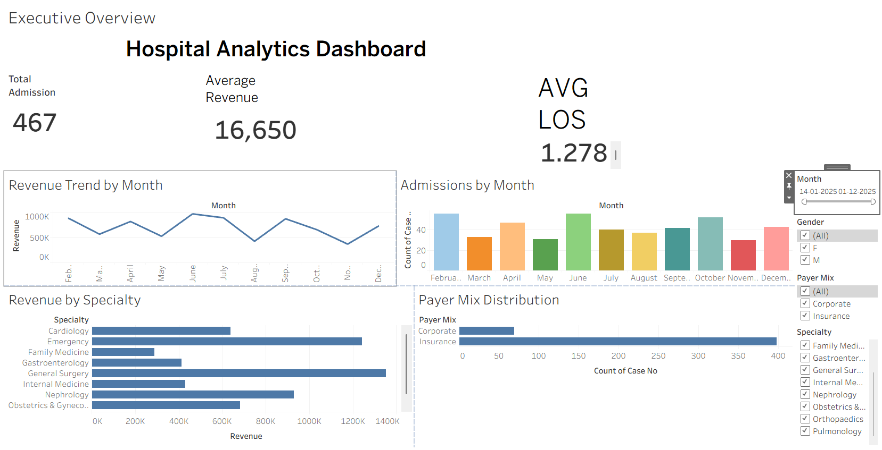
Executive Overview :
Admissions
Average revenue
EXECUTIVE TABLEAU DASHBOARD
SCREENSHOT PLACEHOLDER
Average length of stay
Monthly trends
Specialty performance
Payer mix
Replace this frame with verified project dashboard content.

Slide 9
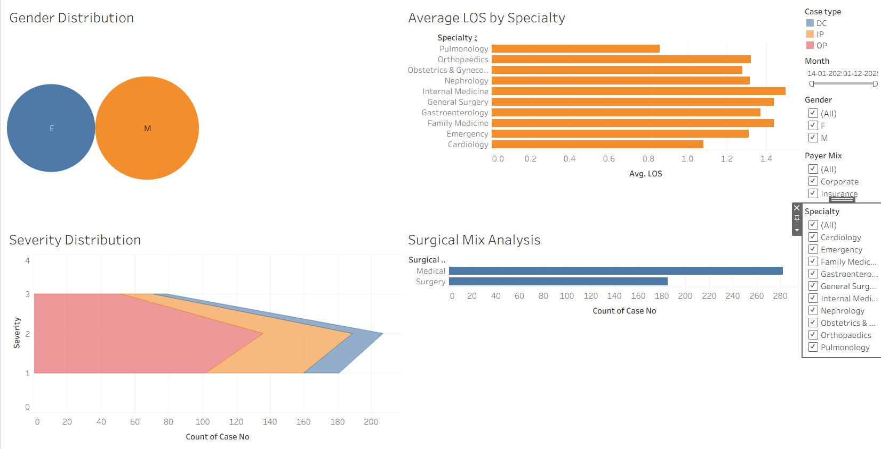
Patient Analytics :
Patient-related patterns
Describe only after chart verification.
PATIENT ANALYTICS
DASHBOARD PLACEHOLDER
Specialty comparisons
Use actual specialty views.
Length-of-stay analysis
Summarize verified distributions or trends.

Slide 10
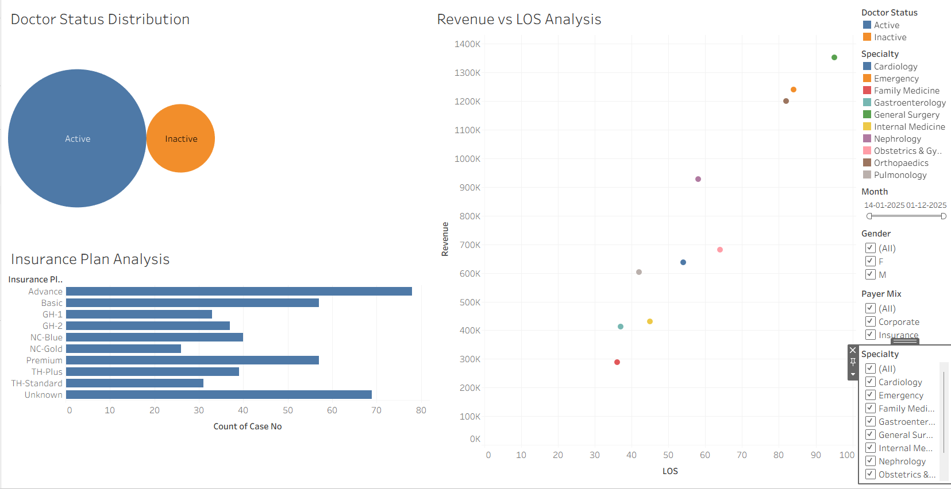
Financial Performance :
Revenue trends
Payer mix insights
FINANCIAL TABLEAU DASHBOARD
SCREENSHOT PLACEHOLDER
Specialty-related financial analysis

Slide 11
Measurable Impact :
VERIFIED PROJECT KPIs
PROJECT CAPABILITIES
  Total Admissions: 500
  Average Length of Stay: Approximately 1.28 days
  Average Revenue per Admission: Approximately ₹17,047
  Total Revenue: ₹85,23,364
Easier data exploration
Clearer, concise reporting
Faster access to summaries
Greater visibility into operational and patient-care metrics

Slide 12
Feature Enhancements :
FUTURE ENHANCEMENT
Automated data refresh
FUTURE ENHANCEMENT
Predictive admission and revenue analysis
FUTURE ENHANCEMENT
Alerts for unusual trends or anomalies
FUTURE ENHANCEMENT
Additional interactive filters
FUTURE ENHANCEMENT
Secure integration with hospital data systems

Slide 13
Team, Q&A & Video
LIKELY QUESTIONS
How was data cleaning handled?
Which tools were most useful?
How were dashboard designs chosen?
TEAM MEMBERS
NAME:NANDINI K M

Slide 14
Thank You
With gratitude to Infosys Springboard, the project mentor, and the audience.

