Slide 1

HOSPITAL OPERATIONS DASHBOARD
MedTrack_DV
A Data Visualization Project for Hospital Performance and Patient Flow
Name: Vidya Mallikarjun Jatti

Slide 2







PROJECT OVERVIEW
About the Project
MedTrack_DV uses Python to prepare hospital data and Tableau to create interactive dashboards.
Hospital performance
Patient movement
Review total intake and clinical stay length.
Track admissions, ward transfers, and discharges.
Department comparison
Resource usage
Compare unit workload, staffing, and efficiency.
Monitor available beds, devices, and staff overtime.
02
Technology Stack: Python (Pandas, NumPy) · Tableau Desktop · Jupyter Notebook

Slide 3

PROJECT FOUNDATION
Problem and Aim
THE CHALLENGE
THE SOLUTION
Raw, complex records
Interactive clarity
Hospital data is large and difficult to understand in raw tables.
Convert hospital data into simple, interactive dashboards that are easy to understand.
03

Slide 4
DATA PIPELINE
Milestone 1: Data Preparation
Collected hospital datasets
Loaded data using Python
Checked missing values and duplicate records
Cleaned the data
Checked dates and IDs
Prepared data for Tableau
Tools: Python, Pandas, NumPy, Jupyter Notebook
04

Slide 5
METRIC DEFINITIONS
Milestone 2: KPI Calculation
Important hospital values were calculated from the prepared data.
PATIENT VOLUME
CARE QUALITY
  Total Admissions
  Total Discharges and Transfers
  Average Length of Stay
  Mortality Rate
  Readmission Rate
CLINICAL CAPACITY
OPERATIONAL LOAD
  Staff-to-Patient Ratio
  Bed Utilization Rate
  Efficiency Score
  Equipment Downtime
  Overtime Hours
05

Slide 6
ARCHITECTURE & FLOW
Milestone 3: Four Dashboards
Hospital Overview
Patient Flow
1
2
Key hospital activity and KPIs
Admissions, transfers and discharges
Department Analytics
Resource Utilization
3
4
Department activity and efficiency
Beds, equipment and staff usage
Flow: Hospital Overview → Patient Flow → Department Analytics → Resource Utilization
06

Slide 7

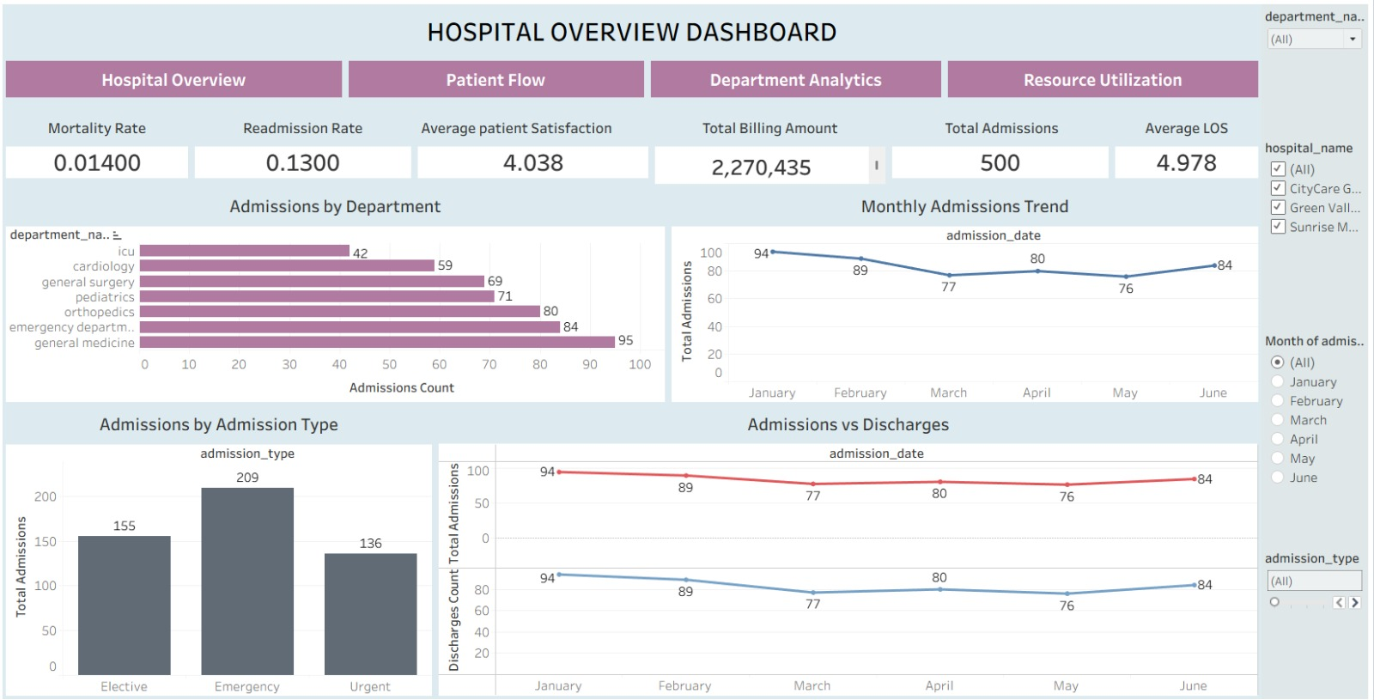
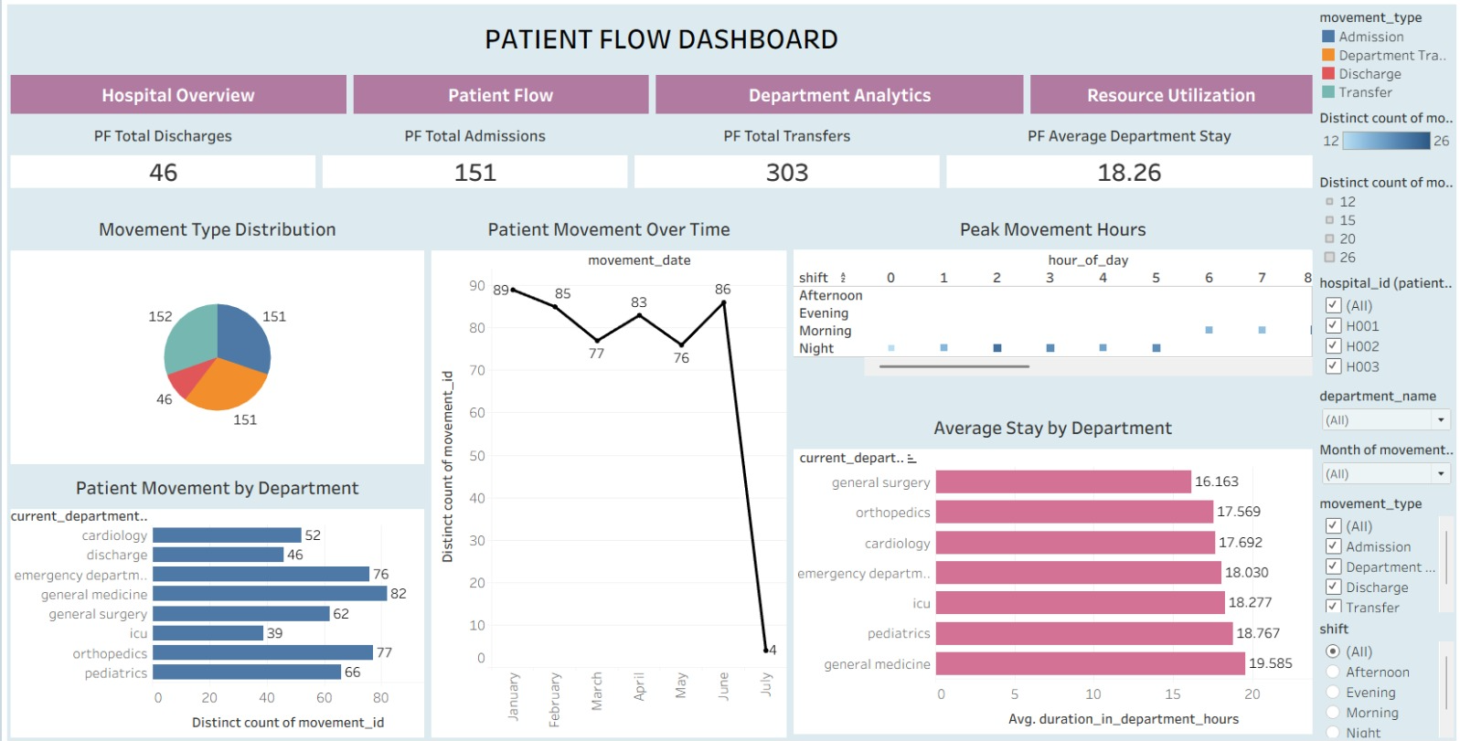

TABLEAU INTERFACE 1 & 2
Hospital Overview and Patient Flow
Hospital Overview
Patient Flow
Shows overall activity, admissions, discharges, length of stay and key KPIs.
Shows patient movement, transfers, admissions, discharges and department stay.
07

Slide 8
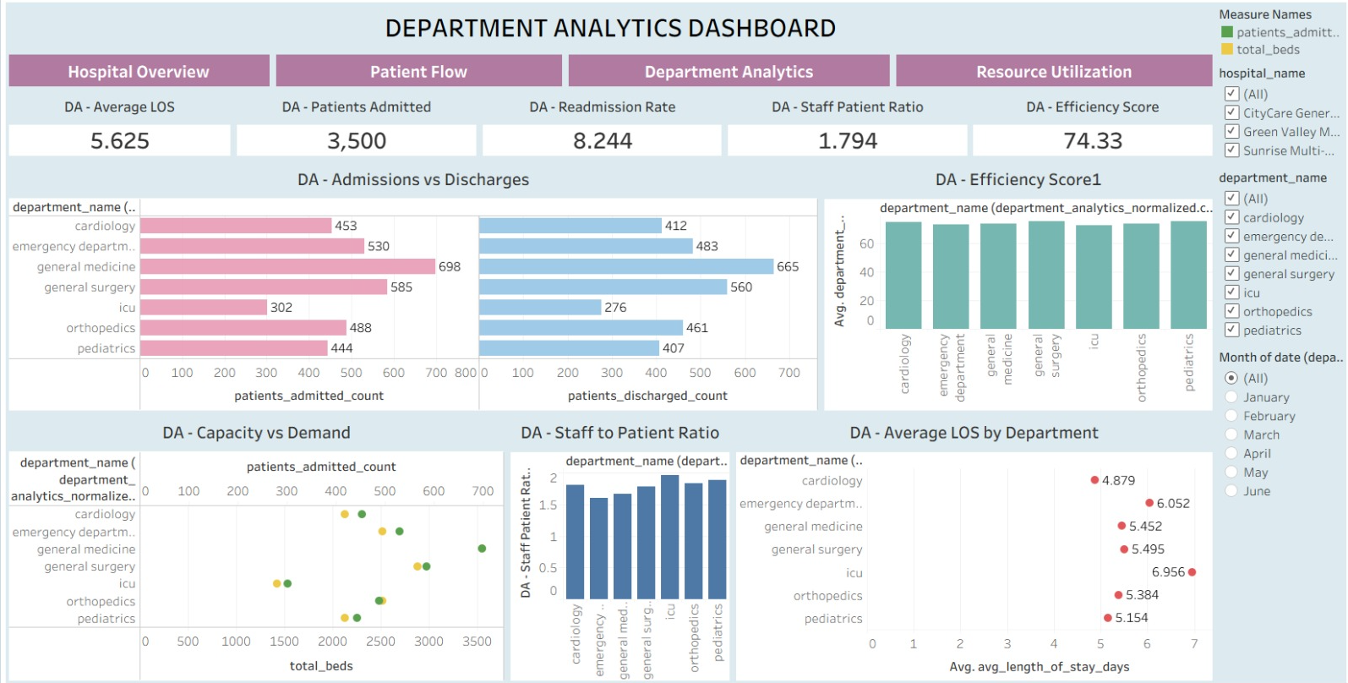
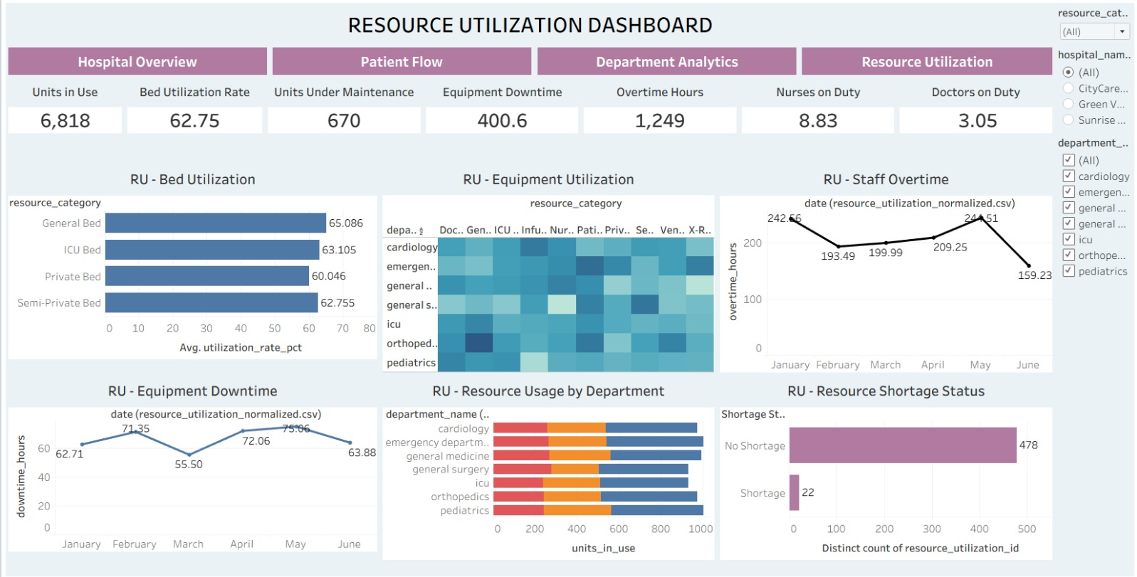
TABLEAU INTERFACE 3 & 4
Department and Resource Dashboards
Dashboard 3: Department Analytics
Dashboard 4: Resource Utilization
Compares department admissions, discharges, average length of stay, staffing levels, and efficiency scores.
Monitors bed occupancy rates, medical equipment maintenance, downtime logs, and nursing overtime shifts.
08

Slide 9




QUALITY ASSURANCE
Milestone 4: Testing and Final Work
Testing and Documentation
Checked KPI calculations
Tested filters, buttons and navigation
Checked dashboard interactions
Prepared QA checklist and testing report; prepared project documentation
09

Slide 10





Conclusion and Future Work
MedTrack_DV converts hospital data into simple, interactive dashboards for understanding hospital operations.
Future Work
Real-time hospital data
Bed usage prediction; Resource prediction
Patient demand prediction
Automated alerts
Thank You
Questions?

