Slide 1
MedTrack_DV
EXECUTIVE REVIEW · HEALTHCARE INTELLIGENCE
Hospital Performance Intelligence System
From raw healthcare data to decision dashboards
Presented by Aman Singh Rawat
Notes:
Introduce MedTrack_DV as an end-to-end intelligence system turning raw hospital data into executive decision-making tools.

Slide 2
Raw hospital data became executive dashboards in four milestones
01
02
03
Operational scope
End-to-end pipeline
Executive decision focus
Hospital operations, patient flow, department performance, resource utilization and patient outcomes.
Data preparation, validation, KPI development and dashboarding turn raw data into insight.
Bridges transactional records and strategic hospital management with timely, actionable intelligence.
Structured delivery lifecycle with data governance from ingestion to visual analytics.
Notes:
Unifying clinical and administrative data into executive dashboards across four structured phases.

Slide 3
Four milestones took the project from data to deployment
M1
M2
M3
M4
MILESTONE 1
MILESTONE 2
MILESTONE 3
MILESTONE 4
Data collection and preparation
KPI development and dashboard preparation
Dashboard development and integration
Testing, validation and delivery
Notes:
Walk through the four milestones from data preparation to delivery.

Slide 4
Milestone 1 turned a Kaggle dataset into a clean, analysis-ready file
STEP 1
STEP 2
STEP 3
STEP 4
Raw data
Quality assessment
Cleaning
Clean CSV
›
›
›
Collected from Kaggle and loaded with Python.
Checks for missing values, duplicates, wrong data types, invalid dates, inconsistent categories.
Cleaned in Python notebooks.
Standardized CSV for Milestone 2.
WHAT THE DATA COVERS
Admissions
Departments
Billing & resources
Patient and hospital identifiers, admission and discharge details
Department types, demographics, readmission information
Billing, test-result and resource fields used for KPIs
Notes:
Data collected from Kaggle, assessed, cleaned in Python and exported as a standard CSV.

Slide 5
Six KPIs measure how the hospital performs
01
02
03
Total Admissions
Occupancy Rate
Average Length of Stay
Total admission records
Occupied beds relative to total beds
Average days patients stay
04
05
06
Readmission Rate
Bed Utilization Rate
Department Efficiency
Percentage of patients identified as readmissions
Use of available bed capacity
Department-level operational performance
Notes:
Six core metrics that drive every dashboard.

Slide 6
Milestone 2 validated the data, built the KPIs and planned the dashboard
PHASE 2.1
PHASE 2.2
PHASE 2.3
Data Validation
Excel Modeling
Storyboard & Prototype
Cleaned dataset validated before any KPI calculation.
Final dataset exported to Excel for dashboard work.
Storyboard and an initial Tableau prototype verified the approach.
Pre-development verification
Wireframing interactions, view hierarchies and KPI formulas eliminated scope creep and confirmed technical feasibility before full Tableau authoring.
Notes:
Milestone 2 bridged data preparation and dashboard authoring through validation and prototyping.

Slide 7
Milestone 3 delivered four interactive Tableau dashboards
Hospital Overview
Patient Flow
Executive KPIs and monthly occupancy trends
Admissions vs discharges, length of stay by department, peak load
Department Analytics
Resource Utilization
Efficiency comparison, capacity vs occupancy tree maps, staff distribution
Bed utilization, active clinical staff, equipment grids
Notes:
Four dashboards, each giving a distinct operational lens.

Slide 8
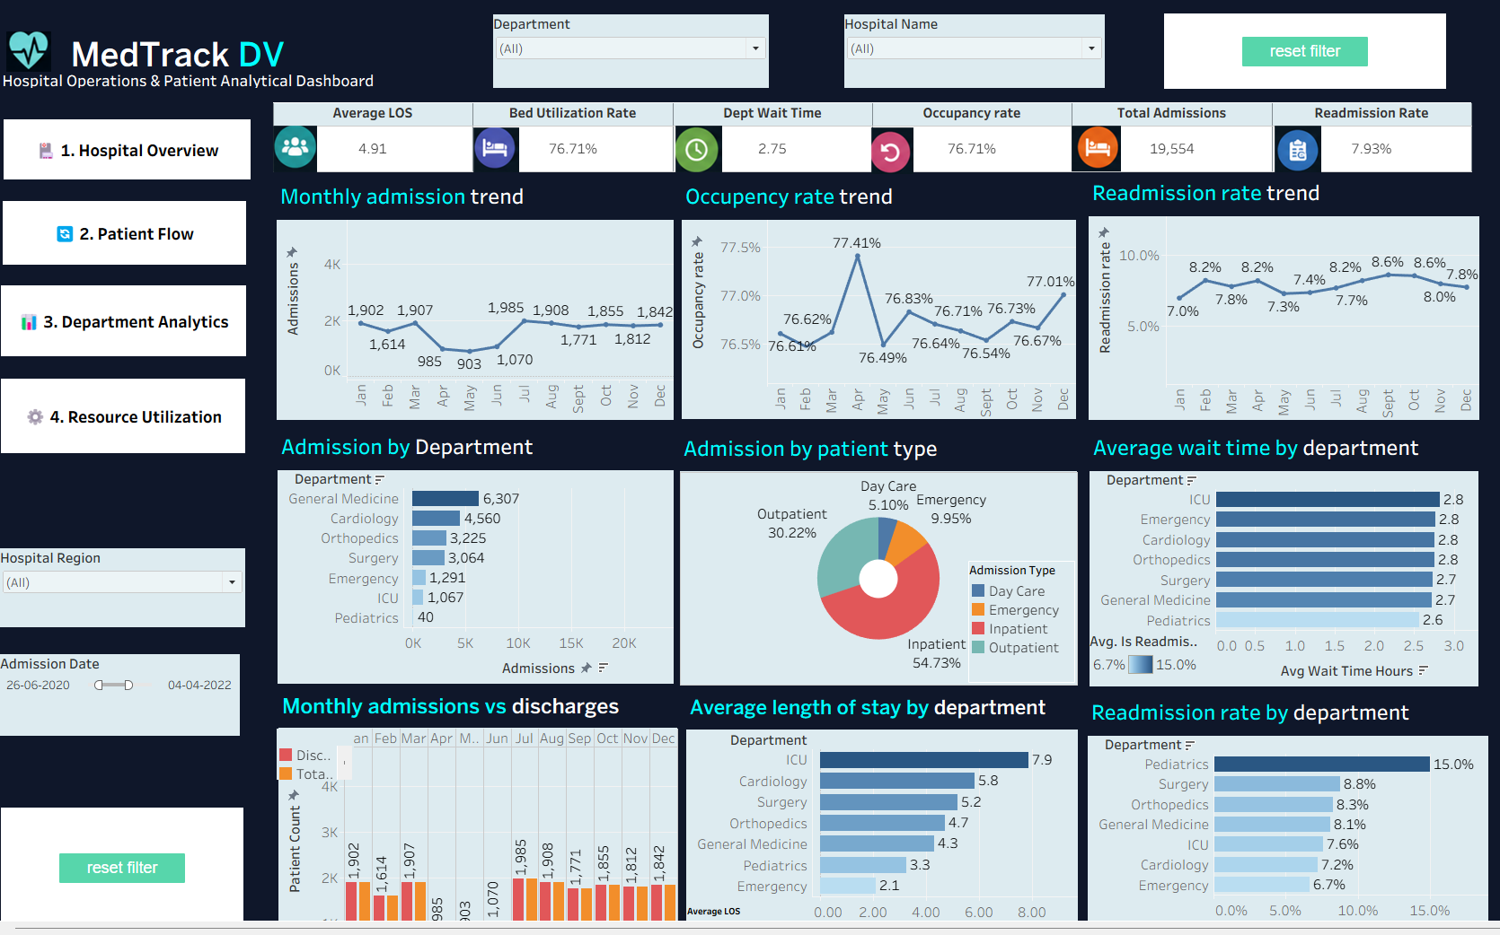
Dashboard 1 · Hospital Overview
DASHBOARD 1 OF 4
Hospital-wide status at a glance
Hospital-wide operational status: admissions, bed occupancy and monthly inflow, outflow and readmission trends.
19,554 admissions · 76.71% occupancy · 4.91-day average stay
General Medicine leads admissions with 6,307 patients
ICU has the longest average stay at 7.9 days
Notes:
Hospital-wide operational status: admissions, bed occupancy and monthly inflow, outflow and readmission trends.

Slide 9
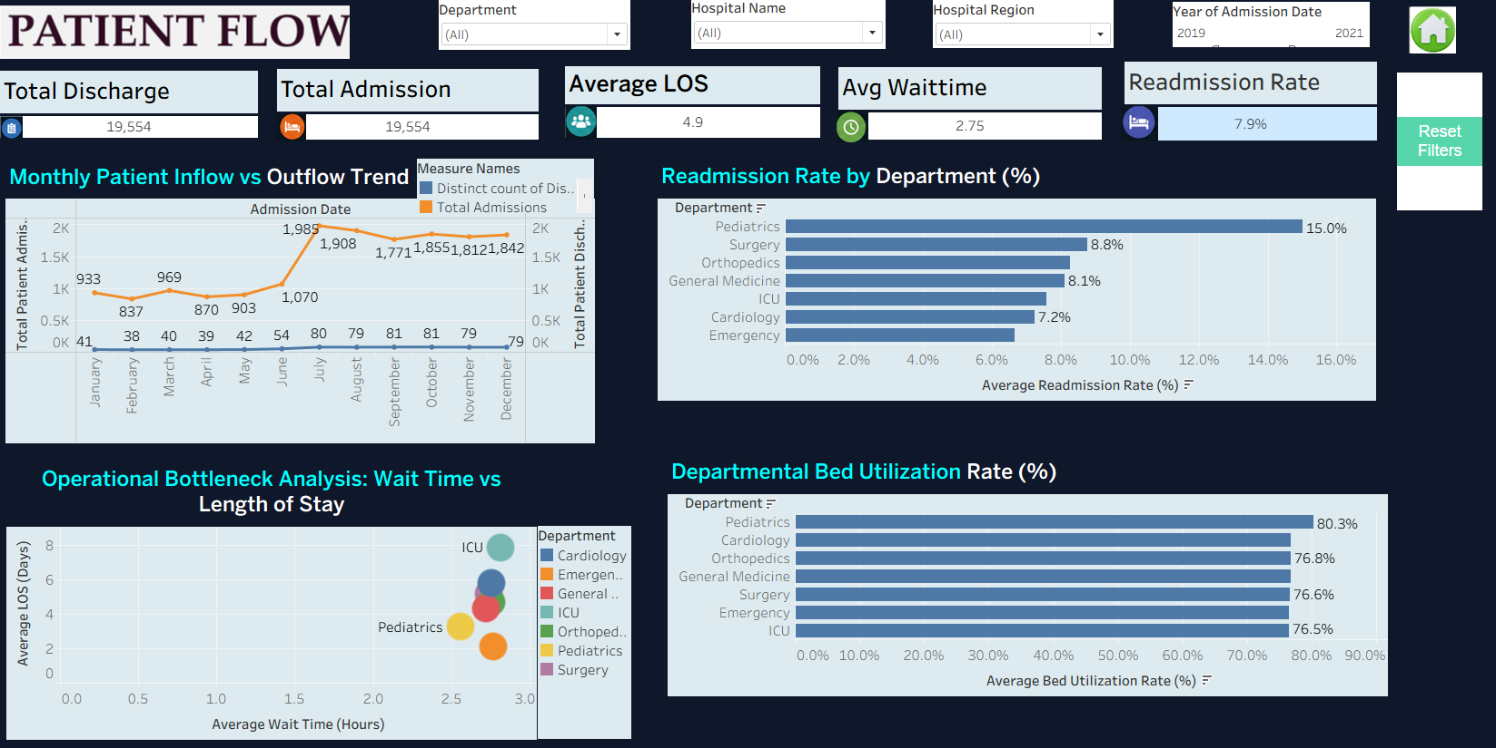
Dashboard 2 · Patient Flow
DASHBOARD 2 OF 4
How patients move through the hospital
Admission vs discharge velocity, length of stay and readmissions, with a wait-time vs stay bottleneck view.
19,554 admissions matched by 19,554 discharges
Pediatrics: highest readmission (15.0%) and bed utilization (80.3%)
Average wait of 2.75 hours and a 7.9% readmission rate
Notes:
Admission vs discharge velocity, length of stay and readmissions, with a wait-time vs stay bottleneck view.

Slide 10
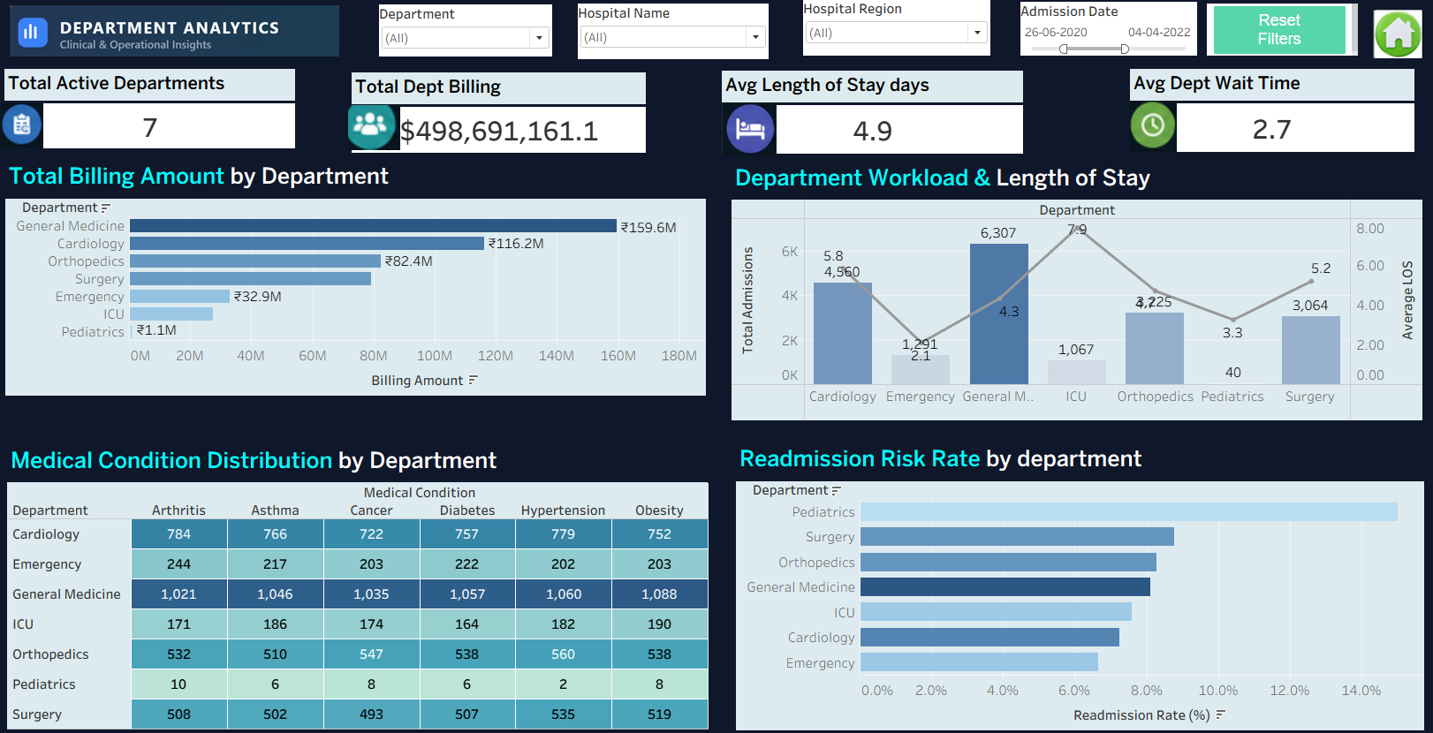
Dashboard 3 · Department Analytics
DASHBOARD 3 OF 4
Which departments carry the load
Departmental workload, billing, condition mix and readmission risk compared side by side.
7 active departments with an average stay of 4.9 days
General Medicine leads billing (₹159.6M) and workload (6,307 admissions)
Condition heatmap covers six conditions across all departments
Notes:
Departmental workload, billing, condition mix and readmission risk compared side by side.

Slide 11
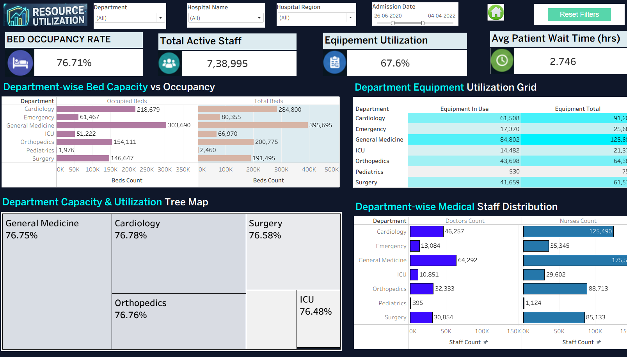
Dashboard 4 · Resource Utilization
DASHBOARD 4 OF 4
Capacity, staff and equipment in use
Bed capacity, staff deployment and equipment utilization tracked across every department.
76.71% bed occupancy · 67.6% equipment utilization
738,995 active staff; average patient wait of 2.75 hours
Occupancy holds near 76–77% in every department
Notes:
Bed capacity, staff deployment and equipment utilization tracked across every department.

Slide 12
An executive dark theme and global filters tie the dashboards together
#0F172A
#1E293B
#00F2FE
#F59E0B
Background · Slate canvas
Container · Card surface
Primary accent · Cyan highlight
Alert accent · Amber attention
Global filter architecture
Interactive parameter actions
Filters synchronized across all views for Hospital, Department, Region and Date Range.
Cross-tab navigation and context-preserving drilldowns between overview and detail sheets.
Notes:
Dark executive look with four global cross-filters and parameter-driven navigation.

Slide 13
Milestone 4 proved the numbers and the interactivity
>95%
KPI accuracy
Cross-verified against Python baseline outputs; >95% accuracy target met
Accuracy target met
Values and filters
Zero missing or broken values; global filter reactivity tested
4 of 4
Reset Filter extension
Dashboard views validated
Added to all 4 dashboard views for one-click resets
Notes:
Validation results: >95% accuracy, zero missing values, one-click reset on all views.

Slide 14
Thank you
Final Tableau dashboard file
https://drive.google.com/file/d/1IdykGftatk46Od2CythAYZoLfaOh3eWr/view?usp=drive_link
Notes:
Share the Google Drive link to the final Tableau dashboard file.

